Slide 1
OCD Related Disorders
Trichotillomania, Excoriation, & Body Dysmorphic Disorder

Slide 2
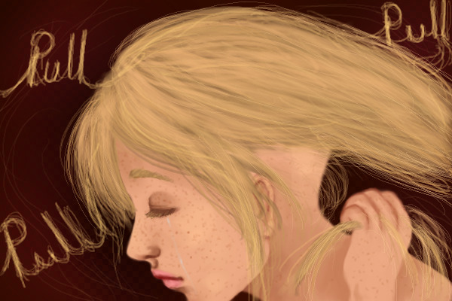
Trichotillomania (Hair-pulling Disorder)
Trichotillomania (trik-o-til-o-MAY-nee-uh) is a disorder that involves recurrent, irresistible urges to pull out hair from your scalp, eyebrows or other areas of your body, despite trying to stop.

Slide 3
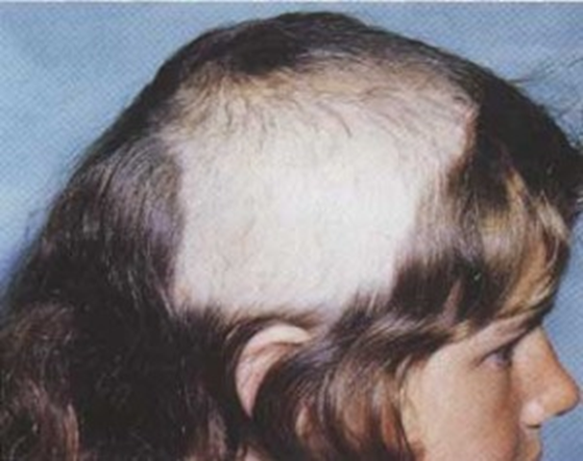
Hair pulling from the scalp often leaves patchy bald spots, which causes significant distress and can interfere with social or work functioning.
People with trichotillomania may go to great lengths to disguise the loss of hair.

Slide 4
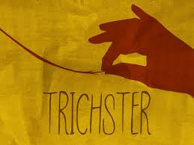
For some people, trichotillomania may be mild and generally manageable. For others, the compulsive urge to pull hair is overwhelming. Some treatment options have helped many people reduce their hair pulling or stop entirely.

Slide 5
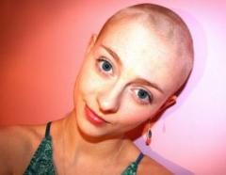
What are the symptoms of trichotillomania?
In addition to repeatedly pulling your hair out, the following symptoms are often also present:
An increasing sense of tension before pulling, or when you try to resist pulling
A sense of pleasure or relief after the hair is pulled
Shortened hair or thinned or bald areas on the scalp or other areas of your body, including sparse or missing eyelashes or eyebrows

Slide 6
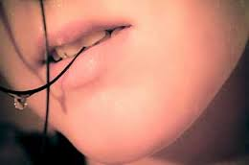
Other Symptoms
Preference for specific types of hair, rituals that accompany hair pulling or patterns of hair pulling
Biting, chewing or eating pulled-out hair
Playing with pulled-out hair or rubbing it across your lips or face

Slide 7
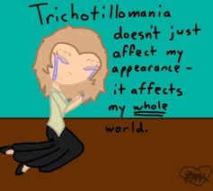
Other behaviors
Most people who have trichotillomania also will pick their skin (we’ll talk about next), bite their nails or chew their lips.
Sometimes pulling hairs from pets or dolls or from materials, such as clothes or blankets, may be a sign.
Most people with trichotillomania pull hair in private and generally try to hide the disorder from others.

Slide 8
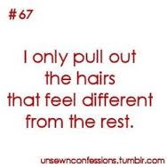
Focused vs. Automatic Pulling
For people with trichotillomania, hair pulling can be:
Focused. Some people pull their hair intentionally to relieve tension or distress — for example, pulling hair out to get relief from the overwhelming urge to pull hair. Some people may develop elaborate rituals for pulling hair, such as finding just the right hair or biting pulled hairs.
Automatic. Some people pull their hair without even realizing they're doing it, such as when they're bored, reading or watching TV.

Slide 9
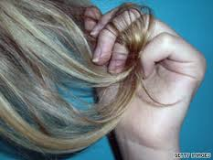
The same person may do both focused and automatic hair pulling, depending on the situation and mood. Certain positions or rituals may trigger hair pulling, such as resting your head on your hand or brushing your hair.
Trichotillomania is a long-term (chronic) disorder. Without treatment, symptoms can vary in severity over time.

Slide 10
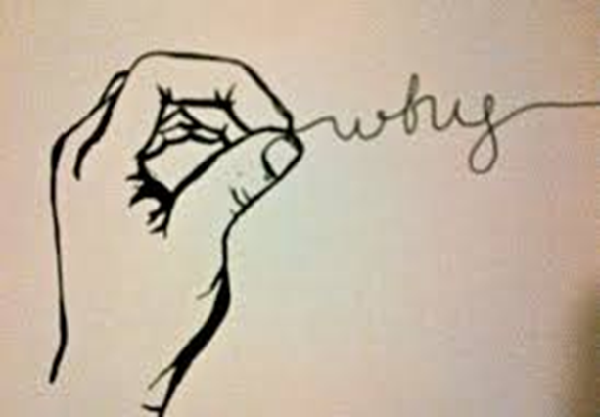
What causes Trichotillomania?
The cause of trichotillomania is unclear. But like many complex disorders, trichotillomania probably results from a combination of genetic and environmental factors. Also, abnormalities in the natural brain chemicals serotonin and dopamine may play a role in trichotillomania.

Slide 11
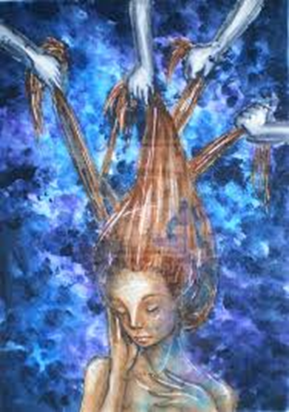
Positive reinforcement. People with TTM often find that pulling out hair feels satisfying and provides a measure of relief. As a result, they continue to pull their hair to maintain these positive feelings.
Other disorders. People who have TTM may also have other disorders, such as depression, anxiety or obsessive-compulsive disorder (OCD).
Gender. Although far more women than men are treated for TTM, this may be because women are more likely to seek medical advice. In early childhood, boys and girls appear to be equally affected.

Slide 12
What are the risk factors?
Family history/Genetics. The disorder may occur in those who have a close relative with the disorder.
Age. Trichotillomania usually develops just before or during the early teens — most often between the ages of 11 and 13 — and is often a lifelong problem. Infants also can be prone to hair pulling, but this is usually mild and goes away on its own without treatment.
Negative emotions. For many people with trichotillomania, hair pulling is a way of dealing with negative or uncomfortable feelings, such as stress, anxiety, tension, loneliness, fatigue or frustration.

Slide 13
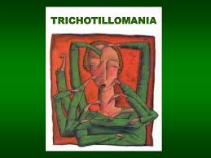
Negative effects
Although it may not seem particularly serious, trichotillomania can have a great impact on your life. Complications may include:
Emotional distress. Many people with trichotillomania report feeling shame, humiliation and embarrassment and experience low self-esteem, depression and anxiety because of their condition.

Slide 14
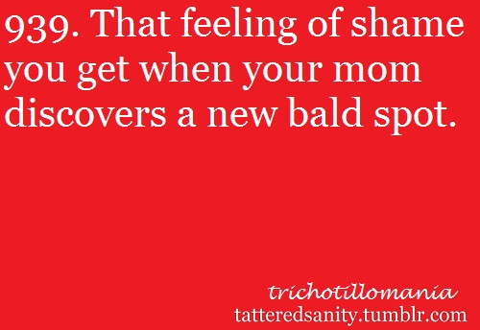
Embarrassment
Problems with social and job functioning. Embarrassment because of hair loss may lead you to avoid social activities and occupational opportunities. People with trichotillomania may wear wigs, style their hair to disguise bald patches or wear false eyelashes. Some people may avoid intimacy for fear that their condition will be discovered.

Slide 15
Physical Effects
Skin and hair damage. Constant hair pulling can cause abrasions and other damage, including infections, to the skin on your scalp or the specific area where hair is pulled, and can affect hair growth.
Hairballs. Eating your hair may lead to a large, matted hair ball (trichobezoar) in your digestive tract. Over a period of years, the hair ball can cause weight loss, vomiting, intestinal obstruction and even death.

Slide 16
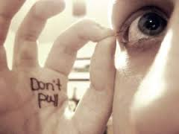
How do you treat TTM?
Habit reversal training is the primary psychotherapy for trichotillomania. This type of therapy helps you learn how to recognize situations where you're likely to pull hair and how to substitute other behaviors instead. For example, you might clench your fists for a period to "freeze" the urge, or redirect your hand from your hair to your ear.
No medications are approved by the FDA specifically for the treatment of trichotillomania. However, antidepressants may help control your symptoms.

Slide 17
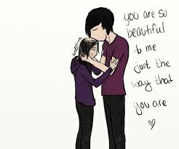
Support
Many people with trichotillomania report feeling alone in their experience of hair pulling. It may help to join a support group for people with trichotillomania so that you can meet others with similar experiences who can relate to your feelings.

Slide 18
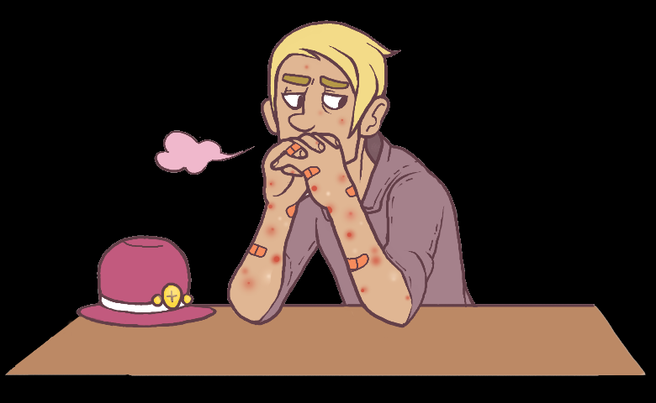
Excoriation (Skin-Picking) Disorder
Similar to Trichotillomania is another, recently added disorder called Excoriation.
The essential feature of this disorder is recurrent picking at one’s own skin.
The most commonly picked areas are the face, arms, and hands, but many individuals pick from multiple sites.

Slide 19
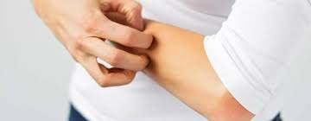
In addition to skin picking, skin rubbing, squeezing, and biting are also common.
Most individuals pick with their fingernails, although many use tweezers, pins, or other objects.
Individuals with excoriation disorder often spend significant amounts of time on their picking behavior, sometimes several hours per day. Skin picking may endure for months or years.

Slide 20
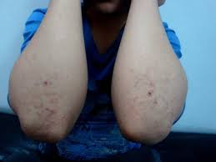
Causes, Risks, & Treatment
In order to qualify as Excoriation, the picking can not be a form of self-injury (which we’ll discuss later in the semester)
The causes, risks, and treatment are similar to Trichotillomania

Slide 21
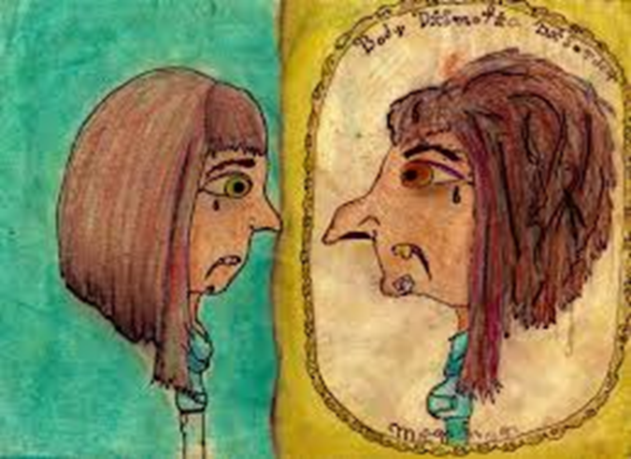
Body Dysmorphic Disorder (BDD)
Body dysmorphic disorder is a type of chronic mental illness in which you can't stop thinking about a flaw in your appearance — a flaw that is either minor or imagined. But to you, your appearance seems so shameful that you don't want to be seen by anyone.

Slide 22
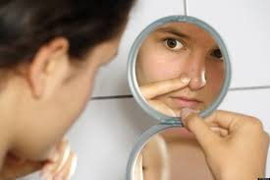
When you have body dysmorphic disorder, you intensely obsess over your appearance and body image, often for many hours a day.
Your perceived flaw causes you significant distress, and your obsession impacts your ability to function in your daily life.

Slide 23
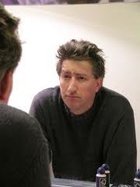
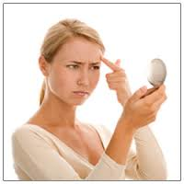
How many people are affected by BDD?
1-2% of population
Equal among men and women

Slide 24
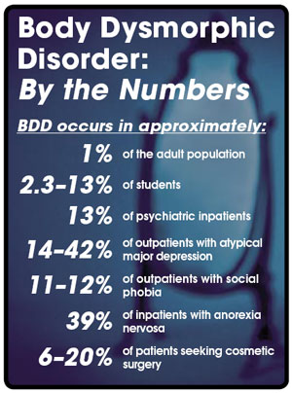

Slide 25
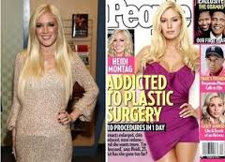
Why have I never heard of this?
BDD has been around for at least 100 years.
The impact of the media has brought greater attention to it.
People are secretive because they are ashamed or don’t want to seem superficial or vain so they rarely talk about it.

Slide 26
How many people?
1-2% of population
Equal among men and women

Slide 28
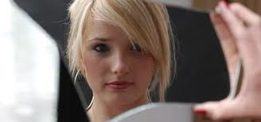
Why don’t I know anyone with this?
People are secretive because they are ashamed or don’t want to seem superficial or vain.

Slide 29
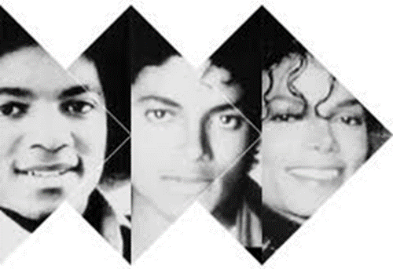
Can’t ever “fix” your flaws
You may seek out numerous cosmetic procedures or excessively exercise to try to "fix" your perceived flaw, but you're never satisfied.
Body dysmorphic disorder is also known as dysmorphophobia, the fear of having a deformity.

Slide 30
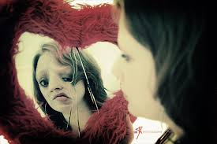
What are the symptoms of BDD?
Preoccupation with your physical appearance with extreme self-consciousness
Frequent examination of yourself in the mirror, or the opposite, avoidance of mirrors altogether
Strong belief that you have an abnormality or defect in your appearance that makes you ugly

Slide 31
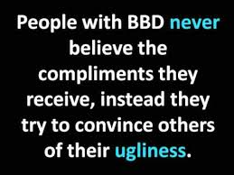
Avoidance of social situations
Feeling the need to stay housebound
The need to seek reassurance about your appearance from others
Frequent cosmetic procedures with little satisfaction
Belief that others take special notice of your appearance in a negative way

Slide 32
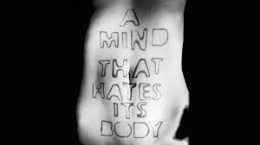
Excessive grooming or excessive exercise in an unsuccessful effort to improve the flaw
The need to grow a beard or wear excessive makeup or clothing to camouflage perceived flaws (long sleeves)
Comparison of your appearance with that of others
Reluctance to appear in pictures

Slide 33
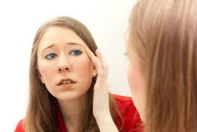
What do they obsess over?
You may obsess over any part of your body, and the body feature you focus on may change over time. But common features people may obsess about include:
Face, such as nose, complexion, wrinkles, acne and other blemishes
Hair, such as appearance, thinning and baldness
Skin and vein appearance
Muscle size and tone

Slide 34
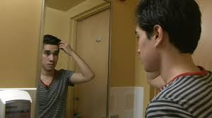
Delusional thinking
You may be so convinced about your perceived flaws that you imagine something negative about your body that's not true, no matter how much someone tries to convince you otherwise.
Concern over and thinking about the perceived flaw can dominate your life, leading to absence from work, school or social situations due to extreme self-consciousness.

Slide 35
What causes body dysmorphic disorder?
It's not known specifically what causes body dysmorphic disorder. Like many other mental illnesses, BDD may result from a combination of causes, such as:
Brain differences. Abnormalities in brain structure or neurochemistry may play a role.
Genes. Some studies show that body dysmorphic disorder is more common in people whose biological family members also have the condition.
Environment. Your environment, life experiences and culture may contribute to BDD, especially if they involve negative experiences about your body or self-image.

Slide 36
When does it start?
Body dysmorphic disorder usually starts in adolescence.

Slide 37
What factors put you at risk?
Like many disorders, the precise cause of body dysmorphic disorder isn't known, but certain factors seem to increase the risk of developing or triggering the condition, including:
Having biological relatives with body dysmorphic disorder
Negative life experiences, such as childhood teasing
Personality traits, including low self-esteem
Societal pressure or expectations of beauty
Having another psychiatric disorder, such as anxiety or depression

Slide 38
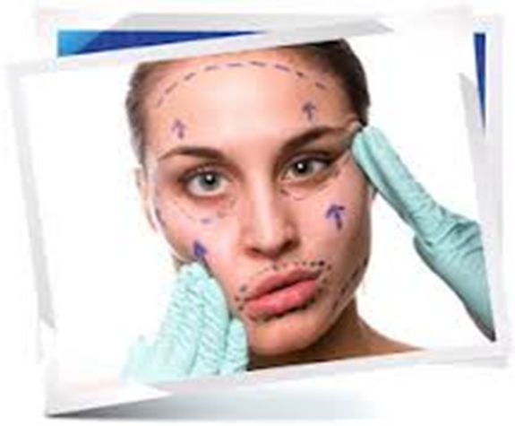
The problem with Cosmetic Surgeries
While it may seem that a procedure to fix your perceived flaw is a good option, skin (dermatologic) procedures, cosmetic surgery, dentistry or other approaches usually don't relieve the stress and shame of body dysmorphic disorder.

Slide 39
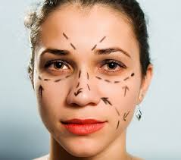
Never Satisfied
You may not perceive the results you hoped for, or you may simply begin obsessing about another aspect of your appearance and seek out more procedures.
35% of those with BDD have cosmetic surgery
40% see a dermatologist

Slide 40
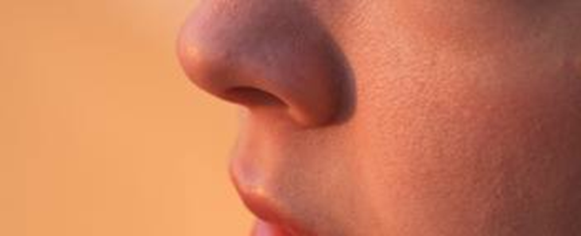
Treatment for Body Dysmorphic Disorder
Treatment of body dysmorphic disorder can be difficult, especially if you aren't a willing and active participant in your care. But treatment can be successful.
The two main treatments for body dysmorphic disorder are cognitive behavioral therapy and medications. Often, treatment involves a combination of these.

Slide 41
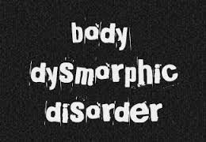
Cognitive Behavioral Therapy
Helps you stop automatic negative thoughts and to see yourself in a more realistic and positive way
Helps you learn healthy ways to handle urges or rituals, such as mirror checking or skin picking
Teaches you other healthy behaviors, such as how to socialize with others

Slide 42
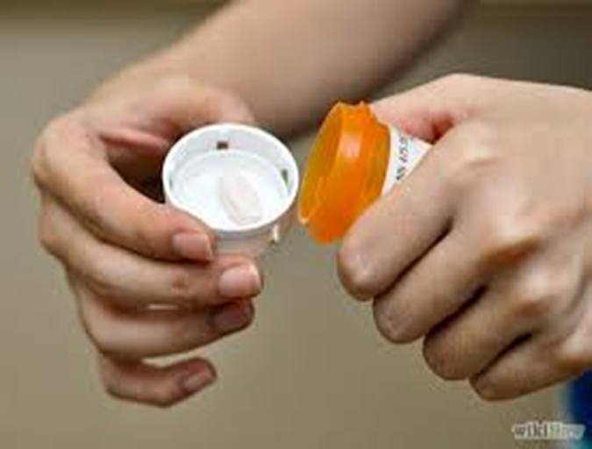
Medication
Although there are no medications specifically approved by the FDA to treat body dysmorphic disorder, SSRIs may be prescribed to help balance serotonin levels in the brains of those with BDD.

Slide 43
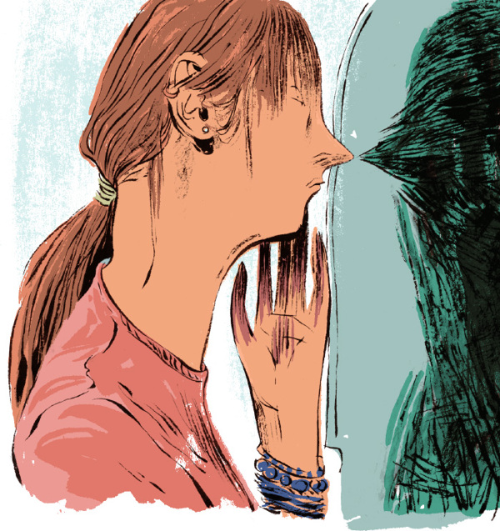
Is Hospitalization Necessary?
Like with many other disorders, in some cases, your body dysmorphic disorder symptoms may be so severe that you require psychiatric hospitalization.
Psychiatric hospitalization is generally recommended only when you aren't able to care for yourself properly or when you're in immediate danger of harming yourself.

Slide 44
Sources
MayoClinic.org
PsychCentral.com

