Slide 1
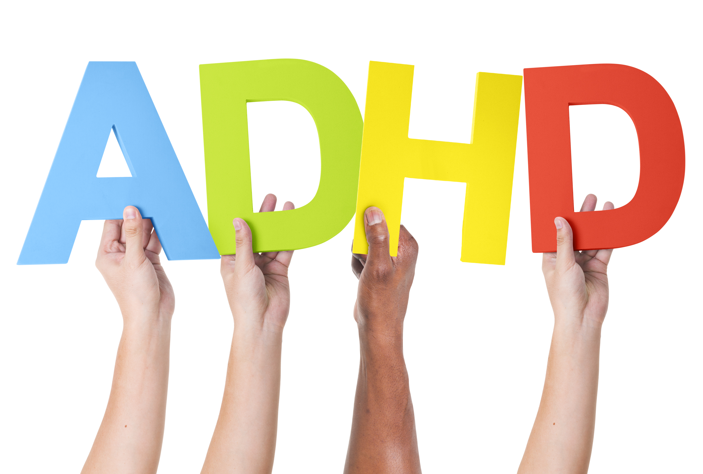
Attention Deficit Hyperactivity Disorder

Slide 2
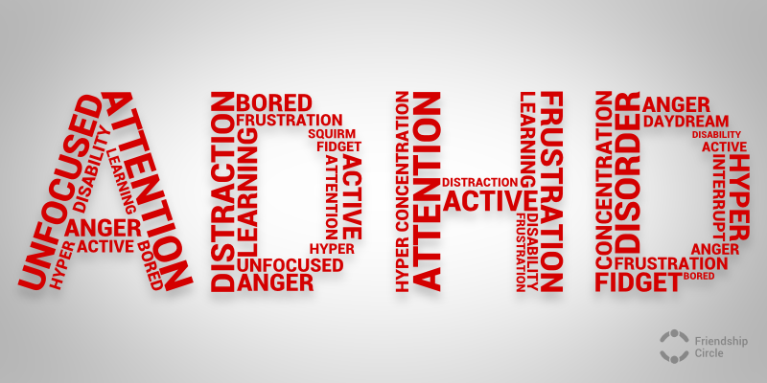
What is ADHD/ADD?
Attention deficit hyperactivity disorder (ADHD) is one of the most common childhood disorders and can continue through adolescence and adulthood.

Slide 3
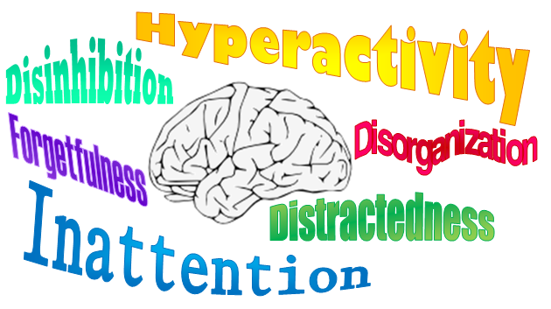
Symptoms of ADHD
Symptoms include difficulty staying focused and paying attention, difficulty controlling behavior, and hyperactivity (over-activity)

Slide 4
3 Types of ADHD
Predominantly hyperactive-impulsive ADHD – majority of symptoms (6 or more) are in the hyperactivity category without inattentiveness (less than 6 symptoms)
Predominantly Inattentive ADHD (previously known as ADD) – majority of symptoms are in the impaired attention and concentration category with fewer in the hyperactivity-impulsivity category
Combined hyperactive-impulsive and inattentive – 6 or more symptoms in each of the above categories
Most children have the combined type of ADHD

Slide 5
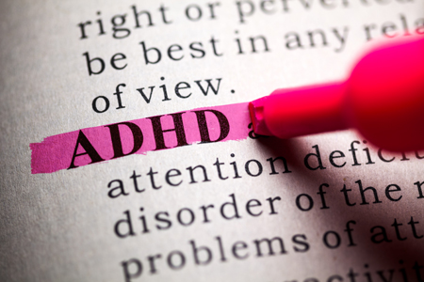
Signs & Symptoms
Inattention, hyperactivity, and impulsivity are the key behaviors of ADHD. It is normal for all children to demonstrate these behaviors, but for kids with ADHD, these behaviors are more severe and occur more often.
To be diagnosed with the disorder, a child must have symptoms for 6 or more months and to a degree that is greater than other children of the same age.

Slide 6
Symptoms of Inattention
Be easily distracted, miss details, forget things, and frequently switch from one activity to another
Have difficulty focusing one one thing
Become bored with a task after only a few minutes, unless they are doing something enjoyable
Have difficulty focusing attention on organizing and completing a task or learning something new
Have trouble completing or turning in homework assignments, often losing things (pencils, assignments) needed to complete tasks or activities

Slide 7
Signs of Inattention Cont.
Not seem to listen when spoken to
Daydream, become easily confused, and move slowly
Have difficulty processing information as quickly and accurately as others
Struggle to follow instructions

Slide 8
Symptoms of hyperactivity
Fidget and squirm in their seats
Talk nonstop
Dash around, touching or playing with anything and everything in sight
Have trouble sitting still during dinner, school, and story time
Be constantly in motion
Have difficulty doing quiet tasks or activities

Slide 9
Symptoms of impulsivity
Be very impatient
Blurt out inappropriate comments, show their emotions without restraint, and act without regard for consequences
Have difficulty waiting for things they want or waiting their turns in games
Often interrupt conversations or others’ activities

Slide 10
Often mistaken for other problems
Children demonstrating the hyperactive and impulsive symptoms of ADHD are often believed to just have emotional or disciplinary problems. Therefore, undiagnosed ADHD not only prohibits the child from learning, but also falsely labels him as a “troublemaker” when in fact, these behaviors are not his fault.

Slide 11
Often go undiagnosed
Children with the inattentive kind of ADHD may go undiagnosed because they are often quiet and less likely to act out than those with the hyperactive/impulsive symptoms. They may get along well with other children and may sit quietly, seeming to work, but they are often not paying attention to what they are doing.

Slide 12
Who is at Risk?
ADHD is one of the most common childhood disorders and can continue through adolescence and into adulthood
The disorder affects 9% of American children age 13 to 18 years
Boys are 4 times more at risk than girls
Studies show that the number of children being diagnosed with ADHD is increasing, but it is unclear why.

Slide 13
Adult ADD
ADHD affects about 4% of American adults age 18 years and older in a given year

Slide 14
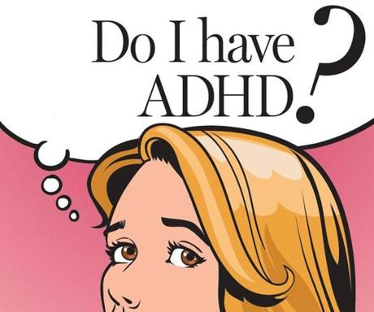
Diagnosis
Diagnosis of ADHD can be tricky because most children get distracted, act impulsively, and struggle to concentrate at one time or another.
Symptoms usually appear early in life, often between ages 3 and 6. Symptoms vary from person to person, which can make ADHD hard to diagnose.

Slide 15
Continued in powerpoint part 2…

