Slide 1
ADHD
Part 2

Slide 2
First to Notice
Parents may first notice that their child loses interest in things sooner than other kids, or seems constantly “out of control”
Often teachers are first to notice when a child has trouble following rules, or frequently “spaces out” in the classroom or on the playground.

Slide 3
No single Test
No single test can diagnose a child with ADHD.
Instead, a licensed health professional needs to gather information about the child and his/her behavior and environment.
Families may first want to talk to the child’s pediatrician who may refer the family to a mental health specialist with expertise in ADHD

Slide 4
Other conditions?
Some children with ADHD also have other illnesses or conditions such as:
A learning disability (language, math, etc.)
Oppositional defiant disorder
Conduct disorder
Anxiety and/or Depression
Bipolar Disorder
Tourette’s syndrome
ADHD may also coexist with a sleep disorder, bed-wetting, substance abuse, or other disorders or illnesses

Slide 5
What Causes ADHD?
While the exact cause of ADHD is not clear, research efforts continue.
Multiple factors have been implicated in the development of ADHD. It can run in families, and studies indicate that genes may play a role. Certain environmental factors also may increase risk, as can problems with the central nervous system at key moments in development.

Slide 6
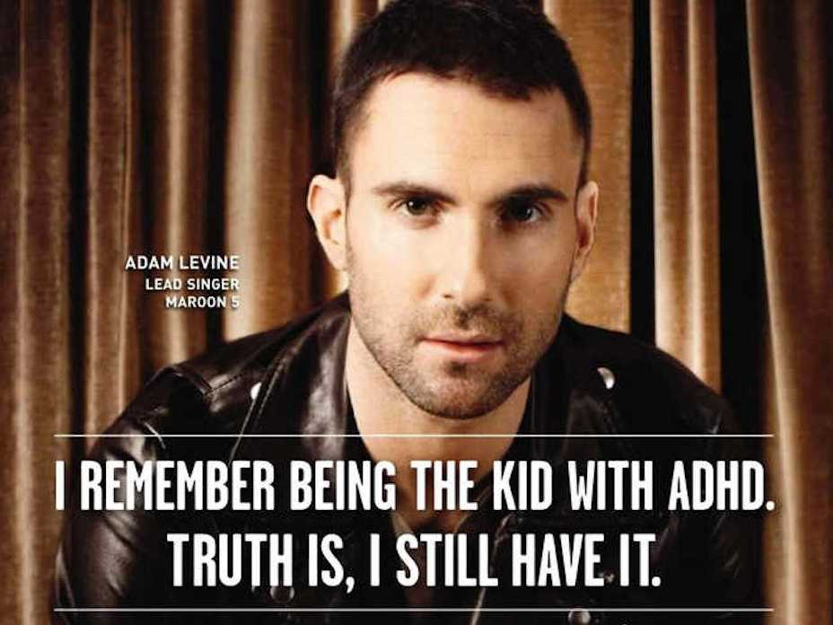
Early Diagnosis
Like every other disorder we discuss this semester, the earlier symptoms are recognized, the earlier you can seek out help.
This will lead to better outcomes for both affected children and their families

Slide 7
Treatments
Currently available treatments focus on reducing the symptoms of ADHD and improving functioning.
Treatments may relieve many of the disorder’s symptoms, but there is no cure.
However, with treatment, most people with ADHD can be successful in school and lead productive lives.
Like other disorders, treatment involves medications and/or therapy

Slide 8
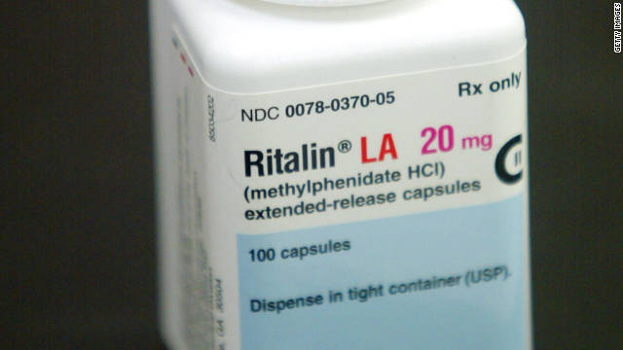
Medications
The most common type of medication used for treating ADHD is called a “stimulant”
Although it may seem unusual to treat ADHD with a medication considered a stimulant, it actually has a calming affect on children with ADHD.
For many kids, ADHD medications reduce hyperactivity and impulsivity and improve their ability to focus, work, and learn.

Slide 9
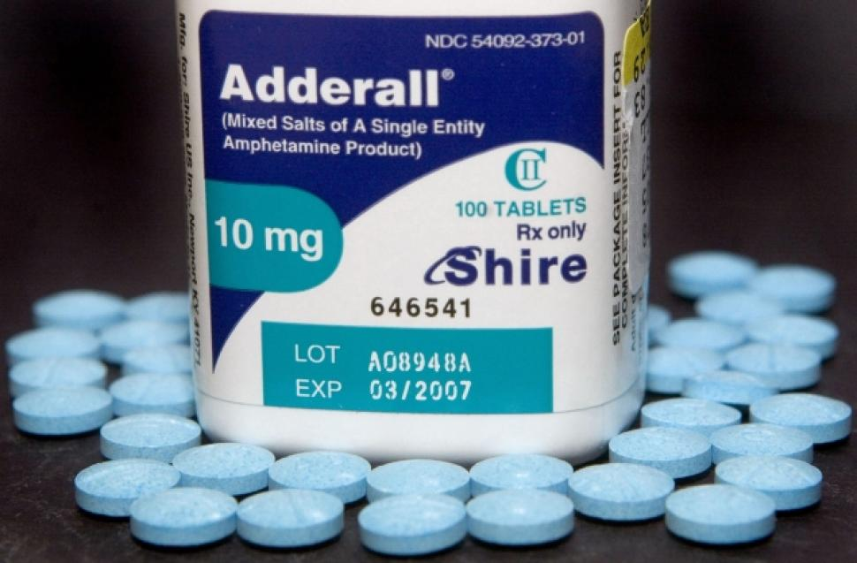
ADHD Meds
However, a one-size-fits-all approach does not apply for all children with ADHD.
What works for one child might not work for another.
One child might have side effects (such as decreased appetite or sleep problems) with a certain medication, while another child may not.
Sometimes several different medications or dosages must be tried before finding one that works for a particular child.

Slide 10
Medication Concerns
The long term effects of psychiatric medications on young children is still not fully known
Because young children’s brains are still developing, the use of medications that affect their brain chemicals is controversial and parents must weigh the risks of treatment with the risks of not treating their child.

Slide 11
Are ADHD meds safe?
Some parents are concerned that stimulant medications may not be safe for a child, however, according to the NIMH, there is little evidence that they may lead to substance abuse or dependence.
Of course, any child taking medications must be monitored closely by caregivers and doctors and the pros and cons should be carefully considered.

Slide 12
Types of Stimulant Medications
Stimulant medications come in different forms, such as pill, capsule, liquid, or skin patch.
Some medications also come in short-acting, long-acting, or extended release varieties. In each of these varieties, the active ingredient is the same, but it is released differently in the body. Long-acting or extended release forms often allow a child to take the medication just once a day before school, so they don’t have to make a daily trip to the school nurse for another dose. Parents and doctors should decide together which medication is best for the child and whether the child needs medication only for school hours or for evening and weekends too.

Slide 13
Who prescribes?
ADHD medications can be prescribed by M.D.s (usually a psychiatrist) and in some states also by clinical psychologists, psychiatric nurse practitioners, and advanced psychiatric nurse specialists.
Some of the most common trade name prescriptions for ADHD are Adderall and Ritalin.

Slide 14
Psychotherapy
Different types of therapy are also used for ADHD.
Behavioral therapy aims to help a child change his or her behavior (such as helping organize tasks or completing schoolwork, or working through emotionally difficult events)
Therapists may also teach children with ADHD social skills, such as how to wait their turn, share toys, ask for help, or respond to teasing.

Slide 15
Sources
National Institute of Mental Health (NIMH)

