Slide 1
Substance and Alcohol Related Disorders
Substance use Disorder
Alcoholism
Gambling Disorder

Slide 2
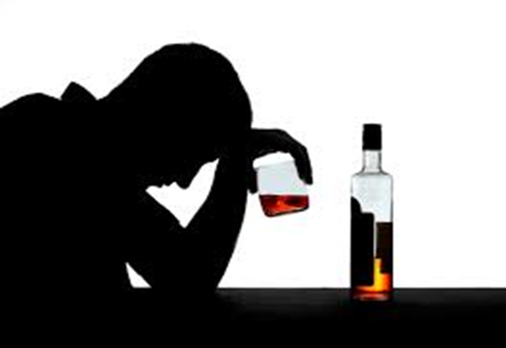
What is a Substance Use Disorder?
According to the DSM-5, a substance use disorder describes a problematic pattern of using alcohol or another substance that results in impairment in daily life or noticeable distress.

Slide 3
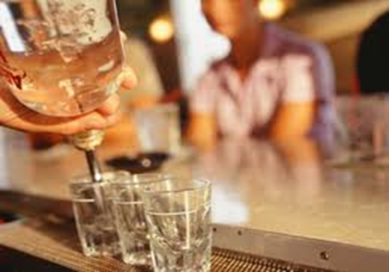
As with most addiction problems, despite any consequences a person who has a problem with either alcoholism or drugs suffers, they will generally continue to use their drug of choice.
They may make half-hearted attempts to stop or cut back their use, but it usually does not work.

Slide 4
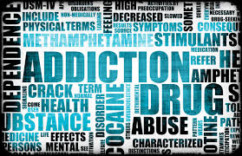
Similarities between alcohol and other substance use
While the criteria to be diagnosed with a disorder due to either alcohol or other drugs is similar, we will be focusing on Alcohol use disorder (which includes a level that's sometimes called alcoholism)

Slide 5
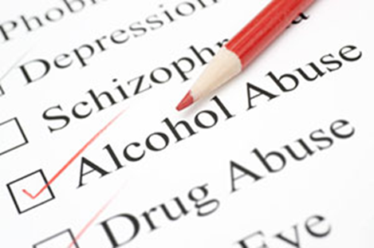
Alcohol Use Disorder
Alcohol Use Disorder is a pattern of alcohol use that involves problems controlling your drinking, being preoccupied with alcohol, continuing to use alcohol even when it causes problems, having to drink more to get the same effect, or having withdrawal symptoms when you rapidly decrease or stop drinking.

Slide 6
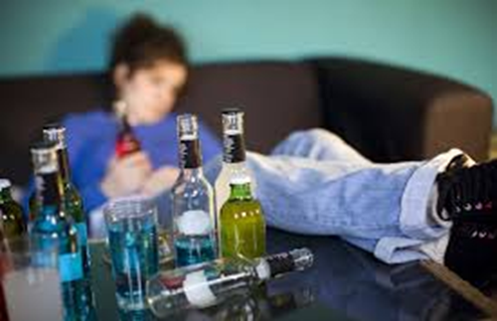
Unhealthy alcohol use
Unhealthy alcohol use includes any alcohol use that puts your health or safety at risk or causes other alcohol-related problems.

Slide 7
Binge drinking
It also includes binge drinking - a pattern of drinking where a male consumes five or more drinks within two hours or a female downs at least four drinks within two hours.
Binge drinking causes significant health and safety risks.

Slide 8
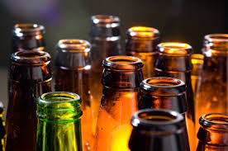
Symptoms of a disorder due to a substance
The DSM-5 states that in order for a person to be diagnosed with a disorder due to a substance, they must display 2 of the following 11 symptoms within 12-months:

Slide 9
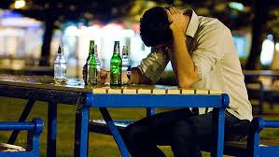
Consuming more alcohol or other substance than originally planned
Worrying about stopping or consistently failed efforts to control one’s use
Spending a large amount of time using drugs/alcohol, or doing whatever is needed to obtain them
Use of the substance results in failure to “fulfill major role obligations” such as at home, work, or school.

Slide 10
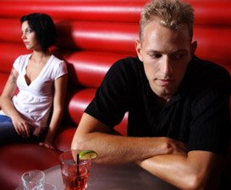
“Craving” the substance (alcohol or drug)
Continuing the use of a substance despite its having negative effects in relationships with others (for example, using even though it leads to fights or despite people’s objecting to it).

Slide 11
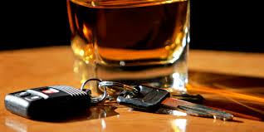
Repeated use of the substance in a dangerous situation (for example, when driving a car)
Giving up or reducing activities in a person’s life because of the drug/alcohol use
Continuing the use of a substance despite health problems caused or worsened by it. This can be in the domain of mental or physical health (psychological problems may include depressed mood, sleep disturbance, anxiety, or “blackouts”).

Slide 12
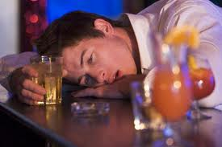
What is a blackout?
Person is unable to recall what happened the next day as a result of drinking

Slide 13
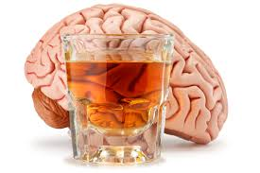
What is tolerance?
Building up a tolerance to the alcohol or drug. Tolerance is defined by the DSM-5 as “either needing to use noticeably larger amounts over time to get the desired effect or noticing less of an effect over time after repeated use of the same amount.”

Slide 14
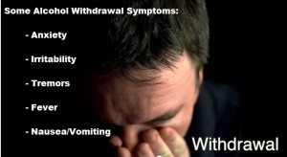
What is withdrawal?
Experiencing withdrawal symptoms after stopping use. Withdrawal symptoms typically include, according to the DSM-5: “anxiety, irritability, fatigue, nausea/vomiting, hand tremor or seizure in the case of alcohol.”

Slide 15
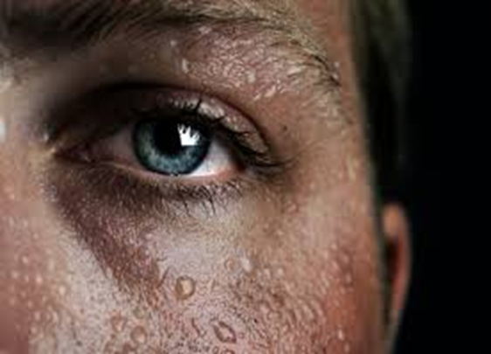
Alcohol Withdrawal
Alcohol withdrawal can occur when alcohol use has been heavy and prolonged and is then stopped or greatly reduced. It can occur within several hours to four or five days later.

Slide 16
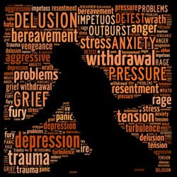
As bad as heroin withdrawal?
Symptoms include sweating, rapid heartbeat, hand tremors, problems sleeping, nausea and vomiting, hallucinations, restlessness and agitation, anxiety, and occasionally seizures. Symptoms can be severe enough to impair your ability to function at work or in social situations.

Slide 17
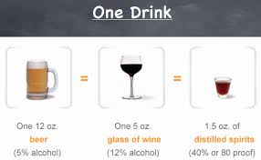
What is considered one drink?
The National Institute on Alcohol Abuse and Alcoholism defines one standard drink as any one of these:
12 ounces (355 milliliters) of regular beer (about 5 percent alcohol)
5 ounces (148 milliliters) of unfortified wine (about 12 percent alcohol)
1.5 ounces (44 milliliters) of 80-proof hard liquor (about 40 percent alcohol)

Slide 18
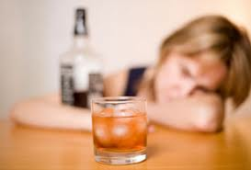
Moderate vs. “Problem” drinking
Moderate drinking is generally defined as 2 drinks or less per day. More than that is generally considered problem drinking.
It is not so much the amount of alcohol that is important as it is the need for it and the inability to stop once you have started drinking.

Slide 19
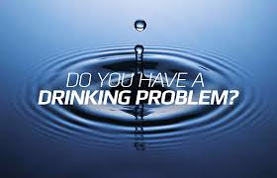
When does drinking become a problem?
If your pattern of drinking results in repeated significant distress and problems functioning in your daily life, you likely have alcohol use disorder. It can range from mild to severe.
However, even a mild disorder can escalate and lead to serious problems, so early treatment is important.

Slide 20
How do you know when you are on the “road to alcoholism”?
Developing a drinking problem is not as clear cut as steps 1,2,3, but this is the typical progression one might follow:
Step 1– drinks may perk up person, relieve anxiety or stress, make special occasions more fun, and temporarily take away the blues – use gradually increases and drinker comes to depend on the mood altering qualities of alcohol

Slide 21
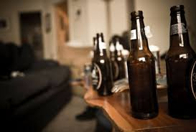
Step 2 – drinker’s life starts to revolve around alcohol – urge to drink starts earlier in the day, preference for alcohol-related activities - increasing tolerance accompanied by blackouts and increasing loss of control
Step 3 – characterized by obsession w/ alcohol to the exclusion of everything else – may drink around the clock – may drink self to death without help

Slide 22
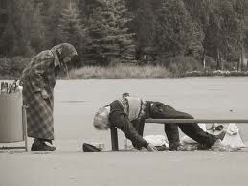
Stereotype of an “Alcoholic”
Walking around with a bottle in a brown paper bag and sleeping on a park bench
In reality, most are functioning alcoholics who hold down a job, have a family, etc.

Slide 23
Denial
Because denial is common, you may not feel like you have a problem with drinking. You might not recognize how much you drink or how many problems in your life are related to alcohol use. Listen to relatives, friends or co-workers when they ask you to examine your drinking habits or to seek help. Consider talking with someone who has had a problem drinking, but has stopped.

Slide 24
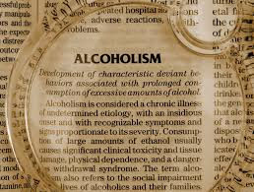
What causes alcohol use disorder?
Genetic, psychological, social and environmental factors can impact how drinking alcohol affects your body and behavior. Theories suggest that for certain people drinking has a different and stronger impact that can lead to alcohol use disorder.

Slide 25
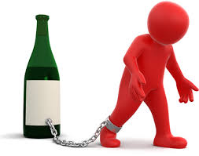
Genetic Predisposition
While most adults who occasionally consume alcohol in moderation are not going to become alcoholics, those who have a genetic predisposition to alcohol use disorder, should never even try alcohol because they are at 4 times the risk of developing alcoholism than the average person.

Slide 26
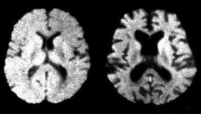
Your Brain Actually Changes
Over time, drinking too much alcohol may change the normal function of the areas of your brain associated with the experience of pleasure, judgment and the ability to exercise control over your behavior. This may result in craving alcohol to try to restore good feelings or reduce negative ones.

Slide 27
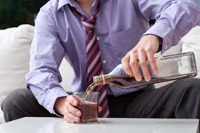
Risk Factors for Alcohol Use Disorder
Steady drinking over time. Drinking too much on a regular basis for an extended period or binge drinking on a regular basis can lead to alcohol-related problems or alcohol use disorder.

Slide 28
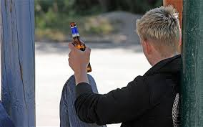
Age
People who begin drinking at an early age, and especially in a binge fashion, are at a higher risk of alcohol use disorder. Alcohol use may begin in the teens, but alcohol use disorder occurs more frequently in the 20s and 30s. However, it can begin at any age.

Slide 29
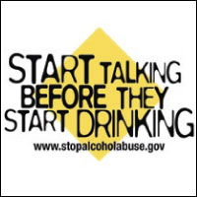
Family History
The risk of alcohol use disorder is 4X higher for people who have a parent or other close relative who has problems with alcohol. This may be influenced by genetic factors.

Slide 30
Depression and other mental health problems
It's common for people with a mental health disorder such as anxiety, depression, schizophrenia or bipolar disorder to have problems with alcohol or other substances.

Slide 31
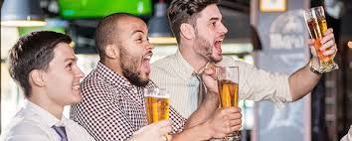
Social and cultural factors
Having friends or a close partner who drinks regularly could increase your risk of alcohol use disorder. The glamorous way that drinking is sometimes portrayed in the media also may send the message that it's OK to drink too much. For young people, the influence of parents, peers and other role models can impact risk.

Slide 32
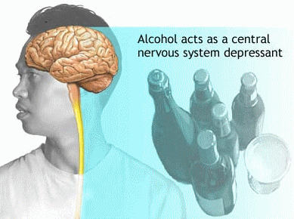
A Depressant
Alcohol depresses your central nervous system. In some people, the initial reaction may be stimulation. But as you continue to drink, you become sedated.

Slide 33
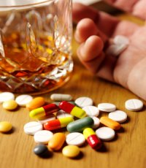
Physical Effects
Too much alcohol affects your speech, muscle coordination and vital centers of your brain. A heavy drinking binge may even cause a life-threatening coma or death. This is of particular concern when you're taking certain medications that also depress the brain's function.

Slide 34
Impact on Your Safety
Excessive drinking can reduce your judgment skills and lower inhibitions, leading to poor choices and dangerous situations or behaviors, including:
Motor vehicle accidents and other types of accidental injury, such as drowning
Relationship problems
Poor performance at work or school

Slide 35
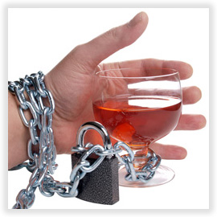
Other Dangers
Increased likelihood of committing violent crimes or being the victim of a crime
Legal problems or problems with employment or finances
Problems with other substance use
Engaging in risky, unprotected sex, or becoming the victim of sexual abuse or date rape
Increased risk of attempted or completed suicide

Slide 36
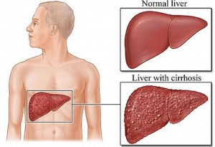
Impact on your health
Drinking too much alcohol on a single occasion or over time can cause health problems, including:
Liver Disease
Digestive Problems
Heart Problems
Neurological Complications
Increased Risk of Cancer
Birth Defects
And Many other physical problems…

Slide 37
Is addiction a choice or a disease?

Slide 38
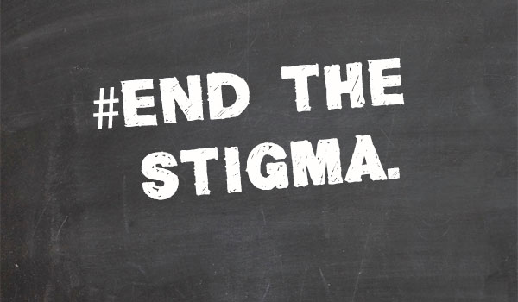
Why do we blame addicts?
If someone says they have cancer we feel bad for them, but if someone says they are an alcoholic or a drug addict we usually blame them for it.
We see cancer as something you don’t have control over, yet we view addiction as something we do have control over and as the fault of the addict.

Slide 39
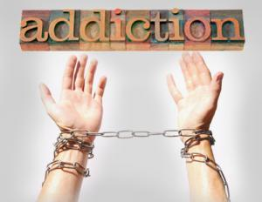
Dependence is not a choice
While it is true that the choice to first use drugs or alcohol is something someone may be able to control, the physical and psychological craving and dependence that can result is not something you can choose.

Slide 40
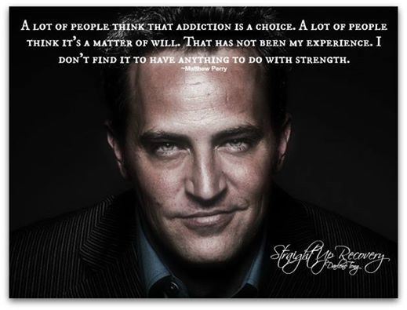

Slide 41
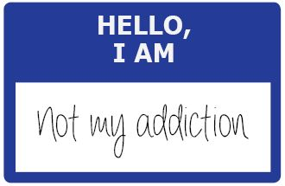
Secret Disease
Living with the disease of addiction often means facing problems alone and in secret.
Research tells us that addiction is a disease like any other, that its roots are genetic, biological, and environmental.
But rather than treating it like the disease that it is, society treats addiction like a moral failure or even a crime.

Slide 42
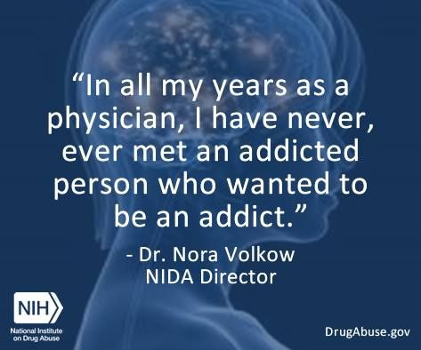
Judgment and Shame
Those who suffer with this disease – along with those who love them – are isolated by judgment and shame.
As a result, the disease often goes unrecognized and untreated, especially among the poor (shatterproof.org)

Slide 43
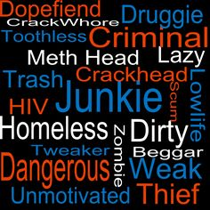
Self-Hatred
“People who are victims of stigma internalize the hate it carries, transforming it to shame and hiding from its effects.”
~ David Rosenbloom
Professor of Public Health
Boston University

Slide 44
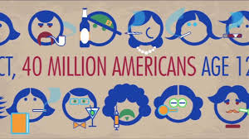
Prison instead of Treatment
As a result of this attitude in America, we have often been more likely to send addicts to prison rather than drug treatment or rehab.
The disease of addiction does not get treated when it is dealt with as a criminal problem rather than as a health problem.

Slide 45
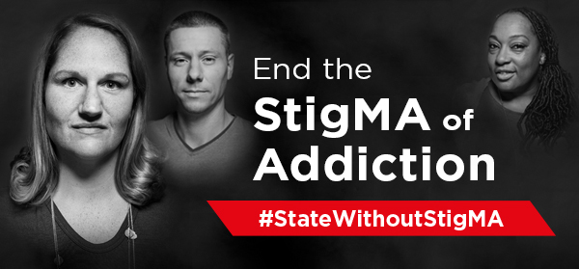
No one wins
In the last ten years or so, states have started to recognize that this view of addiction has not benefitted anyone.

Slide 46
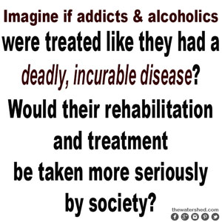
Shifting Attitudes?

Slide 47
Treatment
Treatment for alcohol use disorder can vary, depending on your needs. Treatment may involve a brief intervention, individual or group counseling, an outpatient program, or a residential inpatient stay. Working to stop the use of alcohol to improve quality of life is the main treatment goal.

Slide 48
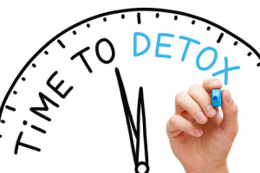
Detox and withdrawal
Treatment may begin with a program of detoxification or detox - withdrawal that's medically managed - which generally takes two to seven days. You may need to take sedating medications to prevent withdrawal symptoms. Detox is usually done at an inpatient treatment center or a hospital.

Slide 49
Other Treatment
Treatment may also include learning skills and establishing a treatment plan, counseling (particularly if there are other mental health issues such as depression) and medication that will make you sick if you drink (called Antabuse).

Slide 50
Continuing Support
Aftercare programs and support groups help people recovering from alcohol use disorder to stop drinking, manage relapses and cope with necessary lifestyle changes. This may include medical or psychological care or attending a support group (like AA).

Slide 51
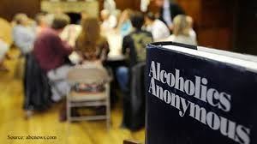
Alcoholics Anonymous (AA)
Does it work?
About 1/3 recover
1/3 struggle back and forth
1/3 become alcohol dependent or die

Slide 52
Sobriety
Despite these sobering statistics, this is still the most effective long term treatment plan for many alcoholics.
This just goes to show how difficult it is to stop drinking once you develop a problem.

Slide 53
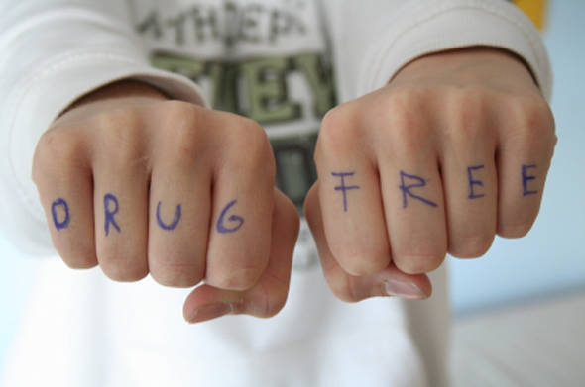
A Lifelong Struggle
For many, attending frequent AA meetings becomes necessary in order to stay sober.
Can never touch alcohol again after becoming sober– even one sip can send you right back down the path to alcoholism.
“Once an alcoholic, always an alcoholic”.

Slide 54
Residential treatment programs
For a serious alcohol problem, you may need a stay at a residential treatment facility. Most residential treatment programs include individual and group therapy, support groups, educational lectures and family involvement.
Residential treatment programs typically include licensed alcohol and drug counselors, social workers, nurses, doctors and others with expertise and experience in treating alcohol use disorder.

Slide 55
Staying Clean & Sober
Once you’re sober you need to focus on changing your habits and making different lifestyle choices.
Consider your social situation. Make it clear to your friends and family that you're not drinking alcohol. Develop a support system of friends and family who can support your recovery. You may need to distance yourself from friends and social situations that impair your recovery.

Slide 56
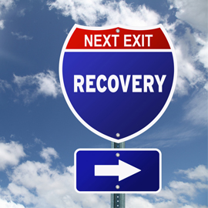
Develop healthy habits
Good sleep, regular physical activity, managing stress more effectively and eating well all can make it easier for you to recover from alcohol use disorder.

Slide 57
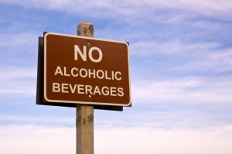
Do things that don't involve alcohol
You may find that many of your activities involve drinking. Replace them with hobbies or activities that are not centered around alcohol.
This can be very challenging for someone who’s lifestyle has revolved around drinking.

Slide 58
Support Groups
Alcoholics Anonymous. AA is a self-help group of people recovering from alcoholism that offers a sober peer group built around 12 steps as an effective model for achieving total abstinence.

Slide 59
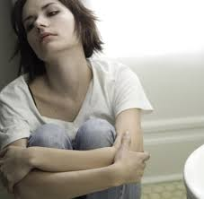
Other Support Groups
Women for Sobriety. Women for Sobriety is a nonprofit organization offering a self-help group program for women who want to overcome alcoholism and other addictions. It focuses on developing coping skills related to emotional and spiritual growth, self-esteem and a healthy lifestyle.

Slide 60
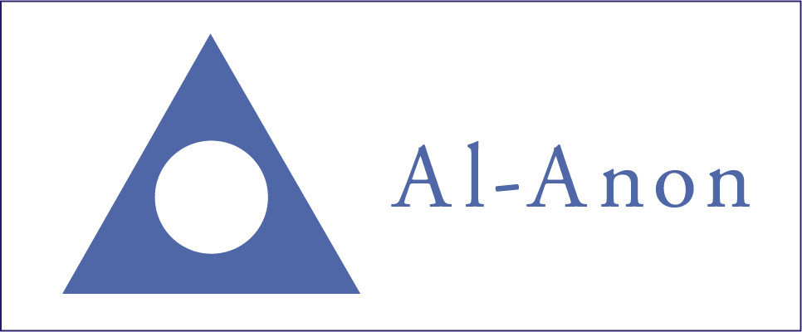
Support for those living with an alcoholic
Al-Anon. Al-Anon is designed for people who are affected by someone else's alcoholism.
Alateen. Alateen groups are available for teenage children of those with alcoholism. In sharing their stories, family members gain a greater understanding of how the disease affects the entire family.

Slide 61
How to help someone with an alcohol problem
See p. 341 in packet

Slide 62
Sources
PsychCentral.com
MayoClinic.org

