Slide 1
Bipolar Disorder
And Other Mood Disorders

Slide 2
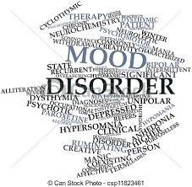
Other Mood Disorders
Persistent Depressive Disorder/Dysthymia
Seasonal Affective Disorder
Post Partum Depression
Bipolar Disorder
Cyclothymia

Slide 3
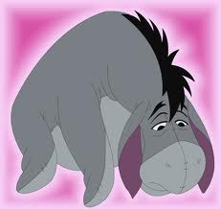
Persistent Depressive Disorder (formerly called Dysthymia or Chronic Depression)
less severe, but longer lasting form of major depression that often goes undiagnosed for years
a depressed mood that occurs for most of the day, for more days than not, for at least 2 years (at least 1 year for children and adolescents)

Slide 4
Symptoms
Individuals with persistent depressive disorder describe their mood as sad or “down in the dumps.” During periods of depressed mood, at least two of the following six symptoms are present.
Poor appetite or overeating
Insomnia or hypersomnia
Low energy or fatigue
Low self-esteem
Poor concentration or difficulty making decisions
Feelings of hopelessness

Slide 5
Diminished Quality of Life
Dealing with a lack of energy or motivation over a long period of time often results in poor self-esteem and an expectation of failure. This type of thinking can reinforce a vicious self-reinforcing cycle —the individual expects nothing to change, and so nothing ever does.

Slide 6
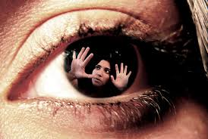
Double Depression?
Many people with dysthymic disorder also experience major depressive episodes. If they have both dysthymia and major depression, they are said to suffer from “double depression.”

Slide 7
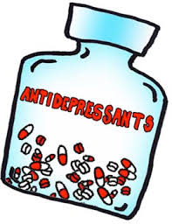
Treatment
Both antidepressant medication and psychotherapy are effective in treating dysthymia.
Medications usually are used to try to help lift the person’s energy levels, while psychotherapy helps to find ways the individual can better cope with and improve his or her life.

Slide 8
Therapy
Psychotherapy can be challenging, however, as the individual often is not motivated to make changes.
Enlisting the person’s support system, such as family or friends, can be beneficial in treatment.

Slide 9
SAD – Seasonal Affective Disorder
Seasonal Affective Disorder (SAD) is a type of depression that typically occurs in the fall and winter, when days are shorter and provide less sunlight.
Depressive symptoms begin in the fall or winter and persist until the spring.

Slide 10
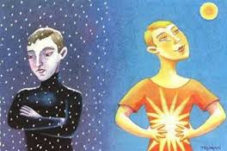
Symptoms
People suffering from SAD either are unable to function or function minimally during the season in which their disorder occurs.

Slide 11
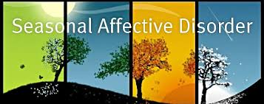
SAD shares several symptoms with other forms of depression including lethargy, sadness, hopelessness, anxiety and social withdrawal.
SAD sufferers crave additional sleep, experience daytime drowsiness, and gain a good deal of weight, often feeling irresistible cravings for sweets.

Slide 12
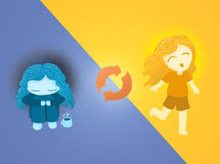
Who is at greatest risk?
Four to six percent of the general population will experience SAD. Women are four times more likely than men to develop SAD.
SAD is more common among the young (ages 20 to 50) with a general decrease in symptoms with age.

Slide 13
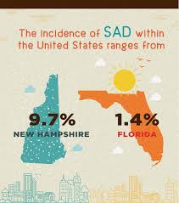
Risk of the disease increases significantly with geographic residence (with increased prevalence at higher latitudes). For example, the incidence of SAD among people living in Florida is 1 percent, while those living in northern latitudes, such as Alaska or New Hampshire, have a rate of approximately 10 percent.

Slide 14
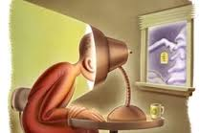
Treatment
Treatment for SAD typically involves a combination of daily light therapy and medication.
Light therapy involves increasing your daily exposure to as much natural light as possible. Special light therapy lights can be purchased, however, since they are expensive, another technique to try is to replace commonly used light bulbs in your home with brighter full/broad spectrum light bulbs that provide light that is similar to natural sunlight.

Slide 15
Exercise and stress management also help to lessen the symptoms of SAD.

Slide 16
New Moms
Up to 10% of women may experience signs of depression after giving birth

Slide 17
Shouldn’t I be happy?
The birth of a baby can trigger a jumble of powerful emotions, from excitement and joy to fear and anxiety. But it can also result in something you might not expect — depression.

Slide 18
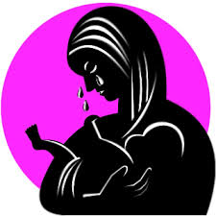
Baby Blues
Many new moms experience the "postpartum baby blues" after childbirth, which commonly include mood swings, crying spells, anxiety and difficulty sleeping. Baby blues typically begin within the first two to three days after delivery, and may last for up to two weeks.

Slide 19
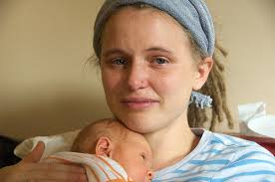
Postpartum Depression
But some new moms experience a more severe, long-lasting form of depression known as postpartum depression. Rarely, an extreme mood disorder called postpartum psychosis also may develop after childbirth.

Slide 20
There’s Help
Postpartum depression isn't a character flaw or a weakness. Sometimes it's simply a complication of giving birth. If you have postpartum depression, prompt treatment can help you manage your symptoms — and enjoy your baby.

Slide 21
Postpartum Baby Blues Symptoms
Signs and symptoms of depression after childbirth vary, and they can range from mild to severe.
Signs and symptoms of baby blues — which last only a few days to a week or two after your baby is born — may include:
Mood swings Crying
Anxiety Reduced Concentration
Sadness Appetite Problems
Irritability Trouble Sleeping
Feeling overwhelmed

Slide 22
Postpartum Depression Symptoms
Postpartum depression may be mistaken for baby blues at first — but the signs and symptoms are more intense and last longer, eventually interfering with your ability to care for your baby and handle other daily tasks. Symptoms usually develop within the first few weeks after giving birth, but may begin later — up to six months after birth.

Slide 23
Postpartum depression symptoms may include:
Depressed mood or severe mood swings
Excessive crying
Difficulty bonding with your baby
Withdrawing from family and friends
Loss of appetite or eating much more than usual

Slide 24
Inability to sleep (insomnia) or sleeping too much
Overwhelming fatigue or loss of energy
Reduced interest and pleasure in activities you used to enjoy
Intense irritability and anger
Fear that you're not a good mother
Feelings of worthlessness, shame, guilt or inadequacy

Slide 25
Diminished ability to think clearly, concentrate or make decisions
Severe anxiety and panic attacks
Thoughts of harming yourself or your baby
Recurrent thoughts of death or suicide
Untreated, postpartum depression may last for many months or longer.

Slide 26
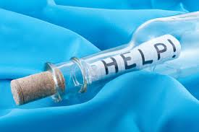
Postpartum Psychosis
With postpartum psychosis — a rare condition that typically develops within the first week after delivery — the signs and symptoms are even more severe. Signs and symptoms may include:
Confusion and disorientation
Obsessive thoughts about your baby
Hallucinations and delusions
Sleep disturbances
Paranoia
Attempts to harm yourself or your baby
Postpartum psychosis may lead to life-threatening thoughts or behaviors and requires immediate treatment.

Slide 27
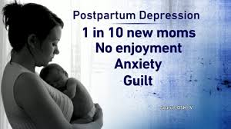
When to See a Doctor
If you're feeling depressed after your baby's birth, you may be reluctant or embarrassed to admit it. But if you experience any symptoms of postpartum baby blues or postpartum depression, call your doctor and schedule an appointment. If you have symptoms that suggest you may have postpartum psychosis, get help immediately.

Slide 28
It's important to call your doctor as soon as possible if the signs and symptoms of depression have any of these features:
Don't fade after two weeks
Are getting worse
Make it hard for you to care for your baby
Make it hard to complete everyday tasks
Include thoughts of harming yourself or your baby

Slide 29
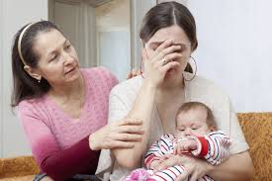
Helping a Friend or Loved One
People with depression may not recognize or acknowledge that they're depressed. They may not be aware of signs and symptoms of depression. If you suspect that a friend or loved one has postpartum depression or is developing postpartum psychosis, help them seek medical attention immediately. Don't wait and hope for improvement.

Slide 30
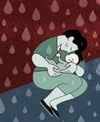
Causes
There's no single cause of postpartum depression, but physical and emotional issues may play a role.
Physical changes. After childbirth, a dramatic drop in hormones ( such as estrogen) in your body may contribute to postpartum depression. Other hormones produced by your thyroid gland also may drop sharply — which can leave you feeling tired, sluggish and depressed.

Slide 31
Emotional issues. When you're sleep deprived and overwhelmed, you may have trouble handling even minor problems. You may be anxious about your ability to care for a newborn. You may feel less attractive, struggle with your sense of identity or feel that you've lost control over your life. Any of these issues can contribute to postpartum depression.

Slide 32
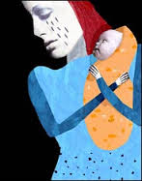
Who is at greatest Risk?
Postpartum depression can develop after the birth of any child, not just the first. The risk increases if:
You have a history of depression, either during pregnancy or at other times
You have bipolar disorder

Slide 33
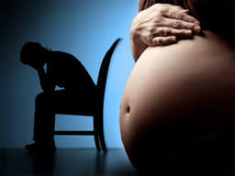
You had postpartum depression after a previous pregnancy
You have family members who've had depression or other mood stability problems
You've experienced stressful events during the past year, such as pregnancy complications, illness or job loss

Slide 34
Additional Risk Factors
Your baby has health problems or other special needs
You have difficulty breast-feeding
You're having problems in your relationship with your spouse or significant other
You have a weak support system
You have financial problems
The pregnancy was unplanned or unwanted

Slide 35
What happens if it’s left untreated?
Left untreated, postpartum depression can interfere with mother-child bonding and cause family problems.
For mothers. Untreated postpartum depression can last for months or longer, sometimes becoming a chronic depressive disorder. Even when treated, postpartum depression increases a woman's risk of future episodes of major depression.

Slide 36
Effects on other Members of the Family
For fathers. Postpartum depression can have a ripple effect, causing emotional strain for everyone close to a new baby. When a new mother is depressed, the risk of depression in the baby's father may also increase. And new dads are already at increased risk of depression, whether or not their partner is affected.

Slide 37
For children. Children of mothers who have untreated postpartum depression are more likely to have emotional and behavioral problems, such as sleeping and eating difficulties, and excessive crying. Delays in language development are more common as well.

Slide 38
Treatment
Treatment and recovery time vary, depending on the severity of your depression and your individual needs. Your doctor may refer you to a mental health provider.
The baby blues usually fade on their own within a few days to one to two weeks. In the meantime:
Get as much rest as you can
Accept help from family and friends
Connect with other new moms
Create time to take care of yourself
Avoid alcohol and recreational drugs, which can make mood swings worse

Slide 39
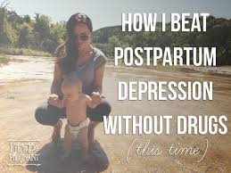
Treatment for Postpartum Depression
Postpartum depression is often treated with psychotherapy, medication or both.
If a woman is breast-feeding, any medication she takes will enter her breast milk. However, some antidepressants can be used during breast-feeding with little risk of side effects to the baby. A woman should work with her doctor to weigh the potential risks and benefits of specific antidepressants.

Slide 40
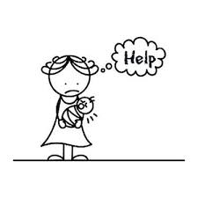
With appropriate treatment, postpartum depression usually goes away within six months. In some cases, postpartum depression lasts much longer, becoming chronic depression. It's important to continue treatment after you begin to feel better. Stopping treatment too early may lead to a relapse.

Slide 41
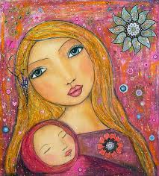
Treatment for Postpartum Psychosis
Postpartum psychosis requires immediate treatment, often in the hospital. Treatment may include:
Medication. When your safety is assured, a combination of medications — such as antidepressants, antipsychotic medications and mood stabilizers — may be used to control your signs and symptoms.
Electroconvulsive therapy (ECT). If your postpartum depression is severe and does not respond to medication, ECT may be recommended.

Slide 42
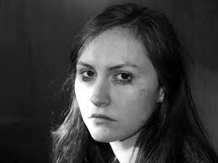
Treatment for postpartum psychosis can challenge a mother's ability to breast-feed. Separation from the baby makes breast-feeding difficult, and some medications used to treat postpartum psychosis aren't recommended for women who are breast-feeding.

Slide 43
Help Yourself
Postpartum depression isn't generally a condition that you can treat on your own — but you can do some things for yourself that build on your treatment plan and help speed recovery.
Make healthy lifestyle choices.
Set realistic expectations.
Make time for yourself.
Avoid isolation.
Ask for help.
Remember, the best way to take care of your baby is to take care of yourself.

Slide 44
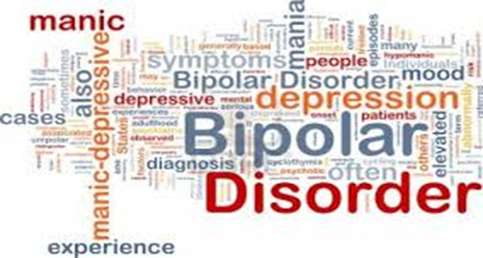
Bipolar Disorder/Manic Depression
All of us experience changes in our moods. Some days we might feel irritable and frustrated; other days, we’re happy and excited. However, individuals with bipolar disorder experience severe mood swings that impair their daily life and negatively affect their relationships.

Slide 45
What does Bipolar mean?
Approximately 2.6 percent of American adults have bipolar disorder (formerly called manic depression or manic depressive disorder), according to the National Institute of Mental Health.
These mood swings include “highs” (mania), when individuals feel either on top of the world or on edge, and “lows” (depression), when they feel sad and hopeless.

Slide 46
Just like the North and South Pole, someone with Bipolar disorder appears to have mood swings that go from one extreme to the other.
Suicide attempts are common in bipolar disorder, especially during depressive episodes.

Slide 47
What causes Bipolar Disorder?
There is no single cause for bipolar disorder. Like all psychological disorders, bipolar disorder is a complex condition with multiple contributing factors, including:
Genetic: Bipolar disorder tends to run in families, so researchers believe there is a genetic predisposition for the disorder. Scientists also are exploring the presence of abnormalities on specific genes.

Slide 48
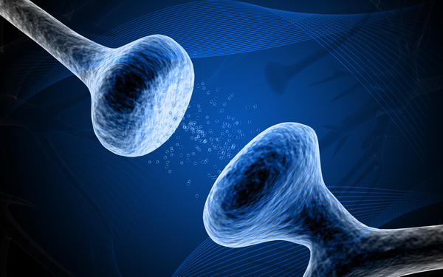
Other Causes
Biological: Researchers believe that some neurotransmitters, including serotonin and dopamine, don’t function properly in individuals with bipolar disorder.

Slide 49
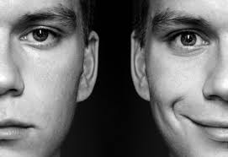
Environmental: Outside factors, such as stress or a major life event, may trigger a genetic predisposition or potential biological reaction. For instance, if bipolar disorder was entirely genetic, both identical twins would have the disorder. But research reveals that one twin can have bipolar, while the other does not, implicating the environment as a potential contributing cause.

Slide 50
Symptoms of Bipolar Disorder
There are four possible bipolar states:
Mania
Hypomania
Depression
A mixture of mania and depression (called a “mixed episode”).
Mood states are highly variable. Some people can experience mood changes in one week, while others can spend months or even years in one episode.

Slide 51
What does mania look like?
Feelings of euphoria and elation or irritability and anger
Impulsive, high-risk behavior, including grand shopping sprees, drug and alcohol abuse and sexual promiscuity
Aggressive behavior
Increased energy, racing thoughts and rapid speech
Fleeting, often grandiose ideas

Slide 52
Decreased sleep (typically the individual doesn’t feel tired after as few as three hours of sleep)
Decreased appetite
Difficulty concentrating; disorganized thoughts
Inflated self-esteem/overconfidence
Delusions and hallucinations (in severe cases)

Slide 53
What does Hypomania look like?
Hypomania is less severe than a full-blown manic episode. the symptoms of mania and hypomania are virtually identical, the key differentiator is the severity. Like mania-light.
Mania is very dangerous because people don’t just act abnormally; they typically endanger themselves or vital parts of their lives. Mania often requires hospitalization due to the damage they are doing.

Slide 54
Hypomania, on the other hand, may be an unusual mood, and it may cause some harm to the person or their lifestyle, but not to the point where they need to be hospitalized. People in hypomania buy 5 pairs of shoes, people in a mania buy 50.
Though it doesn’t sound problematic, increasing hypomania can lead to risky behaviors and full mania.

Slide 55
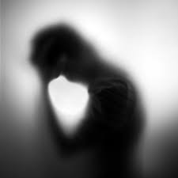
What does Depression look like?
Depressive episodes of bipolar look just like depressive episodes of Major Depressive Disorder
Feelings of hopelessness and sadness
Inability to sleep or sleeping too much
Loss of interest in formerly enjoyable activities; loss of energy (sometimes to the point of inability to get out of bed)

Slide 56
Changes in appetite and weight
Feelings of worthlessness and inappropriate guilt
Inability to concentrate or make a decision
Thoughts of death and suicide

Slide 57
What does a Mixed Episode look like?
Mixed episodes involve simultaneous symptoms of mania and depression, including irritability, depressed mood, extreme energy, thoughts of suicide and changes in sleep and appetite.

Slide 58
Bipolar and Suicide
Because of the high suicide risk in those with bipolar disorder, it’s important to note the warning signs. In addition to those mentioned in the depression symptoms above, others include:
Withdrawing from loved ones and isolating oneself
Talking or writing about death or suicide
Putting personal affairs in order
Previous attempts

Slide 59
What are the Different Types of Bipolar Disorder?
Bipolar I is considered the classic type of bipolar disorder. Individuals experience both manic and depressive episodes of varying lengths.
Bipolar II involves less severe hypomanic episodes (as opposed to the manic episodes of bipolar I); however, their depressive episodes are the same.

Slide 60
Other Types of Bipolar
Cyclothymia is a chronic but milder form of bipolar disorder, characterized by episodes of hypomania and depression that last for at least two years.
Mixed episodes are ones in which mania and depression occur simultaneously. Individuals might feel hopeless and depressed yet energetic and motivated to engage in risky behaviors.
Rapid-cycling bipolar individuals experience four or more episodes of mania, depression or both within one year.

Slide 61
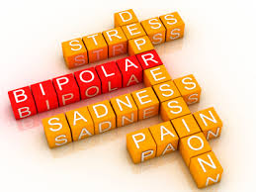
What are the risk factors for Bipolar disorder?
Risk factors include having:
Cyclothymia (see definition above). About half of individuals with cyclothymia will experience a manic episode.
Any other psychological disorder
A family history of bipolar or other psychological disorders
Alcohol and substance abuse
Medication interactions. For instance, antidepressants may trigger mania.
Major life changes
Severe stress

Slide 62
Treatment
Bipolar disorder can be effectively managed with a combination of medication and psychotherapy to help in reducing both the number of episodes and their intensity.
Treatment also can help prevent future episodes if the individual is willing to work on personal issues and develop healthy habits.

Slide 63
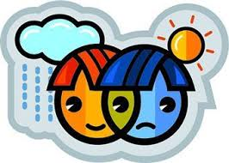
Medication
It is important that bipolar disorder is accurately diagnosed. If a person is diagnosed as having depression, when in fact they have bipolar disorder, an antidepressant would most likely be prescribed.
While Antidepressants might be effective for patients who are in a depressive phase, they can actually trigger mania and exacerbate episodes long term.

Slide 64
Mood Stabilizers
Mood stabilizers are prescribed to help stabilize manic symptoms, prevent future episodes and reduce suicide risk, and are the most commonly prescribed medications for bipolar disorder.
The most well-known of these is lithium, which seems to be effective for most people who experience manic and hypomanic episodes. Other commonly prescribed medications for bipolar disorder include Depakote and Tegretol.

Slide 65
Atypical Antipsychotics
The newest medications, atypical antipsychotics were originally developed to treat psychosis (a symptom of schizophrenia). Like the mood stabilizers above, atypical antipsychotics help to control mood swings. Some of the most commonly prescribed antipsychotics for bipolar are Abilify, Zyprexa, Risperdal, Seroquel, and Clozaril.

Slide 66
Every medication has its own set of potentially serious side effects and these drugs include rapid weight gain, high cholesterol and risk for diabetes.
As always, it is important for patients to be aware of any serious side effects before taking a new medication.

Slide 67
Combination Therapy
When one medication isn’t working, a doctor might prescribe two mood stabilizers or a mood stabilizer along with an another medication to treat symptoms such as anxiety, hyperactivity, insomnia and psychosis. For example, Xanax, a fast-acting benzodiazepine, typically is taken for two weeks before mood-stabilizing medication starts to work.
Sometimes people end up taking multiple medications to offset the side effects caused by another (like insomnia)

Slide 68
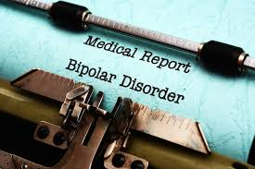
Why do some people stop taking their meds?
Some people decide to stop taking their medications for a variety of reasons. This can be dangerous.
Some people feel that they don’t need it anymore because their symptoms are gone.
Others stop because they don’t like feeling dependent on medication and want to feel like their life isn’t “being controlled by the medication”.

Slide 69
Still others stop because they feel that the medications make them feel like they’re “living in a fog,” or that all their emotions lack any sort of depth.
Whatever the reason, it is important that you talk to your doctor before discontinuing any medication.

Slide 70
Psychotherapy
Psychotherapy is a crucial component of long-term bipolar disorder management. Even when your mood swings are under control, it’s still important to stay in treatment.
Several different therapeutic methods have proven to be effective in treating bipolar disorder, with the most common being cognitive behavioral therapy or CBT.

Slide 71
Cognitive Behavioral Therapy
Cognitive behavioral therapy (CBT) helps individuals develop strategies to cope with their symptoms, change negative thinking and behavior, monitor their moods and predict their mood to try to prevent a relapse.
CBT is a common type of therapy used to treat many psychological disorders.

Slide 72
Suicide
Each year more than 34,000 individuals in America take their own life, leaving behind thousands of friends and family members to navigate the tragedy of their loss.
Suicide is the 10th leading cause of death among adults in the U.S. (homicide/murder is 16th) and the 3rd leading cause of death among adolescents. (NAMI.org)

Slide 73
The Unspoken Tragedy
Suicide is a taboo topic in America that rarely gets spoken about despite the alarming statistics.
There is much secrecy and shame surrounding suicide. Even after someone does take their own life, the real cause of death is often not publicly acknowledged.
The more we try to sweep this problem under the rug, the harder it will become to address this mental health crisis.

Slide 74
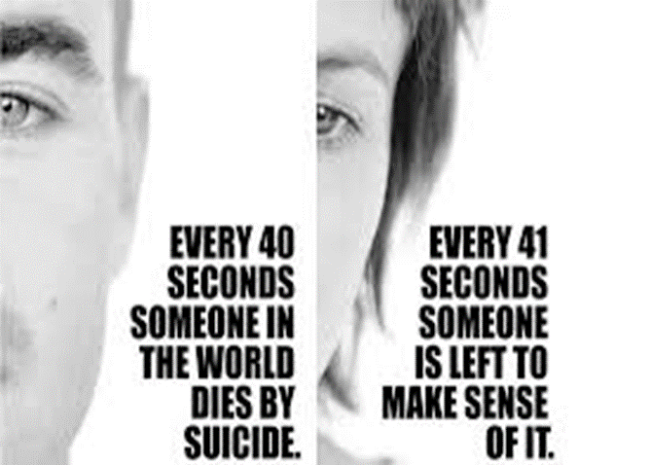
Suicide Statistics
Someone takes their own life every 12 minutes in America
That’s Over 100/day
And Over 30,000/year
For every completed suicide there are 25 failed attempts
Worldwide there are 1 million suicides every year
NAMI.org

Slide 75
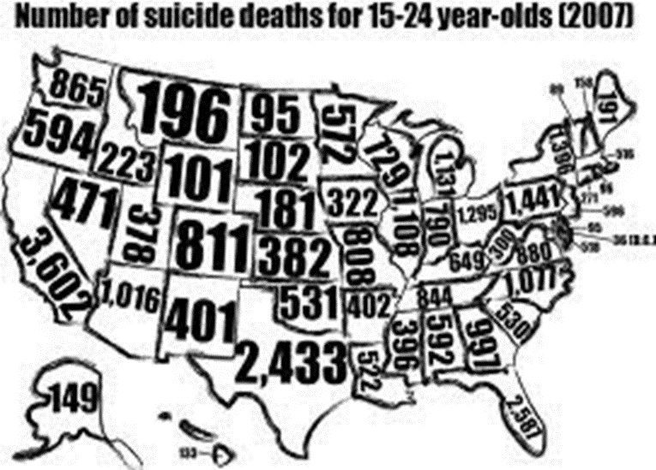
Females are more likely to attempt
However, Males are 4X more likely to succeed
More people die from suicide than homicide each year in America

Slide 76
Warning Signs
In addition to signs for depression:
Direct or indirect suicide threats
Talking/writing about death
Giving away belongings
Dramatic change in personality or appearance
Overwhelming sense of guilt, shame, or rejection

Slide 77
Myths vs. Facts
Take out your In The Mix sheet

Slide 78
How to Help
Listen
Pay Attention
Be straightforward
Suggest they seek help
Don’t agree to keep confidence

Slide 79
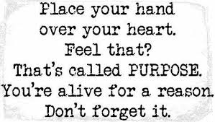
What NOT to say
Don’t lecture
Don’t criticize
Don’t interrogate
Don’t minimize the situation
Don’t say things like “Cheer up”, “It will be okay”, “What do you have to be depressed about” or “I know how you feel”

Slide 80
Sources
MayoClinic.org
PsychCentral.com
Healthyplace.com
NAMI.org

