Slide 1
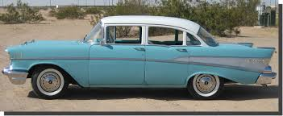
The 1950’s The Post-War years

Slide 2
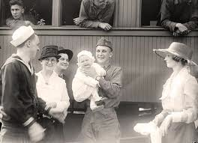
Happy Days?
Returning soldiers wanted to put the horrors of the battlefields behind them when they came back home
Americans could now spend money they had saved when most items were rationed during the war or unaffordable during the Depression

Slide 3
Huge Economic Expansion
Avg. income almost doubled in post-war years
(Went from $1,526 to $2,788)

Slide 4
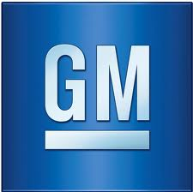
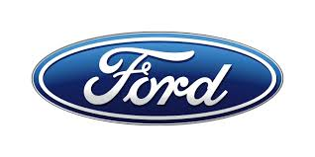
Big Corporations
A few huge firms dominated many industries
Car companies like Ford, Chrysler and General Motors
General Electric (GE) dominated the electrical business

Slide 5
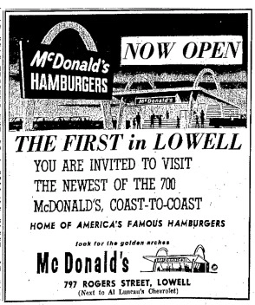
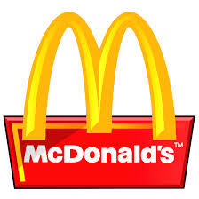
Fast Food
Fast food industry sprung up because of fast, efficient service and location along new busy highways
Ray Croc, the founder of McDonald’s, used assembly-line food production to mass produce cheap burgers

Slide 6
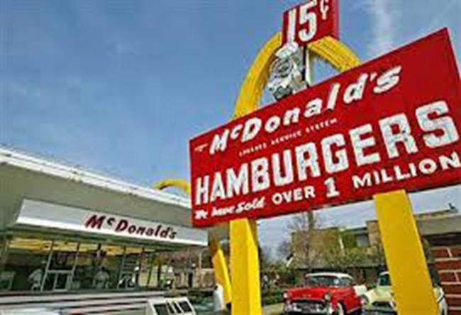
Franchise
McDonald’s and 100’s of other restaurant franchises began to open (a franchise is the right to open a restaurant using a parent company’s brand name and system)
Entrepreneurs of the decade learned that people enjoyed quick service, affordability and consistency. Fast food delivered this and was perfect for adults, teens and children. It could also be easily replicated and franchising spread the successful local restaurant models across the country.

Slide 7
The Birth of a Fast Food Nation
Many of our largest and most popular fast food chains got their start during the 1950’s.
Dunkin Donuts, 1950 – Quincy, Massachusetts
KFC, 1952 – Salt Lake City, Utah (first franchise opened)
Denny’s (as Danny’s Donuts), 1953 – Lakewood, California
Burger King (as Insta-Burger King), 1953 – Jacksonville, Florida
Sonic Drive-In, 1953 – Shawnee Oaklahoma
Taco Bell (as Bell’s Drive-In), 1954 – San Bernardino, California
Pizza Hut, 1958 – Wichita, Kansas

Slide 8
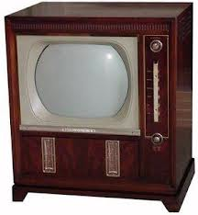
New Technology Transforms Life
New and improved products like dishwashers and gas-powered lawnmowers that saved consumers time and money
Television – Developed in the 1930’s, Americans “fell in love” with it after WWII
2/3 of families owned one by 1953

Slide 9
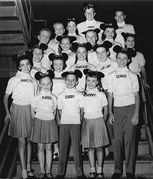
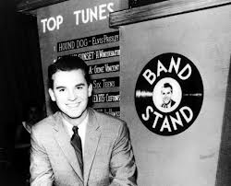
TV
Shows like Howdy Doody and The Mickey Mouse Club, for kids
Comedies like I Love Lucy and Father Knows Best
American Bandstand played popular music for teens
Only 3 networks controlled all the shows

Slide 10
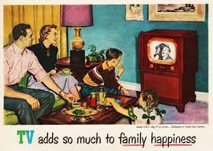
Materialism
Advertising paid for shows on television
TV commercials bombarded Americans with advertisements for the latest consumer products.
Millions of viewers were persuaded to buy the items they saw on television commercials
No remotes to change the channel or on-demand commercial-free viewing so forced to sit through ads!

Slide 11
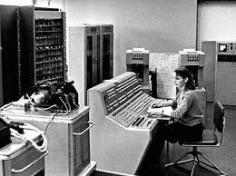
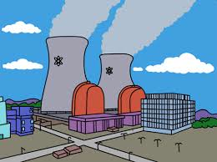
Other Advances
Wartime research led to 1st computers that could fit on a desk instead of filling a room (invention of transistor)
Nuclear power – generated electrical power using same technology as atomic bomb (splitting uranium atoms)

Slide 12
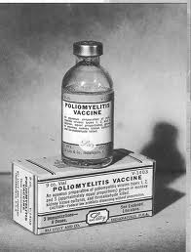
Medicine
Advances in medicine – Jonas Salk’s polio vaccine (had killed or disabled 20,000 kids in US every year)
Penicillin and antibiotics
Surgical advances like heart surgery
Psychiatric medication (for mentally ill)

Slide 13
Changes in the Workplace
Before the war most had blue-collar jobs in factories producing goods
After the war, however, new machines performed many of the jobs previously done by people
By mid 1950’s majority had white-collar jobs working in offices or selling products

Slide 14
Large Corporations = Conformity
White-collar work environment had clean, bright offices
Downside to this: large corporations were impersonal, you had less connection to the products the company made, and employees were often told to dress, think, and act alike

Slide 15
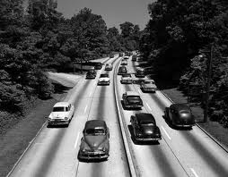
Suburbs and Highways
With so many people working and making a better living than ever before, the Baby boom continued
Growing families wanted to live outside cities and could now drive in to work in new cars on new highways

Slide 16
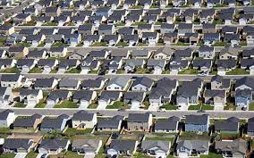
New Homes
GI Bill – gave low-interest loans to soldiers so they could buy a home – “cookie-cutter “neighborhoods (all looked alike) starting springing up everywhere and quickly – called “Levittowns” after developer, Bill Levitt
Could mass produce inexpensively using assembly line techniques – but uniformity was a drawback

Slide 17
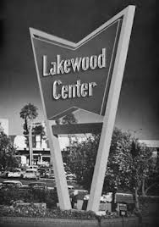
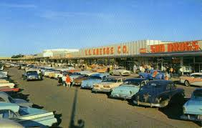
Highways
Stores moved from cities to shopping centers further away in the suburbs
People used more private cars and less public transportation

Slide 18
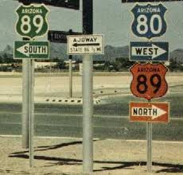
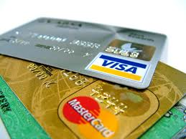
Interstate Highway System
More cars led to building 40,000 miles of roads and highways connecting towns & states
Credit cards introduced so people could buy stuff (gas, etc.) easier while on the road

Slide 19
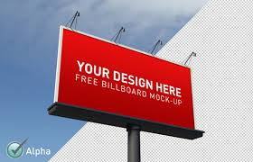
Create a Billboard
There were many changes in Postwar America in the 1950’s. Choose one of the following and design a billboard that advertises/promotes this new aspect of American life:
Credit Cards (Diner’s club, American Express, etc.)
Television
Interstate Highway System
Nuclear Power Plants
McDonald’s/a Fast-food chain
New appliances (electric lawnmower, dishwasher, etc.)
Keep it simple (1 or 2 catchy phrases), but your billboard should include 1.) the product name and 2.) a convincing argument as to why you need it and/or should support it

