Slide 1
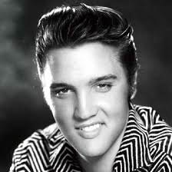
The 1950’s Part 2

Slide 2
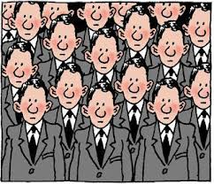
The Mood of the 1950’s
People felt comfortable
Still recovering from years of depression and war so preferred security over adventure
Wanted better life for their children than they had
Now preferred conformity to individuality

Slide 3
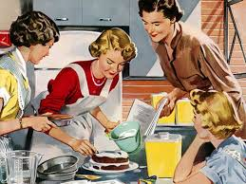
Gender Roles
With the end of the war, women who had been employed in factories and other key jobs were expected to “return to the kitchen”
Their “jobs” were to raise the children and maintain the home
Men of this time often judged themselves and others by what they could afford to buy with the money they earned
Women were expected to play a supporting role for their husbands
This meant dinner on the table when they came home from work and cleaning up after him and the rest of the family
If you were a married woman who worked outside of the home it was usually because you had to and was seen as shameful in middle-class America

Slide 4
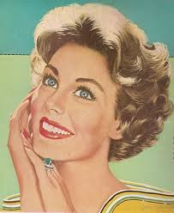
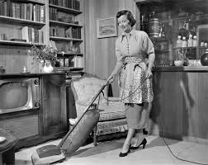
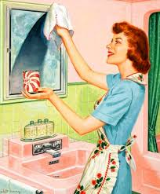
Were they all “Happy Housewives”?
While many women gladly resumed their positions in the home after the war, not all women shared this view and wished for greater rights
However, it would be another decade before the “Womens’ Rights” movement would really take off in America

Slide 5
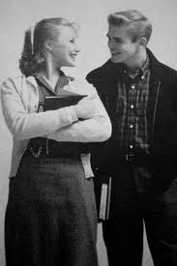
Youth Culture
Called the “silent generation”
Most had little interest in problems of the larger world
Strong economy meant young people could now stay in school instead of dropping out to help family pay bills

Slide 6
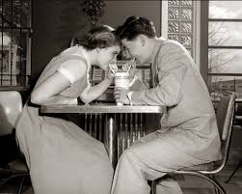
The “Birth of the Teenager”
For the first time in American life, the concept of the “teenager” existed
Instead of jumping right from childhood into adulthood and working life, adolescents now had more leisure time and could enjoy just being a teen
Devoted their energies to pursuing entertainment and fun

Slide 7
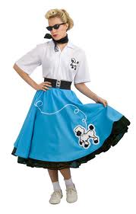
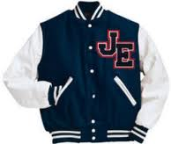
Teen Culture
Ads and movies created image of what it meant to be a teenager
Boys in varsity letter sweaters
Girls in bobby socks and poodle skirts
These images created a greater sense of conformity in style – wanted to have the “in look”

Slide 8
Rock n’ Roll
Rock and roll first introduced – gave teens something rebellious
Chuck Berry, Little Richard and Elvis
Screaming teenage girls and large record sales
Parents thought it was devil’s music and tried to ban it – made it more popular

Slide 9
Challenges to Conformity
While most wanted to fit in, a few rejected the values of their parents and society and felt misunderstood and alone
Jack Kerouac and Allen Ginsberg were two of the leaders of what became known as the “beat generation”
Often dressed in ways that showed their disdain for pop culture and the conformity of others in society
Popularized wearing black, with a beret and goatee
Inspired the “hippies” that would arise a decade later
during the anti-war movement of the 60’s

Slide 10
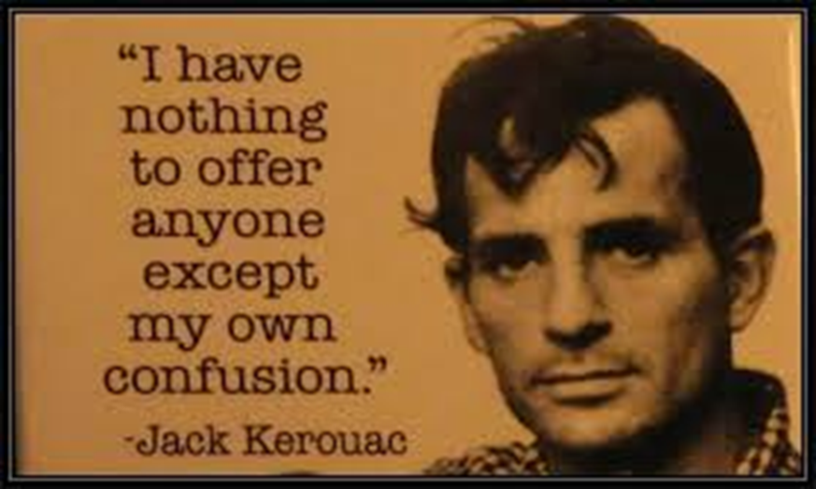
Beatniks
Beatniks – members of the “Beat Generation” – embraced poetry, art, and more meaningful ideas and rejected materialism and the conformity of mainstream America
Author Jack Kerouac, the spiritual leader of the beatniks, gathered with others in coffee houses in San Francisco, California, to share ideas and experiences.
Wrote his best-selling novel, On the Road, on a 250-foot roll of paper not using standard punctuation or paragraph structure to reflect his open approach to life

Slide 11
Resurgence in Religion
In the 1950’s Americans, who had drifted away from religion in earlier years, flocked back to their churches or synagogues.
The new interest in religion was a response in part to the cold-war struggle against “godless communism”
Some looked to religion to find hope in the face of the threat of nuclear war

Slide 12
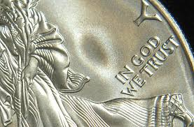
“One Nation Under God”
In 1954 Congress added the words “under God” to the Pledge of Allegiance, and the next year it required the phrase “In God We Trust” to appear on all American currency.
Like other aspects of American life, religion became more commercial. Those in need could call Dial-a-Prayer for the first time, and new slogans such as “The family that prays together stays together” became commonplace.
Evangelists, like Billy Graham, used radio and TV to carry their messages to more people than ever before.

Slide 13
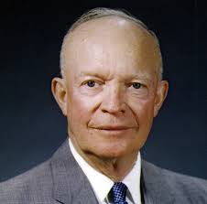
Politics
WWII war hero Dwight Eisenhower (or Ike as he was affectionately called) won the presidential election in 1952 and 1956 (his slogan was “I like Ike”)
As a republican he scaled back some of the social programs that the democrats Truman and FDR supported
Republican ideas – cut spending, reduce taxes, and balance the budget
Continued America’s Cold War against the Soviet Union and Communism

Slide 14
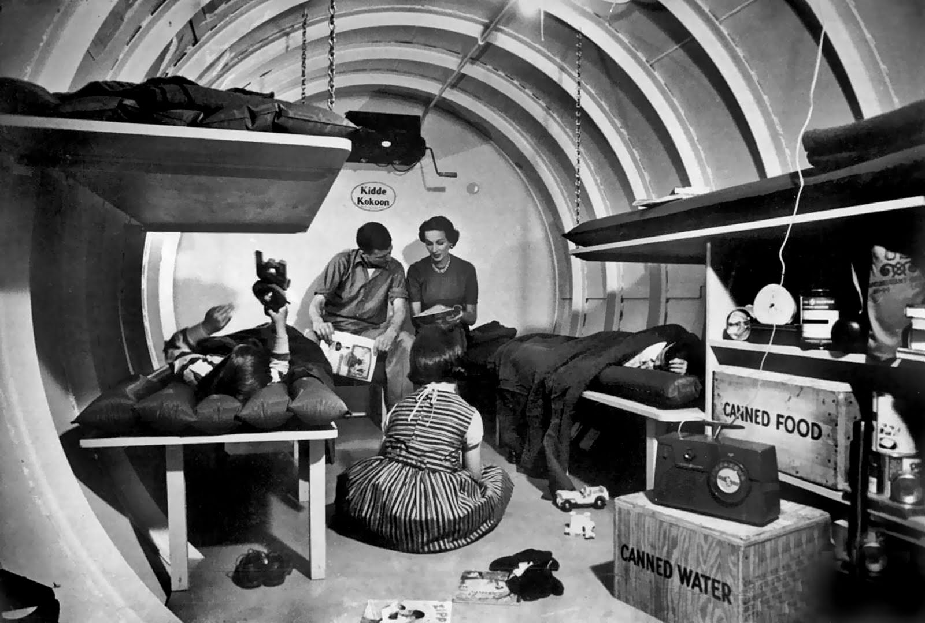
Bomb Shelters
The fear of communism and nuclear war ran deeper than just McCarthy and in the government.
Some families began to build “fallout shelters” underground to be used in the event of a nuclear war
Ranged in cost from $100 Basic models to $5,000 suites

Slide 15
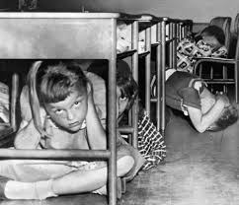
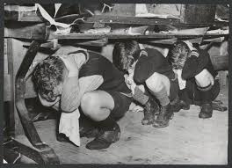
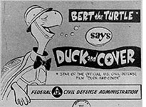
“Duck and Cover”
Duck and Cover Drills were practiced in schools all over America like lock-down drills are today
Kids would to be told to go under their desks and cover their heads for protection
Clearly not going to save you, but psychologically made people feel a greater sense of safety
“Bert the Turtle” cartoon taught kids what to do in the event of a nuclear bomb

Slide 16
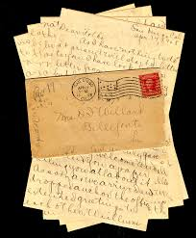
Write a Letter
Imagine you are WWII veteran living in the 1950’s. Write a letter to a friend or relative explaining the changes you have seen since the pre-war days of the Great Depression. Incorporate at least 5 facts (and number or underline them!) from the power point about the 1950’s. Be sure to discuss the improvements to your daily life as well as the opportunities now available to you.

Slide 17
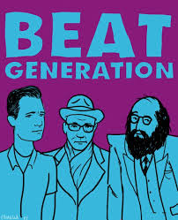
Beat Art & Poetry
Imagine you are a Beat poet or artist
Write a poem (at least 5 stanzas/10 lines) or draw an image that expresses your rejection of the mainstream values of 1950’s America including, materialism (obsession with buying new products) and conformity (acting the same as everyone else)
Keep it appropriate!

