Slide 1
The 1960’s
The Kennedy Years Part 2

Slide 2
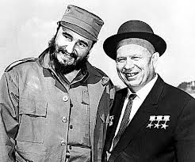
Nikita Khrushchev
Soviet leader who wanted to take advantage of what he saw as America’s weakness
Disturbed by the attempted invasion at the Bay of Pigs, the Soviets pledged their support to Cuba
Decided a year after Bay of Pigs to send nuclear armed missiles to Cuba only 90 miles off the coast of Florida

Slide 3
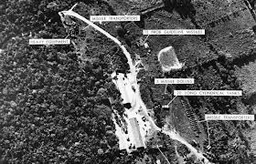
U-2
We found out about it on October 16, 1962, when an American U-2 spy plane photographed the missile bases under construction
Appeared that Khrushchev was trying to bolster Soviet power by positioning missiles so close to the US
Kennedy was convinced that the missiles in Cuba presented a direct challenge to which he must respond

Slide 4
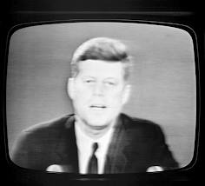
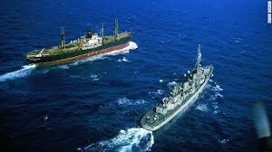
An Act of War?
JFK addressed the nation on TV telling them there would be a naval “quarantine” of the island of Cuba
Calling it a blockade (which it was) would have been seen as an act of war

Slide 5
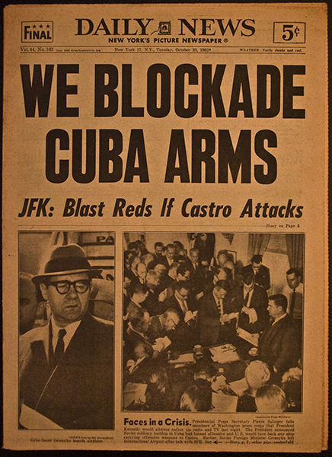

Slide 6
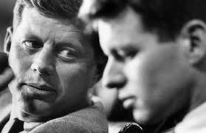
On the Verge of War
President quickly convened top advisers in a series of secret meetings to decide what to do
Some suggested air strikes to knock out missiles, but brother, Robert, argued against it
President put US forces on full alert and bombers and missiles were armed with nuclear weapons
Soldiers prepared to invade Cuba at a moment’s notice

Slide 7
Brothers ~ JFK & RFK

Slide 8
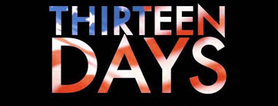
13 Days in October
Over the course of the next 13 days the Cold War came the closest it ever had to turning into a nuclear war
Nuclear warheads on both sides were poised and ready for use
Some close to President thought we should knock out the Soviets missiles
MAD (mutually assured destruction) meant that if one side used them the other would surely retaliate and both countries would be destroyed

Slide 9
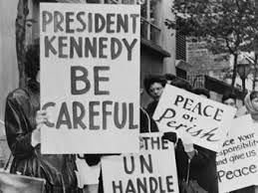
Cuban Missile Crisis
Kennedy demanded that the Soviets withdraw their missiles
Over the next 2 days Americans awaited a response and braced for a nuclear war

Slide 10
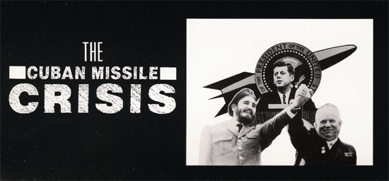
Nuclear war avoided
The crisis came to an end when Khrushchev had Soviet ships reverse course and then agreed to remove the missiles
In exchange Kennedy would end the quarantine and pledged never again to attempt to invade Cuba

Slide 11
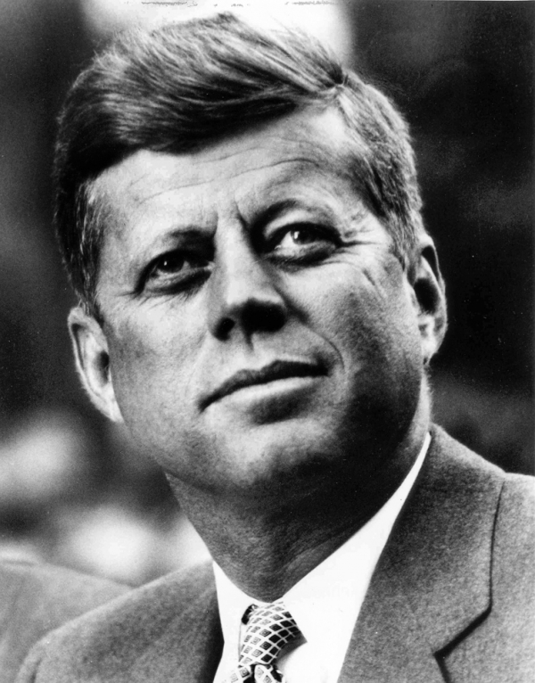
Phew!!
“We have won a considerable victory. You and I are still alive.” ~ Kennedy’s Secretary of State commented to him when it was over
Far more powerful hydrogen bombs had replaced the first atomic weapons, and this was the closest the superpowers had come to using them
Kennedy emerged from the confrontation as a hero for standing up to the Soviets and showing that the United States would not be pushed around

Slide 12
A Step Toward Peace
Cuban Missile Crisis led to a number of efforts to reduce the risk of nuclear war
Kennedy and Khrushchev established a “hot line” between their two nations to allow for immediate discussion in the event of a future crisis
In summer of ‘63 signed the first nuclear treaty since the development of the atomic bomb
The Limited Test Ban Treaty banned nuclear testing above ground to eliminate the radioactive fallout that threatened human, animal, and plant life
Kennedy noted this was “an important first step toward peace, a step toward reason, a step away from war”
However, both countries continued to create bigger and bigger bombs

Slide 13
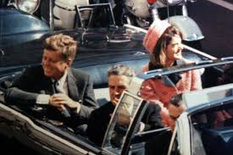
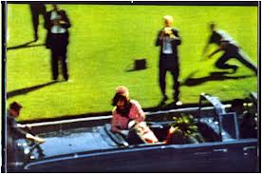
November 22nd, 1963
JFK Assassination
JFK was riding in a convertible in a motorcade in Dallas, TX when 3 shots rang out from a school book depository
The 2nd bullet struck JFK in the head killing him

Slide 14
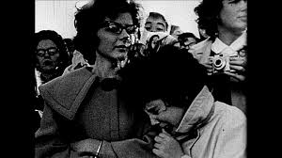
The Country is Devastated
Ask your grandparents where they were when JFK was assassinated and they can probably recall the details like it was yesterday – became a defining moment in the lives of many Americans
Millions of Americans remained glued to their TV sets for the next four days as the impact of the tragedy sank in
A year after his greatest moment, JFK was dead
For many this symbolized the death of the hope and energy that JFK stood for

Slide 15
The assassination that shook the world

Slide 16
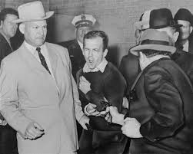
Lee Harvey Oswald
The accused assassin, Lee Harvey Oswald was killed 2 days later by a Dallas nightclub owner and small time mobster named Jack Ruby
Occurred while he was being transferred between jails

Slide 17
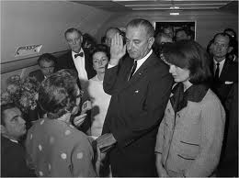
Lyndon B. Johnson (LBJ)
Immediately after the assassination JFK’s vice president, LBJ, was sworn in aboard Air Force One while Jackie Kennedy, still wearing her elegant pink dress stained with her husband’s blood (wanted the world to see “what they did to my Jack”), looked on

Slide 18
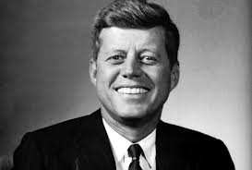
Warren Commission
A commission appointed by LBJ and headed by the Supreme Court Chief Justice, Earl Warren, to investigate the assassination
Determined that Oswald acted alone
Rumors and conspiracies involving the CIA, Mafia, and Cuba’s Castro still exist

Slide 19
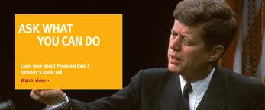
The Kennedy Legend
Kennedy became a martyr and a hero because of his sudden tragic death
As a result of this many of his social programs that he was never able to get going were put into action

Slide 20
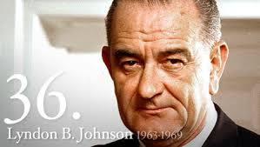
LBJ’s “Great Society”
Like FDR’s New Deal it was a big plan to help society by providing help to schools, Medicare for those over 65, Medicaid to poor Americans and a “war on poverty”

Slide 21
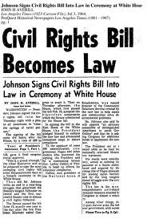
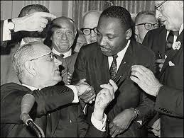
Civil Rights Act of 1964
Part of LBJ’s Great Society, it banned segregation and discrimination in public facilities like restaurants and hotels
Also prevented employers from hiring people based on race

Slide 22
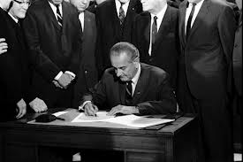
Civil Rights Act of 1968
This law (4 years later) made it illegal to not sell or rent a house to someone based on race

Slide 23
Chapter 18 Review
Complete Key Terms and Comprehension questions on page 560

