Slide 1
The 1960’s
John F. Kennedy (JFK)

Slide 2
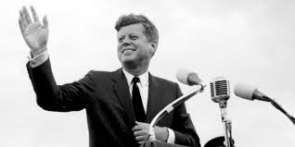
“The Torch has been passed to a new generation of Americans”
As the 1950’s came to an end and the 60’s began, America elected a new and different kind of president.
Instead of an older, protestant, male as our country has always had, Americans elected a young, catholic, named John F. Kennedy

Slide 3
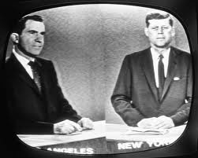
1960 Presidential Election
Between Eisenhower’s VP, Richard Nixon and a young Senator from MA, John F. Kennedy
The first ever televised debate – with the hot studio lights, Nixon appeared tired, sweaty, and nervous
Kennedy, in contrast, looked polished and relaxed

Slide 4
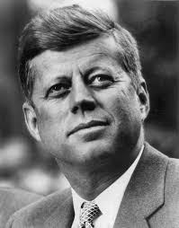
A Generational Shift
JFK won because he represented a new energy and enthusiasm for America
Became the youngest President ever elected at 43

Slide 5
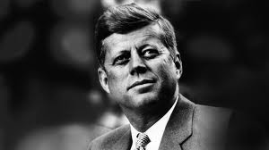
JFK
Intelligent
Handsome
Athletic
Witty
A war hero
A “regular guy”

Slide 6
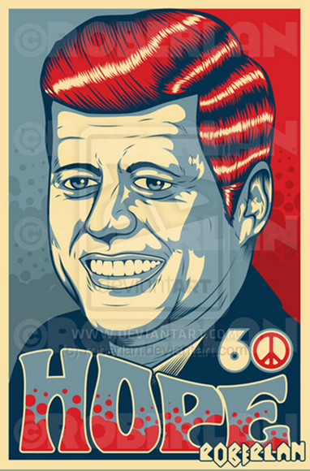
A New Hope
With the ever-looming threat of communism and nuclear war, Kennedy brought optimism to an America who seemed to be losing the Cold War

Slide 7
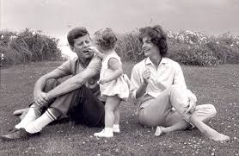
A Popular First Family
New administration was energetic and full of optimism
Jacqueline Kennedy, the First Lady (President’s wife), charmed the country with her grace
Their young children ran around the White House and filled it with life
The Kennedy’s and their friends loved to play touch football on the lawn or take long hikes

Slide 8
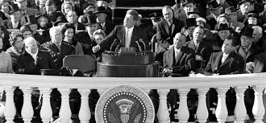
Inaugural Address
In his inspiring Inaugural address, Kennedy challenged Americans with his infamous line “Ask not what your country can do for you, ask what you can do for your country”
He wanted Americans to change the way that they viewed their government and look within to see what they could do to help make the country great

Slide 9
Camelot

Slide 10
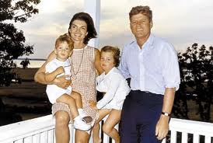
Kennedy White House was referred to as Camelot because JFK, his beautiful wife, Jackie, and their young children brought a sense of youth, magic and idealism to the Presidency (like legendary kingdom of King Arthur)
A country whose power was used for the good of the people

Slide 11
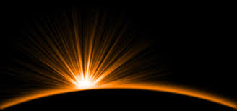
The New Frontier
Name used to describe Kennedy’s proposals to improve the economy, give aid to the poor, and breathe new life into the space program

Slide 12
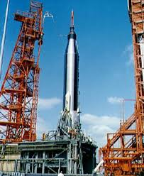
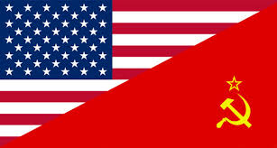
The Space Race
A Cold War competition to see who had the best technology between the US and Soviets and who could put the first man in space
Ultimately was about who was more powerful

Slide 13
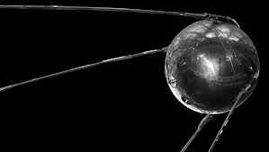
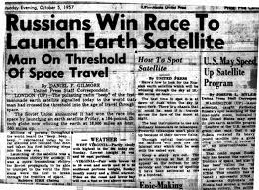
Sputnik
A small satellite (only 184 pounds) put into orbit by the Soviets
Sent shockwaves throughout America because it showed that our archenemy, the Soviets, were technologically superior to us
It also now meant that the Soviets had the ability to arm a rocket with a nuclear weapon that could destroy America

Slide 14
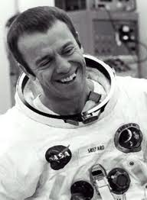
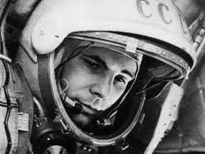
1st Man in Space
Soviets put first man in space, Yuri Gargarin, in 1961 a month before us (Alan Shepard)
Encouraged Kennedy to challenge the nation to land a man on the moon before the decade is out
Led to increased funding for NASA
(National Aeronautics and Space Agency)

Slide 15
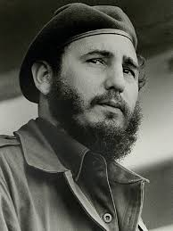
Fidel Castro
Fidel Castro had come to power in 1959 after overthrowing the US-backed dictator Batista
Many poor Cubans supported this because he vowed to improve their lives
Castro took over many US companies operating in Cuba
When the US broke off diplomatic relations, Castro developed ties with the Soviet Union

Slide 16
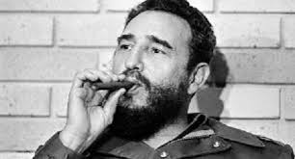
Communism on our Doorstep?
This frightened America because it meant we had a communist nation right next door & we feared revolutions could occur in other poor Latin American nations

Slide 17
Bay of Pigs
Even before Kennedy came to power a plan had been in place to use the CIA to train Cuban opponents of Castro in nearby Guatemala
When training was complete the Cubans would invade Cuba with American backup
On April 17, 1961, just a few months after his inauguration, Kennedy faced his first serious foreign crisis when this attempt was made to invade Cuba and overthrow Castro

Slide 18
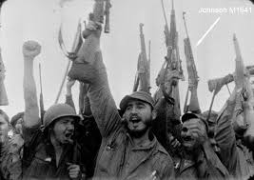
A Total Disaster
The secret leaked out and Castro was able to stop the US-backed troops from coming ashore
the anticipated support of the Cuban people also never happened
Rather than escalate the conflict with the use of massive US forces, Kennedy chose to accept defeat
1,200 soldiers were captured – humiliating to the US

Slide 19
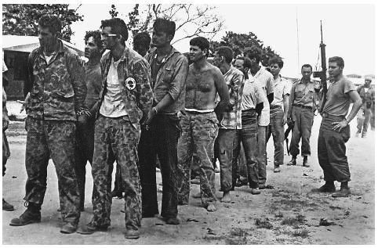
Bay of Pigs Invasion

Slide 20
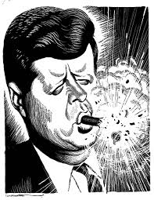
Effects of Bay of Pigs
The United States lost a great deal of prestige in the disastrous attack
Invasion was clumsy and incompetent
Our support of an effort to overthrow a legitimate government was exposed to the world
Latin American countries angered and felt threatened
European leaders questioned the new President’s leadership

Slide 21
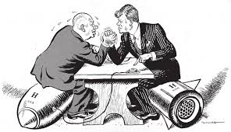
Testing Kennedy
After our failure at the Bay of Pigs Kennedy needed to respond even more firmly to future Communist threats
Kennedy feared that the Soviet leader, Kruschev, had a larger plan to take over Europe when he insisted that the US withdraw from Berlin by the end of the year
In their first meeting (in 1961), Kennedy felt bullied by him

Slide 22
Kennedy’s Response
Kennedy was not going to be pushed around by Kruschev so he …
Increased our military spending
doubled the number of men being drafted into armed services
and built fallout shelters across the country to show that America wouldn’t be pushed around

Slide 23
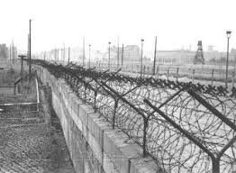
Berlin Wall
The Soviets responded to this by building the Berlin Wall (in August 1961)
This wall would become a symbol of the cold war over the next 40 years
Kennedy went on TV and told Americans that West Berlin was “the great testing place of Western courage and will” and that “we do not want to fight – but we have fought before”

Slide 24
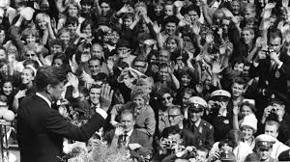
Your Wall Doesn’t Scare Me!
To show his support for West Germany after the wall was erected, JFK traveled to West Berlin in an act of defiance toward the Soviets

Slide 25
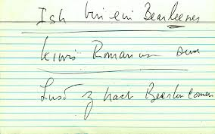
“Ich bin ein Berliner”
Standing near the Berlin Wall in June 1963, Kennedy spoke to a cheering crowd of West Berliners that the United States “will risk its cities to defend yours because we need your freedom to protect ours”
Concluded his speech to the German people with his now famous line, “Ich bin ein Berliner”. I am a Berliner.

Slide 26
