Slide 1
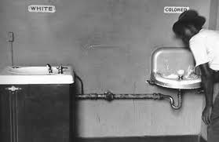
The Civil Rights Movement

Slide 2
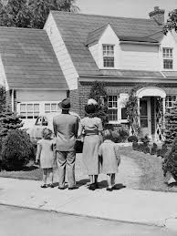
The “American Dream”
1950’s was a prosperous time with suburbs popping up and new cars in the driveway
A house of one’s own with a little plot of land

Slide 3
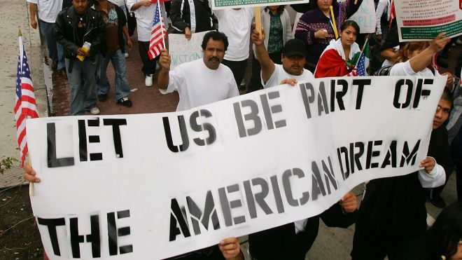
But not for everyone…
Only if you were white

Slide 4
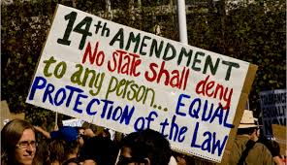
Civil Rights Movement
The civil rights movement was a struggle by African Americans in the mid-1950s to late 1960s to achieve Civil Rights equal to those of whites, including equal opportunity in employment, housing, and education, as well as the right to vote, the right of equal access to public facilities, and the right to be free of racial discrimination

Slide 5
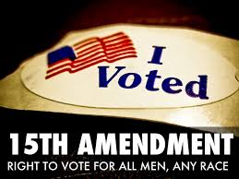
Equal Rights
This movement sought to restore to African Americans the rights of citizenship guaranteed by the Fourteenth and Fifteenth Amendments (right for all citizens to be treated equally and to be able to vote)
These rights had been eroded by segregationist Jim Crow Laws in the South

Slide 6
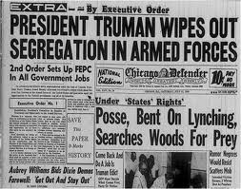
Executive Order 9981
Signed by President Truman in 1948
Required equality of treatment and opportunity to all people in the armed services regardless of race
Began a gradual revolution in American society – beginning of desegregation

Slide 7
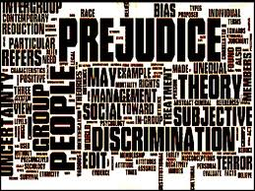
Racial Prejudice
Still deeply ingrained in American life, particularly in the South

Slide 8
Legal discrimination?
Facilities were supposed to be “separate but equal”
Schools were separate, but never equal

Slide 9
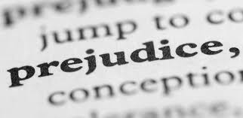
Poor Treatment in North
After both world wars blacks migrated in large numbers from the south to work in northern factories
Owners liked cheap labor, but many whites, fearing they would lose their jobs to them, met them with hostility

Slide 10
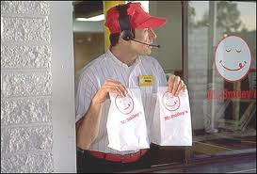
Low paying jobs
Blacks were restricted to simple, low-paying jobs
This forced them to live in ghettos

Slide 11
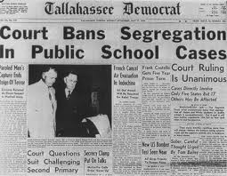
Brown vs. Board of Education
In 1954 the Supreme Court ruled that separate black schools were not equal to white schools
Schools had to be integrated
Many white schools violently resisted and federal troops sometimes had to intervene

Slide 12
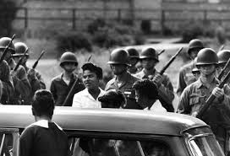
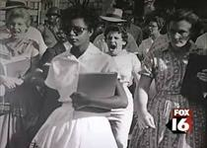
Little Rock Nine
9 black students who were escorted by National Guard troops into Central HS in Little Rock, Ark. while white protesters shouted insults at them

Slide 13
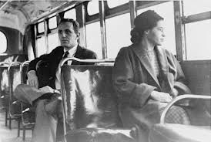
Rosa Parks
A black woman from Montgomery, AL who after a hard day’s work sat down in a seat at the front of the bus
Was a crime not to give up your seat to a white person
She refused to go to the back of the bus and was arrested and jailed

Slide 14
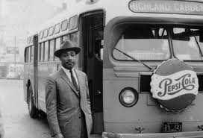
Montgomery Bus Boycott
In response to the arrest blacks in the city refused to ride the bus if they could not ride in the front, even though most of them depended on the busses
Led by a young pastor named Martin Luther King Jr.

Slide 15
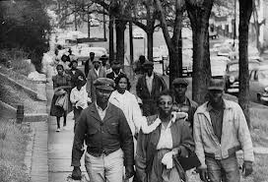
Bus Boycott
Lasted for over a year - despite losing $ busses wouldn’t change policy
50,000 blacks walked or rode bikes up to 12 miles a day

Slide 16
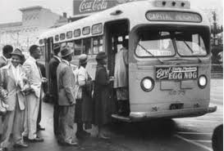
National Attention
Finally Supreme Court ruled it unconstitutional
Focused national attention on MLK Jr. and more importantly on the Civil Rights Movement

Slide 17
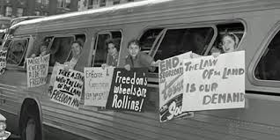
Freedom Riders
Despite ruling segregated public buses unconstitutional, southern states continued to ignore the law
Black and White Civil rights activists rode interstate buses together to challenge local laws that still enforced segregation

Slide 18
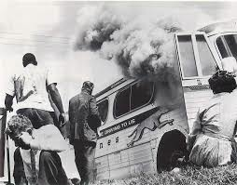
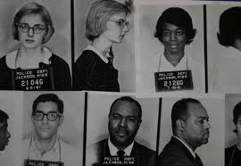
Met With Violence
Often attacked by angry white mobs in the south before being arrested by police (who often first allowed the violent attacks)
In some places, like Birmingham, AL, police cooperated with Ku Klux Klan

Slide 19
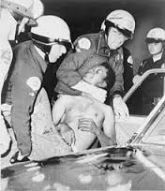
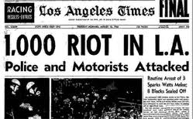
Racial Violence in the 60’s
A black church in Birmingham, AL was bombed killing 4 black girls
2 white civil rights activists are killed while trying to register black voters
Watts riots in LA after police brutality – lasted 6 days and 34 killed

Slide 20
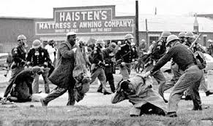
Selma Freedom March
Town in Alabama where racism and discrimination were strong
Though the town had a large black population, they were kept from voting by Jim Crow laws that required them to pass a difficult test in order to vote – most could not
“Bloody Sunday” – attack by state troopers and members of Alabama posses perpetrated on peaceful protest marchers who tried to cross the Edmund Pettus Bridge on March 7, 1965

Slide 21
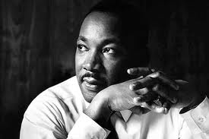
Martin Luther King Jr.
A minister from Montgomery, AL who was the leader of the National Civil Rights Movement

Slide 22
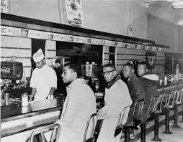
Civil Disobedience
Strategy used by MLK Jr. that he learned from Gandhi in India
Nonviolent resistance – disobey a law, but in a peaceful way
For example, “Sit-ins” – blacks would sit at a lunch counter that was reserved only for whites until the police came and arrested them

Slide 23
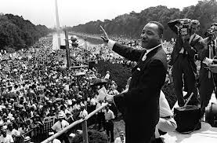
“I have a Dream”
March on Washington – a huge rally for Civil Rights in D.C. in August 1963 in which MLK Jr. gave his famous speech
Dream was to live in a country where blacks and whites could live together in harmony and equality

Slide 24
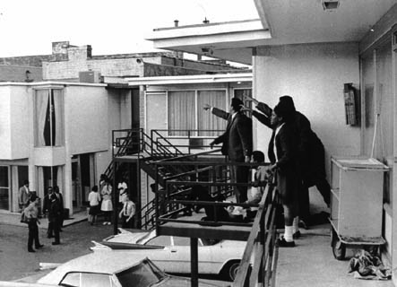
April 4, 1968
MLK Jr. was killed by an assassin while standing on his hotel balcony in Tennessee

Slide 25
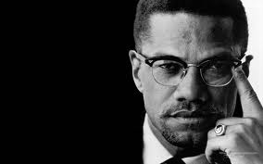
Malcolm X
Wanted rights for blacks as well, but not by “kissing up to the white man and begging for them”
said blacks should be separate, not integrated - if we want respect we need to demand it from the white man
Assassinated in 1965

Slide 26
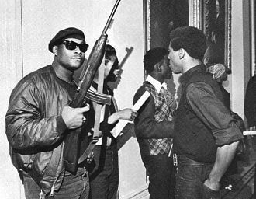
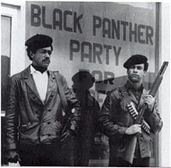
Black Panthers
A militant black political party that rejected peaceful attempts at gaining respect and wanted equality “by any means necessary”

Slide 27
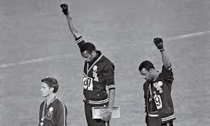
Black Power
To take pride in being black – not to try to be like white people to fit in to their society
“black is beautiful”
African Americans should unite, take charge of their own destiny, and reject white society

Slide 28
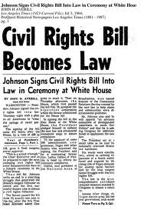
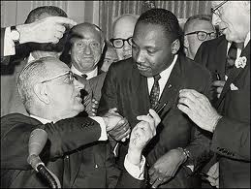
Civil Rights Act of 1964
Part of LBJ’s Great Society, it banned segregation and discrimination in public facilities like restaurants and hotels
Also prevented employers from hiring people based on race

