Slide 1
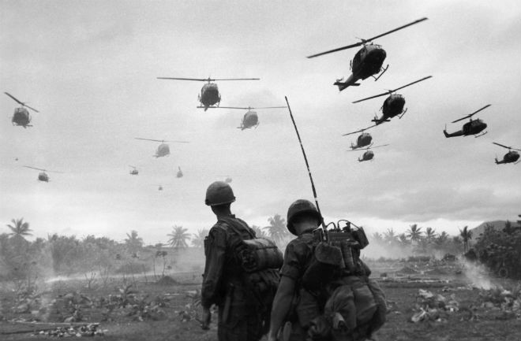
Vietnam 1955 - 1975

Slide 2
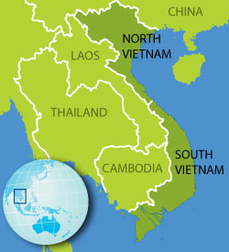
Another Korea?
A communist North and a non-communist South just like in Korea

Slide 3
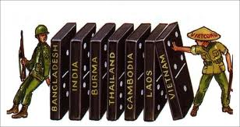
Domino Theory
President Eisenhower’s theory that if one country falls to communism then all those near it will soon follow
Used this as justification for American involvement in Vietnam

Slide 4
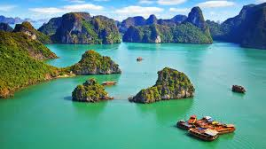
Background
Vietnam had a history of nationalism going back 2,000 years
Spent much of that time resisting takeover by their larger neighbor, China
1800’s became a colony of France

Slide 5
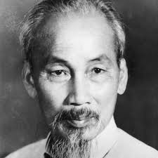
Post WWII
Ho Chi Minh, a nationalist who sympathized with communist ideas, led the Vietnamese independence movement
US, however, only saw him as a communist and therefore an enemy

Slide 6
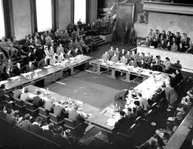
Geneva Conference
While France and Vietnam fought, representatives from those countries, along with the US, Soviet Union, and other SE Asian countries met in Geneva, Switzerland to discuss the situation
Divided Vietnam into 2 separate countries in July, 1954

Slide 7
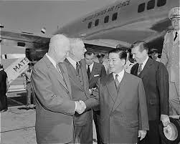
South Vietnam
President Kennedy supported the unpopular and corrupt ruler of South Vietnam (Ngo Dinh Diem) because he was pro-American
We opposed elections to unify the country because we feared the people would vote in the popular communist Ho Chi Minh

Slide 8
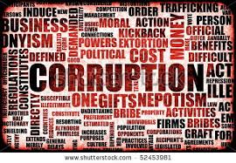
Corrupt and Unpopular
S. Vietnamese ruler lacked support in his own country and imprisoned those who criticized him
Money that was sent by the US to aid South Vietnam went to corrupt officers instead of to the people it was supposed to benefit

Slide 9
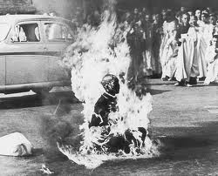
Monks on Fire
Buddhist monks doused themselves in gasoline and set themselves on fire in the streets of Vietnam to protest the South Vietnamese ruler’s treatment of Buddhists (he was Catholic)

Slide 10
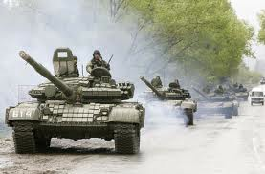
Coup/Overthrow
Kennedy knew that the S. Vietnamese ruler was going to be overthrown anyway and feared a communist takeover, so he supported a military coup that ousted him from power

Slide 11
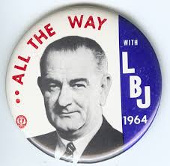
1964 Presidential Election
LBJ tried to keep the war from becoming an issue
“We are not about to send American boys nine or ten thousand miles away from home to do what Asian boys ought to be doing for themselves” (but didn’t send “advisors”)
Tried to paint his opponent, Barry Goldwater, as a dangerous radical who would lead the nation into nuclear war (“Daisy Ad”)

Slide 12
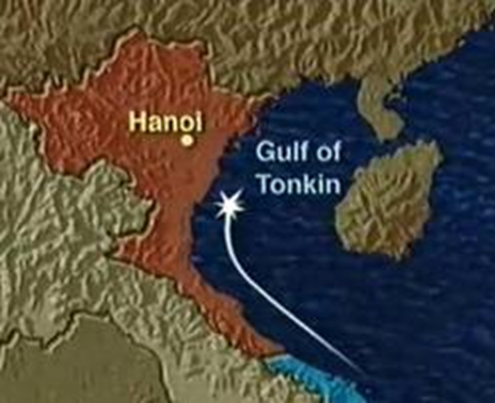
Gulf of Tonkin - 1964
A few months before the election LBJ made a dramatic announcement that North Vietnamese torpedo boats had attacked US surveillance ships (some doubted this claim) in international waters 30 miles from North Vietnam

Slide 13
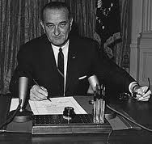
Tonkin Gulf Resolution
LBJ asked Congress and obtained authority to expand American involvement in Vietnam by sending as many troops as needed to prevent further aggression
Basically gave the President complete control over what the U.S. did in Vietnam

Slide 14
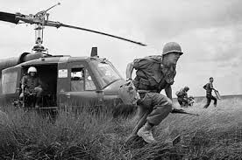
Excuse for War
This incident was used to deepen American involvement in Vietnam
1st American ground troops enter in 1965
Begins what will become a lengthy and controversial war with more and more young Americans being sent to fight in a foreign land

Slide 15
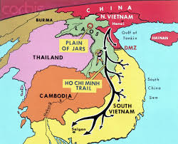
Ho Chi Minh Trail
North Vietnamese troops, weapons and supplies poured into the South via this route that passed through Laos and Cambodia (off limits to American troops)
By 1965 it looked like North Vietnam and the communists were close to victory

Slide 16
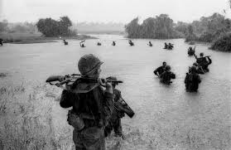
Escalation
The number of troops in Vietnam gradually increased throughout the 1960’s
Start of 1965 – only 25,000
By the end of the year 184,000
1966 – 375,000
1968 – 500,000
Also stepped up
bombing of North
- North only intensified
their efforts

Slide 17
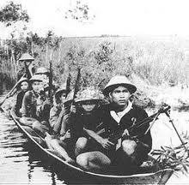
Viet Cong (VC)
Communist guerillas in the south that, with the support of the North Vietnamese (NVA) fought against South Vietnam
Masters at moving through and blending in to the local terrain

Slide 18
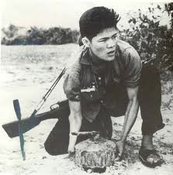
Why so difficult to defeat?
Despite being outgunned (with more advanced weapons) and outnumbered, the VC had advantages
Could be “invisible” because they knew the terrain – sniper fire and then disappear
Had supporters in the South so could move around easily
Were willing to die for their cause

Slide 19
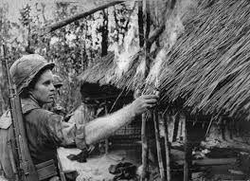
Search & Destroy
S
Unlike previous wars (such as WWII), success was not determined by land captured, but rather by the body count
A successful mission was one in which a large number of VC and NVA were killed

Slide 20
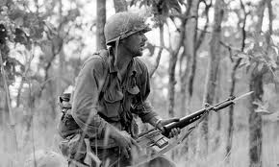
Unclear Objectives
A hill or other location might be overtaken only to be abandoned a few days or weeks later
Didn’t capture an area and keep it
How do you know when you’ve “won”?

Slide 21
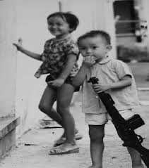
Enemy is Everywhere
One of the most challenging aspect of this war was not knowing who was a friend and who was an enemy
VC dressed same as civilians
A 9-year old child could shoot and kill you or an elderly woman might be hiding weapons in her hut
Darkness of nighttime was especially challenging as you could be killed before you knew what hit you

Slide 22
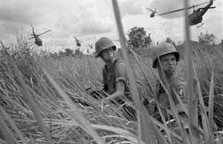
Other Challenges
The South Vietnamese (for whom we were supposedly fighting for) seemed indifferent to their efforts
Fighting conditions – carried heavy weapons through 10-foot-tall elephant grass and across flooded rice paddies that were infested with poisonous snakes and insects
Lack of conventional tactics made defeating VC very difficult – often escaped before able to be captured or killed

Slide 23
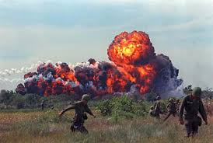
An Ugly War
Saturation bombing tore North Vietnam apart – bombing destroyed the country and contributed to over a million deaths (man civilian)
American soldiers constantly faced the hazards of Viet Cong booby traps, diseases and surprise attacks
VC used South Vietnamese as human shields. Americans would fire back into villages of innocent civilians – made them not trust Americans

Slide 24
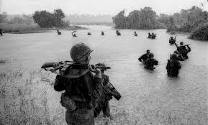
A Quick War?
Many believed early on that VC would be easily defeated by the might of America
Did not count on the resilience and determination of VC and NVA
Thought we were on the brink of driving them out of South Vietnam and victory would come soon

Slide 25
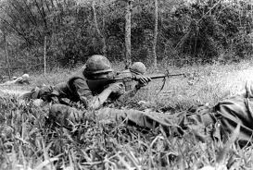
Tet Offensive
A series of massive attacks by the Viet Cong against the South (January 30th 1968 – Vietnamese Lunar New Year)
Most importantly, it was a psychological defeat because Americans began to see that the war was unwinnable
Those being sent to Vietnam after this knew they were going to fight for a lost cause

Slide 26
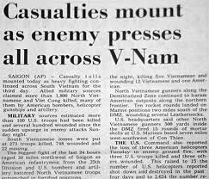
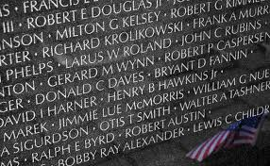
American casualties
By 1968 over 1,000 Americans were being killed each month in Vietnam
60% of these deaths are 21yrs. old or younger
Yet, this same year 4 times as many young men are drafted as the year before

Slide 27
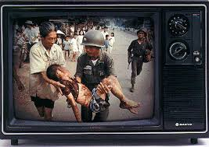
The 1st Television War
Unlike WWII, news coverage is not subject to government censorship
50 million Americans tune in nightly
These is the first unrestricted view of graphic images of war
Over 50% of Americans knew someone who was killed or wounded

Slide 28
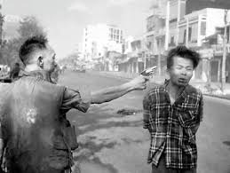
Images of Violence
90% of evening news is dedicated to Vietnam War after the Tet Offensive
Images of horror are broadcast into homes of millions of Americans
Famous image of prisoner being shot dead in the street becomes a symbol of the war’s brutality

Slide 29
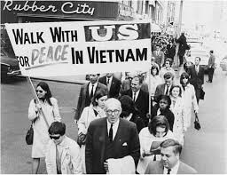
Changing Public Opinion
With each year that the war drags on public opinion turns more and more against it
No longer just the “hippies” and young people opposed to it
Angered turned toward returning Vets
Stories of atrocities in Vietnam are revealed in US media

Slide 30
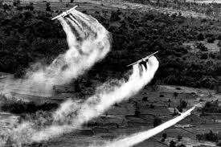
Agent Orange
A chemical used to destroy Viet Cong hiding places by killing leaves and thick jungle plants
Also killed crops and caused health problems in humans, including American soldiers

Slide 31
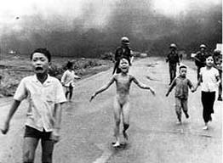
Napalm
Napalm - jellylike substance that burns uncontrollably (at up to 3,600 degrees) when dropped from planes
Hot enough to melt steel

Slide 32
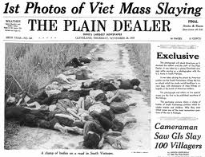
My Lai Massacre
In March 1968, American troops entered the South Vietnamese village of My Lai
Had heard that Viet Cong forces were hiding in the village, but instead found only women, children, and old men
Several soldiers, already on edge, tired, and frustrated by guerilla tactics opened fire killing at least 175 innocent civilians

Slide 33
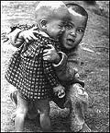
The Toll of War
Symbolized the brutality of the war
Many saw Americans as just as bad
Many vets called “baby killers” after this

Slide 34
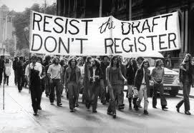
LBJ’s failure
LBJ failed to win the “hearts and minds” of the American people because he chose to use the draft to supply troops and people believed it was a pointless war

Slide 35
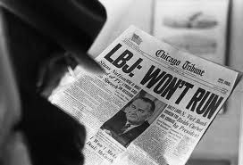
LBJ’s Surprise announcements
He would stop bombing North Vietnam so that peace negotiations could begin
He would not run for reelection

Slide 36
Peace With Honor
Richard Nixon runs for President in 1968 claiming that he has a plan for peace to end the war
Becomes evident after he is elected that peace is not at hand as he had promised
Protestors become frustrated with Nixon and the failed peace talks in Paris (2 years)
In early 1970 Nixon secretly authorizes sending American troops into Cambodia (previously forbidden) to stop ability of NVA from launching attacks into South Vietnam
A political gamble because it looks like an invasion of Cambodia/expansion of the war

Slide 37
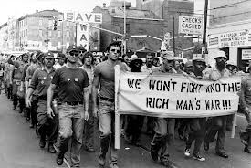
Avoiding the Draft
Those who had money could avoid the draft either by enrolling in college or fleeing to Canada or other countries
The poor and minorities made up the bulk of the soldiers drafted because wealthy could get deferments

Slide 38
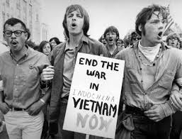
Body Bags
As more body bags were seen on TV coming home from Vietnam the anti-war movement began to gain momentum

Slide 39
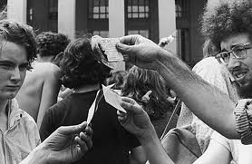
College campuses
Large demonstrations against the war were held on college campuses across the country
Many campuses had to temporarily close down because protests became more violent – burned draft cards and chanted “Hell no we won’t go”
Many returning Vets joined the Anti-War movement

Slide 40
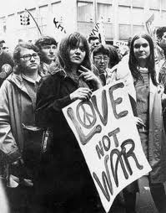
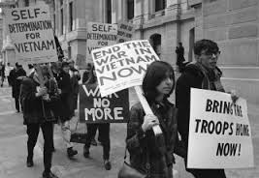
The Generation Gap
The “battle” between young people and “anyone over 30”
Two different ways of viewing the world
“Don’t trust anyone over 30”

Slide 41
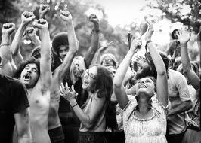
Counterculture Movement
Young people in the 60’s who rejected the values of the rest of society - a different interpretation of the American dream
Believed in peace and love and wanted to end the war in Vietnam

Slide 42
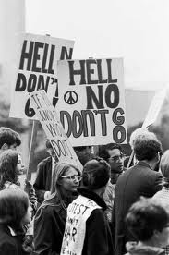
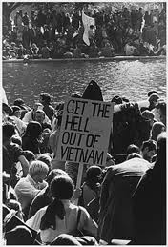
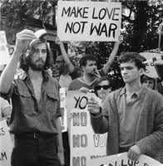
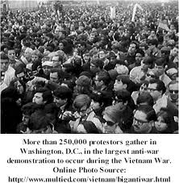
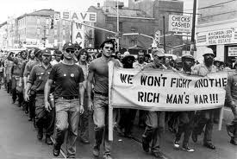

Slide 43
Hippies
A derogatory term used for those who acted and dressed a particular way (abbreviated form of “hipster”)
Emphasized change and experimentation that the older generation saw as immoral and even Un-American

Slide 44
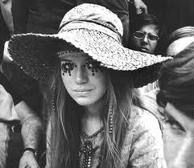
Hippies cont.
Embraced human sexuality, women’s rights, and experimentation with recreational use of marijuana and LSD
Young people in long hair (men too) wore what seemed to older people like “bizarre” gypsy/homeless outfits

Slide 45
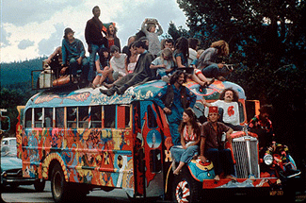

Slide 46
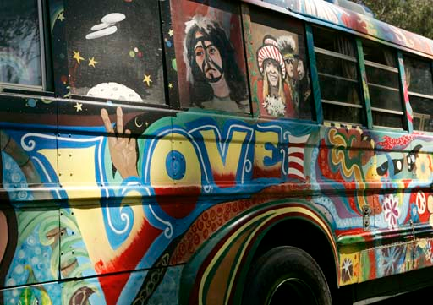

Slide 47
Music of the 60’s
Many musicians came to impact the counterculture movement including the Beatles, Jimi Hendrix, and the Grateful Dead

Slide 48
Bob Dylan & Janis Joplin

Slide 49
Government Reaction
The government assumed that the counterculture movement was backed by the communists
Used the FBI and even CIA to infiltrate antiwar organizations
In reality, most were everyday 20-29 year-olds who simply were disgusted and outraged by the war

Slide 50
Robert F. Kennedy (RFK)
Brother of JFK
The most electable anti-war candidate for President

Slide 51
Another Kennedy Assassination
Assassinated 2 months after MLK Jr. in 1968

Slide 52
1968 Democratic National Convention
10,000 anti-war protestors gathered in Chicago to oppose the Democratic candidate, Hubert Humphrey who was not against the war
Republican candidate Richard Nixon wins the election with promise to end the war

Slide 53
D’etente
Richard Nixon’s strategy to get us out of the war
Means “normalizing” relations
Played nice with China and Soviet Union to reduce the tension
Trade and arms limitation
agreement

Slide 54
“Saving Face”
Nixon tried to get both sides to have “peace with honor”
This way no one has to lose this Cold War battle
1st President to visit China since WWII

Slide 55
Vietnamization
When it became clear that the war was dragging on and more and more Americans were being killed, Nixon decided to turn the war over to South Vietnam

Slide 56
Would continue to supply weapons and training, but reduced American soldiers
Between 1968 and 1972 went from 500,000 to only 39,000 Americans

Slide 57
Did this strategy work?
No – the South Vietnamese couldn’t hold off the North on their own
South Vietnamese didn’t support their own government and had little will to fight

Slide 58
Cambodia
In early 1970 Nixon secretly authorizes sending American troops into Cambodia (previously forbidden) to stop ability of NVA from launching attacks into South Vietnam (along Ho Chi Minh Trail)
A political gamble because it looks like an invasion of Cambodia/expansion of the war

Slide 59
Kent State University
Next day student’s across the country protest this on college campuses
Demonstrators at Kent State in Ohio become violent
Inexperienced National Guard troops were called in to “restore order”
In span of 13 seconds 67 shots are fired on the crowd killing 4 students and injuring 9 others (incl. one permanently paralyzed)

Slide 60
Public Reaction
Public reaction is horrified & widespread
4 million college students go on strike
450 colleges & high schools forced to shut down
100,000 demonstrators marched on Washington in protest
Nixon withdrew troops from Cambodia (which the war had spilled into), but stepped up bombing raids
Congress took back the Tonkin Gulf Resolution in protest

Slide 61
Loss of Morale
Honorable Exit becomes goal instead of victory – soldiers just try to ride out their time and get back home to their families
Troops that remained in Vietnam in the early 1970’s began to feel like pawns in a lost cause and many lost their morale
Lots of drug and alcohol abuse (50% admit to trying marijuana, opium or heroin)
Many became openly rebellious refusing to risk their lives in battles that they saw as pointless

Slide 62
Nixon’s reelection
Guaranteed his reelection by promising that “peace is at hand”

Slide 63
How did we finally get out?
Signed a peace agreement with North Vietnam in 1973 which withdrew our troops and returned POW’s

Slide 64
POW’s
Prisoners Of War – soldiers captured during the war
Many sat in miserable North Vietnamese prisons for nearly a decade
Some were never found or returned

Slide 65
The fall of Saigon
As Nixon’s presidency fell apart South Vietnam was defeated by the North Vietnamese (April 1975) because Congress refused to send any more aid to South Vietnam since it had been such an ugly and pointless war

Slide 66
The most unpopular and divisive war in American history
We spent $150 billion
Lost 58,000 American soldiers
Ended up losing the war

Slide 67
Impact on our Government
People lost faith in the government and our nation’s leaders as a result of this war

Slide 68
Timeline
Create a timeline of events beginning with American involvement in Vietnam and ending with the fall of Saigon.
You should include a total of 10 labeled events, each with a drawing or visual of some sort that represents each event

