Slide 1
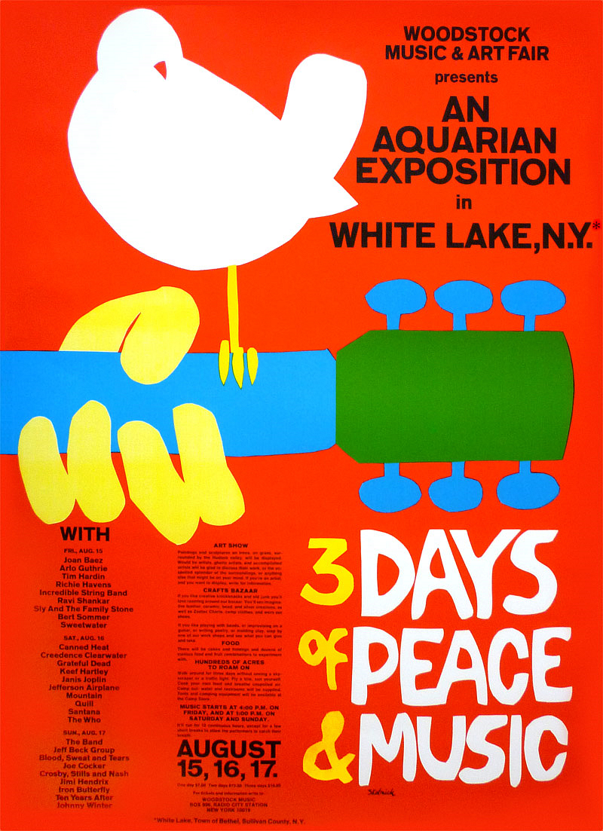
Woodstock, The Moon, & Watergate

Slide 2
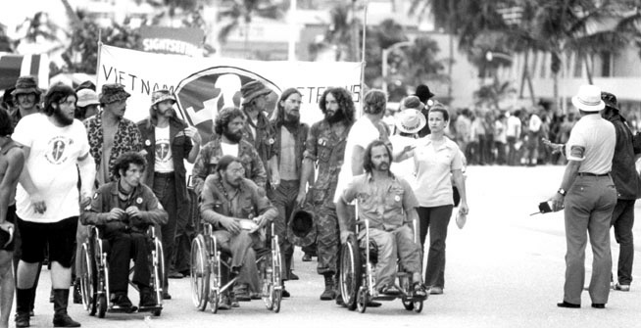
Not a Warm Welcome Home
Unlike WWII (the “Good War”), Vietnam vets were not welcomed home with parades
Viewed by the public with guilt and suspicion – some saw soldiers as “baby killers”

Slide 3
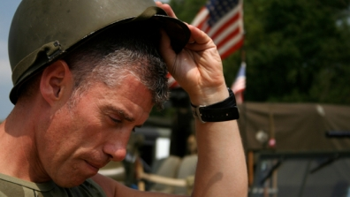
“Damaged goods”
Even those without physical wounds suffered psychological wounds and many couldn’t readjust to normal civilian life
Many became alcoholics and drug addicts, ended up homeless or even committed suicide

Slide 4
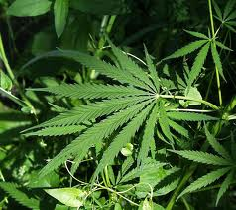
Drug Use in America
The use of drugs used to be just in the cities among street criminals, but by the 60’s drugs were being used by middle-class youth who came from “good” families and were college educated

Slide 5
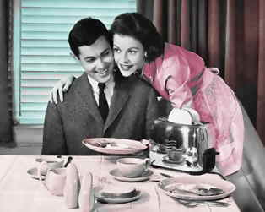
Rejection of the “American Dream”
Many youth in the 60’s saw the happy marriage, successful career, and a house with a white picket fence as phony, empty, and meaningless – rejected their parents’ values

Slide 6
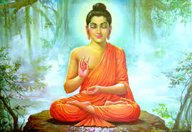
Eastern Religions
Some of the younger generation turned to gurus (spiritual leaders) who rejected materialistic beliefs and focused on peace and love rather than possessions
Many rejected their traditional Christian upbringings and embraced Eastern religions like Buddhism

Slide 7
lysergic acid diethylamide
LSD or acid is a hallucinogenic drug some used to “expand” their minds by creating a “psychedelic” experience

Slide 8
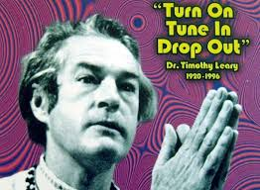
“Turn on, tune in, and drop out”
Timothy Leary, a Harvard Psychology professor, promoted LSD acid trips by taking drugs (turn on) to see what was really important in life (tune in) and therefore you could “drop out” of the meaningless mainstream existence
This became the slogan of a generation

Slide 9
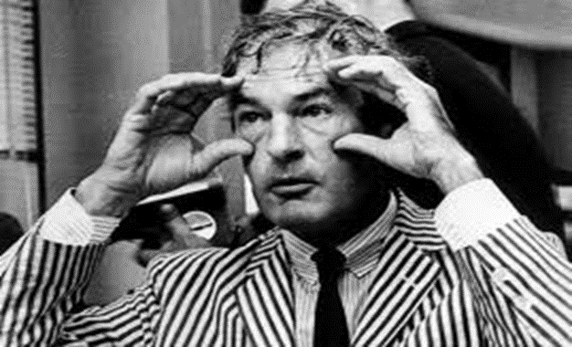
Timothy Leary
Timothy Leary believed that the drug had potential therapeutic benefit
Harvard disagreed and fired him, claiming his research was not scientific and that he was just promoting recreational drug use to his students
President Nixon called him the “most dangerous man in America”

Slide 10
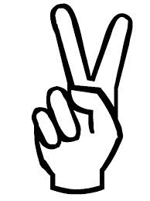
The “hippie movement”
Despite the stereotype of all being on drugs, the focus of most “hippies” was on kindness, affection, looking out for one’s fellow humans, tolerance, caring for the environment, and in general living in peaceful coexistence

Slide 12
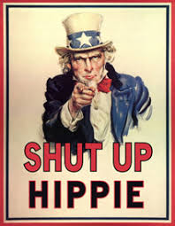
Was everybody a hippie in the 60’s?
Contrary to common belief, not everybody was a hippie in the 60’s, not even all young people
In fact, the hippies were often viewed with scorn by many in society

Slide 13
Woodstock Music Festival
As the 60’s drew to a close, organizers planned a music festival on a dairy farm in upstate New York
Originally billed as 3 Days of Peace and Music, this festival would go on to become the most iconic gathering of musicians in American history

Slide 14
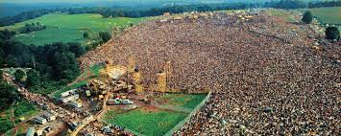
Larger than expected
When thousands more people showed up than anticipated, they made the decision to open the concert to everyone, free of charge.
Close to half a million people attended Woodstock, jamming the roads with eight miles of traffic.

Slide 15
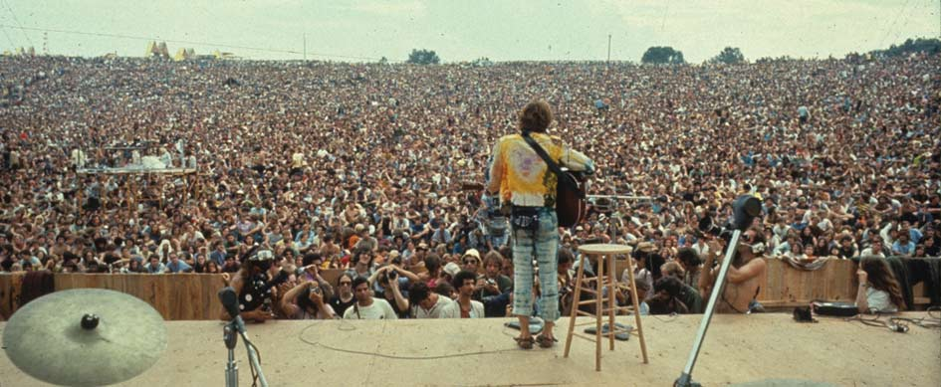
Sex, Drugs, and Rock & Roll
This open-air rock music festival ran from August 15-17, 1969
Soaked by rain and wallowing in the muddy mess, young fans best described as “hippies” euphorically indulged in music, drugs, and sex

Slide 16
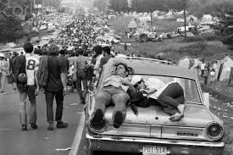
Peace and Chaos?
With not enough bathroom facilities and first-aid tents to accommodate such a huge crowd, many described the atmosphere at the festival as chaotic.
There were surprisingly few episodes of violence, though one teenager was accidentally run over and killed by a tractor and another died from a drug overdose.

Slide 17
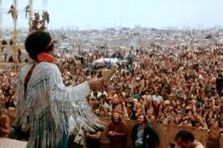
Musicians such as Janis Joplin, Arlo Guthrie, Creedence Clearwater Revival, The Who, and The Grateful Dead took the stage
The most memorable moment of the concert for many fans was the closing performance by Jimi Hendrix, who gave a rambling, rocking solo guitar performance of “The Star Spangled Banner.”

Slide 18
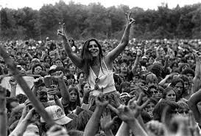
Woodstock Nation
A number of musicians performed songs expressing their opposition to the Vietnam War, a sentiment that was enthusiastically shared by the vast majority of the audience.
Later, the term “Woodstock Nation” would be used as a general term to describe the youth counterculture of the 1960s.

Slide 19
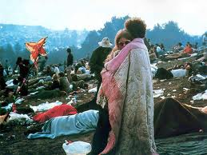
A Fitting end to the Decade
Came to symbolize that generation’s rebellion against the establishment and it’s war in Vietnam
Music of the 60’s unified youth culture
Also symbolized a generation’s hope for a better world

Slide 20
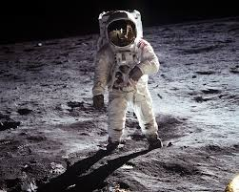
Man on the Moon
Kennedy promised in 1961 to put a man on the moon by the end of the decade
No one believed it was possible since we had always come in 2nd place in the space race to the Soviet Union

Slide 21
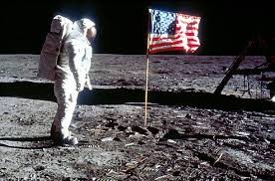
One Small Step…
On July 20th, 1969 people were glued to their TVs as they watched live pictures of 2 American astronauts (Neil Armstrong and Buzz Aldrin) setting foot on the moon
“The Eagle has landed” (the name of the spaceship)
“That’s one small step for man, and one giant leap for mankind”

Slide 22
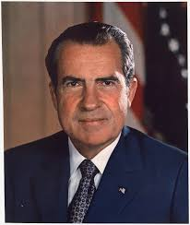
Richard Nixon
After losing his earlier bid for the presidency to JFK in 1960, his election in 1968 was particularly sweet
The country needed strong leadership in 1968 and someone to unify the country
Unfortunately, Nixon was a very divisive politician, rather than a unifier

Slide 23
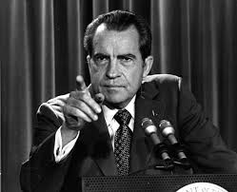
Not your Typical Politician
Unlike most politicians, Nixon was a reserved and remote man.
Uncomfortable with people, he often seemed stiff and lacking in humor and charm.
As a result, many Americans neither trusted nor liked him

Slide 24
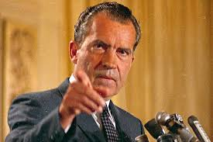
Nixon’s Disadvantages
Despite his skillful handling of the vice presidency under Eisenhower, Nixon never seemed quite comfortable in his role as a public figure
He had few close friends, and insulated himself from the press and other people
One of his close aides stated that there was “a mean side to his nature” and he would say or do anything to defeat his enemies

Slide 25
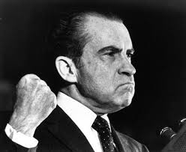
The “Enemies List”
Nixon’s enemies were his political opponents, the press corps, and leaders of the antiwar movement.
He was highly suspicious of anyone who he viewed as an “enemy” and would go to great lengths to exact revenge on those who crossed him

Slide 26
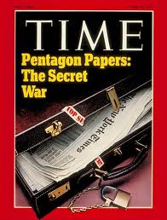
The Pentagon Papers
A series of secret articles that were published and damaged the government (in the NY Times 1971)
Classified documents showed how government officials lied to both the public and Congress about the war in Vietnam – shocked the public and added to the growing antiwar movement
Presidents made secret decisions and waged undercover war against N.Vietnam in the early 60’s without the public knowing about it

Slide 27
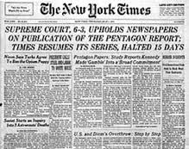
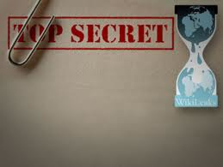
The Leak
Pentagon Papers got leaked to the public when a former govt. worker leaked it to the New York Times
The Govt. tried to stop their publication, but the Supreme Court upheld freedom of the press and said it could be published

Slide 28
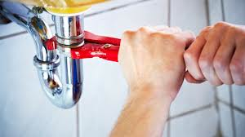
The Whitehouse “Plumbers”
Nixon’s secret group formed after the release of the sensitive military information contained in the Pentagon Papers
They were assigned to “plug any leaks” that resulted from the Pentagon Papers even if they had to do it illegally (broke into leaker’s psychiatrist’s office to dig up dirt to try to discredit him)

Slide 29
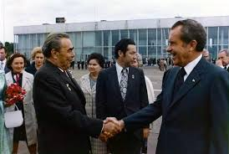
All Bad News?
Not all news coming out of the government was bad
Nixon made historic breakthroughs with two of our arch enemies – China & the Soviet Union

Slide 30
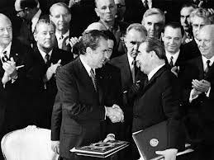
SALT
Strategic Arms Limitation Talks
An important agreement for the first time during the Cold War between the US and Soviet Union to limit the number of nuclear missiles in their arsenals

Slide 31
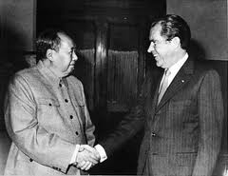
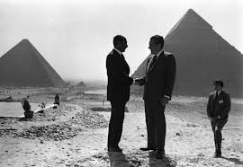
Nixon’s Achievements
Besides SALT, Nixon visited Mao Tse Tung in China and reopened relations with them
Nixon also helped keep peace in the Middle East after the Arab-Israeli War in 1973

Slide 32
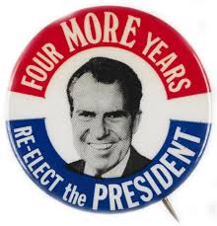
1972 election
As the 1972 election approached, Nixon was in a good position to win reelection (would end up winning 49 out of 50 states)
Nixon’s campaign began fundraising and looking for ways to bolster their candidate
Unfortunately, they will eventually end up getting caught for engaging in activities that others probably did, but got away with in the past

Slide 33
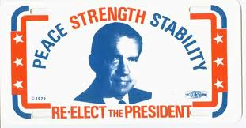
CREEP
The committee to reelect the President (CRP)
The President’s suspicious and secretive nature caused Nixon’s fiercely loyal aides to operate as if the White House was constantly under attack, surrounded by political enemies

Slide 34
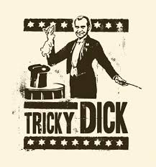
“Tricky Dick”
Nixon earned this nickname for his tactics and the scandalous series of events that would eventually end his presidency
In the process of trying to get Nixon reelected the CRP used spying against the democratic party and other “dirty tricks” to try to make his challenger look bad

Slide 35
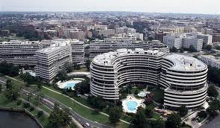
The Watergate Scandal
During the Presidential campaign Nixon’s “plumbers” were arrested for breaking in to the Watergate office building (to install illegal wire taps on the phones) which was the headquarters of the Democratic National Committee (June ‘72)
Goal was to dig up any dirt on Nixon’s opponents

Slide 36
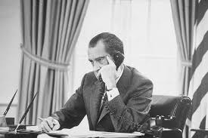
The Coverup
What initially looked to be a simple break-in the FBI soon traced back to the Committee to Reelect the President (CRP)
Nixon contacted the CIA and tried to get them to persuade the FBI to stop its investigation on the grounds that the matter involved “national security”
This action would come back to haunt the President

Slide 37
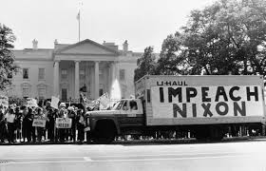
Nixon’s involvement
While Nixon, himself, was not involved in planning the break-in, he now had become part of the illegal coverup.
In doing so, he set the stage for impeachment on charges of obstruction of justice, abuse of power, and eventually refusal to obey a congressional order (to turn over tapes)

Slide 38
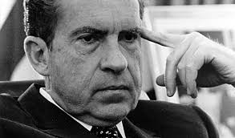
The trail leads to Nixon
Nixon claimed it was all a conspiracy against him and that it was nothing more than a “third rate burglary” that he had nothing to do with it.
However, this will be revealed to be untrue

Slide 39
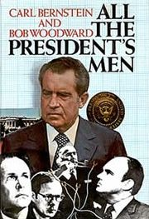
“All the President’s Men”
Nixon’s inner circle all started talking when faced with hard jail time (up to 40 years)

Slide 40
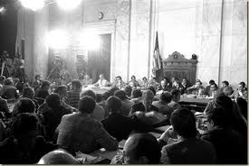
The Watergate Hearings
The Senate appointed a special committee to hold televised hearings to investigate what happened
Millions of Americans watched, fascinated, as the story unfolded like a mystery thriller

Slide 41
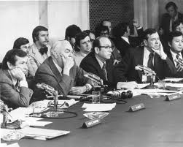
What was revealed?
Nixon instructed the FBI not to investigate Watergate
Nixon bribed the Watergate burglars in return for their silence (“hush money”)
And the biggest bombshell…

Slide 42
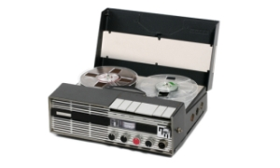
Secret Tape Recordings
The most dramatic moment came when one aide revealed the existence of a secret taping system in the President’s office that recorded all meetings and telephone conversations.
The system was set up to provide a historical record of Nixon’s presidency.
Now those audiotapes could show whether or not Nixon had actually been involved in the coverup.

Slide 43
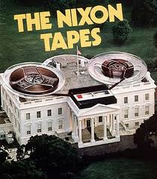
The “White House Tapes”
Secret tape recordings Nixon made of White House conversations would now be used against him
He refused to turn them over and when he was finally forced to there was 18 ½ minutes of suspicious gaps on them

Slide 44
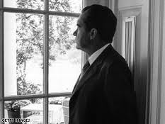
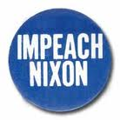
Impeachment
At this point Congress began the process that could lead to Impeachment (bringing charges of misconduct against a government official)
Impeachment would involve being put on trial (on charges of obstruction of justice and abuse of Presidential powers) and could lead to removal from office

Slide 45
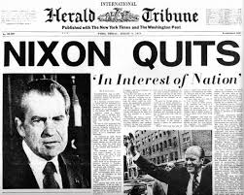
The Impeachment Process
To remove Nixon from office, a majority of the House of Representatives would have to vote for impeachment, and the Senate would then have to hold a trial.
The outcome seemed obvious.
Before that could happen, Nixon resigns

Slide 46
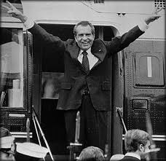
Nixon Resigns
Nixon released the last tapes that showed his guilt in the Watergate burglary and on August 9th, 1974 he became the 1st and only President to resign from office
However, he contends right up until the end that “I am not a crook”

Slide 47
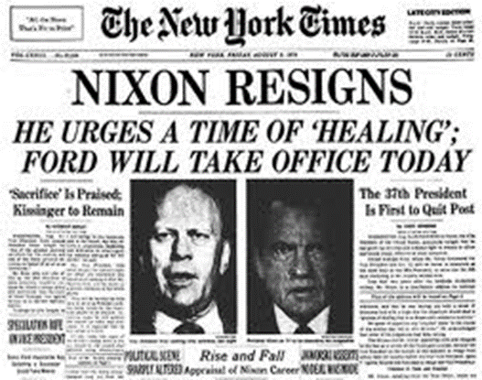
Country Needs to “Heal”
President Ford (the only President to never be elected) uses his newly gained powers of the Presidency to issue an executive pardon “for the good of the country”
Very controversial – this decision may have cost Ford the 1976 election
Nixon never does any jail time

Slide 48
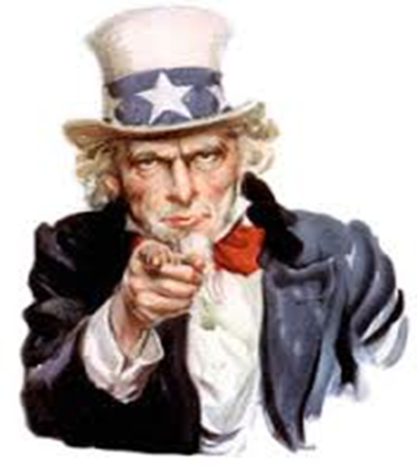
A Broken Country
The war in Vietnam followed by the Pentagon Papers and finally the Watergate scandal, leave Americans with a major distrust of their government.
Americans vote for a quiet, humble, former peanut-farmer (the opposite persona of Nixon) by the name of Jimmy Carter in 1976.

Slide 49
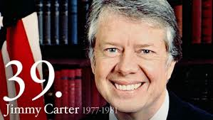
Jimmy Carter
A major reason he won the Presidency in 1976 was because of the public’s distrust of the Washington establishment after Watergate
He seemed like a down-to-earth, soft spoken and humble man (he even taught Sunday school!)

Slide 50
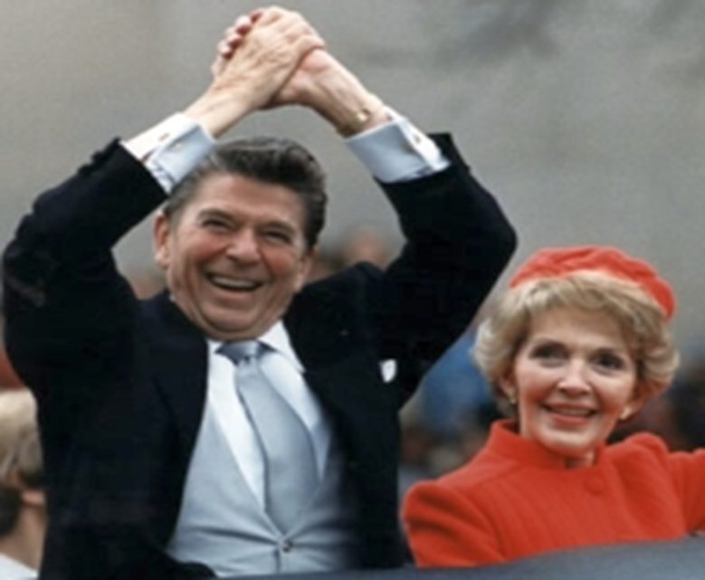
Ronald Reagan
In won’t be until the 1980’s that Americans start to feel good about the country again, with the election of a former actor named Ronald Reagan

