Slide 1
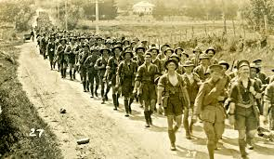
Chapter 10 Section 1
The Road to War

Slide 2
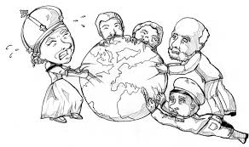
Factors leading to WW1
Imperialism – Rivalry among European powers to gobble up the remaining areas of the world that were not yet colonized.

Slide 3
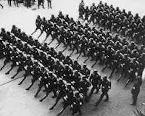
Factors Cont.
Militarism – A policy of building up your armed forces in preparation for war.
What happens when you are always planning for war?

Slide 4
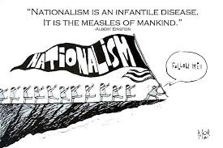
Factors Cont.
Nationalism – Countries acting in their nation’s interests often went against the interests of another nation.
Ethnic minorities in a country wanting independence often led to violence.

Slide 5
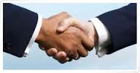
Factors Cont.
Alliances – Various combinations of nations had each others back.
If one was attacked their allies came to their aid.

Slide 6
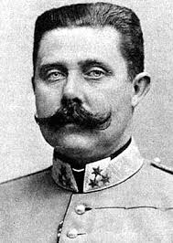
Archduke Francis Ferdinand
The heir to the throne of the Austro-Hungarian Empire.
Visiting Sarajevo, the capital of the new province (Bosnia) in the empire.

Slide 7
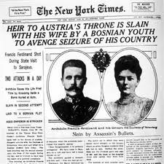
The Spark that Ignited the War
The Archduke and his wife were assassinated. (On June 28th 1914 by a Bosnian Nationalist who thought the empire had no right to rule Bosnia. )
Thought Serbia was behind it so they declared war on them. (their tiny neighbor and long time rival)

Slide 8
Chain Reaction
Russia, who was Serbia’s protector, began mobilization (getting troops ready for war).
Germany, Austria-Hungary’s chief ally, demanded that Russia stop mobilizing.
Russia refused and France, Russia’s ally, began to mobilize its troops.

Slide 9
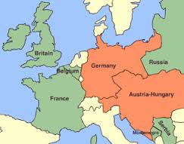
Germany Strikes First
Germany was sandwiched between Russia and France and wanted to avoid being trapped on both sides.

Slide 10
Great Britain Enters the War
Germany hoped they would remain neutral because GB had the most powerful navy in Europe.
In order to attack France, Germany had to travel through the small country of Belgium who was protected by Great Britain.

Slide 11
The Great War (WW1)
Within one week after the war started all the great powers of Europe had been drawn into it.
The Central Powers – Germany and Austria-Hungary.
The Allies – Russia, France, Serbia, and Great Britain.

Slide 12
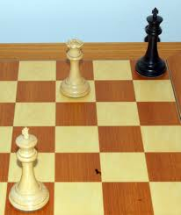
Stalemate
A situation in which neither side can gain the advantage.
Both sides were equal in size and strength.

Slide 13
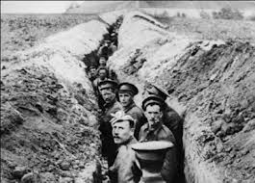
Trench Warfare
Dug out muddy, rat-infested trenches with an empty “no man’s land” in between them.
Neither side could push the other back more than a few miles.

Slide 14
The War Expands
By spring of 1915 the Ottoman Empire (present day Turkey) joined the Central Powers.
Italy joined the Allies.

Slide 15
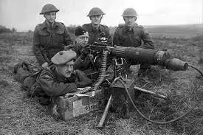
New Weaponry
Led to massive number of deaths. (26,000 British killed in a single day)
Artillery shells and hand grenades killed most who tried to cross “no-man’s land”.
Those not killed by that were mowed down by machine guns (450 rounds/minute) or choked by poison gasses.

Slide 16
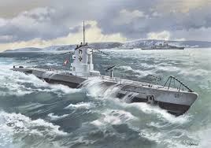
Desperation
As morale sank soldiers attacked civilians by burning their fields, killing their livestock, and poisoning their wells.
German subs torpedoed any ship they suspected of aiding the Allies.

Slide 17
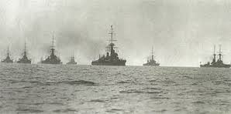
Break the Stalemate
British setup naval blockade to starve the German people.
None of these strategies worked.

Slide 18
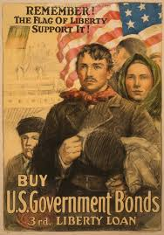
Personal
Many Americans felt personally involved in Europe’s war because more than 1/3rd of them were 1st or 2nd generation immigrants and still identified with their old homelands.

Slide 19
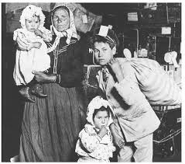
German and Irish Americans
Favored the Central Powers because the Irish disliked Great Britain for past conflicts and the Germans for obvious reasons.

Slide 20
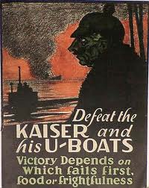
Opposition to Germany
Most Americans opposed the Central Powers because their ruler, Kaiser Wilhelm (means emperor), was an autocrat who ruled with unlimited power.
Also saw Germans as cold-blooded people who were obsessed with war.

Slide 21
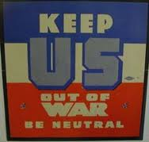
Neutral
America proclaimed its neutrality (in 1914) because we did a lot of foreign trade and didn’t want our investments at risk.

Slide 22
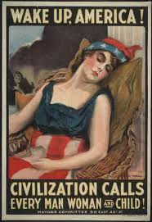
Two Sides
Preparedness movement – Wanted to build up America’s military to be prepared in case we had to get involved.
The Peace movement – Mostly women and progressives who wanted citizens to know that their increased taxes were paying for the “preparedness” movement.

Slide 23
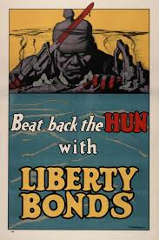

Slide 24
