Slide 1
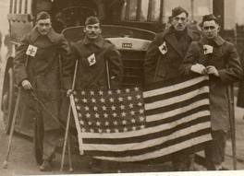
Chapter 10 – Section 3
Americans on the European Front

Slide 2
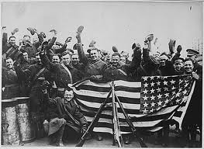
U.S Enters the War
In April 1917 the US sends supplies, weapons, and only a few token troops (about 14,000) to France.

Slide 3
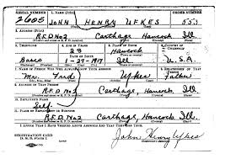
Selective Service Act
Law that authorized a draft of young men for military service
Our military wasn’t big enough (needed 3 million, but we only had 120,000)
A lottery picked 3 mill. (out of 24 mill. men)

Slide 4
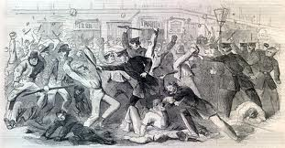
Draft Riots
Unlike the Civil War, riots didn’t break out because people felt this would be the “war to end all wars”

Slide 5
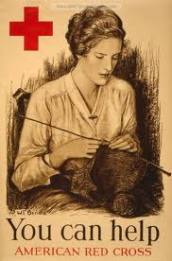
Women in the War
Many served as nurses, drivers, and clerks

Slide 6
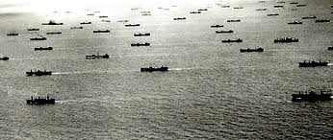
Convoys
Groups of unarmed ships surrounded by a ring of armed ships to prevent against sub attacks (u-boats had sunk 430 ships by 1917 – this cut the number in half)

Slide 7
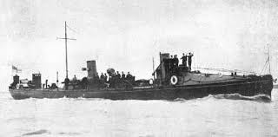
Torpedo boats
American ships specially equipped to track and destroy submarines

Slide 8
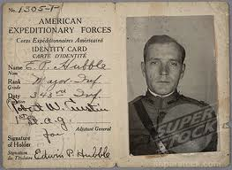
American Expeditionary Force (AEF)
Name given to American troops during WW1
Consisted of draftees, volunteers, and National Guardsmen from the U.S.

Slide 9
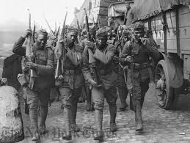
African American troops
300,000 troops discriminated against during WW1
Kept apart from white troops
Not allowed in the Marines at all
Only given minor jobs in Army & Navy

Slide 10
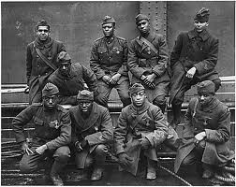
Harlem Hell Fighters
The 369th infantry
African American regiment that persuaded their white officers to let them fight with the French troops
Earned France’s highest combat medal for distinguished service (Croix de Guerre)

Slide 11
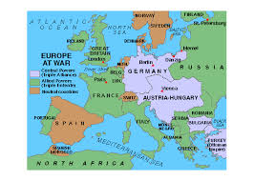
Russia Drops Out
Vladimir Lenin, the leader of the Russian Revolution, promises to make peace with Germany after the Czar is gone
Allows Germany to focus on fighting French and British (the Western Front) and no longer has to fight on both sides

Slide 12
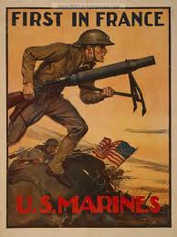
The Tide Turns
American Marines lost half their troops, but dug in and prevented the Germans from overtaking Paris
(“We dig no trenches to fall back on. The Marines will hold where they stand.”)

Slide 13
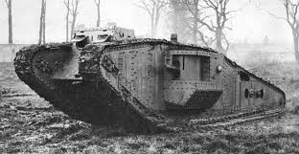
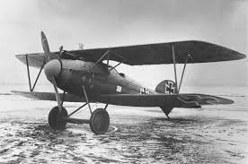
New Weapons Help Win the War
Two new weapons helped the Allies win the War
The Tank – could cross trenches and roll through barbed wire
Airplanes – could drop bombs and engage in aerial “dog fights” (between planes)

Slide 14
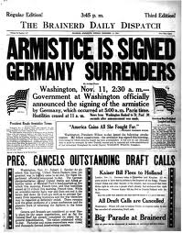
The Armistice
The cease-fire to the war
November 11, 1918 at eleven o’clock in the morning – “the eleventh hour of the eleventh day of the eleventh month”
Celebrated in Europe as Armistice Day and in America as Veterans Day (official holiday declared by Pres. Wilson in 1919)

Slide 15
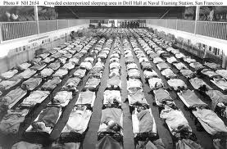
Death Toll
50,000 American soldiers died in battle in WWI
Many more died of influenza (the flu)
Would have been much higher if not for the volunteer nurses in the Red Cross

Slide 16
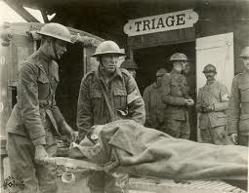
European Deaths
Over 8 million soldiers and sailors were killed during the conflict (1914-1918)
An average of more than 5,000/day

Slide 17
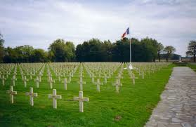
European Civilians
During and immediately after the War millions more civilians died from starvation, disease, or war-related injuries
Europe was permanently changed as a result

Slide 18
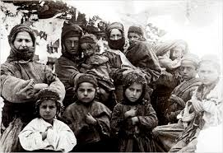
Genocide
The organized killing of an entire people
(Most well-known was the Holocaust in WWII)
During WWI Ottoman forces kicked out and killed hundreds of thousands of Armenian civilians who they suspected of disloyalty to the government (continued into early 1920’s)

