Slide 1
Chapter 10 Section 4
On the Home Front

Slide 2
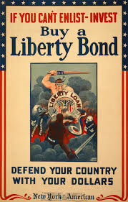
Liberty Bonds
Bonds that were bought for face value and could later be redeemed for their original value plus interest.
Sold to raise $ for the war effort. (Raised $20 billion)

Slide 3
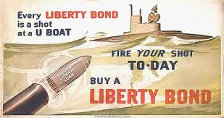
“Every Scout to Save a Soldier”
Girl and Boy scouts setup booths on street corners.
Movie stars gave speeches.
Artists drew colorful posters.
“Four-minute men” gave 4 min. speeches before movies, plays, school meetings, etc. trying to persuade people to buy them.

Slide 4
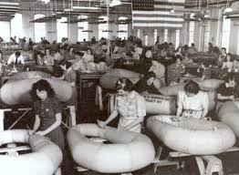
Economic Changes
Industry converted to the production of war goods.

Slide 5
Government Controls
The government controlled who could make what and how much they could make.
Price controls – Determined the prices for food and fuel.
Rationing – Only allowed people to use a small amount of a good.

Slide 6
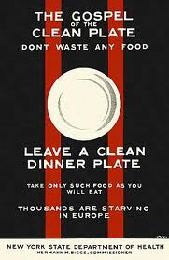
“Gospel of the Clean Plate”
Reached out to women for help by telling them to not throw away any leftovers and not to give out second helpings.

Slide 7
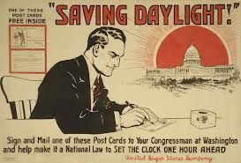
Daylight Savings Time
Added an extra hour of daylight to the day in the summer
Cut back on the need for light and fuel

Slide 8
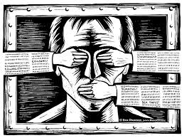
Govt. Control of News and Information
Imposed censorship on the press and banned some publications that spoke out against the war to enforce loyalty on U.S. citizens

Slide 9
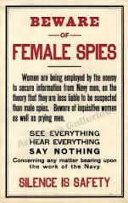
Revival of Nativism
Anti-immigrant feelings renewed
Many feared spies might try to stop America’s war effort by destroying transportation or communication networks so many recent immigrants were treated as suspicious

Slide 10
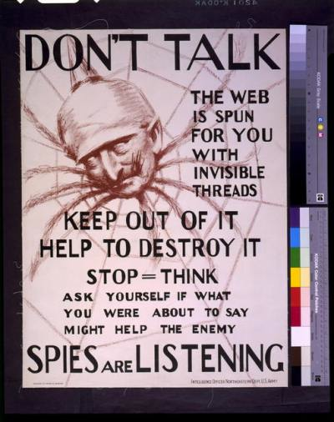

Slide 11
“Hate the Huns”
German Americans referred to as “Huns” by fellow Americans (much like Arab Americans were called “Terrorists” after 9/11) – reference to brutal invaders
Many arrested for no reason
Often attacked and lynched by mobs during the war
German musicians not allowed to perform
Hamburger (named after the city of Hamburg in Germany) renamed “liberty sandwich” and German measles called “liberty measles”

Slide 12
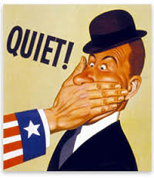
The Sedition Act
Made it illegal to discuss anything “disloyal” or to say anything bad about the government or the military
Basically shut down any dissent
Over 1,000 people were convicted and sent to prison

Slide 13
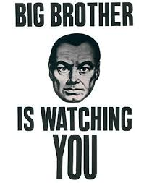
Hypocrite?
President Wilson claimed we were fighting for liberty and democracy overseas, yet was taking those very things away from Americans

Slide 14
Industrial Workers of the World (IWW)
Political radicals like socialists and the IWW said the war was nothing more than an argument between greedy imperialist capitalists

Slide 15
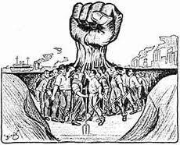
Union leaders
Union leaders, like Samuel Gompers, didn’t like the IWW and other radical groups because they were giving patriotic union members a bad name (because people associated these groups with the unions)

Slide 16
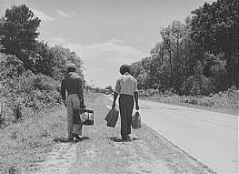
The Great Migration
500,000 African Americans left the South to work in northern factories to produce supplies for the war
The war cut off the supply of immigrants coming from Europe to America and many young white men had been taken out of the factories and sent off to war

Slide 17
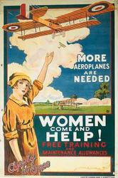
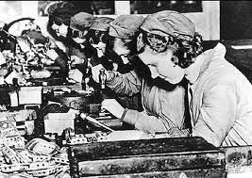
Advances for Women
400,000 joined the industrial work force (jobs in factories) and moved into jobs usually reserved for men (letter carriers, telegraph messengers, elevator operators, etc.)

Slide 18
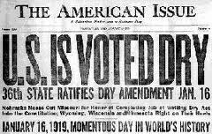
18th Amendment
Made it illegal to make, sell, or transport alcoholic beverages
After nearly 100 years of trying, finally in 1919 it was passed because Congress wanted to be patriotic and conserve the grain needed to make alcohol for bread to feed the soldiers overseas

Slide 19
Create a Poster
You have been hired by the Committee on Public Information during WW1
Create a propaganda poster for one of these causes:
Selling Liberty Bonds
The “Gospel of the Clean Plate”
Support of the Sedition Act

