Slide 1
Chapter 12 – Section 1
The Economy in the Late 1920’s

Slide 2
Reasons to be optimistic about the economy in the late 1920’s
Wages had increased
Low unemployment
Heavy investing in the booming stock market

Slide 3
Welfare Capitalism
Employers raised wages and provided benefits like paid vacations, health plans, and even English classes for recent immigrants
“kept the workers happy” so they wouldn’t strike (kept Unions in check)

Slide 4
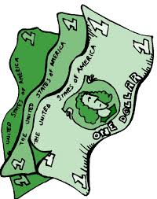
Misleading prosperity & wealth
A tiny % of rich Americans owned most of the nation’s wealth
Most made under $2,500/year and had no savings (80% had none)

Slide 5
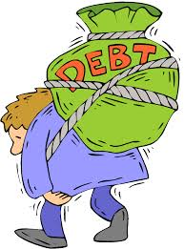
Buying on credit = Bad idea
People bought stuff whether or not they could afford it
Installment plans meant didn’t have to pay cash upfront anmore
Led to an increase in personal debt

Slide 6
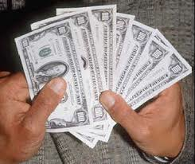
Speculation
The practice of making high-risk investments in hopes of “getting rich quick”

Slide 7
Different kind of investors
Used to be only the rich who played the stock market before WWI
Now everyday people invested their entire life savings

Slide 8
“Buying on Margin”
Allowed even more people to invest
Only had to put down a small % to buy a stock and could borrow the rest

Slide 9
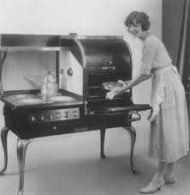
Why so many unbought consumer goods?
Despite rising wages, people still could not afford to buy them as fast as assembly lines churned them out

Slide 10
Overproduction of goods
Caused industries such as automobile to slow down
Related industries too – steel, rubber, glass

Slide 11
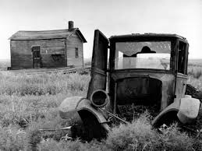
Trouble for farmers in 1920’s
During WWI demand for wheat & cotton gave them profits
Used these profits to buy more land & machinery
After war ended, demand dropped causing farm prices to drop so farmers couldn’t pay off loans

Slide 12
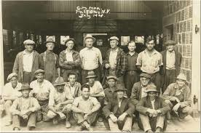
Life for factory workers
Still long hours and little pay for most
56 hours/week and 16 cents/hour
Tough conditions in coal mines & textile mills

Slide 13
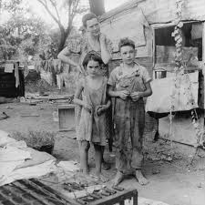
*5 Factors leading to major disaster
1. Uneven wealth
2. Rising debt (buying on credit)
3. Stock speculation
4. Overproduction
5. Hardships for farmers and workers

Slide 14
Persuasive Essay
Assume the role of the writer of a business column in a 1920’s newspaper. Write an essay to persuade your readers either a) to take advantage of the money-making opportunities in the booming economy, or b) to show caution in their investments and avoid speculation.

