Slide 1
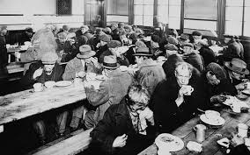
Chapter 12 – Section 3
Social Effects of the Depression

Slide 2
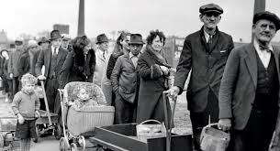
Reality of Life in 1931/1932
Lost your job
Money in bank is gone
Can’t pay rent or mortgage so out on the street
Kids had to quit school to help support family
Poor were hit the hardest

Slide 3
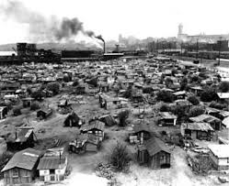
Hoovervilles
Those at the bottom who had no place to go moved in with relatives or drifted
Built shanty towns with cardboard or scrap metal
Called “Hoovervilles” to mock the President, whom people blamed for the crisis

Slide 4
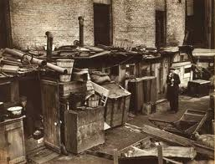
Hooverville

Slide 5
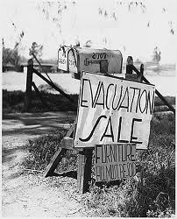
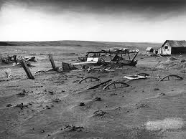
Farmers
Low farm prices so couldn’t pay mortgage
Banks took their land or foreclosed on farms

Slide 6
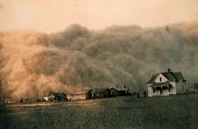
The Dust Bowl
Region of the Great Plains where drought and dust storms took place for much of the 1930’s
Added to the already harsh conditions of the Depression

Slide 7
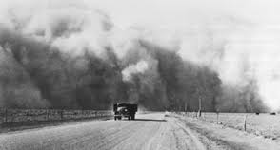
What did Dust Bowl families do?
Left Oklahoma, Kansas, and Texas to go to find work on farms in California

Slide 8
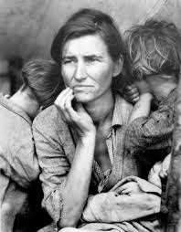
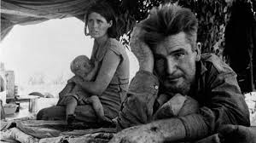
Dorothea Lange
Photographer whose pictures showed the desperation and courage of the families trying to feed their hungry children and babies
Got the public to demand the Govt. take action to help

Slide 9
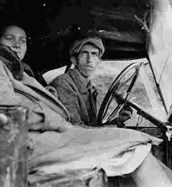
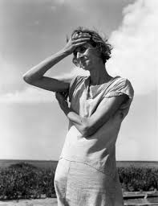
Psychological Effect on the Nation
Caused great anxiety about losing your job
Many became depressed and even committed suicide

Slide 10
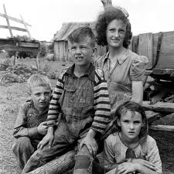
Effect on people’s health
Those who couldn’t afford food or shelter got sick more easily, especially children
Poor diet and no medical care

Slide 11
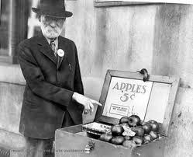
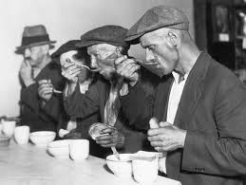
How did people in the countryside survive? The city?
Grew food and ate berries and other wild plants
In city sold apples, pencils, etc.
Begged for food
Fought over scraps in restaurant garbage cans

Slide 12
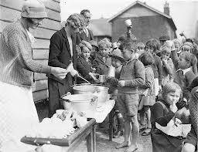
Other stressors
As families moved in together crowded houses/apartments
Had to give up even little pleasures like ice cream or movies

Slide 13
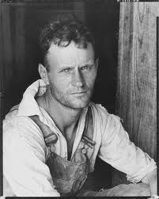
How did many men feel? Why?
Like failures
Couldn’t provide for their families
Ashamed of being home during normal work hours
Didn’t want to ask friends for help

Slide 14
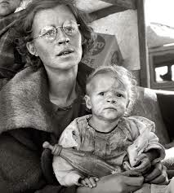
What happened to those women who had jobs?
Accused of taking jobs away from men
Would not hire married women and fired if you got married

Slide 15
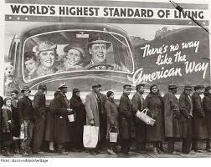
Increased Discrimination
Blacks, Hispanics, and Asians lost low-paying jobs (that whites usually didn’t want)
Relief programs (bread lines, etc.) didn’t help minorities
56% blacks unemployed compared to 25% whites
Worse in South - lynchings increased

Slide 16
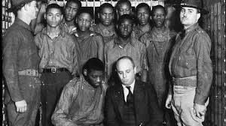
The Scottsboro Boys
Group of 9 black youth riding the rails in Scottsboro, Alabama
Quickly convicted of raping 2 white women on the train and sentenced to die before they could even get a defense lawyer

Slide 17
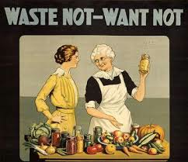
Depression mentality
Those living during this time learned not to waste anything
If it’s still usable you don’t get rid of it and only spend what you absolutely must

Slide 18
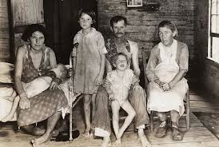
Homework essay
Write a ½ - 1 page narrative telling your tale as a person trying to survive the Depression. Be sure to include specifics from the notes.

