Slide 1
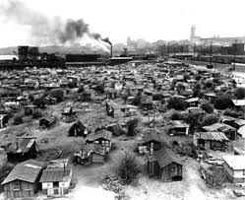
Chapter 12 – Section 4
Surviving the Great Depression

Slide 2
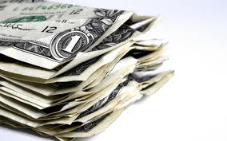
The “Depression Generation”
Even those who recovered enough to live a very comfortable life never forgot it
Continued to “pinch pennies” as if financial ruin was just around the corner
Many stopped buying on credit and instead saved cash for years for needed items

Slide 3
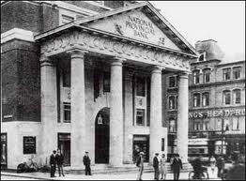
Lost Trust in the Banks
People started stuffing money under their mattresses and hiding it around the house rather than putting it in the bank
Afraid the banks would lose it again

Slide 4
Neighbor helping neighbor
People pulled together and helped each other out during the Depression, particularly those that they saw as worse off than themselves

Slide 5
Communists & Socialists
Suddenly they gained in popularity during the Depression
They offered new solutions to the country’s problems and promised a fairer distribution of wealth

Slide 6
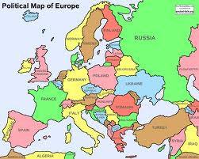
Riots in Europe
Unlike Americans who remained law-abiding and peaceful, Europeans reacted to their economic problems by rioting and calling for radical change

Slide 7
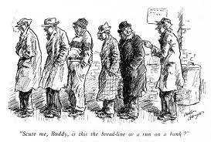
How did humor help people through the Depression?
Many political cartoons in newspapers tried to make people laugh at their troubles
Terms like “Hoovervilles”, “Hoover blankets” (old newspapers) and “Hoover flags” (empty pockets turned inside out) tried to make light of the situation

Slide 8
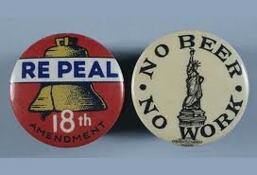
21st Amendment
In 1933, after 14 years, prohibition was repealed (overturned)
Most saw it as an end to a failed social experiment
Believed it would stop the gangsters who profited from bootlegging

Slide 9
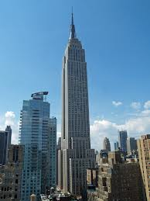
The Empire State Building
Begun in 1930, it was seen as a symbol of hope
Up to 4,000 people/day worked on it
At the time the world’s largest building

Slide 10
*5 Signs it was the end of an Era
1931 – Al Capone sent to prison
1932 – Charles Lindbergh’s son kidnapped and murdered
1933 – Calvin Coolidge – the President during the good times of the Roaring Twenties dies
1935 – Babe Ruth retires from baseball
Henry Ford now seen as an enemy of workers/unions rather than a genius

