Slide 1
Chapter 12 – Section 5
The Election of 1932

Slide 2
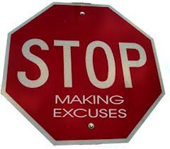
Hoover’s Excuse
Blamed the Depression on “world-wide economic problems beyond our control” rather than on problems within the US economy

Slide 3
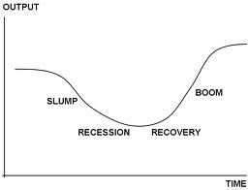
Why didn’t he do anything?
He believed we just had to remain confident and things would improve themselves soon (business cycle)

Slide 4
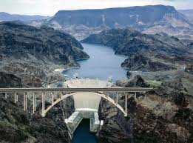
What did the government finally do to help create jobs?
Spent more on projects like buildings, roads and parks
Built the Hoover Dam

Slide 5
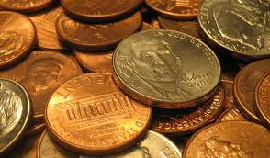
Hawley-Smoot tariff
The highest import tax in history to protect industries at home
Backfired because Europeans raised their tariffs which almost stopped international trade and hurt the economy even more

Slide 6
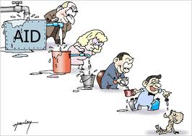
Reconstruction Finance Corporation (RFC)
Gave govt. money to bankers so that they could give loans
Theory was that prosperity at the top would help the economy as a whole (trickle down economics)
Hoover viewed by many as only helping the rich

Slide 7
Why not give direct help to the poor?
Hoover said it would destroy people’s self-respect and create a large bureaucracy (a complex disorganized system)
People started to see Hoover as cold-hearted

Slide 8
John Maynard Keynes
British economist who said that massive govt. spending could help a collapsing economy and encourage more private spending

Slide 9
Why weren’t his ideas popular at first?
Went against the “American way”
Philosophy of capitalism says govt. should stay out of business and let it fix itself (laissez faire)

Slide 10
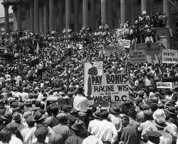
The Bonus Army
In summer of 1932, 20,0000 WWI vets marched to Washington, set up camps, and demanded the pension bonus now that they had been promised they would get in 1945

Slide 11
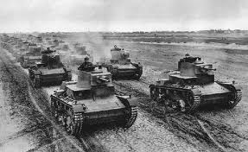
Hoover’s response?
Sent in our own military against them using guns, tanks, and tear gas vs. bricks and stones
Made Hoover look even worse

Slide 12
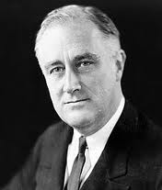
FDR – Franklin Delano Roosevelt
Governor of NY who ran for President in 1932
Promised the American people a “New Deal”

Slide 13
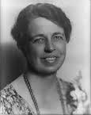
Eleanor Roosevelt
FDR’s wife
An outspoken person on behalf of women and the poor

Slide 14
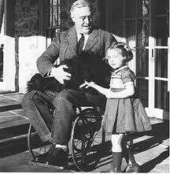
In touch with the “ordinary man”
Even though FDR was rich, he wanted to help those less fortunate and didn’t like the gap between the rich and the poor
Was paralyzed by polio in the 1920’s - made him more like those he wanted to help (even though no one ever saw this)

Slide 15
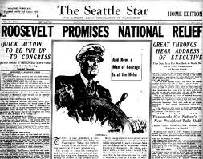
What was the election of 1932 “really about”?
Could and should the govt. try to fix people’s problems or not
Democrats and FDR said YES - Republicans said NO

Slide 16
FDR changes the role of the President and the Govt. forever
Govt. took on more responsibility for taking care of those who couldn’t make it on their own
Govt. became their only hope

Slide 17
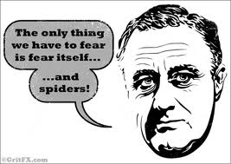
FDR’s Inaugural address
FDR’s famous line…”The only thing we have to fear is fear itself”

