Slide 1
Chapter 13
FDR & The New Deal

Slide 2
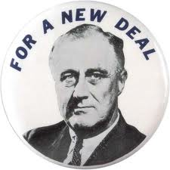
The New Deal
FDR’s program of relief, recovery, and reform aimed at stopping the problems caused by the Depression

Slide 3
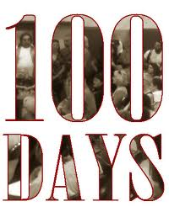
The Hundred Days
The 1st 100 days of FDR’s presidency in which he passed through program after program to create jobs and help stimulate the economy

Slide 4
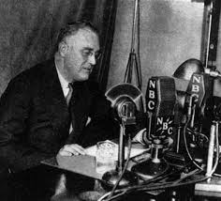
Fireside Chats
FDR’s regular talks to the nation over the radio
His easy manner and confidence reassured people and made them feel better

Slide 5
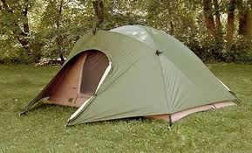
2nd Bonus March
Handled it differently than Hoover
Provided veterans with campsites and Eleanor even visited them and heard their stories

Slide 6
Bank Holiday
FDR closed all the banks for 4 days so govt. inspectors could determine if they were healthy
Most were and so it restored people’s confidence in banks and they put their $ back in so banks could make loans that would help stimulate the economy

Slide 7
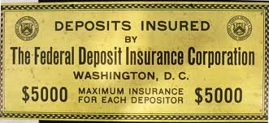
FDIC
The Federal Deposit Insurance Corporation
Created to protect people’s bank deposits up to $5,000 ($250,000 today)

Slide 8
WPA
The Works Progress Administration
Govt. funded projects to build or improve public facilities like roads, airports & schools

Slide 9
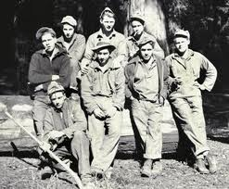
CCC
Civilian Conservation Corps
Put 2 ½ million unmarried men to work restoring and maintaining America’s forests, beaches, and parks

Slide 10
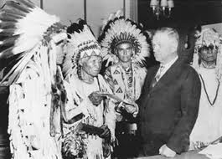
Indian Reorganization Act
Ended the sale of tribal lands and restored ownership of some lands to Indian groups

Slide 11
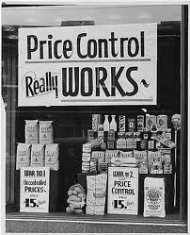
Regulation of private businesses
Set up industry-wide codes that regulated prices and production
Required companies to provide info. about their finances if they offered stock for sale

Slide 12
SEC
Securities & Exchange Commission
Oversaw the stock market and limited the purchase of stock on margin

Slide 13
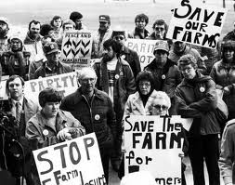
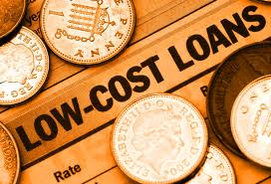
Homes & Farms
Govt. helped save homes & farms by making mortgages or payments more manageable by providing low-interest loans

Slide 14
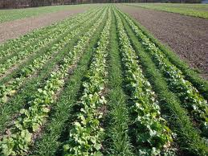
Farm prices
Govt. helped raise low farm prices by paying farmers not to raise certain crops & animals
Less supply would raise prices

Slide 15
TVA
Tennessee Valley Authority
Helped farmers and created jobs in one of the country’s least developed regions by reactivating a hydroelectric power facility that provided cheap electric power to the Tennessee Valley

Slide 16
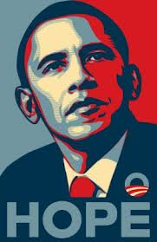
African Americans
FDR broke new ground by appointing many African Americans to govt. positions

Slide 17
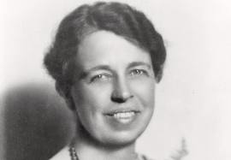
Eleanor Roosevelt
A “different kind” of first lady
Outspoken woman for the times
Toured the country in place of her husband

Slide 18
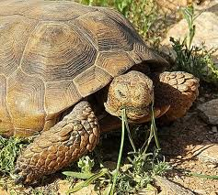
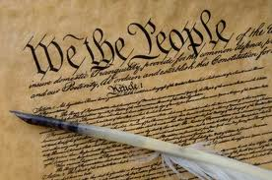
Criticism of New Deal
Improvements were not significant or quick
Some claimed it was unconstitutional

Slide 19
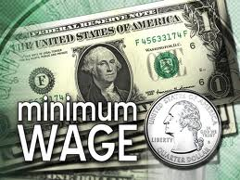
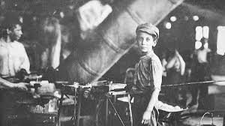
New Labor Laws
Couldn’t prohibit unions
Banned child labor
Set minimum wage for all workers

Slide 20
Social Security Act
Retired workers receive social security payments at age 65
Unemployment insurance to workers who lost their jobs
Payments to the blind & physically disabled

