Slide 1
Chapter 14 – Section 2
The Road to Victory in Europe

Slide 2
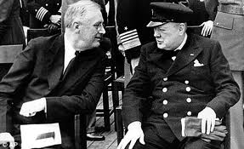
The Atlantic Charter
Agreement drawn up by FDR and Winston Churchill (the leader of Gr. Britain)
Met secretly to discuss goals for peace
August 1941 (when we knew we’d soon be entering the war)

Slide 3
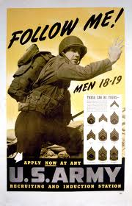
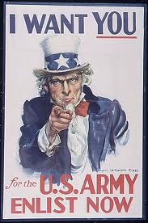
After Pearl Harbor…
Thousands of men received official notices to enter the army or navy
Tens of thousands more volunteered to serve

Slide 4
The 4 Freedoms
FDR said these were what we are fighting for
Freedom of speech and expression
Freedom to worship God in their own way
Freedom from want or need
Freedom from fear

Slide 5
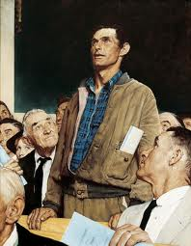
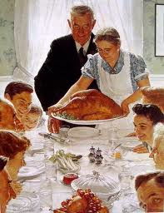

Slide 6
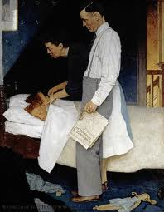
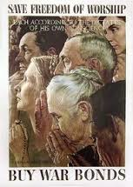

Slide 7
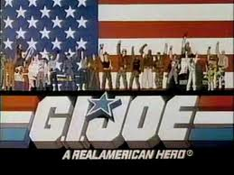
G.I.’s
What American soldiers called themselves
After the “government issue” stamp that appeared on all uniforms, weapons, etc.

Slide 8
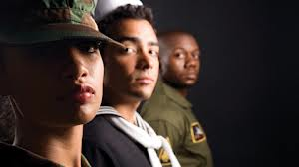
Diverse armed forces
Mexican, African, Japanese, and Native Americans all served in our military

Slide 9
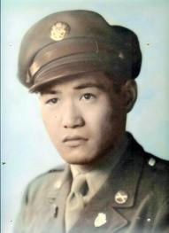
Challenges
African and Japanese Americans initially not allowed to join
Had to fight in segregated units
Not initially allowed in combat (finally needed them due to increased casualties)

Slide 10
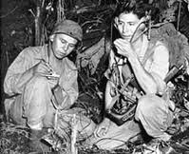
Navajo “Code Talkers”
Native American marines who served as radio operators using a code based on their native language that the Japanese couldn’t break when they eavesdropped on marine radio transmissions

Slide 11
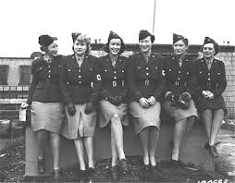
Women in the Armed Forces
Served in all capacities except combat
Air tower operators, mechanics, drivers, photographers – 275,000 women

Slide 12
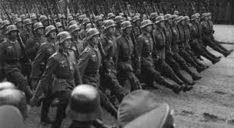
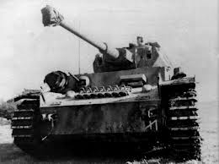
Situation in Europe in 1941
Most of the continent had been overrun by Germany
Many feared they could not be stopped

Slide 13
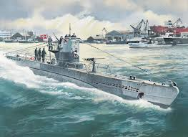
Battle of the Atlantic
Groups of up to 30 German subs (called wolfpacks) tried to isolate Great Britain by using subs to sink American convoys and merchant ships carrying needed supplies

Slide 14
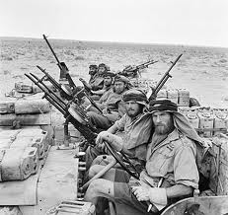
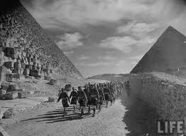
North Africa
British & U.S. forces together defeated thousands of Italians & Germans

Slide 15
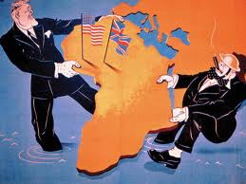
Casablanca, Morocco
FDR and Churchill meet again in N. Africa
They agree to continue to concentrate on winning in Europe before trying to win the war in the Pacific against the Japanese
Also agree they will only accept unconditional surrender of Germany, Italy and Japan

Slide 16
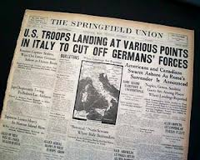
Invasion of Italy
American troops attack through N. Africa
Mussolini is overthrown, but the German troops fiercely resist
After many months and many casualties, the Americans finally capture Rome

Slide 17
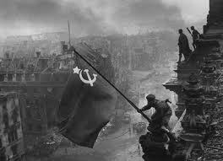
Broken Pact
After losing the Battle of Britain Hitler breaks his neutrality pact with Stalin and attacks the Soviet Union

Slide 18
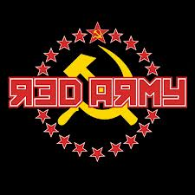
Red Army
Soviet soldiers (Red Army) were overwhelmed by the Germans because they were unprepared, poorly equipped, and had no support from the allies

Slide 19
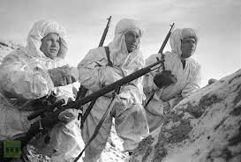
Battle of Stalingrad
Turning point in the war
During harsh Russian winter the Red Army finally defeats the Germans and begins pushing them back out of their territory

Slide 20
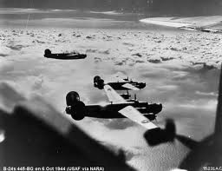
The Air War
American planes bombed Germany by day and British RAF bombed them by night to “soften” the country for the planned land invasion

Slide 21
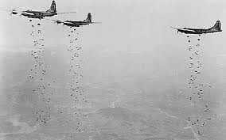
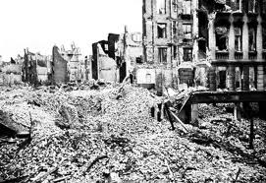
Carpet Bombing
Planes dropped a large number of bombs over a large area rather than specific targets
Led to heavy damage in cities and many civilian deaths

Slide 22
Preparation for Invasion
Massive buildup of troops in southern England as American, British, and Canadian forces were joined by Polish, Dutch, Belgian, and French troops
Germans strengthened their defenses along the French coastline in anticipation of an invasion
Germans added machine-gun emplacements, barbed wire fences, land and water mines, and underwater obstructions to prepare for the imminent attack

Slide 23
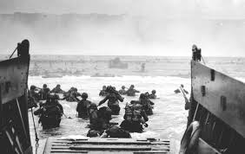
D-Day
The largest landing by sea in history (4,600 invasion craft and warships)
Allied forces crossed the English Channel and invaded German-controlled France
Dwight Eisenhower (future President) ran the operation
23,000 airborne British and American soldiers, in a nighttime daring maneuver, were dropped behind enemy lines

Slide 24
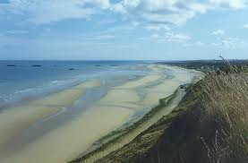
Normandy
The coast of France where the Allies landed and attacked (150,000 troops)
Thousands of Allied deaths, but a half a million men came ashore in one week

Slide 25
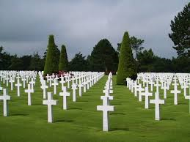
Omaha Beach
Code name for one of the landing sites
Fierce fighting led to 2,000 Allied casualties

Slide 26
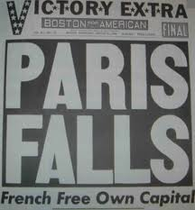
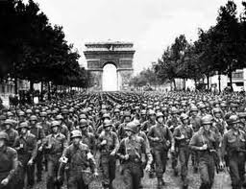
Liberated Europe
American, British, French and Canadian forces free Paris, Belgium, and Holland from German control

Slide 27
Battle of the Bulge
Fierce counterattack by the Germans in Belgium
Largest battle of the war – over 600,000 G.I.s
80,000 killed or wounded
Turning point in the war because most Nazi leaders realized the war was lost after this
Allies pushed into German homeland after this
Led by the war’s finest general, George S. Patton

Slide 28
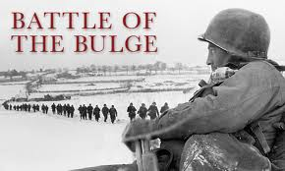
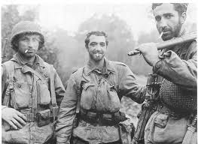
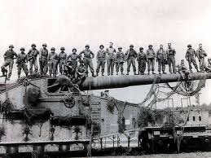

Slide 29
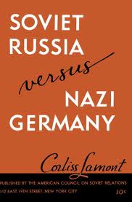
Germany vs. Soviet Union
Fighting from 1941-1945 was horrific
3 million German soldiers
27 million Soviet soldiers and civilians killed

Slide 30
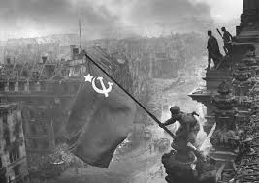
Final Outcome
Soviets captured the German capital of Berlin
Even though it had already been bombed out by the Allied planes, it was a matter of pride

Slide 31
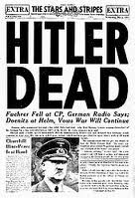
Fate of Hitler & Germany?
On May 1, 1945 Hitler commits suicide rather than surrender
May 8th Germany surrenders despite Hitler’s command to fight to the death

Slide 32
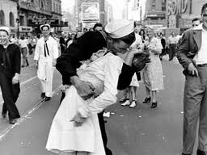
V-E Day
Victory in Europe Day when soldiers and civilians celebrated the end of the war in Europe
War wasn’t over yet – still had to defeat Japan

Slide 33
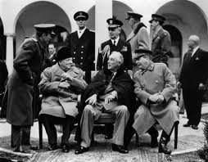
Yalta Conference
Meeting between FDR, Churchill and Stalin in city in Soviet Union near the Black Sea
Discussed the plan for the post-war world

Slide 34
What was decided?
Split Germany into 4 zones controlled by each of the Allies
Soviets were supposed to allow free elections in the zone they controlled (since they were totalitarian) – it didn’t happen
Soviets end up dominating Eastern Europe

