Slide 1
Chapter 14 – Section 3
The War in the Pacific

Slide 2
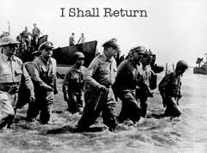
Philippines
American forces fighting under General Douglas MacArthur in the Philippines were attacked by the Japanese – FDR realized situation was hopeless so ordered MacArthur to escape to Australia - he promised his soldiers he’d be back
The holdouts hid out in rock tunnels
Finally, running low on ammo and food 11,000 soldiers surrendered

Slide 3
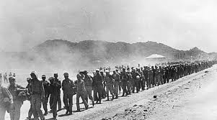
Bataan Death March
Japanese considered it dishonorable to surrender
Code of the samurai said it was better to kill yourself (bushido)
Marched 60 miles to prison camps
Many executed by guards when they couldn’t keep up – at least 10,000 died during the 6-12 day march due to abuse and starvation

Slide 4
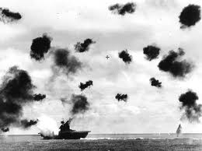
Battle of the Coral Sea
Important because the American navy prevented the Japanese from attacking and invading Australia, though they suffered many losses

Slide 5
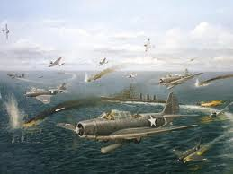
Battle of Midway
Midway Island near Hawaii
Fought entirely from the air
Sank 4 Japanese aircraft carriers
Important because Japan was unable to launch anymore offensive attacks after this

Slide 6
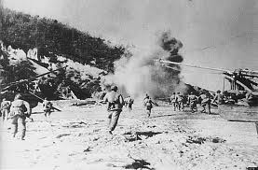
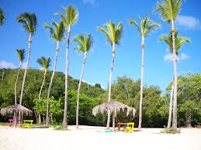
Island Hopping Strategy
We selectively attacked or bypassed specific enemy-held islands in the Pacific
Suffered heavy casualties, but captured islands near Japan which allowed planes to reach its cities with tons of explosives

Slide 7
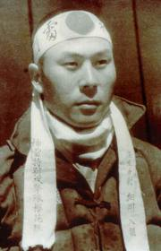
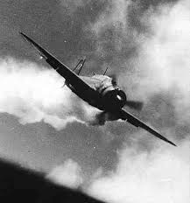
Kamikazes
Suicide planes used by the Japanese
Purposely crashed into targets strapped with massive bombs

Slide 8
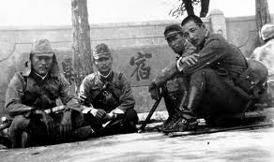
Japanese soldiers
Very few surrendered
To be killed was an honor – to be taken prisoner a disgrace
Therefore treated their prisoners of war as dishonored men
Of 5,000 defending one island only 17 were taken prisoner

Slide 9
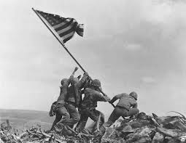
Battle of Iwo Jima
A heavily armed rocky volcanic island
Only 14 sq. miles, but took months to capture
Lost 25,000 soldiers – 27 medals of honor awarded for bravery – more than any other single battle

Slide 10
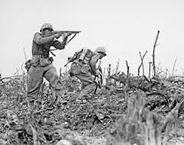
Battle of Okinawa
Fought on island near Japan
Important because was last obstacle to allied invasion of Japan
Massive invasion – 2nd only to D-Day in Normandy
50,000 Americans killed – costliest battle of the war in the Pacific
After this victory it opened the way for the invasion of Japan

Slide 11
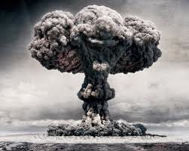
Albert Einstein
Wrote a letter to FDR in August of 1939 telling him that an incredibly powerful new type of bomb could be built and that the Germans were probably already working on such a weapon

Slide 12
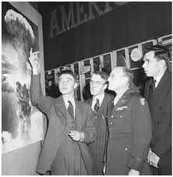
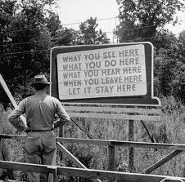
The Manhattan Project
The top secret plan to build this bomb before the Germans could first

Slide 13
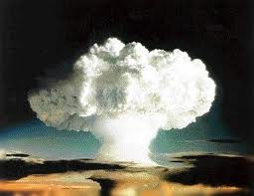
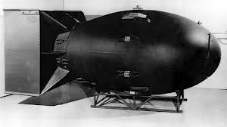
Robert Oppenheimer
Headed the building of the bomb
Tested it out in the desert of New Mexico
Atomic bomb blew a huge crater in the Earth and shattered windows 125 miles away

Slide 14
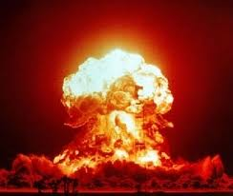
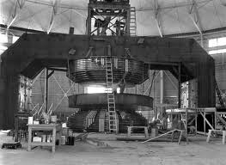
How do you build an atomic bomb?
By first splitting the nucleus of the uranium atom then creating a chain reaction in which the splitting of one atom would cause another atom to break apart
The energy released would cause a massive explosion

Slide 15
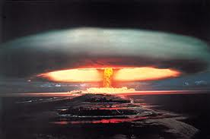
H-Bomb
Hydrogen bomb uses fusion (combining of atoms) rather than fission (splitting of atoms) to release energy
About 1,000 X more powerful

Slide 16
5 other options to dropping “the bomb” on Japan
Massive land invasion
Naval blockade
Demonstration on a deserted island to show its awesome power
Continued conventional bombing
Don’t insist on unconditional surrender

Slide 17
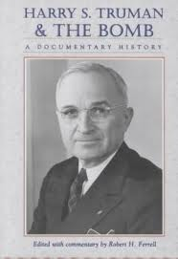
Final Decision
Even though many scientists who worked on it didn’t think the A-bomb should be used, President Truman (who had only taken over for FDR 3 months earlier after he suddenly died in April 1945) made the decision to use it
After heavy American casualties at Iwo Jima and Okinawa did not want to see thousands more likely killed during an invasion of Japan
“You should do your weeping at Pearl Harbor” Truman quoted as saying in 1963

Slide 18
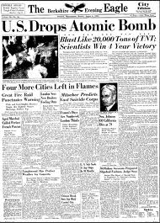
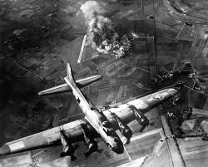
Hiroshima
U.S. dropped an atomic bomb – code named “Little Boy” on Hiroshima, Japan on Aug.6 1945
A single B29 bomber dropped it
3/5 of a second the city was gone

Slide 19
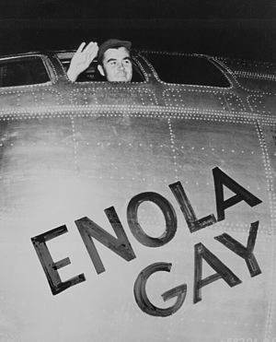
Enola Gay
Plane that dropped the atomic bomb

Slide 20
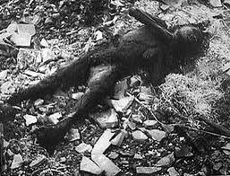
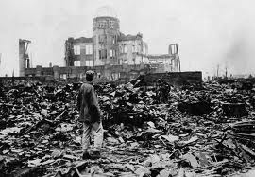
Killed 140,000 on the spot or a few months later from the horrible burns or radiation
10,000 were never found
70,000 injured or disfigured
90% of buildings were flattened

Slide 21
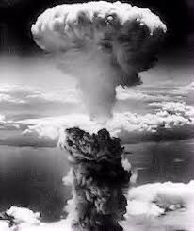
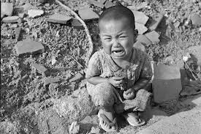
3 Days Later
Dropped a 2nd bomb called “Fat Man” on city of Nagasaki producing similar devastation & death
Skin burned right off people’s bodies
Was it justified?

Slide 22
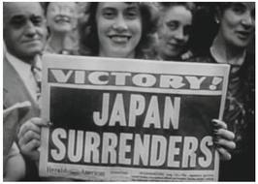
V-J Day
Japanese people are stunned by what has happened and surrender the next day
V-J Day – Victory in Japan Day is celebrated in America
Official surrender signed aboard the U.S.S. Missouri in Tokyo Bay on Sept. 2
War is finally over

Slide 23
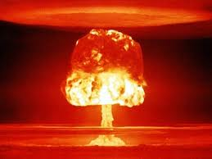
A-Bomb Essay
Was the use of the Atomic bomb to end WWII justified? Write a ½ - 1 page argument either for or against using this powerful bomb.

