Slide 1
Chapter 15 – Section 1
The Shift to Wartime Production

Slide 2
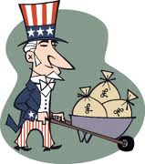
End of the Depression
The Allies’ (France & Great Britain) factories had been destroyed by Germany
By supplying them with goods that were mass produced in the U.S. it bolstered our economy

Slide 3
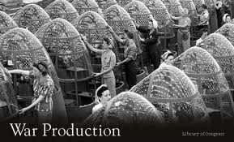
Office of War Mobilization (OWM)
Agency set up by FDR to coordinate the war effort at home
Stopped making consumer goods like cars and lawn mowers and instead made supplies for the war
OWM decided what materials were needed

Slide 4
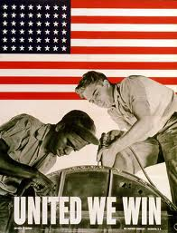
“Assistant President”
Head of the OWM was called this because while FDR ran the war, he basically ran the country saying what people could and couldn’t buy or use

Slide 5
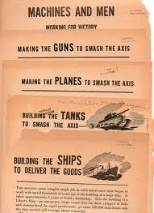
Wartime Production
Examples
Typewriter plants made machine guns
Shirt factories made mosquito netting
Ford car factories made bombers/planes
Very few people were allowed to buy cars – only those who really needed them (like rural doctors)

Slide 6
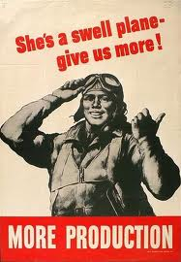
Lots of Military Supplies
300,000 airplanes
80,000 landing craft
100,000 tanks & armored cars
6 million rifles & machine guns
41 billion rounds of ammo
5,600 Liberty ships

Slide 7
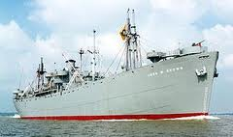
“Liberty Ships”
Used to carry supplies or troops
Ships built for the war using assembly line techniques to mass produce them instead of building one from the bottom up

Slide 8
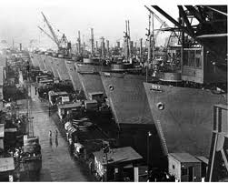
Built different sections in different parts of the shipyard
Huge cranes moved them and then welded together
Could build in 46 days rather than 150 (set record in 4 days!)

Slide 9
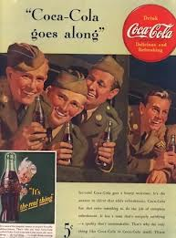
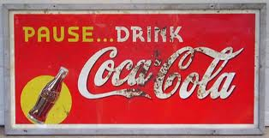
Pride & Patriotism
Besides just making money, companies like Coca-Cola wanted to “get a bottle of Coca-Cola to every man in uniform wherever he is and whatever it costs”
Produced an army of consumers after the war who had enjoyed it while in uniform

Slide 10
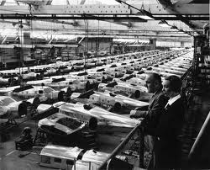
Unemployment & Wages
Unemployment dropped dramatically to 2% by 1945
Pay went up 27% in just 3 years

Slide 11
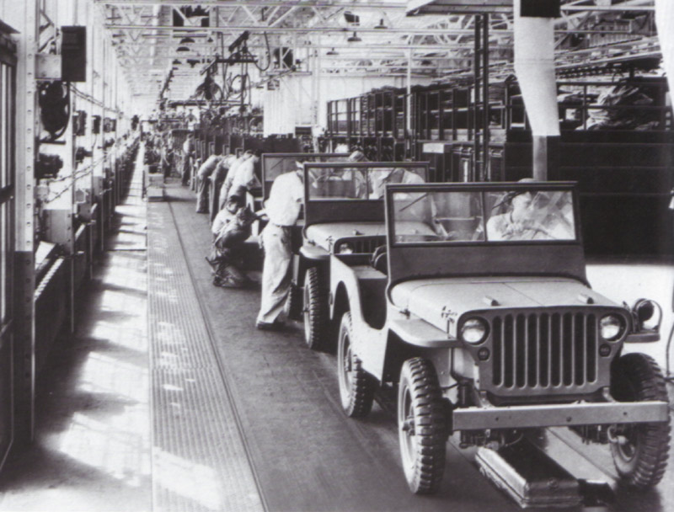

Slide 12
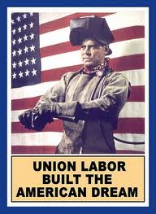
Unions & Owners
Unions and business owners agreed not to strike or have lockouts (keeping employees out to avoid meeting their demands)
Didn’t last b/c profits for companies got bigger, but wages stayed the same

Slide 13
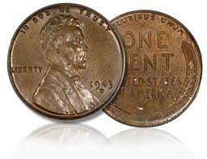
Cost of the War?
$321 billion – 10 X more than WWI
Paid for by raising taxes on income and consumer goods for half of it
Borrowed the other half

Slide 14
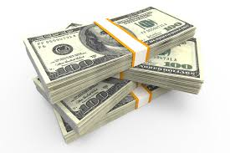
Deficit Spending
Govt. spending of borrowed money
Turned the economy around overnight, but created a huge national debt that caused economic problems later

Slide 15
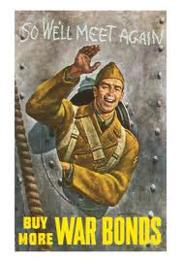
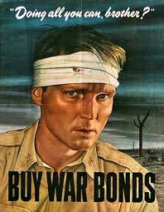
War Bonds
Government savings bonds bought by individuals to finance the war
Advertised by movie stars and war heroes

Slide 16
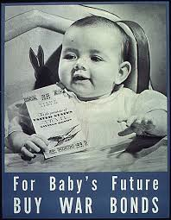
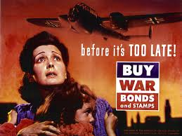

Slide 17
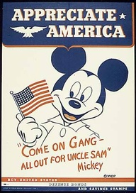
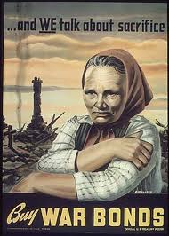
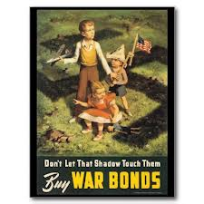
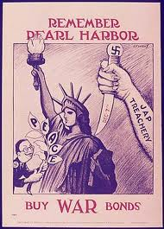
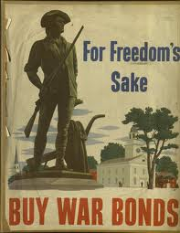

Slide 18
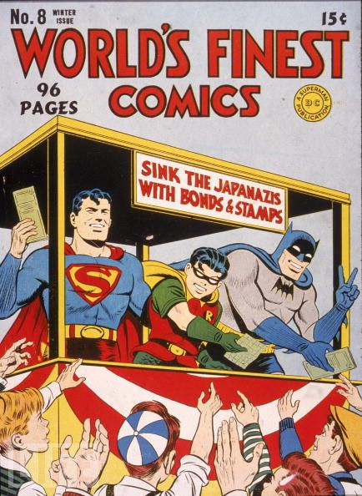

Slide 19
Create a War Bonds Poster
You have been hired by the government to design a poster to help sell war bonds.
Use an image and phrase that you think will help persuade the American people to invest in these bonds to help finance the war.
The message should be simple yet powerful. (and appropriate!)

