Slide 1
Chapter 15 – Sect.2
Daily Life on the Homefront

Slide 2
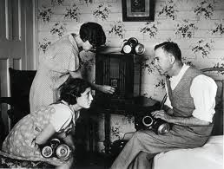
Daily Life Affected
Nearly everyone had a relative or friend in the military and so closely followed the news on the radio
Many soldiers’ wives and kids moved in with relatives
Many families had to move to take defense jobs

Slide 3
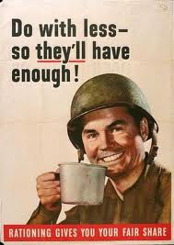
More $ but still can’t buy stuff
Couldn’t buy things like cars and home appliances because of shortages and rationing
Could only buy small amounts so they could conserve for the war effort

Slide 4
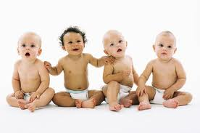
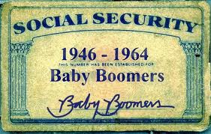
Baby Boom
Birthrate doubled from the 1930’s
Before and especially after the war
People were more optimistic

Slide 5
Spending $
People instead spent their money on books and movies
Paperback books made bestsellers more affordable
Carried “pocketbooks” with them into combat

Slide 6
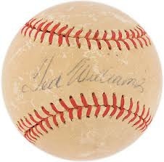
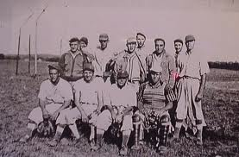
Baseball
4,000 of the 5,700 major & minor league players were in the military
Put out ads in newspapers to recruit players
People still flocked to games

Slide 7
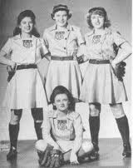
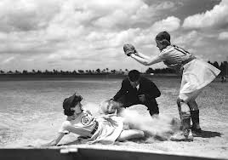
All-American Girls’ Baseball League
A professional baseball league started during the war
Was sexist – women had to attend charm school and wear impractical skirt uniforms

Slide 8
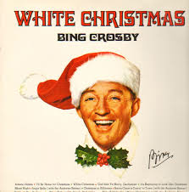
Music
Songs of hope & patriotism were popular during the war like “Praise the Lord and Pass the Ammunition”
Ballads about longing for loved ones
“White Christmas” by Bing Crosby was a favorite Christmas tune of the troops overseas

Slide 9
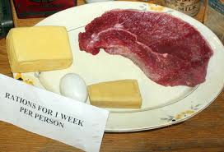
Consumer Items Unavailable
During the duration of the war supplies like metal, rubber, and nylon were needed for military use
The same went for food

Slide 10
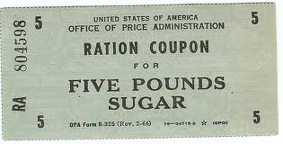
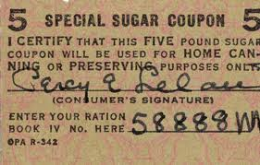
Imported Goods
Imported goods like sugar, tropical fruits, and coffee were in short supply because trade routes were cut off to those places during the war
the Philippines was the source of most of our sugar and was cut off when it fell to the Japanese

Slide 11
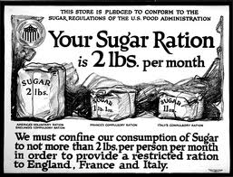
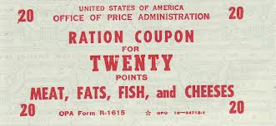
Inflation
In order to prevent inflation (price increases) resulting from shortages, the govt. froze prices on certain items and began to ration (limit) scarce items

Slide 12
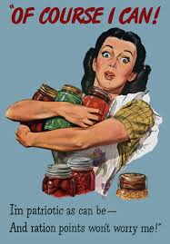
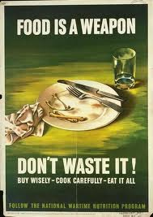
Nothing Wasted!

Slide 13
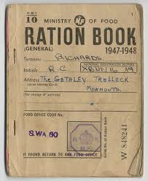
Ration Books
Consumers were given coupon books worth a certain # of points that they could use for things like coffee, meat, butter, and shoes
Each item was assigned a point value
Once you used up your points you had to wait for your next coupon book or trade coupons with your neighbors
Trade a sugar coupon for a bread coupon

Slide 14
Gas Rationing
Gas for cars rationed too on the basis of need
Signs read “Is this trip necessary?”

Slide 15
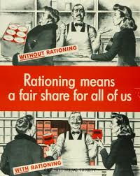
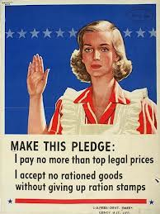
Office of War Information
Worked with magazines, radio, and advertisers to create patriotic posters and ads
A lot of propaganda to boost morale while people were being asked to make sacrifices

Slide 16
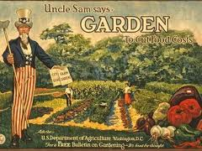
Victory Gardens
Home gardens planted by people in suburbs and cities to make up for the farm produce sent to feed the soldiers
Produced 1/3 of country’s vegetables by 1943

Slide 17
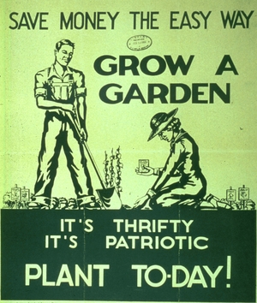

Slide 19
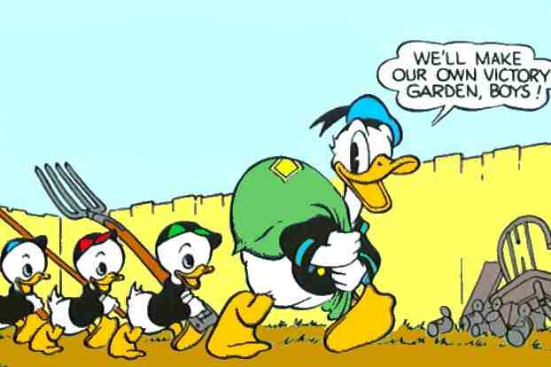

Slide 20
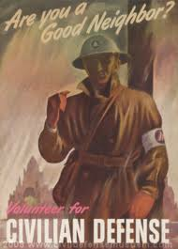
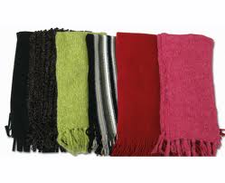
Preparation for an Attack
Drew shades for nighttime “blackouts” in case of a bombing raid
Men too old for army joined the Civilian Defense and tested air-raid sirens
Women knit scarves and socks or rolled bandages for the Red Cross

Slide 21
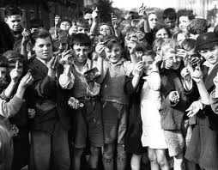
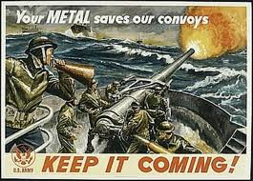
Children Helping
Even kids got involved in the war effort by collecting recycled metal, paper, and tires
Collected tin cans, pots & pans, razor blades, old shovels, even old lipstick tubes
Glycerin from kitchen fats saved to make powder for bullets or shells

Slide 22
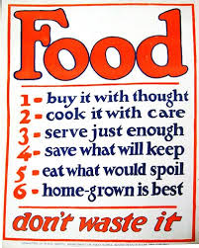
War Slogans
“Play Your Part”
“Conserve & Collect”
“Use it up, wear it out, make it do or do without”

Slide 23
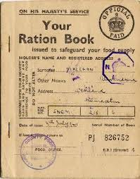
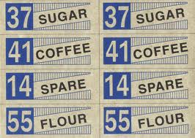
Assignment
Create a Ration Book
Think of 10 things you use on a regular basis
It can be food, electronics, anything you use daily
Assign a point value to each and then create 10 coupons for your book
You have a total of 500 Ration points to use

