Slide 1
Chapter 15 – Section 3
Women During the War

Slide 2
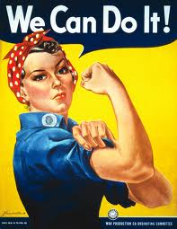
Rosie the Riveter
A fictional character from a song who goes to work in a defense plant while her man is away at war
Used by the Govt. to recruit women to the work force during the war
She represents patriotism and doing your part to help the war effort

Slide 3
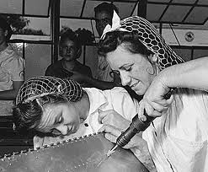
Married Women
Before the war most disapproved of married women working
Seen as taking jobs away from men, especially during the Depression

Slide 4
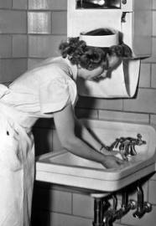
Before the War
Used to only have jobs as teachers, nurses, sales clerks or household servants
Received lower pay than men

Slide 5
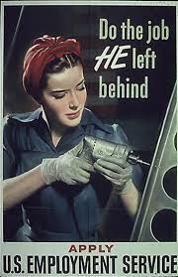
Better Paying Jobs
Manufacturing jobs that paid more $ opened up to women, particularly in the defense industries
Worked on airplanes and shipyards as riveters, steelworkers, and welders

Slide 6
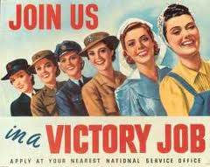
Dramatic Increase
5 million more older & married women worked outside the home during the war
The Office of War Information actively recruited them saying it was their “patriotic duty”

Slide 7
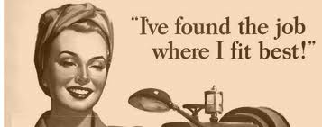
Why Women Enjoyed working
Earned more $ to pay off debts from Depression
More interesting & challenging than staying at home
Patriotic reasons – helping “brings my sons home quicker”

Slide 8
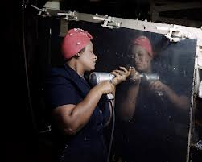
African American Women
Unlike white women, many already had to work
Mostly as house servants
Fought discrimination (through lawsuits and protests) to get jobs in factories like white women during the war

Slide 9
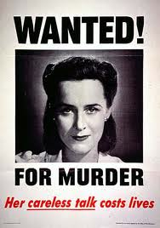
Challenges
Managers often treated them unfairly (could be fired for “socializing”)
Daycare was limited – left kids with relatives
Received less pay for same work as men
Didn’t advance quickly because had less seniority since they hadn’t worked before

Slide 10
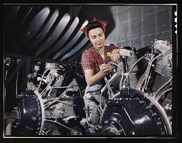
Back to the Kitchen
Govt. assumed women would leave their jobs when the war ended and things would be just like they used to be
Many did not want to – it felt good to do something besides just “cook a meal”

Slide 11
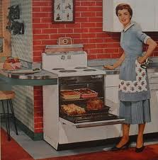
Returning Servicemen
Expected to get their jobs back
Wanted the kind of family life they had known before the war with a wife “in the kitchen”

Slide 12
Assignment
Imagine you are a married woman who has been working in a factory during the war.
Write a ½ to 1 page letter to a relative explaining what your experience has been like and how you feel about going back to “your old life” now that the war is over

