Slide 1
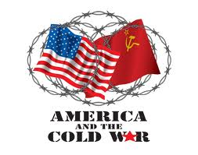
The Cold War

Slide 2
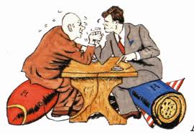
The War that wasn’t really a War
The Cold War was a 40 year postwar strategic & political “battle” between the philosophies of democracy & communism
No bullets were ever fired, but rather a lasting, state of hostility toward one another

Slide 3
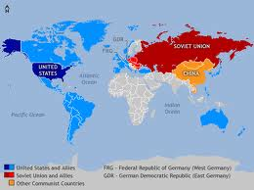
Who was this “war” between?
American and other Western democracies (like France and Gr. Britain) vs. the Soviet Union and the Eastern European nations that the Red Army occupied (Poland, Czechoslovakia, East Germany)

Slide 4
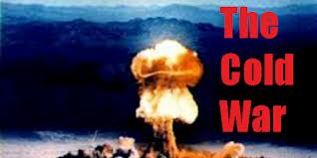
What was the big fear?
That the Cold War would lead to WWIII

Slide 5
The United Nations (UN)
A world organization created after WWII to keep peace and prevent another world war

Slide 6
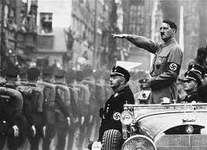
What to do with Germany now that the war was over
The United States and the West wanted to rebuild a stable Germany
The Soviet Union wanted revenge and total control over Germany since they had suffered so much loss (27 mill.)
They didn’t want to ever fear being invaded by them again

Slide 7
The Marshall Plan
A plan to rebuild the economies of Europe
To be funded by the U.S.
16 Western European nations participated - the Soviets and their satellite nations ( countries they controlled) did not

Slide 8
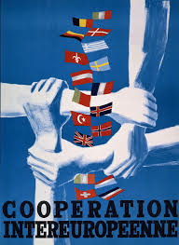
Why would we want to pour $13 billion into Europe?
Helping the economies of the European countries would help spread democracy
If we did not then totalitarian leaders (like Hitler or Mussolini) might rush in to fill the void

Slide 9
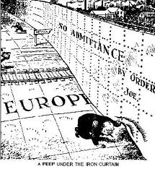
The “Iron Curtain”
Churchill used this phrase when speaking of the Soviet Union’s intentional total cutting off of any contact between the communist countries of Eastern Europe and the democratic countries of Western Europe and the U.S.

Slide 10
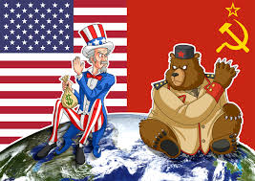
The “Truman Doctrine”
President Truman’s threat that the U.S. would act to halt the spread of communism wherever in the world it threatened democracy

Slide 11
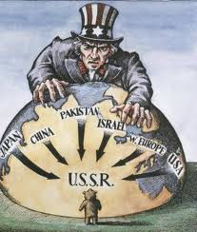
Containment
The U.S.’s policy of combating the spread of communism by containing it whenever and wherever it tried to spread

Slide 12
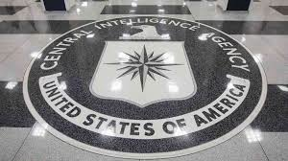
National Security Act of 1947
Created the Department of Defense
Created the CIA (Central Intelligence Agency)

Slide 13
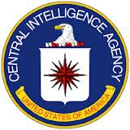
Mission of the CIA
To secretly gather info. about what was going on in other countries, particularly the Soviet Union
Controversial because they often did things that neither the President nor Congress knew about or approved of
Some feared it would be like a secret police in totalitarian govt.’s (like Hitler’s gestapo)

