Slide 1
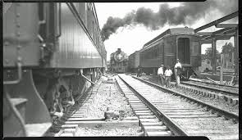
Birth of the “New South”
Chapter 3 – Section 3

Slide 2
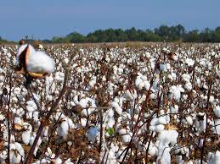
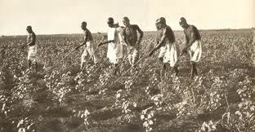
Plantations after the war
Was hard for planters to find people willing to work for them (b/c picking cotton in the hot sun felt like slavery to newly freed African Americans)
Could find better, higher paying jobs like railroads ($2/day vs. 50 cents – women only made 6 cents)

Slide 3
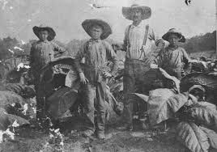
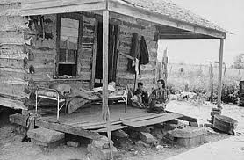
Sharecropping
Farming arrangement in which a family was paid w/ a share of the crop at harvest time
Unfair b/c some were evicted w/out pay after harvest or charged for housing and other expenses (ending up in debt at end of year)
Can’t pay it so trapped on the plantation

Slide 4
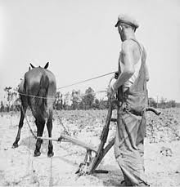
Tenant farming
Similar, but better
Also didn’t own the land, but rented it like an apartment
Your own boss – chose what to grow, etc.
Higher social status than sharecroppers

Slide 5
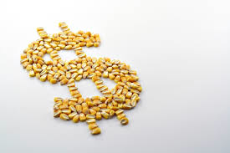
Changes in the Economy in the South during Reconstruction
Change in labor fore (40% white vs. 90% black before)
Cash crops not food crops (cotton, tobacco, sugar cane – had to import food)

Slide 6
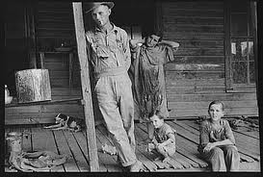
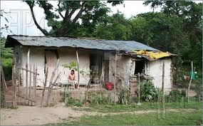
Economic changes cont.
Cycle of debt - rural poverty among both blacks and whites (only 1 in 20 blacks owned land 10 years later)
Rise of merchants (new class of wealthy southerners)

Slide 7
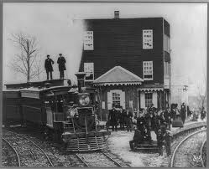
Railroads
Rebuilding and addition of new railroads allowed small towns to turn into cities (Atlanta, Richmond, Nashville, etc.)

Slide 8
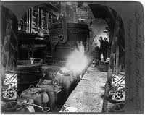
Still didn’t rival the North
Industrial growth in South didn’t make finished goods like furniture
Early, less profitable stages of production, sent North to be finished and sold

Slide 9
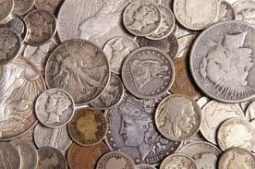
“Gospel of Prosperity”
The strong belief that the growth of business would bring good times for everyone
This philosophy guided reconstruction efforts throughout the 1870’s

Slide 10
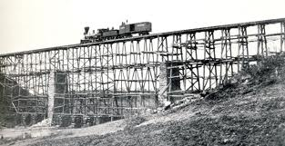
Importance of infrastructure
The public property and services that a society uses
The South had to be completely rebuilt
Created business opportunities
Roads, bridges, canals, railroads, telegraph lines

Slide 11
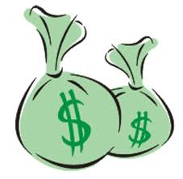
$$ for South
In addition to rebuilding infrastructure, $ was spent on services for citizens in South
i.e. public schools by 1872 (which North already had)

Slide 12
Source of $
Some Reconstruction $ came from Congress and private investors, but much of it came from heavy taxes on southerners (rich and poor)
Resentful about financial burden on top of having war debt already

Slide 13
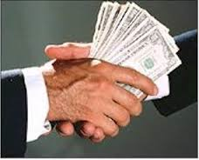
Corruption
Occurred in business and government
Worst fraud w/ railroads
Bribes paid to Senators – loans given – money spent on personal use and RR never build before claiming bankruptcy (today it is uncovered and prosecuted, but not back then)

Slide 14
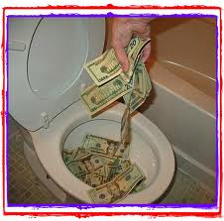
Bad Reputation
Reconstruction ended up with such a bad reputation b/c of the waste and corruption from all (black and white, Democrat and Republicans, North and South)

