Slide 1
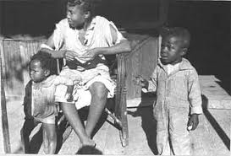
The End of Reconstruction
Chapter 3 – Section 4

Slide 2
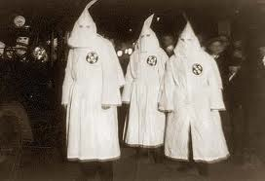
The KKK
Formed in 1866
Mostly ex-confederate officers and plantation owners who had been excluded from rejoining politics

Slide 3
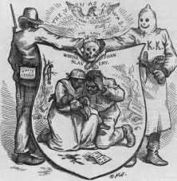
Beliefs and Goals of KKK
To defend the superiority of whites against the “inferior race”
To keep blacks in submissive role using fear and intimidation

Slide 4
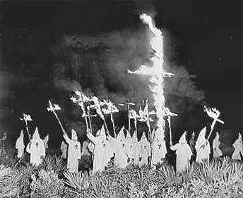
Tactics
KKK appeared hooded and robed, burning crosses in yards
Used torture, kidnapping and murders

Slide 5
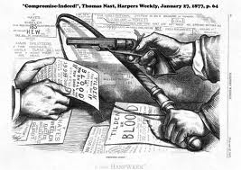
Federal Government’s Response
Passed laws essentially banning the KKK
Worked at first, but as troops withdrew from the South they reappeared

Slide 6
5 Reasons for end of Reconstruction by mid-1870’s
Heavy taxes & spending put South in deeper debt
It symbolized corruption, greed, and ineffective government
Southerners retook control of state govt. after federal troops withdrew and they blocked many Reconstruction policies

Slide 7
Continued…
Northerners didn’t fully support racial equality
Economic downturn in 1873 took focus away from equal rights

Slide 8
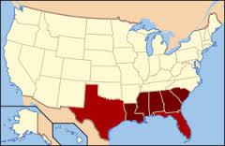
The Solid South
New group of southern democratic voters who reversed many reforms under Reconstruction

Slide 9
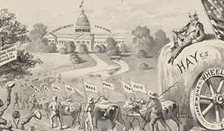
Compromise of 1877
Disputed election gave Presidency to Hayes (Republican) in exchange for all federal troops out of the South
Gave control of southern politics to democrats and essentially ended Reconstruction

Slide 10
5 Successes of Reconstruction
It restored the Union
It repaired the South
Helped economies of both North & South
Gave rights to African Americans
Created mandatory public schools in South

Slide 11
6 of its Failures
Blacks remained powerless and in cycle of poverty
Southern state govt.’s and KKK denied blacks right to vote
Racist attitudes continued in both North and South

Slide 12
Continued…
South’s economy slow to industrialize (and continued to lag behind the North)
Reconstruction left bitterness (of southerners to the Federal Govt.)
Didn’t address needs of other powerless groups (like women, farmers, and workers seeking safer conditions)

Slide 13
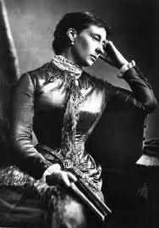
Angry Women
Many women stood with the Radical Republicans and supported abolitionists and rights for blacks, but weren’t given the same rights themselves

