Slide 1
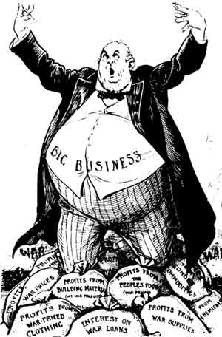
The Growth of Big Business
Chapter 4 – Section 2

Slide 2
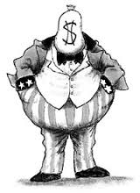
Robber Barons
Name often given to business leaders
4 Reasons (what does “robber” suggest?)
Drained the country of its natural resources
Persuaded politicians to interpret laws in their favor
Drove competitors to ruin
Paid workers meager wages & forced dangerous and unhealthy working conditions

Slide 3
Captains of Industry
Positive name for business leaders
3 Reasons
They increased the supply of goods that people wanted by building factories (appliances, etc.)
Created jobs in their factories (so people could earn $ to buy these goods)
Started and funded great museums, libraries, and universities (still around today)

Slide 4
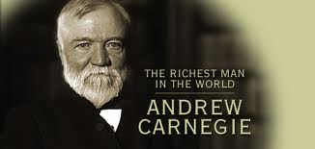
Andrew Carnegie
Self made millionaire who controlled the steel industry and drove others out of business by lowering his prices (sound familiar? Like Walmart)
Gave $ to open 3,000 libraries
Donated $350 million for art & research
(Was he good or bad? – helped the country, but at the price of poor work conditions and other companies)
(What city was he from? Think football….)

Slide 5
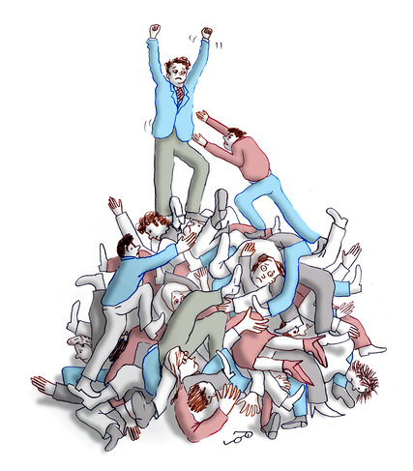
Social Darwinism
The idea that the “fittest survived” and would succeed in business
The government should not interfere (businesses not taxes and could treat workers as they wished)

Slide 6
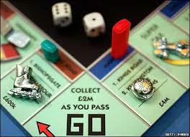
Monopoly
Complete control of a product or service
Bought out or drove competitors out of business
Can then charge whatever they want

Slide 7
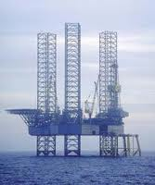
Cartel
Businesses that make the same product agree to limit the supply of their product, thus keeping prices high (today – oil, drug cartels)

Slide 8
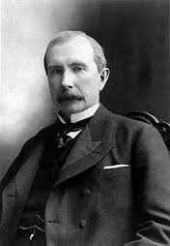
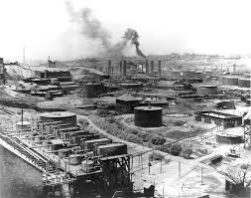
John D. Rockefeller
Oil tycoon who was able to undersell his competitors (like Walmart)
Got around anti-monopoly laws by creating a Standard Oil Trust

Slide 9
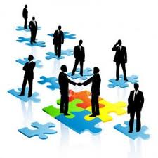
Trust
A group of separate companies (not one) placed under the control of a single managing board of trustees (controlled by Rockefeller)
Because companies didn’t officially merge, no laws were violated

Slide 10
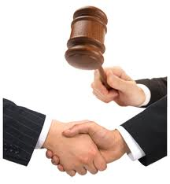
Anti-Monopoly laws
Laws like the Sherman Antitrust Act didn’t really work to break up monopolies because politicians refused to attack powerful business leaders and rarely enforced these laws
(Ironically, were used to break up labor unions b/c workers combined to “gain an advantage”)

Slide 11
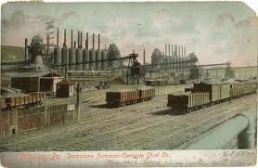
Vertical vs. Horizontal Consolidation
Horizontal is bringing together a bunch of companies in the same business (Rockefeller)
Vertical is gaining control of all aspects of the business (mining the iron, railroads that transport it, steel itself – like Carnegie did)

Slide 12
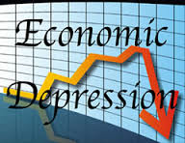
4- Year Depression
Companies made more goods than they could sell so…
Had to lower prices so…
Have to cut wages and lay off workers (to cover losses)
Severe shock to the economy (laid off workers don’t buy stuff)
Led to a 4-year depression starting in 1893

Slide 13
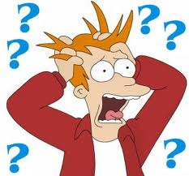
Panic
As a result investors fear that businesses in heavy debt might not be able to repay their loans
Investors rush to sell stock, stock prices fall, companies go bankrupt
(500 banks and 15,000 businesses failed)

Slide 14
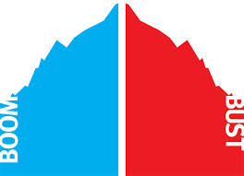
The “Business Cycle”
Period of “boom and bust”
Business expands, peaks, then declines, recession, recovery, and repeats
When it gets bad enough a recession becomes a depression which lasts longer and is harder to get out of (b/c no job creation = little consumer confidence = no hiring ~ it’s a cycle)

Slide 15
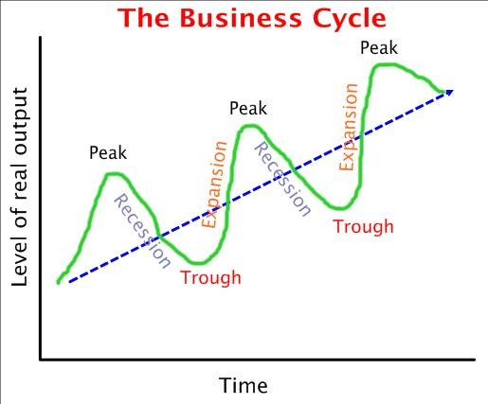

Slide 16
Homework
Draw 2 cartoons ~ one depicting business leaders as “robber barons” and the other as “captains of industry”.
Alternatively, write a 200 word essay that explains why business leaders were referred to by each of these names and which you think is more accurate.

