Slide 1
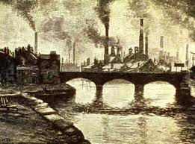
Chapter 4 – Section 3
Industrialization and Workers

Slide 2
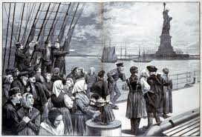
Contract Labor Act
Labor was scarce during the Civil War so this law encouraged immigration to the U.S.
Allowed employees to enter contracts w/ foreigners and pay the cost of passage in exchange for up to a year of work
(brought 14 million people to U.S. between 1860-1890)

Slide 3
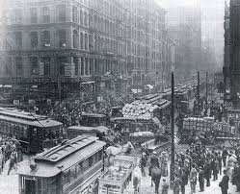
Move to the City
In the late 1800’s between 8-9 million people moved to the cities
Due to poor economic conditions on nation’s farms
Drought combined w/ low prices and competition from foreign wheat left farmers poor
Lot of jobs in factories and faster-paced life of the city was a draw for many

Slide 4
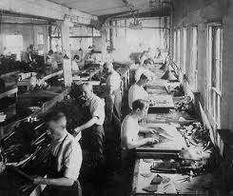
A “family affair”
Wages were so low that everyone in the family had to work in the factory to provide enough for the family

Slide 5
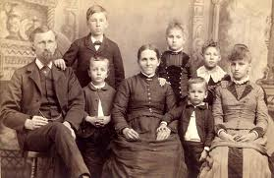
Typical Family
Kids usually left school by 12 or 13 to work
Girls went to factories, brothers might stay in school
Mom might take job and leave kids w/ relative or neighbor (no daycare)
If a parent died, kids as young as 6 or 7 had to work or go hungry

Slide 6
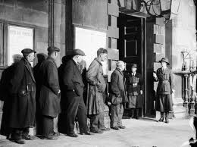
Unemployment
There was no unemployment insurance or welfare
Social Darwinism theory said poverty resulted from personal weakness (helping the unemployed would encourage “idleness”)
Private charities helped the neediest w/ food and clothing (but they had limited resources and couldn’t help everybody)

Slide 7
Typical work day/week
10 hours/day – 6 days/week
Sometimes 12 hours/day
Laws limiting workday weren’t enforced

Slide 8
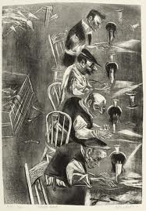
Piecework
Under this system you were paid per piece that you produced
Favored the young and strong (the old and less able suffered)

Slide 9
Increasing efficiency
Workers were negatively affected by this b/c it forced them to do more work at the same pay
Endangered their health and safety
Often led to layoffs w/ fewer people doing more work (today we outsource to China or India and have machines doing the work)

Slide 10
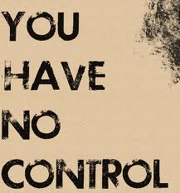
Different Routine
Unlike life on the farm, the routine of the factory was ruled by the clock
Told when to start, break and stop
On farm you labored at your own pace

Slide 11
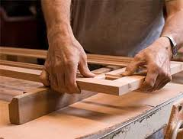
Worker and Product
The relationship between the worker and the product changed in the factory
Craftsmen once created a project from start to finish & performed a variety of tasks
In the factory you did one small task over and over

Slide 12
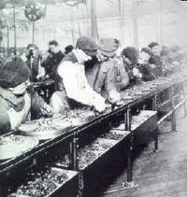
Division of labor
Divided production into separate tasks
This was good for owners, but bad for workers b/c while it made workers more efficient, it also took the joy out of the work (rarely saw the finished product)

Slide 13
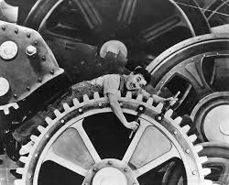
“Hands”
The workers, known as hands, were viewed by the factory owners as interchangeable parts (very impersonal)
Like parts of a machine (get what they can out of you and then get rid of you)

Slide 14
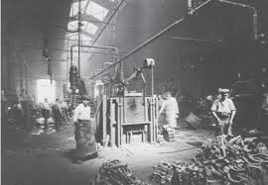
Harsh Working Conditions
Strict discipline (fired or fined for being late, answering back, talking on the job, etc.)
Boring work
Deafening noise of machines
Poor ventilation and lighting
Frequent accidents and deaths (due to faulty equipment and poor training ~ 675 deaths/week compared to 120 today)

Slide 15
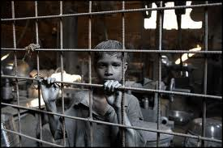
So Why Stay?
It was still better pay and opportunity than most people could find elsewhere

Slide 16
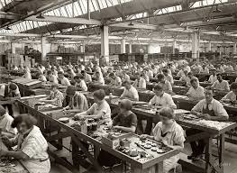
No advancement for women
Women had little chance of advancing in factory work b/c the better jobs were thought of as “jobs for men”

Slide 17
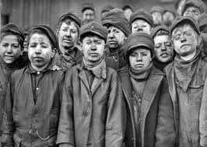
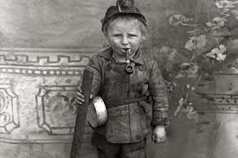
Extra Dangerous for Children
Working in factories and children was particularly dangerous and unhealthy for children b/c they were still growing
Stunted their bodies and minds
(later laws would begin to end child labor)

Slide 18
Homework
In a 200-250 word essay, explain what your day-to-day life is like as a typical factory worker in the late 1800’s. Explain who else in your family works and why.

