Slide 1
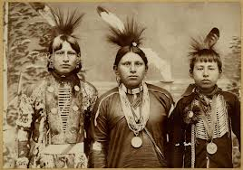
Chapter 5 ~ Section 2
Conflict with Native Americans

Slide 2
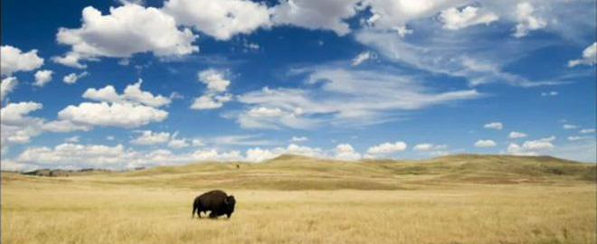
View of the West
For generations, many Americans viewed it as a wild, empty, big space, freely available to those brave enough to tame it.

Slide 3
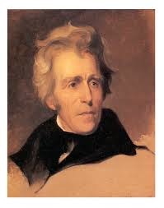
President Jackson
In the 1830’s rounded up the Cherokee and crowded them into “Indian Territory” in present day Oklahoma. ( Trail of Tears 1838 – 1839 )

Slide 4
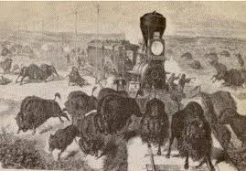
Impact of Railroads
Settlers moved into towns along RRs and pushed Native Americans out.

Slide 5
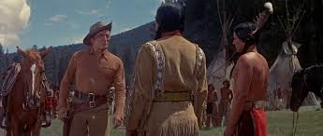
Right to take their land
White settlers felt justified taking Indian lands because they believed they had a greater right to it (because they “Improved” it by producing more food and wealth than Native Americans did)

Slide 6
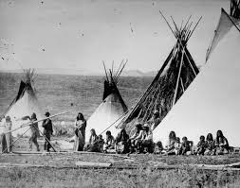
Reaction
Indian peoples saw white settlers as invaders.
Wanted to continue to live off of their land free of outside influence.

Slide 7
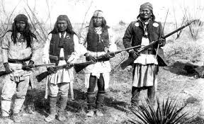
Response
Some Native Americans tried to be friendly
Others resisted this invasion violently

Slide 8
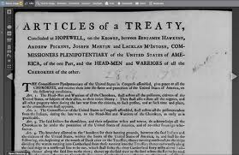
Treaties
Many tribes signed treaties selling their lands because they realized they were outgunned and outnumbered.

Slide 9
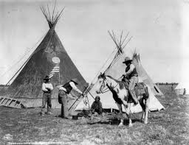
Reservations
Federal lands set aside for Native Americans.
Were forced to move onto the worst land around ( Bad soil, etc. ) that settlers didn’t want.

Slide 10
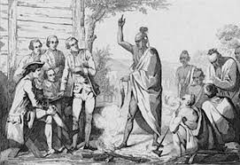
Failed Treaties
Treaties often fell apart because they were not signed with full approval of the affected Indian groups.
They also had different concepts of owning land. (Indians didn’t understand that they wouldn’t be allowed to continue to use it)

Slide 11
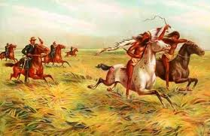
Broken Treaties
This often led to acts of violence on both sides which set off cycles of revenge and counter-revenge.

Slide 12
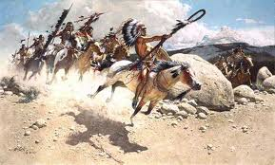
Navajo & Apache Wars
Wars in the Southwest with these tribes lasted 25 years (Started in 1861)
These tribes were finally all forced onto reservations, starved, or were killed in battle.

Slide 13
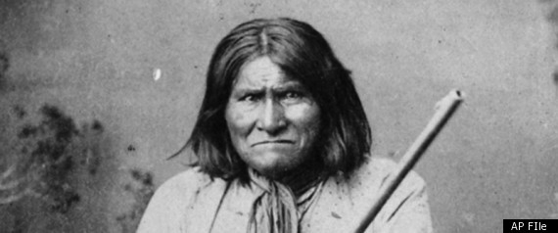
Geronimo
Apache leader who led group of rebel warriors continuing raids on whites until he surrendered (In 1886)

Slide 14
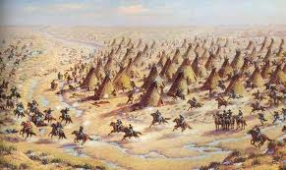
Cheyenne Indians
Were wiped out in the 1860’s and 70’s.
Peaceful village of 450 men, women, and children were massacred. (Surrendered their land and moved to reservations the following year)

Slide 15
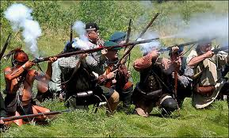
Sioux
The first Sioux war was triggered by the government building a road through their lands.
In response the Sioux ambushed and slaughtered more than 80 soldiers. (In 1866)

Slide 16
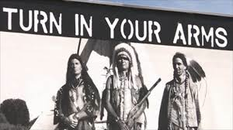
2nd Sioux War
Began when the government allowed miners to go into the Black Hills ( modern day South Dakota ) in search of gold.
Chief Sitting Bull and the Sioux left their reservation.
General Custer was sent to find and round them up.

Slide 17
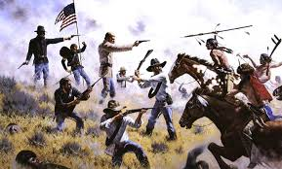
Battle of Little Big Horn
Custer’s force was surprised by a larger than expected force of Sioux at the Little Big Horn River ( In Montana )
Custer and 200 soldiers were killed.

Slide 18
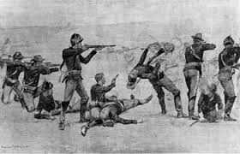
Massacre at Wounded Knee
Chief Sitting Bull’s followers were handing over weapons in surrender when someone fired a shot.
Soldiers opened fire killing 200 unarmed Sioux. ( Including 70 women and children )

Slide 19
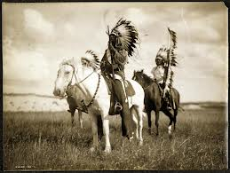
Indian Culture?
Indian culture virtually disappeared.

Slide 20
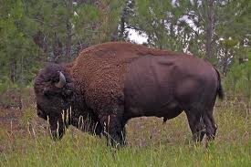
Buffalo (Tatanka)
Extremely important to the peoples of the Great Plains.
Relied on it for food, clothing, shelter, fuel, and tools.

Slide 21
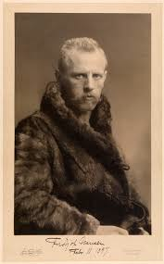
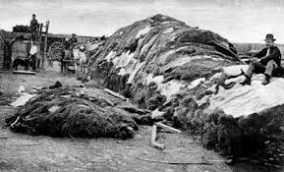
5 Reasons the Buffalo Nearly Disappeared
Hunted for food for RR workers.
To clear the range (so cattle could graze)
To satisfy demand for hides (craze back East)

Slide 22
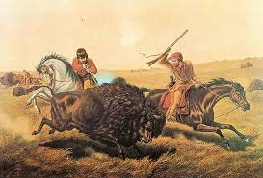
Buffalo cont.
For sport/fun.
To wipe out Plains peoples’ food supply (Encouraged by govt.)

Slide 23
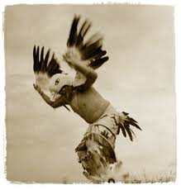
Banned Religions
Gov. made it a crime ( In 1884 ) for Indians to practice their religions.
Believed the Native Americans still needed to be “civilized” ( Thought their way of life was wrong. )
Christian Missionaries ran their schools and reservations.

Slide 24
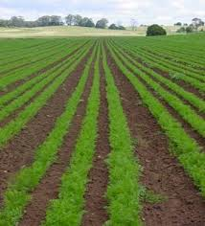
Dawes Act
A law that required them to farm individual plots of land.
Had no interest in, or experience, farming.
( They roamed the land, not contained to one spot or area )

Slide 25
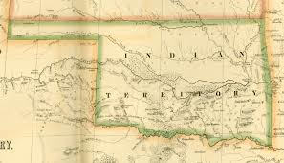
Indian Territory
A flood of settlers entered the territory they had been forced onto and became squatters

Slide 26
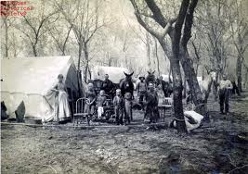
Boomers
Settlers who staked off claims ( with government approval ) in Indian territory after the Civil War.
( 10,000 in a few hours in Oklahoma City )

Slide 27
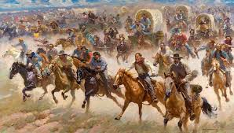
Sooners
People who snuck past the government to claim land early. ( Before a pistol was fired and everyone else rushed in )

Slide 28
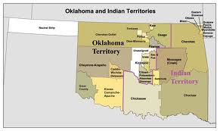
Oklahoma
Most of Indian Territory became the state of OK after settlers pressured Congress.

Slide 29
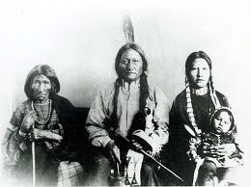
Homework
Write a 1 paged letter from the point of view of a Native American explaining what you see happening around you.

