Slide 1
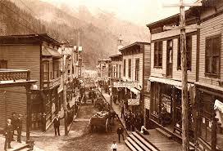
Chapter 5 Section 3
Farming, Mining, and Ranching.

Slide 2
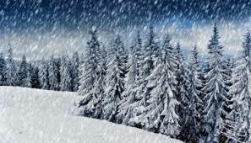
Not a Farmer’s Paradise.
Unpredictable rainfall and not enough.
Hot summers over 100 degrees.
Blizzards and bone-chilling cold winters.
Droughts and hot winds led to dust storms and prairie fires.
Grasshoppers and locusts ravaged crops.

Slide 3
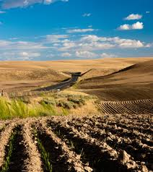
Dry Farming
Planting crops that don’t need much water and keep the fields free of weeds. ( Because of dry climates )

Slide 4
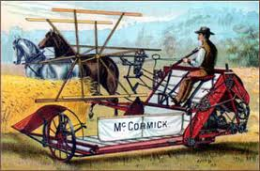
Change
In the late 1800’s machines helped save them time and effort. ( plowing, spreading grain, and husking corn )

Slide 5
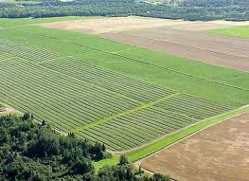
Agricultural Knowledge
New farming techniques such as crop rotation, hybridization, (Crossing of different plants to produce new varieties ) preservation of water and top soil.

Slide 6
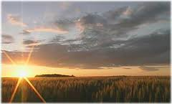
Bonanza Farms
Farms controlled by large businesses that specialize in single cash crops which they mass produce. (and sell at enormous profits for investors)

Slide 7
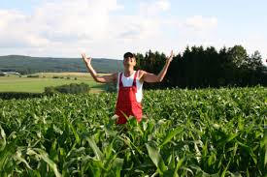
Problems
This sometimes led to supply rising faster than demand.
Extra supply leads to prices falling.
This led to farmers going into debt if they couldn’t pay off their machines. ( Designed for specific crops )
Many had bought more land than they could manage.

Slide 8
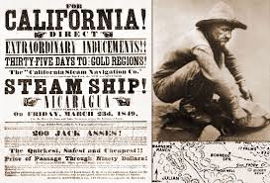
Gold
Gold and the lure of quick wealth drove people to California and Pikes Peak, Colorado.

Slide 9
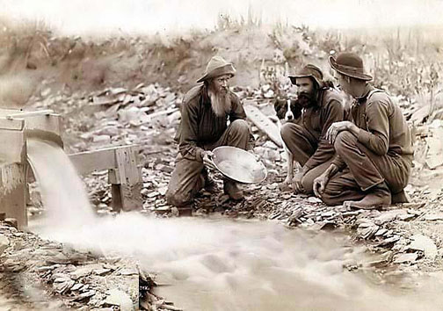
Miners
All different kinds of people ( Black, White, Former RR workers, even some women ) headed West in search of gold.

Slide 10
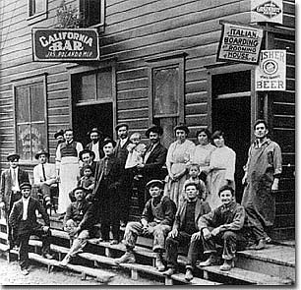
Mining Towns
Developed a reputation for gambling and drunkenness. (In actuality most mining towns settled quickly)

Slide 11
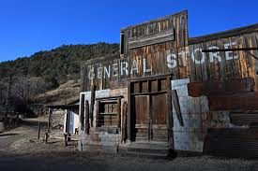
Ghost Towns
Many gold prospectors packed up quickly and left mining towns.
All of the easily gathered precious metals were quickly found ( The rest were buried deep in mines ).

Slide 12
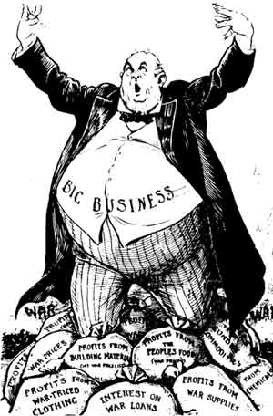
Large Corporations
The only ones who could afford the machinery, tunnels, and mine shafts required to reach these riches.
EVERYTHING turned to “Big Business”

Slide 13
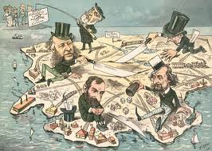
Big Business
Large companies that began taking over.
More cost effective and had resources that individuals did not.

Slide 14
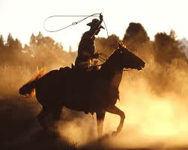
Cowboys
Settlers in Texas learned cattle ranching and how to be “Cowboys” from the Mexicans.
( Including dress, ranching, and equipment )

Slide 15
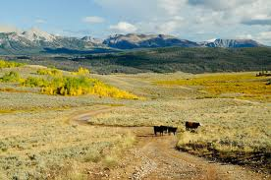
Open Range
Land was opened for grazing cattle by the removal of the Indians and the destruction of the buffalo.

Slide 16
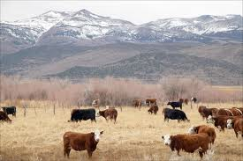
Profitable Business
Ranchers made good money because the high demand for beef in Eastern cities. ( $3 to $5 per head to raise, but sold for $30 to $50 per head in the cities)

Slide 17
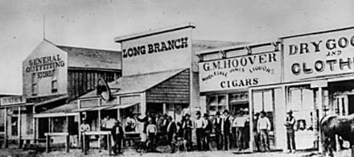
Cow Towns
Towns specifically built for receiving cattle until they were shipped out by railroad. (had cow pens to hold cattle)
Abilene and Dodge City, KS.
Cheyenne, WY.

Slide 18
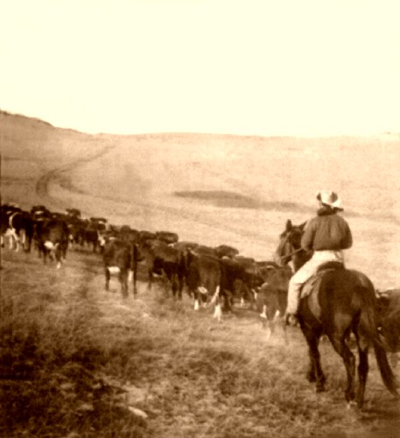
The “Long Drive”
Transporting of cattle from the ranges to the cow towns by cowboys.

Slide 19
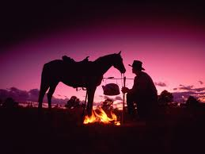
Difficult Cowboy Life
Rough, muddy trails
Pounding thunderstorms
Stampedes
Attacks by cattle thieves
18 hour days (in the saddle on constant alert)

Slide 20
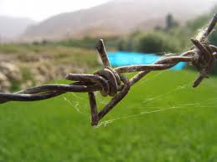
The End of the Cowboy
Invention of barbed wire.
Market overstocked with cattle.
Overgrazing. ( Damaging the prairie grasses )
Harsh winters killed cattle. ( 85% froze or starved between 1885 – 1887 )

