Slide 1
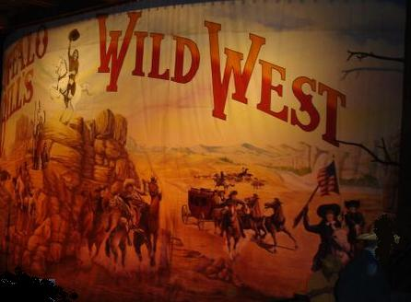
Chapter 5 Sections 4 & 5
Frontier Myths

Slide 2
youtube
( Play “Home on the Range” and “Don’t Fence me In“ – Support the nation’s most cherished images of itself )

Slide 3
Populism
A movement started by farmers and other working class people.
Demanded radical changes in Federal economic and social policies. (progressive income tax)

Slide 4
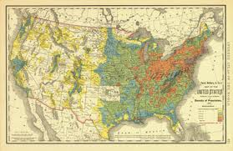
Fading frontier
By 1900 most of the frontier had been tamed and turned into states.

Slide 5
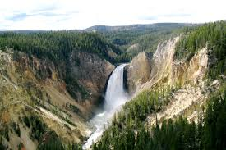
Yellowstone National park
The country’s first national park.
Created in Wyoming in 1872 to preserve Western lands.

Slide 6
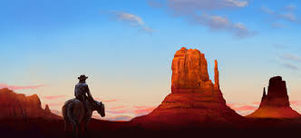
Adventurous spirit
The frontier had symbolized the individualistic, adventurous spirit of America.

Slide 7
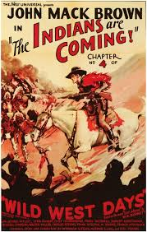
Myths of the “Wild West”
Destruction of the Native American culture and the contribution of immigrants from Japan and China is overlooked when glorifying the “Wild West’

Slide 8
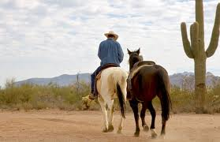
Land of opportunity?
Most settlers in the West struggled and often gave up and went back home.

Slide 9
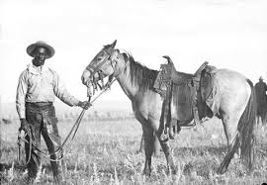
African Americans
Over 9000 went West to become Cowboys or Ranchers.
Thousands more served in the military.

Slide 10
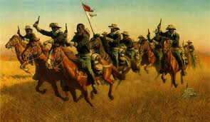
Buffalo Soldiers
African American soldiers serving in the U.S Army out West. ( Nicknamed this by Native Americans )

Slide 11
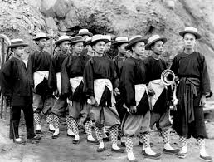
Asian Immigrants
Asians on the West Coast were isolated into separate neighborhoods and prohibited from owning land.

Slide 12
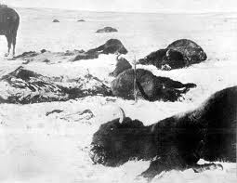
Destroying the Environment
Settling the West greatly affected the natural environment.
Treated natural resources like they were limitless.
Railroad tunnels destroyed mountains.
Huge mines scarred the land and leveled forests.
Over cultivation eroded fields.
Senseless slaughter nearly wiped out the buffalo.

Slide 13
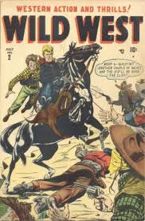
Romantic image
The false image of the American Cowboy was created by adventure novels about stage coach robberies and killings.

Slide 14
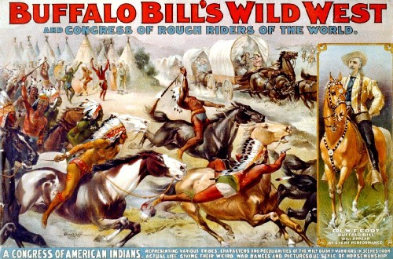
Buffalo Bill
William Cody ( A.K.A. Buffalo Bill ) helped create the myth of the “Wild West” with his shows.
“Wild West” shows were like a circus with rodeos, roping contests, and staged battles between the “Good” Army and the “Bad” Indians.

Slide 15
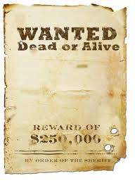
Stereotype
The stereotype of the “Wild West” character was that you had to be tough and “mean with a pistol” to survive.
The reality is that most were not.

Slide 16
Girl Scouts
Created in 1912 to “make girls tougher”. ( Boy Scouts were created in 1911 )

