Slide 1
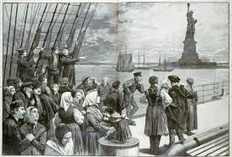
Chapter 6 Sections 1 & 2
Coming to America

Slide 2
The Gilded Age
Underneath a thin layer of prosperity was much poverty and corruption in the late 1800’s. (Gilded means covered with a thin layer of gold)

Slide 3
Laissez-Faire
A policy in which businesses operate without government regulation. (No rules or restrictions)
Benefits the rich company owners not the workers.

Slide 4
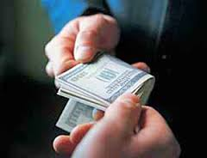
Bribes
Big businesses got what they wanted by bribing politicians. (Central Pacific RR budgeted $500,000 per year)

Slide 5
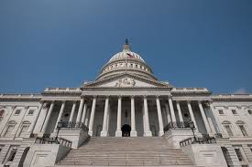
Spoils System
Elected officials appointed their friends and supporters to positions even when they were unqualified. (end up with dishonest people in government)

Slide 6
Why People Were on the Move
Crop failures and famine.
Shortage of land and jobs.
Rising taxes.
Religious and political persecution.

Slide 7
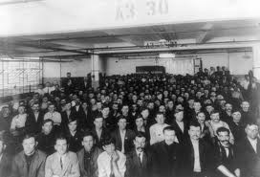
Population Explosion
Between 1865 and 1920 the population in America doubled. (from 31.5 million to over 60 million)

Slide 8
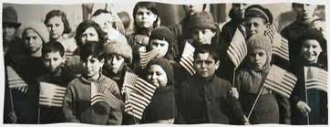
Stories About America
Immigrants heard that everyone could go to school.
Young men weren’t forced to serve long years in the military.
Citizens could freely take part in a democratic government.

Slide 9
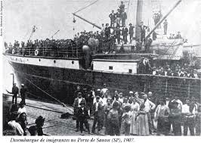
Journey Across the Atlantic
Steam-powered ships took 2 to 3 weeks.
(by 1900 only took 1 week)

Slide 10
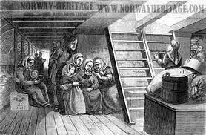
Steerage
Large open area beneath the ship’s deck where most immigrants traveled.
(couldn’t afford cabins)
Limited toilet facilities, no privacy, and poor food, but the fare was cheap.

Slide 11
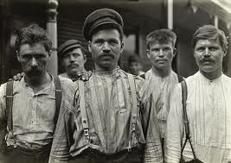
Birds of Passage
Young men who worked for several months or years and then returned home.

Slide 12
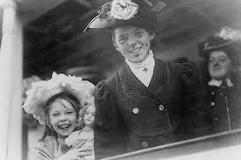
Where did most immigrants come from?
Between 1865 and 1890 most came from northern Europe. (Germany, England, and Ireland)
In the 1890’s most came from Southern (Italy and Greece) and Eastern (Russia and Poland) Europe.

Slide 13
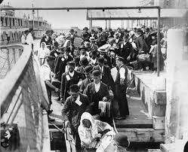
Busy Ports
Most immigrants came through Boston, Philadelphia, and Baltimore in the East.
Most Asians came through San Francisco and Seattle in the West.

Slide 14
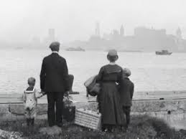
Ellis Island “The Golden Door”
A huge reception center for steerage passengers opened here in 1892.
70% of all immigrants came through New York City.

Slide 15
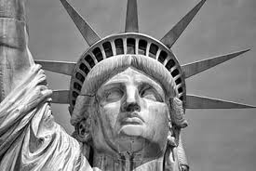
Statue of Liberty
Given to the United States as a gift from France (in 1886) and represented the U.S. as a place of refuge and hope.

Slide 16
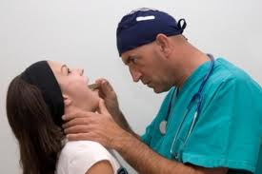
Requirements for Entry
Had to pass a physical exam (beginning in 1892) to make sure immigrants were not bringing any contagious diseases in.

Slide 17
Quarantine
Had to be placed in isolation for a time period to prevent the spread of diseases like Tuberculosis.

Slide 18
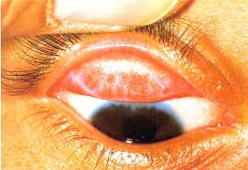
Trachoma
A contagious eye disease that causes blindness. ( Hardening of the lid )
You would be deported ( Sent back to your country ) if you had it.
( Read Quote on Page 213 )

Slide 19
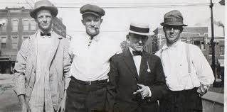
Irish
Half of all immigrants to NYC ( between 1847 and 1860 ) were from Ireland.
A great potato famine caused many to leave. (One million died from starvation)

Slide 20
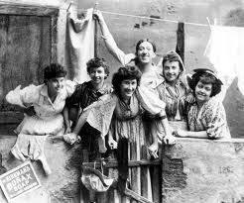
Newly Arrived Immigrants
Many tried to find relatives or friends who were already here.
Others were on their own.

Slide 21
Dangerous
Ports were often dangerous places because criminals hung out with fake offers of housing and jobs to new immigrants, but then stole money and baggage from the unwary.
( Pg. 215 Polish Immigrant story )

Slide 22
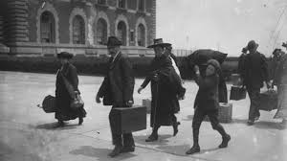
Where Did Immigrants Settle?
In communities already established by previous settlers from their country.
( Italians in NY, Irish in Boston, )
Only 2% went to the South.

Slide 23
Taken Advantage Of
There were very few jobs available so employers paid immigrants less. (women received only half of men’s pay)

Slide 24
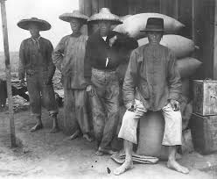
West Coast
Most immigrants who came through West Coast ports were from China and Japan.

Slide 25
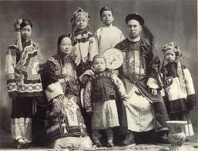
Didn’t fit in
Asian immigrants were often not accepted because they were culturally very different (appearance, food, and dress seemed very strange) from Americans and Europeans. (others were suspicious of and even hostile towards them)

Slide 26
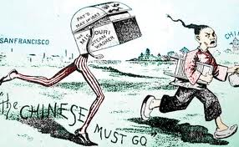
Inferior
Racists groups claimed that Asians were physically and mentally inferior.
Asians accepted lower wages which unions didn’t like.

Slide 27
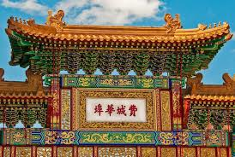
Chinatown
Chinese avoided this hostility by moving into Chinatown sections of cities. (like San Francisco)

Slide 28
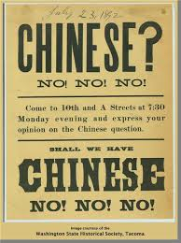
Chinese Exclusion Act
Prevented Chinese from entering the country. (in effect until 1943!)

Slide 29
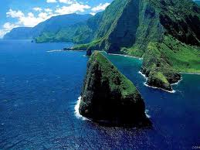
Hawaii
Many Japanese immigrants entered the country here to work on sugar plantations. (U.S. Obtained it in 1898)
Many Japanese settled in LA area.

Slide 30
Japanese
Many produced foods and vegetables in Southern CA for work.

Slide 31
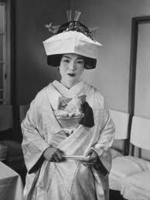
Picture Brides
Japanese women whose marriages had been arranged through the exchange of photographs across the Pacific Ocean.

Slide 32
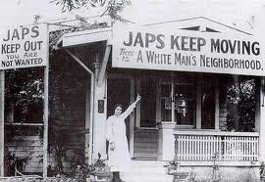
Segregation
Japanese, Chinese, and Korean school children were forced to attend separate schools in San Francisco. (in 1906)
(Take Eto story Pg. 215)

Slide 33
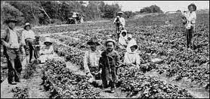
Webb Alien Land Law
Banned Asians from owning farm land.

Slide 34
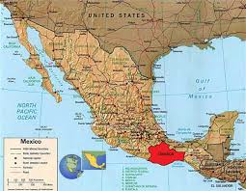
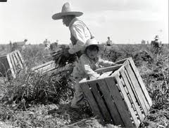
Mexicans
10% of Mexico’s population emigrated to the U.S. around WWI to work in mines and farms. (to produce materials for the war effort)

Slide 35
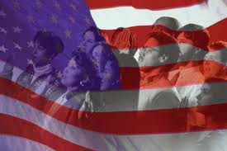
American Dream
Millions of immigrants just wanted simple comforts, to make a little money, and the chance for a better life.

Slide 36
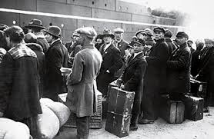
Homework Essay
Imagine you are an Asian or European immigrant coming to America. In 1 page explain why you left and what you hope to gain by leaving your homeland. Also, discuss the journey over here and what you encountered immediately upon arrival in this country.

