Slide 1
Chapter 6 Section 3
The Challenge of the cities

Slide 2
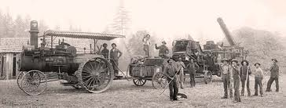
Decline in Farms
Between 1880 and 1910 the number of people living on farms fell from ¾ to ½ of the population. (new machines replaced the need for manual labor)

Slide 3
Move North
Many black Southerners moved to Northern cities to escape racial violence against them.
Also because crops were destroyed by bugs (Boil Weevil) and floods.

Slide 4
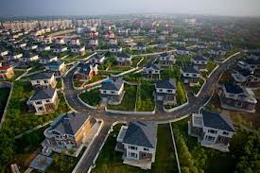
Suburbs
Residential communities surrounding the cities that those who could afford it lived in. (Fare for public horse-drawn carriage)

Slide 5
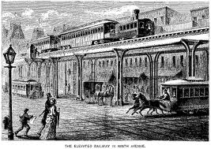
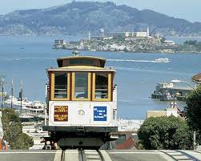
Transportation
New methods of transportation made commuting to the suburbs easier.
Elevated Trains (Above congested streets in New York -1868)
Cable Cars (San Francisco – 1873)

Slide 6
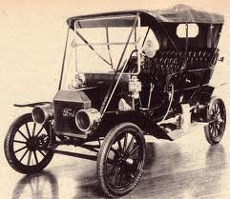
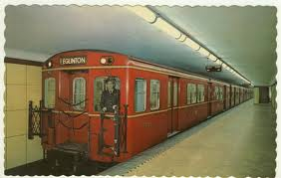
Electric Trolleys (Richmond, VA – 1888)
Subway Trains (Boston 1897)
Automobiles invented 1893 ( Mass produced in 1910’s)

Slide 7
Taller Buildings
Buildings got higher because they ran out of urban space (Before the Civil War no more than 5 stories)

Slide 8
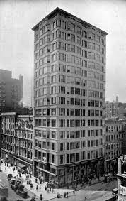
First Skyscraper
1885 in Chicago. (Insurance Company)
10 Stories high.
Iron and Steel Framework.
4 passenger elevators. (Invented in 1853)

Slide 9
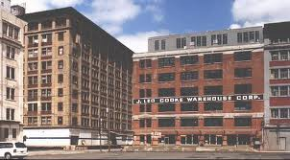
Expanding Cities
Specialized areas emerged within cities. ( Retail shops in one area, banks and Govt. offices, industrial and warehouse district, etc. )

Slide 10
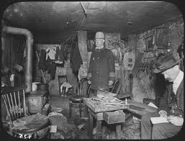
Tenements
Low-cost apartment buildings designed to house as many families as the owner could pack in.

Slide 11
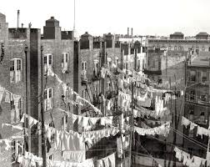
Slums
A group of dirty, run-down tenements turned an area into a slum.

Slide 12
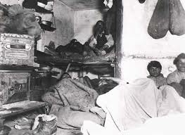
Conditions in the Slums
Hundreds crammed into space meant for a few families.
Soot from coal in machines made the air dark and foul (Even in daylight)
Open sewers attracted rats and other disease spreading vermin.

Slide 13
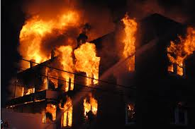
Fire
Fire was a huge danger because tenement buildings were so closely packed together that fires spread quickly. (Consuming whole neighborhoods)

Slide 14
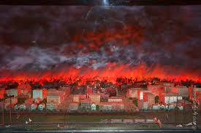
Great Chicago Fire (1871)
18,000 buildings burned.
250 dead.
100,000 homeless.
$2 Billion damage. (In today’s money)
A similar fire a year later in Boston.

Slide 15
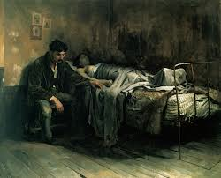
Contagious Diseases
Crowded tenement conditions allowed diseases (Like Yellow Fever) to spread quickly in one area.
(In NYC 6 out of 10 babies died before their first birthday)

Slide 16
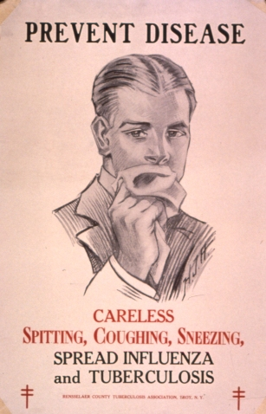
Other Diseases
Cholera
Malaria
Tuberculosis
Diphtheria
Typhoid (Prairie Fever)

Slide 17
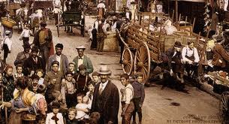
Ghettos
An area in which one ethnic or racial group dominated. (From WWII – Jews)
The comfort of familiar language and traditions.
Protection. (Could get beat up if you passed a street boundary)

Slide 18
Restrictive Covenants
Agreements among homeowners not to sell land or houses in the better neighborhoods to certain people.
African Americans, Mexicans, Asian Americans, Jews.

Slide 19
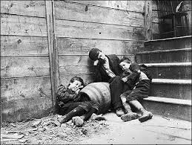
“How the other half lives”
Book about the horrors of tenement life.
Made Americans aware of poverty in cities.
Got New York to change laws to improve them.

Slide 20
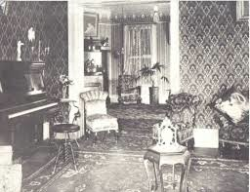
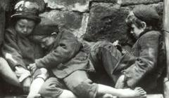
Gap
Gap between the rich and the poor got bigger.
(Middle and upper class lived in nice areas of city or moved to the suburbs)

Slide 21
Improvements
City officials began to provide:
- Police and Fire protection
- Transportation systems
- Sewage Disposal
- Electric and Water service
- Health Care

Slide 22
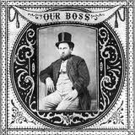
Political Machine
An unofficial city organization designed to keep a particular group in power.
Usually headed by a single powerful “Boss”.

Slide 23
Intimidation and Bribery
Political Machines worked through the exchange of favors.
Gave out city jobs and contracts in exchange for support of their candidate on election day.

Slide 24
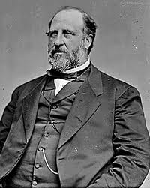
Boss Tweed
The notorious leader of the Tammany Hall political machine that ran New York City’s Democratic Party.

Slide 25
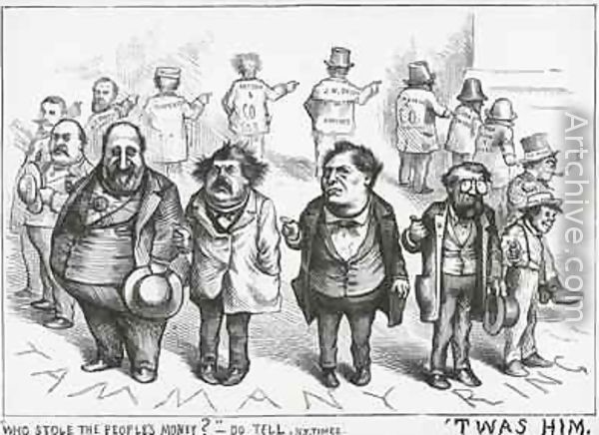
“Robbed” The City Treasury
Tweed and his pals submitted false receipts and persuaded businesses to pay him for nonexistent services.

Slide 26
Essay
Imagine you live in the slums of Chicago in the early 1900’s. Write one page describing your life and the challenges you face (be sure to incorporate information you learned in this section)

