Slide 1
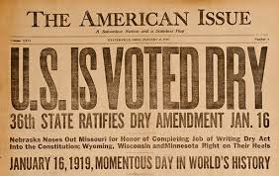
Chapter 6 – Section 4
Ideas For Reform

Slide 2
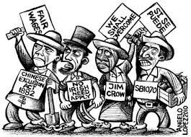
Immigrants
Many Americans thought that immigrants were the cause of all problems in the cities.

Slide 3
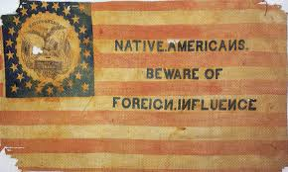
Nativism
Anti-Immigrant feelings and favoring native-born Americans.

Slide 4
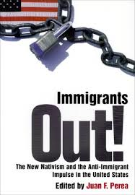
Goals of Nativists
Teaching only English culture and language in schools.
Make it tougher to be a citizen or get a job if you were a foreigner.

Slide 5
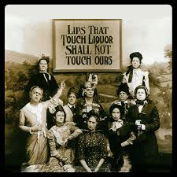
Temperance Movement
An organized campaign to eliminate alcohol consumption.
Believed alcohol led to personal tragedies.

Slide 6
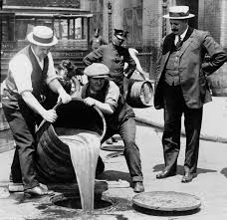
Prohibition
A ban on the manufacturer and sale of alcoholic beverages.

Slide 7
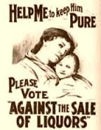
Saloons
Prohibitionists believed that saloons undermined public morals and gave immigrant men a place to strategize (taking over our jobs and even taking over the U.S.)

Slide 8
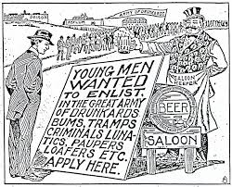
Vices
Immoral or corrupt behaviors.
Drugs, gambling, prostitution.
Believed alcohol led to these things.

Slide 9
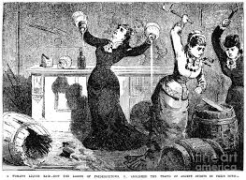
Purity Crusaders
Wanted to rid the community of unwholesome and illegal activity.
(For example, descriptions of methods to prevent unwanted pregnancy were seen as obscene. Also wanted to kick out police who took bribes to ignore illegal activity.)

Slide 10
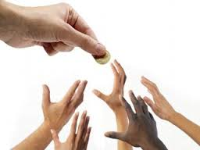
Churches and Charities
Tried to reform society by helping the needy.
Was controversial because “American Values” were forced on them.
(Told immigrants how to cook, clean, and raise their children while ignoring their cultures’ customs.)

Slide 11
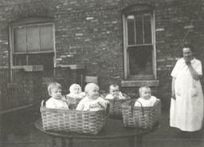
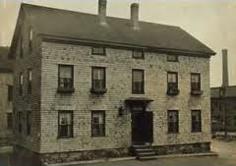
Settlement Houses
A house in the middle of a poor neighborhood that acted as a community center. (Lived among the poor to understand their needs)
Offered child-care, legal-aid, and health-care.
(400 of them by 1910, supported by donations and volunteer staff)

Slide 12
Assignment
Create a poster promoting Prohibition.

