Slide 1
Chapter 7 Section 1
The Expanse of Education

Slide 2
High school Dropouts
By 1900, most states had laws requiring children (Aged 8 -14) to attend school.
However, most did not receive a HS diploma and only acquired basic skills because they had to drop out to work.

Slide 3
Literacy
The most important function of schools back then was to teach literacy. (The ability to read and write)
Seen as necessary in order to succeed in life.

Slide 4
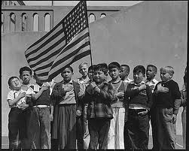
Assimilation
The process by which people of one culture learn the culture and way of life of another.
Students were “Americanized” by learning the values of patriotism, hard work, and saving your $.
(Also American foods and games like baseball.)

Slide 5
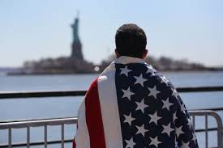
Fear
Some immigrant parents feared that their kids would forget their heritage and where they came from. (Culture and Language)

Slide 6
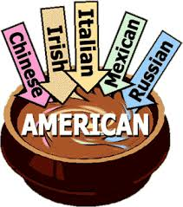
Blending of traditions
Contact between Americans and newer immigrants led too a changing American culture.

Slide 7
Inferior schools
Schools for Mexican, Asian, African, and Native American children received far less money and resources than the white Schools. (Segregated)

Slide 8
Changes in Higher education
250 Colleges opened.(Between 1880-1900)
Women's Colleges too. (Co-ed Women had to stand)

Slide 9
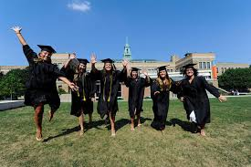
Daughters
Parent’s feared sending their daughters to college because it might make them too independent.
(“Unmarriageable” or brought them in contact with unacceptable friends)

Slide 10
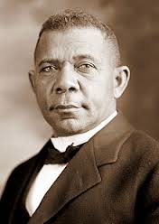
Booker T. Washington
Black leader who said blacks should focus on education (Vocational skills) to get better jobs and out of poverty and not focus on equal rights.
(Economics security more important than political equality)

Slide 11
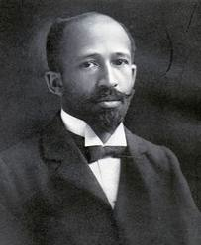
W.E.B. Dubois
Black leader who said Washington was “selling out” too white America and that African Americans had to step up for equal rights.

Slide 12
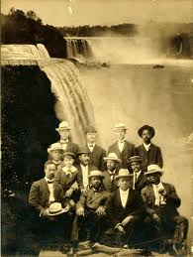
Niagara Movement
DuBois group that pushed for an end to racial discrimination and full equality for African Americans.

Slide 13
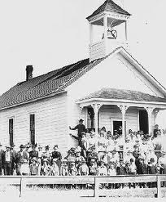
Homework Essay
Write a 200 word essay describing the state of America’s schools in the late 1800’s. Make sure to include both the advances that had been made and those that still needed to be strived for.

Slide 14
Assignment
Create a poster / flag showing 4 American values today.
What do you think we as Americans value?
Are they the same or are they different?

