Slide 1
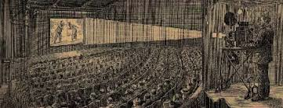
Chapter 7 Section 2
Entertainment

Slide 2
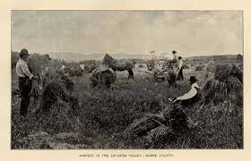
Different Entertainment
Rural Americans only celebrated after the harvest or during special occasions.
Factory workers in cities wanted fun things to do after long hours on the job.

Slide 3
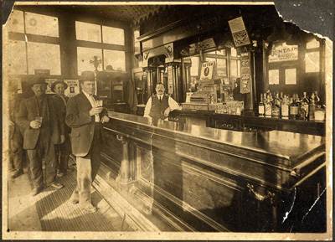
Saloons
Men met up here with those from their neighborhood or ethnic group.

Slide 4
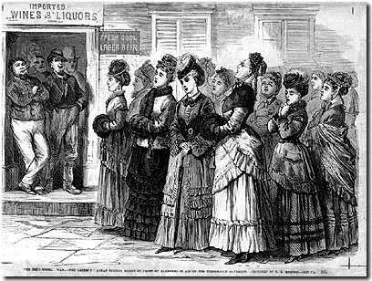
Women’s Entertainment
Went to dance halls and cabarets to see musical shows and dance the latest dances.

Slide 5
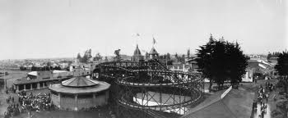
Trolley Parks
Amusement parks built at the ends of trolley lines where families got together.

Slide 6
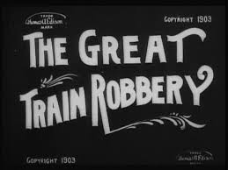
The 1st “Moving Picture”
The Great Train Robbery. (1903)

Slide 7
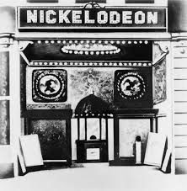
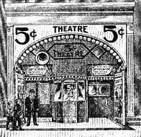
Nickelodeons
Theatres setup in converted stores (or warehouses) that charged a nickel admission and showed slapstick comedies and other films to 200,000 daily.

Slide 8
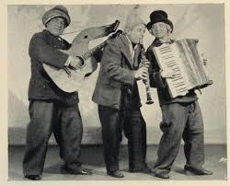
Vaudeville
A popular, inexpensive variety show consisting of comic sketches making fun of ethnic and racial groups.
Song and dance routines, ventriloquists, jugglers, trapeze artists.
(Pg. 236 “Moral Cleanliness”)

Slide 9
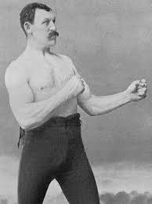
Sports
Boxing, horse racing, and football (Adaptation of Europe’s rugby) became popular in late 1800’s.

Slide 10
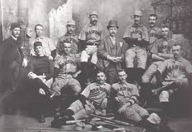
Baseball
The most popular sport.
Cops, Firefighters, Teachers all started own clubs.
When crowds grew they enclosed the fields and charged admission. (1870’s Best players were paid)
(1869 1st official team – Cincinnati Red Stockings)

Slide 11
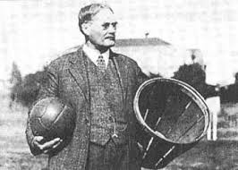
Basketball
Only major sport invented in America in 1891.
(Springfield MA – Dr. James Naismith, a gym teacher)

Slide 12
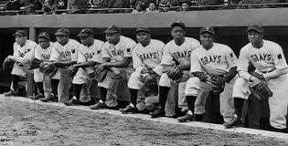
Discrimination
Existed even in sports.
Even the best African Americans had to play in segregated leagues. (Until the 1940’s)

Slide 13
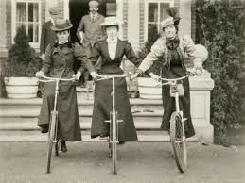
Women’s sports
Swimming, ice skating, bicycling, basketball.

Slide 14
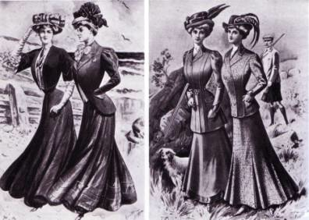
Clothing Styles
Biking required practical clothing so women’s clothing styles switched from corsets (which wrapped tightly around their torsos and restricted breathing) to more comfortable clothing.

Slide 15
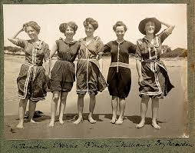
Revised Rules
Rules for women’s sports were revised because “stiff competition and hard physical exertion were unhealthy for women”.
(When swimming women had to wear stockings under short dresses because of society’s strict dress codes)

Slide 16
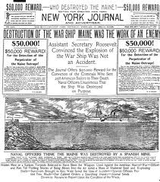
Newspaper Circulation
10X more people read.
New machines allowed to print quicker.
Not just news, but now sports, comics, and other special sections.

Slide 17
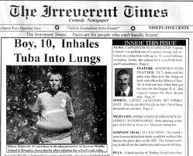
Yellow Journalism
“Sensational” news stories with details about murders and scandals aimed at selling more newspapers.
Invented facts and exaggerated the ordinary.
(Referred to the yellow ink used in a popular comic strip of the era)

Slide 18
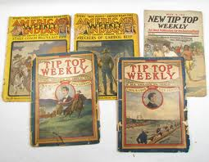
Magazines and Popular Fiction
Articles about achieving the American Dream, Protesting political corruption, and descriptions of specific regions of the country. (With great color and detail)

Slide 19
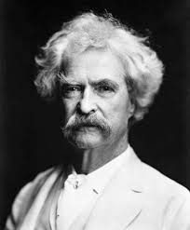
Mark Twain
Real name was Samuel Langhorne Clemens.
Wrote The Adventures of Tom Sawyer and Huckleberry Finn. (about youthful adventure along the Mississippi River)

Slide 20
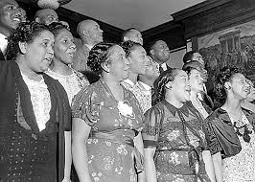
Negro Spiritual
Groups of African Americans singing religious folk songs.
Enjoyed by all. (Even white people)

Slide 21
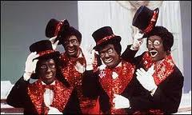
Minstrel Shows
White actors performed in “Blackface”. (painted their hands and faces black with wide grins)
Made fun of African-American music and dance by mimicking them.

Slide 22
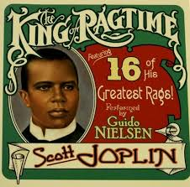
Ragtime
Musical form that originated among black musicians in saloons in the South.
Upbeat piano tunes over a marching-band beat.
(Youtube: The Entertainer)

Slide 23
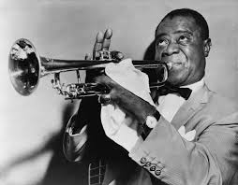
Jazz
Originated in New Orleans.
Improvised music. (Call-and-response instruments respond to a single “leader”)
Phonograph helped jazz become a national passion by 1915.

Slide 24
Assignment
Create the front page of a newspaper from the early 1900’s. You should include at least three articles about entertainment. (Sports, music, books, movies, etc.) You do not need to write a complete article, but each one should contain at least three sentences. You should also include at least one picture/drawing.

