Slide 1
Chapter 7 Section 4
Women in the late 1800’s

Slide 2
The “Woman Question”
What role should women have in society?
Should they have the same rights as men?

Slide 3
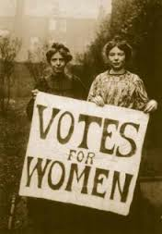
What women wanted
To be able to vote.
To control their own property and income.
To have access to hire education and professional jobs.

Slide 4
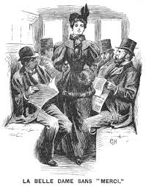
Not so fast
Some argued that allowing women economic and political power would upset the social order and women would lose their femininity.

Slide 5
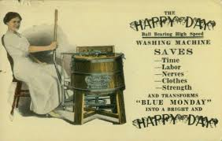
Easier work and free time
Women’s work in the home was made easier by new inventions.
Electric machines. (washing machine)
Store bought clothing. (rather than making own)
Food in tin cans and pre-prepared. (rather than making own or butchering and preserving own meat)

Slide 6
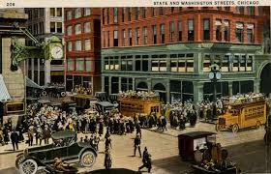
Department stores
Stores that carried a wide variety of goods at lower prices than smaller shops or general stores. (Like Wal-Mart or BJ’s – Buy in bulk and is cheaper)
Macy’s (In NY - 1858)
Marshall Field (In Chicago – 1865)

Slide 7
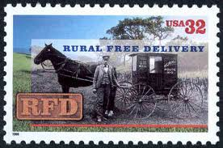
Rural Free Delivery
Free shipping on big-city goods all over small town America.

Slide 8
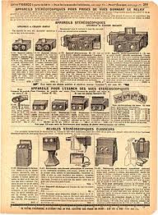
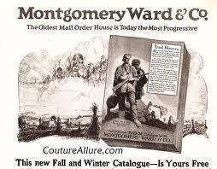
Mail-Order Catalogs
Printed materials advertising a wide range of goods you can purchase through the mail. (Sears, Roebuck and Company, Montgomery Ward)
Like ordering online today. (Amazon or E-Bay)

Slide 9
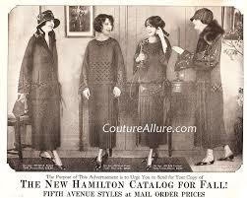
Women in the workplace
1 in 8 workers were women in the late 1800’s
Mostly single.
Assumed they would leave when married. (So never promoted)
Earned 30% to 60% less than men.

Slide 10
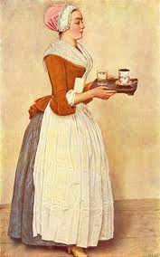
Domestic Work
1 in 5 homes employed live-in servants.
Mostly immigrants or African-American.
Dawn to Dusk 6 and ½ days per week.
Cooked, cleaned, and cared for kids.
Many had their own families living elsewhere.

Slide 11
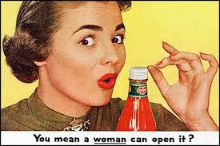
Stereotype of women
In the late 1800’s American society believed that women were not mentally able to learn or hold a professional job. (They would become sick or “go crazy” if they tried to)

Slide 12
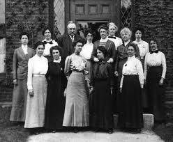
Women’s jobs
Only jobs available to women were ones that didn’t put them in competition with men. (Mostly in women’s colleges and hospitals)
Only single women worked. (“Careers and Married Life” did not go together)

Slide 13
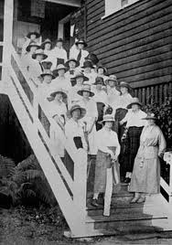
Women’s clubs
Many joined for intellectual and social reasons.
Gave them experience in speaking and writing.
Increased their self-confidence.

Slide 14
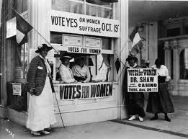
Social Changes
Many women’s clubs worked on issues like suffrage (The right to vote) and prohibition.

Slide 15
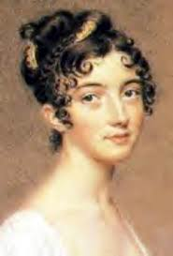
Changing styles
Women’s hairstyles became shorter. (For convenience)
Shortened skirts and got rid of corsets. (For more comfort)

Slide 16
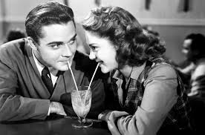
Dating and marriage customs
Began to go out on unsupervised dates. (without a chaperone)
Women in unfulfilling marriages sometimes divorced. (Up from 1 in 12 to 1 in 9 – 1 in 2 today!)

Slide 17
assignment
Write a 1 paged letter from a woman in the late 1800’s explaining what her daily life is like and how it has changed in recent years.

