Slide 1
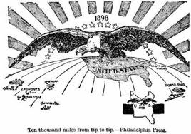
Chapter 8 Section 3
Expansion under Roosevelt and Taft

Slide 2
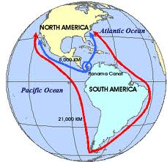
Long Journey
Americans traveling by sea used to have to travel all the way around South America (15,000 miles) to get from the East to West coast.

Slide 3
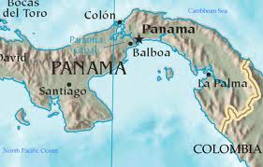
Panama Canal
U.S. wanted land in Panama to build a canal through Central America so they could get a quicker route from the Atlantic to Pacific. (Only 6,000 miles)

Slide 4
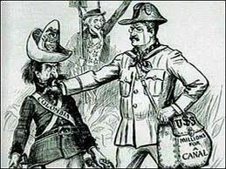
Deal
In order to get the land from Panama we agreed to support their independence from Colombia.
Also paid $10 Million for a 10-mile wide strip of land for the Canal Zone. (40 Miles long)

Slide 5
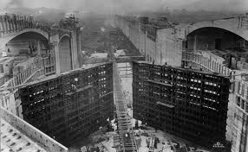
Construction
Took 10 years to build (1904-1914)
Finished 6 months ahead of time and $23 million under budget.
Built by workers from several countries. (with no construction experience)

Slide 6
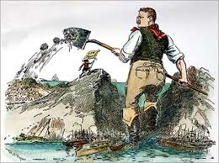
National Security
Even though our means of acquiring the Canal were questionable, most Americans felt it was necessary for national security and prosperity.

Slide 7
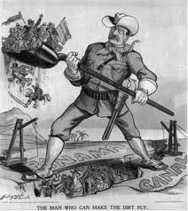
Latin America
There were a lot of negative feelings towards the U.S. for many years afterwards because of our illegal means used to acquire the Canal Zone. (We paid Colombia $25 million in 1921 to try to make up for it)

Slide 8
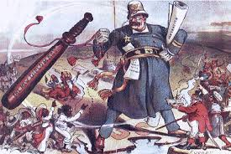
“Speak Softly and Carry a Big Stick”
Teddy Roosevelt’s famous line about how to deal with other countries.
Be gentle, but use the threat of American military might to get what you want if necessary.

Slide 9
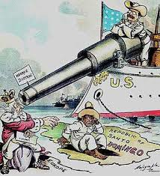
Roosevelt Corollary
Addition to the Monroe Doctrine that said the U.S. didn’t intend to take over other countries, BUT it would intervene and act as an international police power if we felt American interests were threatened.

Slide 10
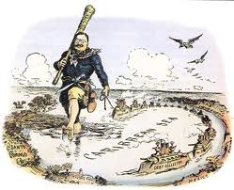
Frequent Intervention
This policy led to frequent U.S. intervention in Latin America.
Angered Congress because President did what he wanted.

Slide 11
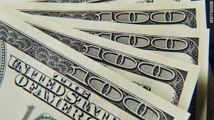
Dollar Diplomacy
President Taft’s change in foreign policy.
Substituted dollars for bullets – Investment instead of military force.

Slide 12
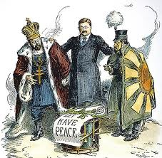
Russo-Japanese War (1905)
Whoever won the war would determine who controlled China.
Important to us because we wanted to maintain an “open door” with China.
(Became peace negotiator between the 2 and won the Nobel Peace Prize)

Slide 13
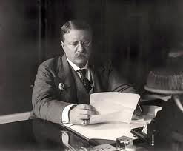
Modern President
Teddy Roosevelt helped created the modern image of the President by his boldness and constant activity.

Slide 14
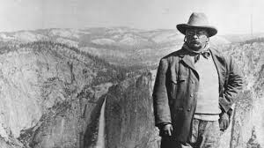
Conservationist
T.R. acted as a vocal conservationist by helping to preserve the nation’s natural resources and wild life.
Created National Parks.

Slide 15
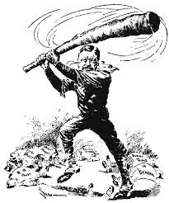
Essay
Should the U.S. still “speak softly and carry a big stick” in our dealings with other countries or should we pursue a different approach to our foreign policy?

