Slide 1
Anti-Imperialists
People opposed to the U.S. becoming an imperialist nation.

Slide 2
Arguments Against
Goes against our nation’s belief in “liberty for all”.
Enough difficulty at home already. (shouldn’t take on more responsibilities)
If our government sends troops to other countries to control how they act, how do we know they won’t use military force to crush dissent at home?

Slide 3
Role of Racism
A belief that differences in character or intelligence are due to one’s race.
Nations being conquered were all non-white (black Africa and Asians)

Slide 4
Fear
Some anti-imperialists feared that it would encourage people of different racial backgrounds to move to the U.S.

Slide 5
Economic Arguments
Costs too much for tax payers to pay for armed forces all over the world.
Workers from annexed territories would come to America and compete with American workers for jobs (and work for less).

Slide 6
Arguments for Imperialism
A new frontier for the American imagination.
To gain foreign markets to sell our stuff.
Strategic and security reasons.

Slide 7
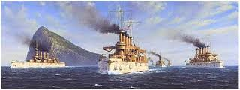
Great White Fleet
Part of the U.S. Navy sent on a cruise around the world (1907) to demonstrate the might of the American Navy.

Slide 8
Corrupt Leaders
We often supported many corrupt (and sometimes cruel) rulers in Latin America because they supported American interests in exchange for our keeping them in power.

Slide 9
Mixed Feelings
Many countries resented America’s interference around the world, but some welcomed it and even turned to the U.S. for help.

