Slide 1
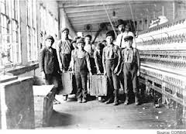
Chapter 9 Section 1
The Origins of Progressivism

Slide 2
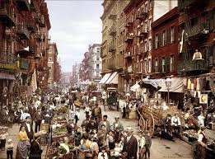
Growth of Cities
Three negative consequences of the growth of America’s cities:
Unemployment.
Unsafe working conditions.
Political Corruption.

Slide 3
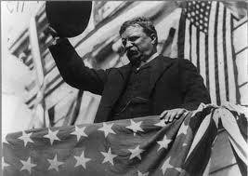
Help
Many people wanted the government to get more involved in solving the nation’s problems.

Slide 4
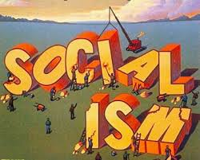
Socialism
An economic and political philosophy favoring public or government control of property and income.

Slide 5
Goals of Socialists
End the capitalist system (Big companies make profit).
Distribute wealth more equally.
Nationalize American industries.

Slide 6
How?
Hoped to do this through voting not through revolution.

Slide 7
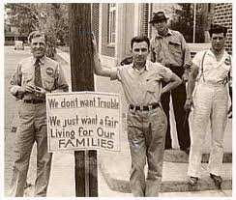
Labor Movement
Union members who wanted:
Reduced work hours.
Better wages.
Better working conditions.

Slide 8
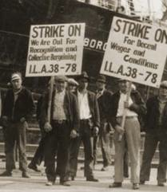
Injunction
A court order which prohibited Union workers from going on strike.

Slide 9
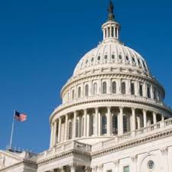
Municipal Government
City government wanted political appointments based on qualifications instead of favors.

Slide 10
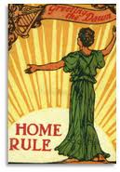
Home Rule
A system in which cities have self-rule instead of being dominated by State governments (Controlled by corrupt political machines).

Slide 11
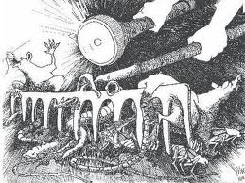
Muckrakers
Journalists who investigated issues of public concern like slums and sweatshops and alerted the public to the corruption in business and politics.
Criticized (by Teddy Roosevelt) for “Earning a living by making up lies about honest men”.

Slide 12
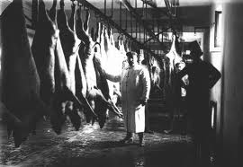
The Jungle
Upton Sinclair’s book about the horrors of the meat packing industry.
(Bad beef killed more soldiers in the Spanish American War than bullets.)
Led to creation of federal meat inspection programs (FDA).

Slide 13
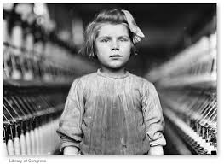
The Progressive Era (1890-1920)
Called this because various groups tried to bring about “Progress” in society by getting rid of the corruption in government.

Slide 14
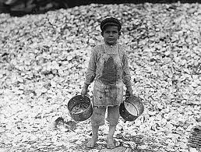
Watchdog
Progressives did not want the government to own businesses, but to be a watchdog to make sure businesses treated workers and competing companies fairly.

Slide 15
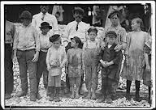
Social Welfare Programs
Programs designed to help the working poor because of low wages, unemployment, and workplace hazards.
Unemployment, accident and health insurance.
Social Security system to aid the disabled and elderly.

Slide 16
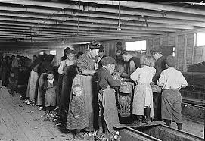
Women Reformers
Cared about labor (workplace) issues because many women and children were factory workers.

Slide 17
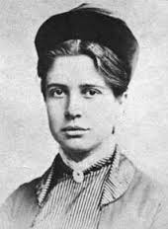
Florence Kelley
Women who came from a wealthy Pennsylvania family who fought for better work conditions for women and to get children out of the workplace.

Slide 18
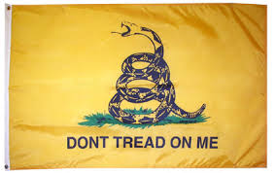
Opposition to Progressives
Many poor families, the very people progressives were trying to help, often disliked them because they couldn’t survive without sending their children to work.
They also didn’t want the government having any say in their housing or healthcare.

