Slide 1
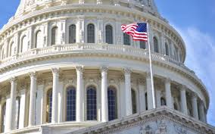
Chapter 9 Section 2
Progressive Legislation

Slide 2
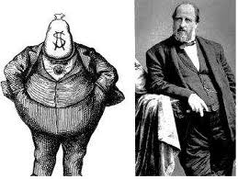
Political Machines
As Progressive reformers gained popularity they were driven out of power or forced to work with them to improve city life.

Slide 3
Utilities
Cities took control of utilities (such as water, gas, and electricity) away from monopolies who charged too much.

Slide 4
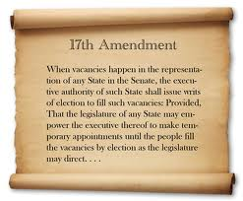
More Power to Voters
17th Amendment – Said citizens, not the state legislature, choose their U.S. Senator.
Initiatives – By getting a certain % of voters’ signatures the proposed law will be put on the ballot in the next election.

Slide 5
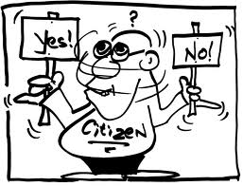
Power to the People
Referendums – Citizens can petition that a law passed by the legislature be “referred” to voters for their approval or rejection.
Recall – Voters can remove public officials from office before the next election.

Slide 6
Fire
March, 1911 a cigarette ignited a fire on the 8th floor of a shirt company.
Doors were locked to prevent theft so 146 people died.
City appointed fire inspectors, mandatory fire drills, and had to unlock and fireproof exits.

Slide 7
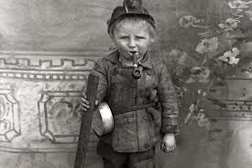
New Labor Laws
Companies often brought the government to court because they claimed they had no right to interfere with how they ran their companies as long as employees agreed to it.

Slide 8
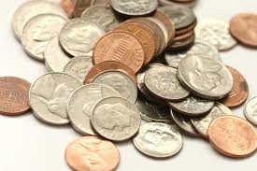
Minimum Wage
Massachusetts was the first state to require a minimum wage in 1912.
Many states followed soon thereafter.

Slide 9
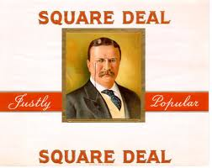
“Square Deal”
Teddy Roosevelt’s slogan for his Presidency because he claimed to negotiate fair deals for both unions and company owners.

Slide 10
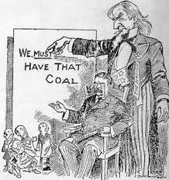
Threat of Force
TR threatened to use the army to seize and operate the mines (In 1902) because the owners refused to negotiate with the striking mine workers.
Without coal the nation would not have any heating fuel.

Slide 11
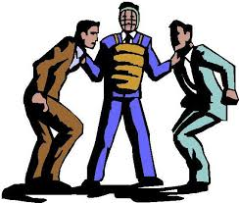
Arbitration
When an impartial (not for either side) 3rd party decides on a legally binding solution.
You have to accept their decision.

Slide 12
Pure Food and Drug Act and Meat Inspection Act
Required:
Accurate labeling of ingredients.
Strict sanitary conditions.
A rating system for meats.

Slide 13
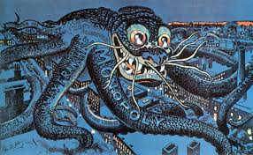
Anti-Trust Action
A court action taken to break up monopolies because there were many trusts that controlled a lot of smaller companies that needed to be supervised.
(Done 42 times by the government)

Slide 14
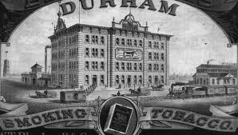
Largest Trusts
Beef, oil, and tobacco companies.

Slide 15
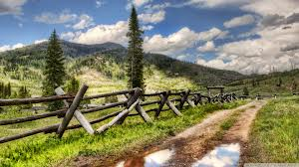
Environmental Protection
Created national parks like Yellowstone (1872 in WY) and Yosemite (1890 in CA).
Created the U.S. Forest Service.
Put aside 200 million acres of land for forests, mineral reserves, and water projects.

Slide 16
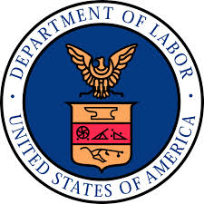
Department of Labor
A new part of the government created to protect women and children in the workplace.

Slide 17
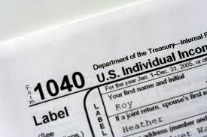
16th Amendment
Created an income tax which collected more money from the wealthy (before relied on tariffs which pushed up the price of goods).

