Slide 1
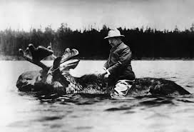
Chapter 9 Section 3 & 4.
Progressive Presidents and Suffrage at Last

Slide 2
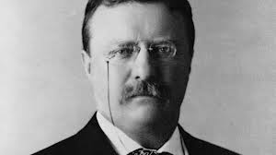
Teddy Roosevelt Runs Again
Even though he had vowed not to run again for President (and had hand-chosen Taft as his successor) TR decided to run again because he felt Taft did not fight for progressive issues like ending child labor, regulation of business, and women’s right to vote.

Slide 3
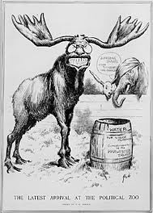
Bull Moose Party
The nickname of the Progressive party that broke from the Republican party (got its name from TR’s line “I feel fit as a bull moose”).

Slide 4
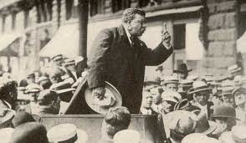
Assassination Attempt
TR was shot in the chest while campaigning.
He continued his speech for 1 and ½ hours before seeking medical care (“It takes more than this to kill a bull moose”)

Slide 5
Clayton Antitrust Act
Made strikes, peaceful picketing, and boycotts legal.
Setup the FTC (Federal Trade Commission) to punish companies that followed unfair business practices.

Slide 6
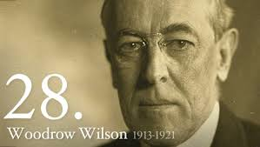
Woodrow Wilson
President that did not fight for social justice.
Allowed Jim Crow laws and opposed a Constitutional amendment giving women the right to vote.

Slide 7
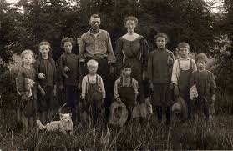
Groups Still Hurting
Even though Progressives helped the working poor in cities, they did not help rural farmers or African Americans.

Slide 8
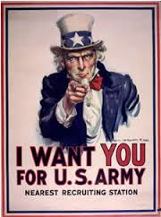
World War 1
Calls for more changes suddenly became less important when WW1 broke out in Europe (In 1914).

Slide 9
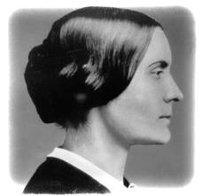
Susan B. Anthony
Women who first fought against slavery and then for women’s suffrage (right to vote).

Slide 10
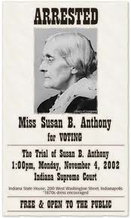
Civil Disobedience
A nonviolent refusal to obey a law in an attempt to change the law.
Anthony insisted on voting in NY and was arrested (in 1872).

Slide 11
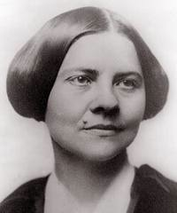
Suffragist Leaders
Elizabeth Cady Stanton.
Lucy Stone. (from West Brookfield)

Slide 12
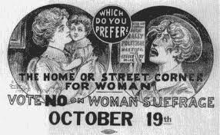
Arguments Against Women Voting
They were already powerful enough.
It would blur the distinction between the sexes by making women more “masculine”.

Slide 13
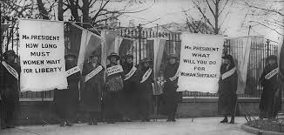
Suffragist Strategies
Tried to amend the Constitution.
Tried to get individual states to allow it.

Slide 14
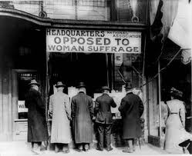
Successful?
At first only individual states gave women the right to vote.
Women in frontier states seen as “tougher” and equal to men.
Changing the Constitution is very difficult. (Requires 2/3rds of each house of Congress and 3/4ths of state legislatures)

Slide 15
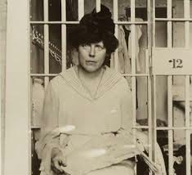
More Hardcore
As suffragist fighters fought harder they were sent to prison and often went on hunger strikes to protest prison conditions.

Slide 16
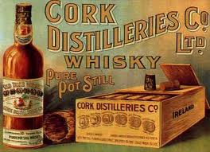
Opposition
The liquor industry fought hard against giving women the right to vote because many women supported prohibition

Slide 17
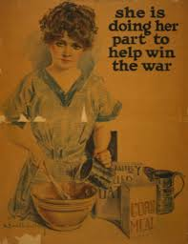
Benefit of the War
WWI helped the women’s movement because many women patriotically took on jobs left by men.

Slide 18
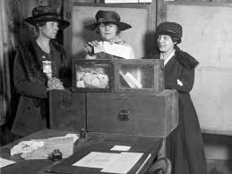
19th Amendment
In 1920 women were finally given the right to vote. (They had been trying since 1868)

Slide 19
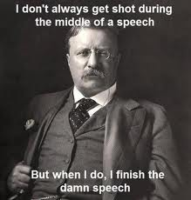

Slide 20
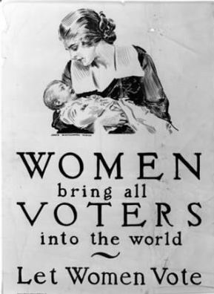

Slide 21
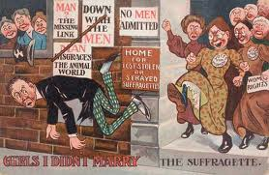

Slide 22
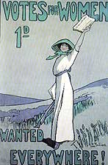

Slide 23
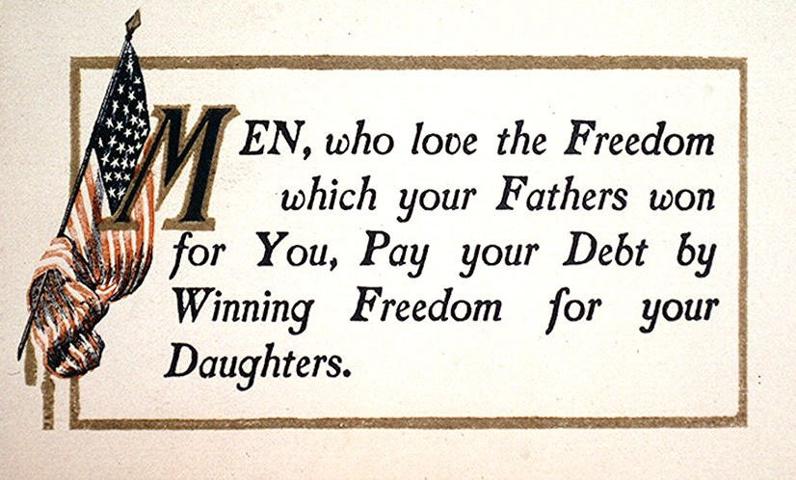

Slide 24
