Slide 1
The Cold War
The Korean War 1950-1953

Slide 2
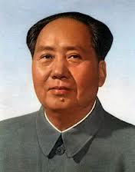
China
Became a Communist nation in 1949 under Mao Tse Tung
U.S. feared communism may spread throughout Asia

Slide 3
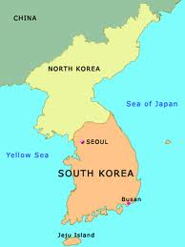
Korea after WWII
After Japanese were defeated Korea was occupied by the Soviets in the North and the US in the South
UN wanted to create one unified democratic Korea, but the Communist North didn’t want this

Slide 4
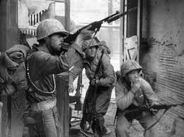
June 1950
Communist-backed forces trained by the Soviets and Chinese invade South Korea and push them all the way back to the tip of Korea

Slide 5
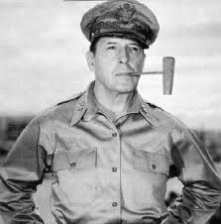
General Douglas MacArthur
Led a United Nations (UN) force that drove the North Koreans back past the 38th parallel

Slide 6
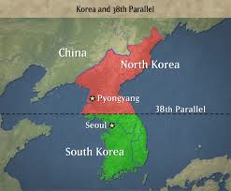
38th parallel
The line that divided the Soviet controlled North from the U.S. controlled South

Slide 7
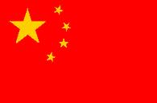
Hesitant to invade N. Korea
Truman didn’t want to provoke the Chinese & Soviets directly
No UN troops would enter any part of China or the Soviet Union

Slide 8
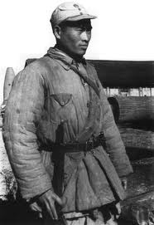
MacArthur invades N. Korea
North Korean capital of Pyongyang fell
Just when it looked like the war was over communist soldiers from China helped drive UN troops back into South Korea
Communist China did not want a democratic Korea next door

Slide 9
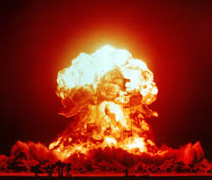
U.S. response?
MacArthur wanted to retaliate against the Chinese
Truman and the UN said No b/c if we directly attacked China this might trigger nuclear war with the Soviets

Slide 10
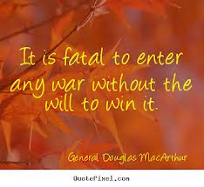
MacArthur stripped of command
MacArthur spoke out against the President (a big No No!) and was dismissed for subordination
Lost his job, but seen as a hero by many Americans

Slide 11
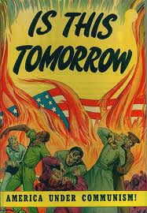
American public
Many Americans, including Sen. Joseph McCarthy, sided with the General against the President
Fueled by anti-communist fears back home

Slide 12
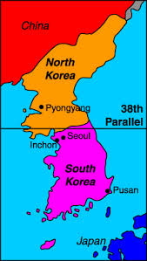
Stalemate
Over the next 2 years both sides dug in at the 38th parallel pounding one another, but getting nowhere

Slide 13
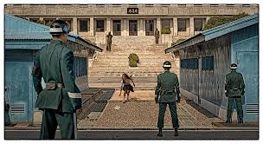
Negotiations…Finally
Both sides finally agreed to create a demilitarized zone (DMZ) - a buffer zone where no one would have soldiers
Also agreed to release POW’s
Only signed a truce – war never officially ended

Slide 14
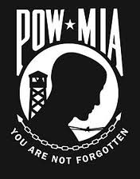
North Korean POW’s
Communists didn’t want to allow N. Korean POW’s to choose whether or not to return home b/c many would rather stay in non-communist S. Korea (25,000 did)

Slide 15
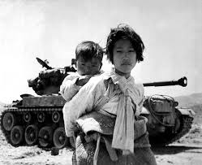
Final Death Toll
About 2 million North Korean troops plus another million civilians
About the same in South Korea
55,000 U.S. soldiers killed

Slide 16
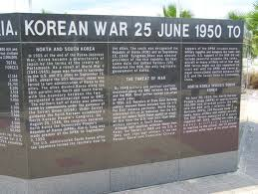
Results of Korean War
Korea never reunited, but we did contain communism in North Korea
Many frustrated at loss of American lives “all for nothing”
War never officially ended – a cease fire still exists to this day

Slide 17
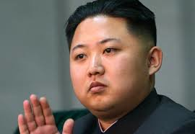
Present Day North Korea
Troops still aiming guns at one another across 38th parallel
28,000 US troops still in South Korea
New, young leader, Kim Jong Un, wants to acquire nuclear weapons to prove himself and flex his muscles

