Slide 1
Dissociative Disorders
Dissociative Amnesia
Dissociative Identity Disorder
Depersonalization-Derealization Disorder

Slide 2
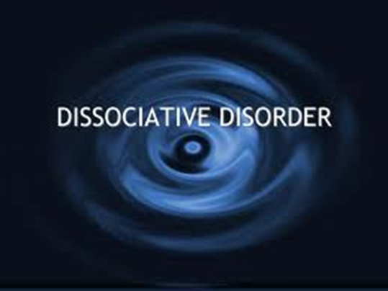
What is a dissociative disorder?
Someone with a dissociative disorder escapes reality in ways that are involuntary and unhealthy.
The sense of self has become separated (dissociated) from previous memories, thoughts, or identity

Slide 3
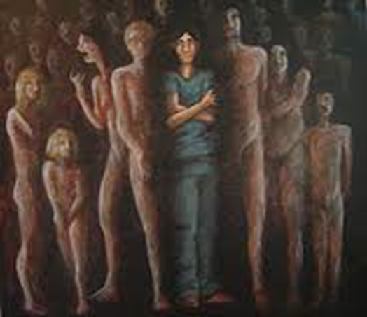
The symptoms of dissociative disorders range from amnesia to alternate identities depending on the type you have.
Symptoms usually develop as a reaction to trauma and help keep difficult memories at bay. Times of stress can temporarily worsen symptoms, making them more obvious.

Slide 4
There are three major dissociative disorders defined in the Diagnostic and Statistical Manual of Mental Disorders (DSM), published by the American Psychiatric Association:
Dissociative Amnesia
Dissociative Identity Disorder ( formerly known as Multiple Personality Disorder)
Depersonalization-derealization disorder

Slide 5
What is Dissociative Amnesia?
A dissociative disorder in which memory loss is more severe than normal forgetfulness and that can't be explained by a medical condition.

Slide 6
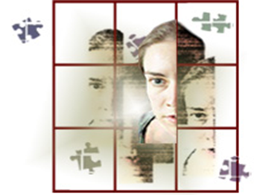
Symptoms of Dissociative Amnesia
You can't recall information about yourself or events and people in your life, especially from a traumatic time.
Dissociative amnesia can be specific to events in a certain time, such as intense combat, or more rarely, can involve complete loss of memory about yourself.

Slide 7
What is a dissociative fugue?
Symptoms may sometimes involve travel or confused wandering away from your life (known as a dissociative fugue).

Slide 8
Fugue State
In a fugue state a person may form a new identity, new friendships, even a new line of work.
An episode of amnesia may last minutes, hours, or, rarely, months or years.

Slide 9
What is dissociative identity disorder?
This disorder, formerly known as multiple personality disorder, is characterized by "switching" to alternate identities.

Slide 10
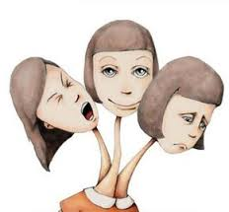
What are “alters”?
You may feel the presence of one or more other people(sometimes called “alters”) talking or living inside your head, and you may feel as though you're possessed by other identities.

Slide 11
As a patient switches from one identity to another, each alter/personality has a unique name and personal history. They usually differ in age, gender, voice, and even such physical qualities as handedness (left or right) or the need for eye glasses.

Slide 12
Sometimes these personalities are aware of each other and sometimes they are not.
People with dissociative identity disorder typically also have dissociative amnesia and often have dissociative fugue.

Slide 13
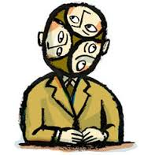
On the rise?
Before the 1970’s there were fewer than 100 cases diagnosed
During the 1980’s alone more than 20,000 cases were diagnosed – almost all in the United States
The average number of personalities has also increased from 3 to 12 with some people reporting dozens of personalities

Slide 14
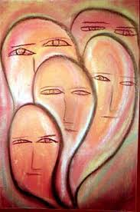
Is it real?
This is a rare and controversial disorder and psychologists disagree as to whether or not it is even real.
Some believe that psychiatrists may be unintentionally suggesting multiple personalities to their clients.

Slide 15
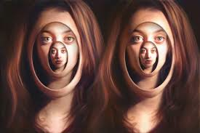
How is it different from schizophrenia?
People with DID experience many personalities living in the same mind. Schizophrenics do not. They are always the same person.
People with DID do not experience the delusions and hallucinations that schizophrenics do. Schizophrenics may hear or see people, but they do not become these people.

Slide 16
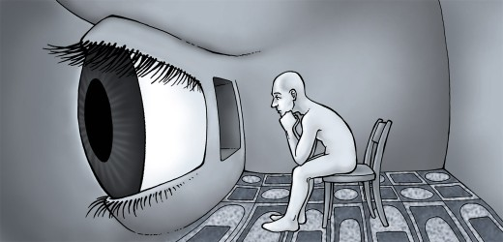
What is Depersonalization-derealization disorder?
This disorder involves a sense of detachment or being outside yourself — observing your actions, feelings, thoughts and self from a distance as though watching a movie (depersonalization).
This feeling can either be ongoing or episodic.

Slide 17
Other people and things around you may feel detached and foggy or dreamlike, and the world may seem unreal (derealization).
Symptoms, which can be profoundly distressing, may last only a few moments or come and go over many years.

Slide 18
What causes Dissociative Disorders?
Dissociative disorders usually develop as a way to cope with trauma.
The disorders most often form in children subjected to long-term physical, sexual or emotional abuse or, less often, a home environment that's frightening or highly unpredictable.
The stress of war or natural disasters also can bring on dissociative disorders.

Slide 19
Learned in Childhood
Personal identity is still forming during childhood. So a child is more able than an adult to step outside of him/herself and observe trauma as though it's happening to a different person. A child who learns to dissociate in order to endure an extended period of youth may use this coping mechanism in response to stressful situations throughout life.

Slide 20
Negative Effects
Self-harm
Suicidal thoughts and attempts
Alcoholism and drug use disorders
Mood, Anxiety or Other disorders
Severe headaches

Slide 21
Other Problems
Dissociative disorders are also associated with major difficulties in personal relationships and at work.
People with these conditions often aren't able to cope well with emotional or professional stress, and their dissociative reactions — from tuning out to disappearing — may worry loved ones and cause people at work to view them as unreliable.

Slide 22
Treatment
Psychotherapy is the primary treatment for dissociative disorders.
Although there are no medications that specifically treat dissociative disorders, doctors may prescribe antidepressants, anti-anxiety medications or antipsychotic medications to help control the mental health symptoms associated with dissociative disorders.

Slide 23
Sources
MayoClinic.org
Thinking About Psychology, 2nd Edit.

