Slide 1
Feeding & Eating Disorders
FED

Slide 2
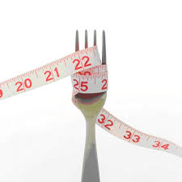
Eating Disorders
Anorexia
Bulimia
Binge Eating Disorder
OSFED
Pica
Rumination Disorder
Avoidant/Restrictive Food
Intake Disorder

Slide 3
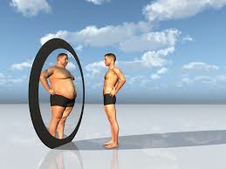
What is your body image?
Your perception of your appearance, regardless of what the mirror, or other people have to say
Many people, not just those with eating disorders, have a negative body image, even when they are a healthy weight (especially teens)
Doesn’t matter how you actually look, but rather it’s how you perceive the way that you look
In fact, others might be envious of the way you look, but you could still have a negative body image

Slide 4
Unhealthy Body Image & Eating Patterns
Anorexia, bulimia, and binge eating disorder all have characteristics specific to that disorder, however they all involve poor body image, low self-esteem and unhealthy eating patterns that begin gradually and build to the point where a person feels unable to control them.

Slide 5
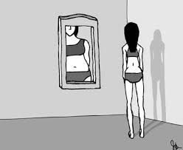
Anorexia Nervosa
This disease is characterized by a morbid fear of being fat and a distorted view of one’s own body
People with this condition (85-90% women) look in the mirror and see themselves as fat, even when they are so thin that their bones are becoming prominent

Slide 6
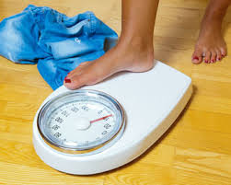
Anorexia
It may all start with an ordinary weight-loss diet
The anorexic reaches his or her first goal, and is so delighted that another lower goal is set.
Losing weight becomes so gratifying, confers such a sense of power and control, that as each target is met, a new one is set.

Slide 7
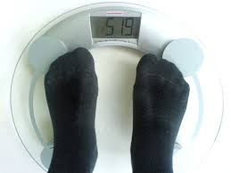
The downward spiral continues until weight dips dangerously low.
Losing weight becomes the most important thing in life – more important than family, work, or even health
It is not just an out of control diet – it’s an addiction
It’s no longer about food, it’s now about control

Slide 8
Who becomes anorexic?
Anorexia most often develops in the teen years, but it can occur at any age
Anorexics tend to be achievement-oriented perfectionists who nevertheless lack self-esteem
Many come from families genetically loaded for addiction and have subconsciously chosen what they see as a safer option

Slide 9
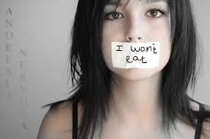
Warning Signs
Warning signs of anorexia include:
Significant weight loss of 15 to 25% below desirable weight
Frequent trips to the scale during the day
Eating rituals such as measuring and weighing everything that is to be eaten, cutting food into tiny pieces, pushing food around the plate without eating it, secretly discarding food, and eating food discreetly

Slide 10
Physical effects
Eventually menstrual periods in women become irregular or cease entirely
Excess body hair may begin to sprout
Anorexics are usually fatigued, depressed, and weak, with a below-normal body temperature
In spite of muscle weakness, they often become addicted to exercise as part of their fanatic weight-control program

Slide 11
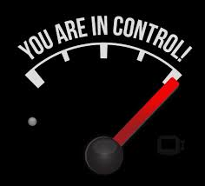
Why is anorexia not really about weight?
While it may start off being about weight loss, anorexia is ultimately about CONTROL
Weight and body image are symptoms of deeper problems
Anorexics generally feel powerless and that they can’t control what’s going on around them, but the one thing that they can at least control, is their weight
Can feel powerful and in control about something in their life by controlling food intake

Slide 12
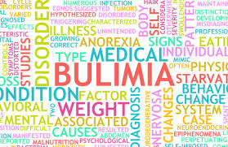
Bulimia Nervosa
Bulimia can develop after anorexia takes hold, or it can start without previous anorectic behavior
Builimia is an ED in which a person binges (overeats) and purges (gets rid of food)
Food becomes a source of comfort for bulimics – a way of managing conflict and stress in their lives

Slide 13
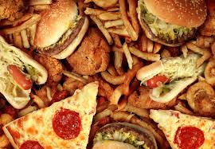
Bulimia
The binge may involve an immense amount of food, for example, eating a gallon of ice cream along with a couple of boxes of cookies: an intake of 3,000 to 50,000 calories in a two-hour period is not unusual

Slide 14
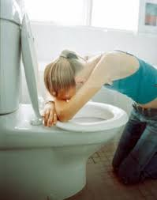
Binging and Purging
After a binge or just an ordinary meal with family, bulimics feel remorseful and guilty over their lack of control and secretly purge themselves
Purging is usually through self-induced vomiting and/or the use of laxatives, but sometimes through strenuous exercise

Slide 15
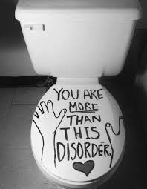
Who becomes bulimic?
Like anorexia, bulimia is most likely to begin in the teen years, but can start at any time
It is more common than anorexia and some believe that 1 in 5 women try purging themselves at one time or another
At least 1 million Americans are estimated to be seriously affected, roughly 5 – 10% of them males

Slide 16
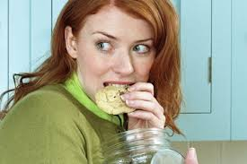
Hard to Tell
Bulimia is less obvious to others than anorexia, since bulimics can maintain their normal weight or even be overweight (the weight range is from 15% below to 15% above normal)
Bulimics binge in private, so others rarely know how much they are eating

Slide 17
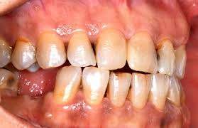
Physical & Psychological Effects
There are, however, some physical signs of bulimia:
Puffiness in the cheeks or under the chin caused by swollen salivary glands
Abnormal menstrual periods
Excessive tooth decay and gum disease (a result of the acidity of the vomit that is frequently induced)

Slide 18
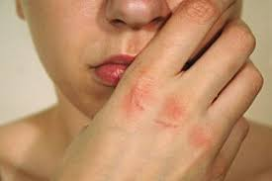
Scars on the back of the hands (from forcing fingers down the throat to trigger the gag reflex)
Depression and self-injury (such as cigarette burns) are also common

Slide 19
Anorexia vs Bulimia
While the anorexic revels in a sense of control, the bulimic feels guilty and out of control, and is therefore more likely to be depressed
The anorexic’s addiction is to thinness, the bulimic’s to excessive eating.
Some bulimics actually steal to support their eating habit (again, a familiar addictive behavior)

Slide 20
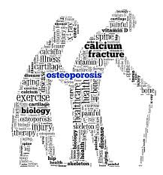
Health Consequences
Both anorexia and bulimia require professional treatment.
Without it, they can lead to serious medical problems, including thinning of the bones (osteoporosis), irregular heart rhythm, rupture of the stomach, deterioration of other vital organs, and infertility

Slide 21
Highest Mortality rate of any Psychological Disorder
If a woman with an eating disorder does become pregnant and continues her behavior, she could put both herself and her baby at risk.
Eating disorders can be fatal. 6-10% of people with eating disorders die as a result of starvation, cardiac arrest, or suicide.

Slide 22
Getting Help
Don’t be embarrassed about an eating disorder
Like other addictions, it is a medical problem and requires prompt medical help from experienced professionals
Be open and honest in describing your eating problem to your doctor

Slide 23
Treatment
Treatment should be individualized, and may be given on an outpatient or hospital basis
Psychotherapy, nutritional reeducation, and group or family counseling is common
Participation in a special Twelve-Step group for bulimics (part of an Overeaters Anonymous program) may also be recommended

Slide 24
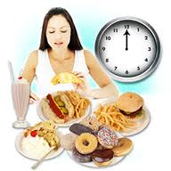
Binge eating disorder (BED)
Eating large amounts of food within 2 hours at least once weekly (but usually more often) for 3 months without purging to get rid of food
The person experiences a sense of lack of control over eating during the episode (a feeling that one cannot stop eating or control what or how much one is eating)

Slide 25
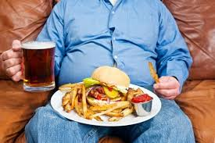
Other criteria for diagnosis (3 or more)
Eating much more rapidly than normal
Eating until feeling uncomfortably full
Eating large amounts of food when not physically hungry
Eating alone because of feeling embarrassed by how much one is eating
Feeling disgusted with oneself, depressed, or very guilty afterward

Slide 26
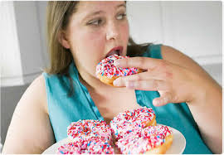
New Disorder
The DSM-5 (released in May 2013) lists binge eating disorder as a diagnosable eating disorder. BED has previously been listed as a subcategory of EDNOS in the DSM-4.
Full recognition of BED as an eating disorder diagnosis is significant because some insurance companies will not cover an individual’s eating disorder treatment without a DSM diagnosis.

Slide 27
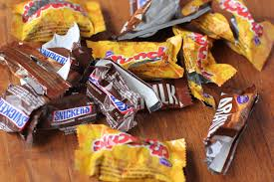
Other Behavioral Characteristics
Lots of empty wrappers and containers indicating consumption of large amounts of food
Stealing, hiding, or hoarding food
Creating lifestyle schedules or rituals to make time for binge sessions

Slide 28
Emotional and Mental Characteristics
Experiencing feelings of anger, anxiety, worthlessness, or shame preceding binges.
Initiating the binge is a means of relieving tension or numbing negative feelings.
Co-occurring conditions such as depression may be present
Feeling disgusted about one’s body size. Those with BED may have been teased about their body while growing up.

Slide 29
Thought Patterns & Personality Types
Those with rigid and inflexible “all or nothing” thinking
A strong need to be in control
Difficulty expressing feelings and needs
Perfectionist tendencies
Working hard to please others (take care of everyone else’s needs, but not their own)

Slide 30
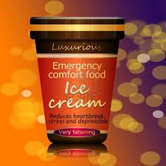
Comfort food
Food that makes one feel better
Use food as a way of coping with stress in life – Food fills an emotional void
Food = love, affection, happiness, etc.

Slide 31
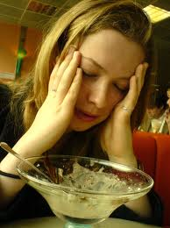
Mouth Hungry Vs. Stomach Hungry Hungry for something other than food – i.e. love, affection, comfort vs. genuine physical hunger

Slide 32
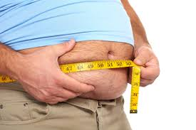
Obese does not necessarily = BED!
*It is important to note that not everyone who is overweight or even obese binges or has Binge Eating Disorder
Weight gain may or may not be associated with BED

Slide 33
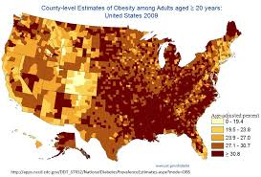
BED Demographics
BED is the most common eating disorder in the United States affecting1-5% of the population, including 3.5% of women, 2% of men, and up to 1.6% of adolescents
In women, BED is most common in early adulthood. In men, BED is more common in midlife.
BED affects people of all demographics across all cultures.

Slide 34
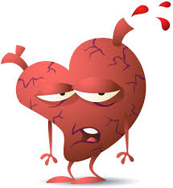
Physical Effects
Most obese people do not have BED. However, of those who do, up to 2/3 are obese; people who struggle with BED tend to be of normal or heavier-than-average-weight
The most common health risks for those with BED are those associated with clinical obesity such as:
High cholesterol and blood pressure
Heart disease
Type II diabetes
Fatigue
Sleep apnea

Slide 35
Psychological Effects
People with BED often express distress, shame and guilt about their eating behaviors
Often report a lower quality of life than those without BED
Often experience symptoms of depression and anxiety

Slide 36
BED Treatment
Like other EDs, treatment should be individualized, and may be given on an outpatient or hospital basis
Psychotherapy, nutritional reeducation, and group or family counseling is common
Participation in a special Twelve-Step group (such as Overeaters Anonymous) may also be recommended

Slide 37
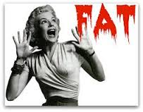
Social Stigma of BED
Many people suffering from binge eating disorder report that it is a stigmatized and frequently misunderstood disease.
Greater public awareness that BED is a real diagnosis – and should not be just viewed as occasional overeating – is needed in order to ensure that every person dealing with BED has the opportunity to access resources, treatment, and support for recovery

Slide 38
OSFED (Other Specified Feeding or Eating Disorder)
Formerly called EDNOS
Up to 70% of all eating disorders may fall into this category
Person may have similar symptoms to anorexia or bulimia, but not meet the criteria for those diagnoses
Binge eating disorder used to fall into this category, but in the DSM-5 is now its own FED

Slide 39
Types of OSFED (Other Specified Feeding or Eating Disorder)
Atypical Anorexia, Bulimia or Binge Eating Disorder (low frequency or limited duration)
Purging Disorder (without bingeing)
Night Eating Syndrome

Slide 40
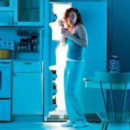
Night Eating Syndrome (considered OSFED)
Night eating syndrome is not the same as binge eating disorder, although individuals with night eating syndrome are often binge eaters.
It differs from binge eating in that the amount of food consumed in the evening/night is not necessarily large nor is a loss of control over food intake required.

Slide 41
Symptoms of Night Eating Syndrome
Those with night eating syndrome may be overweight or obese. They feel like they have no control over their eating behavior, and eat in secret and when they are not hungry. They also feel shame and remorse over their behavior.
They may hide food out of shame or embarrassment. Those with night eating syndrome typically eat rapidly, eat more than most people would in a similar time period and feel a loss of control over their eating.
They eat even when they are not hungry and continue eating even when they are uncomfortably full.

Slide 42
Not Just A Midnight Snack
Feeling embarrassed by the amount they eat, they typically eat alone to minimize their embarrassment. They often feel guilt, depression, disgust, distress or a combination of these symptoms.
Those with night-eating syndrome eat a majority of their food during the evening. They eat little or nothing in the morning, and wake up during the night and typically fill up on high-calorie snacks.
Traits of patients with night-eating syndrome may include being overweight, frequent failed attempts at dieting, depression or anxiety, substance abuse, concern about weight and shape, perfectionism and a negative self-image.

Slide 43
Pica
This FED is characterized by the persistent craving and compulsive eating of nonfood substances for at least one month.
Those with Pica have the desire to eat such things as paper, chalk, soil, clay, sand, and even metal or glass.
Besides the immediate threat of consuming some of these substances, long term effects such as lead poisoning can result from children eating painted plaster

Slide 44
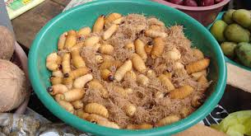
Pica
In addition to consuming these substances for at least one month, the person also has to meet the following criteria in order to be diagnosed with Pica:
The person does not meet the criteria for having either autism (ASD) or schizophrenia
The eating behavior is not related to any cultural factors (may not be considered bizarre or unusual in certain cultures)

Slide 45
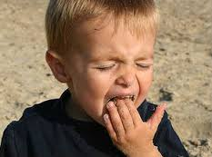
Pica and Children
Pica used to be categorized as a disorder first diagnosed in infancy, childhood, or adolescence because it is typically a feeding and eating disorder of infancy or childhood. However, the DSM-5 now lists it as a FED because it can now be diagnosed at any age.

Slide 46
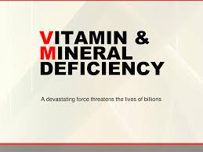
Causes
May be a physical cause such as a mineral deficiency (often times an iron deficiency)
Psychological explanations suggest that mental-health issues such as OCD and schizophrenia can sometimes cause pica

Slide 47
Treatment
Treatment varies according to the individual person (child, adult, etc.), but usually focuses on dietary changes, including determining if there are any mineral deficiencies
Therapy is similar to that used to treat obsessive compulsive or addictive disorders
Medication may also be used to help treat mood or anxiety related symptoms
Treatment is generally successful and this disorder often fades with age, even when untreated

Slide 48
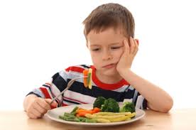
Avoidant/Restrictive Food Intake Disorder (ARFID)
ARFID, also known as Selective Eating Disorder (SED) is a new term that some people think just means “picky eating”, but is actually a FED that prevents the consumption of certain foods.
People with ARFID don’t have anorexia or bulimia, but they still struggle with eating and as a result don’t eat enough to keep a healthy body weight.

Slide 49
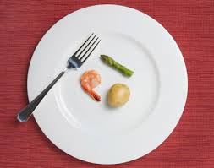
Types of Eating Problems that might be considered ARFID include:
Difficulty digesting certain foods
Avoiding certain colors or textures of food
Eating only very small portions
Having no appetite
Being afraid to eat after a frightening episode of choking or vomiting

Slide 50
Consequences
Because they don’t get enough nutrition in their diet, people with ARFID lose weight, or, if they’re younger kids, they may not gain weight or grow as expected.
Many people with ARFID need supplements each day to get the right amount of nutrition and calories.

Slide 51
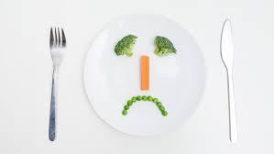
Effects on Day-to-Day Lives
People with ARFID may have issues at school, or with their friends because of their eating problems.
For example, they might avoid going out to eat or eating lunch at school, or it might take so long to eat that they’re late for school or don’t have time to do their homework.
Some people with ARFID may go on to develop another eating disorder, such as anorexia or bulimia

Slide 52
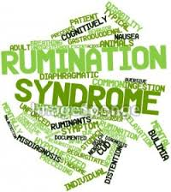
Rumination Disorder
Rumination disorder is a condition in which people repeatedly and unintentionally spit up (regurgitate) undigested food from the stomach, re-chew it, and then either re-swallow the food or spit it out.
Rumination is a reflex, not a conscious decision, yet the underlying causes are psychological

Slide 53
Rumination Disorder
Rumination disorder may go undiagnosed because it is often confused with other conditions, including bulimia nervosa
Because the food hasn’t been digested, people with this disorder often report that the food tastes normal, not acidic like vomit.
This condition has long been known to occur in infants and people with developmental disabilities, but it can also rarely occur in older children, adolescents, and adults

Slide 54
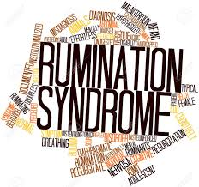
Causes
The exact cause of rumination disorder is not known, however, there are several factors that may contribute to its development:
Physical illness or severe stress may trigger the behavior
Neglect or an abnormal relationship between the child and the mother or primary caregiver may cause the child to engage in self-comfort. For some children, the act of chewing is comforting.
It may be a way for the child to gain attention.

Slide 55
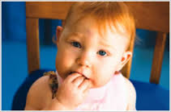
How common is Rumination Disorder?
Because most children outgrow this disorder, and older children and adults with this disorder tend to be secretive about it out of embarrassment, it is difficult to know exactly how many people are affected. However, it is considered to be uncommon.
This most often occurs in very young children (between 3 and 12 months), and in children with cognitive impairments and may occur slightly more often in boys than girls (though few studies exist to confirm this)

Slide 56
Treatment
Treatment focuses mainly on changing the child’s behavior. Several approaches include:
Encouraging more interaction between mother and child during feeding – more attention
Reducing distractions during feeding
Making feeding a more relaxing and pleasurable experience
Aversive conditioning, which involves placing something sour or bad-tasting on the child’s tongue when he or she begins this behavior

Slide 57
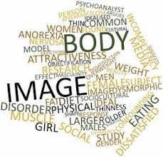
Psychological and Physical similarities of all eating disorders
See page 332

Slide 58
When does it start?
Seeds are planted in early childhood
Check out p.333 & 334

Slide 59
How to help someone with an eating disorder
See page 336

Slide 60
Sources
Mayoclinic.org
KidsHealth.org
WebMd
NationalEatingDisorders.org

