Slide 1
Gambling Disorder
Compulsive Gambling

Slide 2
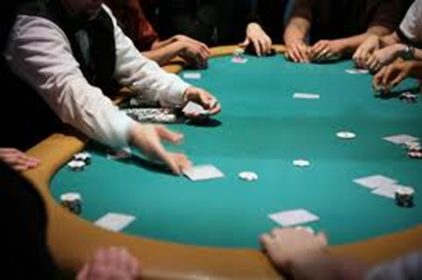
What is Compulsive gambling?
Compulsive gambling, also called gambling disorder, is the uncontrollable urge to keep gambling despite the toll it takes on your life.
Gambling means that you're willing to risk something you value in the hope of getting something of even greater value.

Slide 3
Why is gambling lumped in with drugs and alcohol?
Gambling can stimulate the brain's reward system much like drugs and alcohol can, leading to addiction.
Just like drugs and alcohol, gambling can quickly become addictive and spiral out of control.

Slide 4
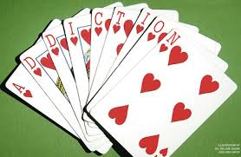
If you're prone to compulsive gambling, you may continually chase losses, hide your behavior, deplete savings, accumulate debt, or even resort to theft or fraud to support your addiction.

Slide 5
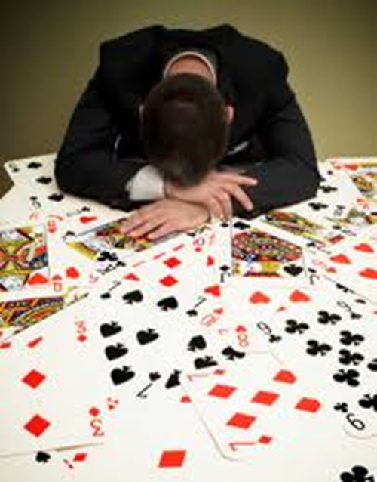
Can Destroy Lives
Compulsive gambling is a serious condition that can destroy lives. Although treating compulsive gambling can be challenging, many compulsive gamblers have found help through professional treatment.

Slide 6
Symptoms of compulsive (pathologic) gambling
Gaining a thrill from taking big gambling risks
Taking increasingly bigger gambling risks
Preoccupation with gambling
Reliving past gambling experiences
Failed efforts to cut back on gambling

Slide 7
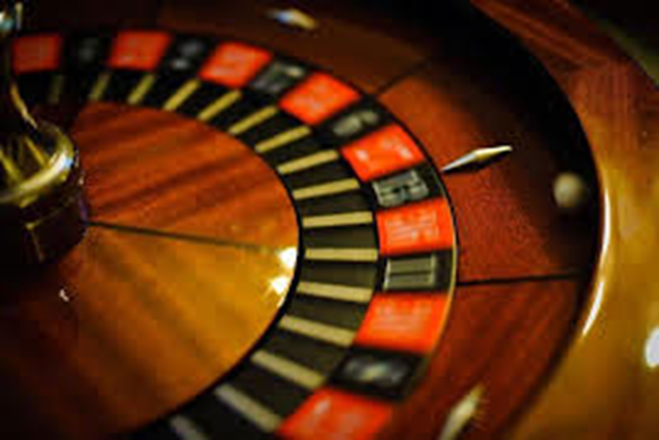
Taking time from work or family life to gamble
Concealing or lying about gambling
Feeling guilt or remorse after gambling
Borrowing money or stealing to gamble
Gambling as a way to escape problems or feelings of helplessness, guilt or depression

Slide 8
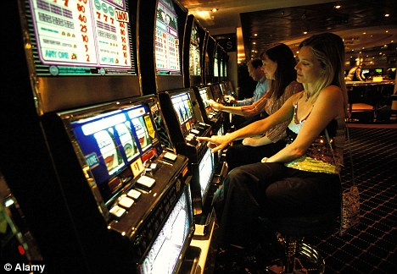
How does it turn into an addiction?
On rare occasions, gambling becomes a problem with the very first wager. But more often, a gambling problem progresses over time. In fact, many people spend years enjoying social gambling without any problems. But more frequent gambling or life stresses can turn casual gambling into something much more serious.

Slide 9
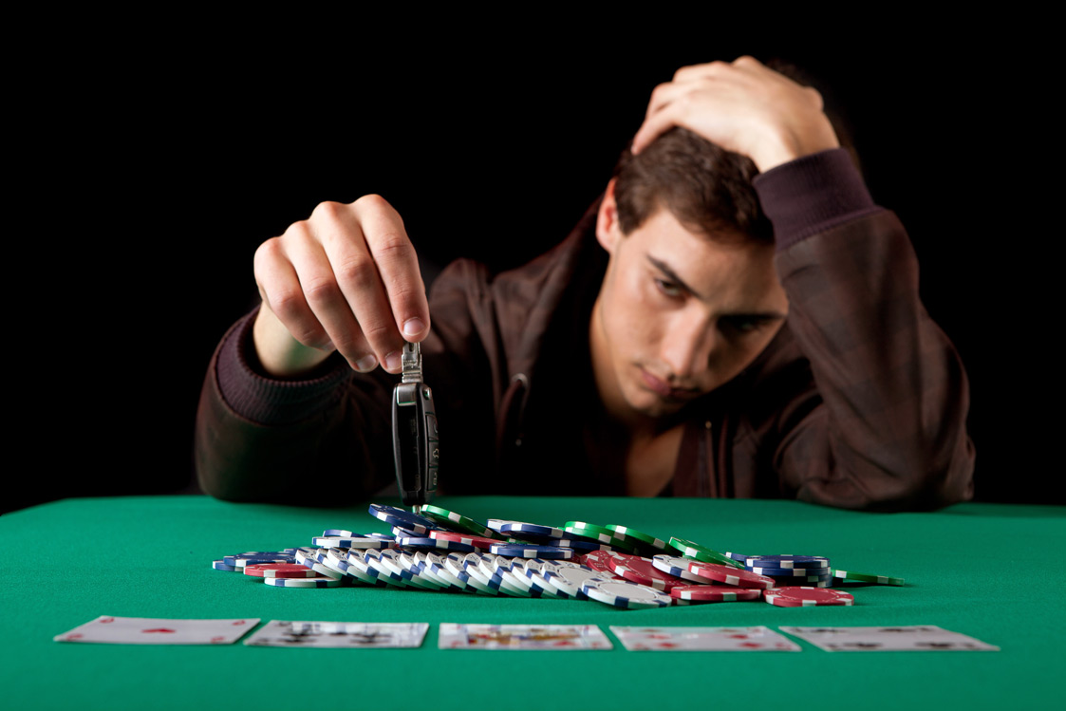
An Unhealthy Escape
During periods of stress or depression, the urge to gamble may be especially overpowering, serving as an unhealthy escape.
Eventually, a person with a gambling problem becomes almost completely preoccupied with gambling and getting money to gamble.

Slide 10
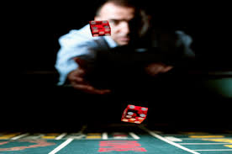
Not about the $$
For many compulsive gamblers, betting isn't as much about money as it is about the excitement.
Sustaining the thrill that gambling provides usually involves taking increasingly bigger risks and placing larger bets. Those bets may involve sums you can't afford to lose.

Slide 11
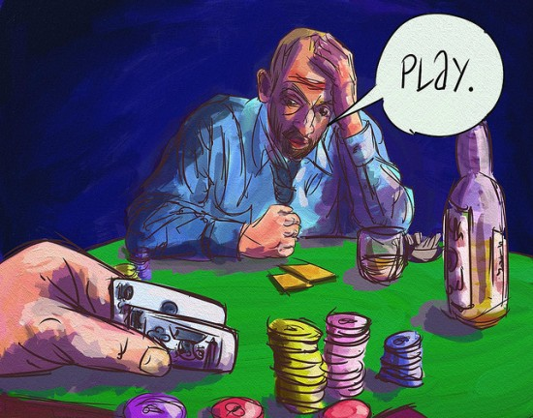
Don’t know when to Stop
Unlike most casual gamblers who stop when losing or set a loss limit, compulsive gamblers are compelled to keep playing to recover their money - a pattern that becomes increasingly destructive over time.

Slide 12
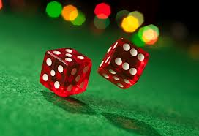
Three Phases of the Gambling Cycle
Winning – unrealistic optimism
Losing – denial, chases losses
Desperation – obsessed, blame, life falls apart

Slide 13
Can they recover from it?
Some compulsive gamblers may have remission where they gamble less or not at all for a period of time. However, without treatment, the remission usually isn't permanent.

Slide 14
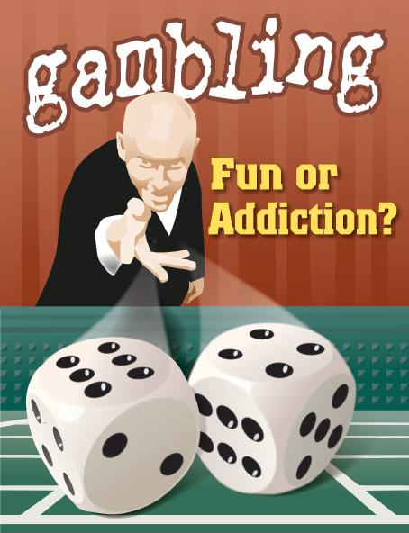
When is it time for help?
If family members, friends or co-workers express concern about your gambling, you should listen to their worries. Because denial is almost always a characteristic of compulsive or addictive behavior, it may be difficult for you to recognize that you have a problem.

Slide 15
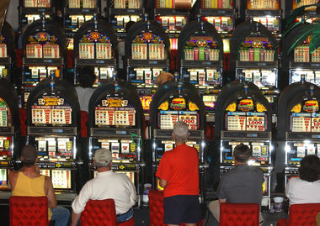
What causes compulsive gambling?
Exactly what causes someone to gamble compulsively isn't well understood. Like many problems, compulsive gambling may result from a combination of biological, genetic and environmental factors.

Slide 16
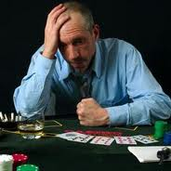
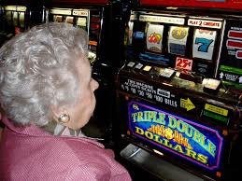
Who has a gambling problem?
Mostly men but cases in women are on the rise

Slide 17
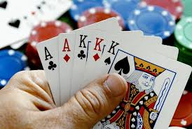
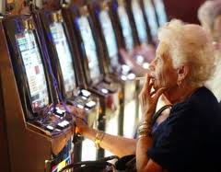
Men vs. Women
Men more competitive card games
Women slot machines / scratch tickets where they are more emotionally and physically comfortable

Slide 18
Income Level
Can affect anyone, but often becomes a problem for those who can afford it the least
View money as the root cause and also the solution to their problems

Slide 19
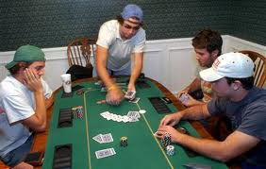
Teenagers
5-8% of teens
Mostly males
Not for the money, but for excitement, escape, or to relieve depression
Usually starts in college for males and later for females

Slide 20
Who is at greatest risk?
Other behavior or mood disorders. People who gamble compulsively often have substance abuse problems, mood or personality disorders, or attention-deficit/hyperactivity disorder (ADHD). Many compulsive gamblers abuse alcohol, and many experience major depression.

Slide 21
Age. Compulsive gambling is more common in younger and middle-aged people.
Gender. Compulsive gambling is more common in men than in women. Women who gamble typically start later in life, are more apt to have depression, anxiety or bipolar disorders, and may become addicted more quickly. But gambling patterns among men and women have become increasingly similar.

Slide 22
Family influence. If one of your parents had a gambling problem, the chances are greater that you will, too.
Certain personality characteristics. Being highly competitive, a workaholic, restless or easily bored may increase your risk.

Slide 23
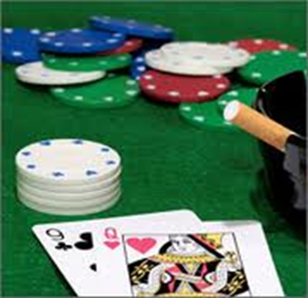
Negative Effects
Relationship problems
Financial problems, including bankruptcy
Legal problems or imprisonment
Job loss or professional stigma
Associated alcohol or drug abuse
Poor general health
Mental health disorders, such as depression
Suicide

Slide 24
Isn’t it unethical for the government to allow this?
Gambling is big business in states where it is legal
Can generate billions of dollars per year
Brings in state tax revenue

Slide 25
Admitting you have a problem
Treating compulsive gambling can be challenging. That's partly because most people have a hard time admitting they have a problem. Yet a major part of treatment is working on acknowledging that you're a compulsive gambler.

Slide 26
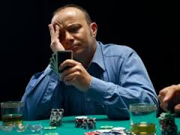
Treatment
If your family or your employer pressured you into therapy, you may find yourself resisting treatment. But treating a gambling problem can help you regain a sense of control - and it may help heal damaged relationships or finances.
The 3 main approaches are psychotherapy, medication, and self-help groups.

Slide 27
Psychotherapy
Behavior therapy uses systematic exposure to the behavior you want to unlearn (gambling) and teaches you skills to reduce your urge to gamble.

Slide 28
Medication
Antidepressants and mood stabilizers may help treat problems that often go along with compulsive gambling — such as depression, obsessive-compulsive disorder or ADHD - but not necessarily compulsive gambling itself.

Slide 29
Self-help Groups
Some people find self-help groups, such as Gamblers Anonymous, a helpful part of treatment.

Slide 30
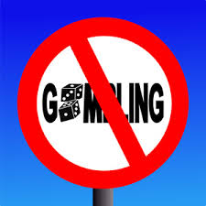
Relapse
Even with treatment, you may return to gambling, especially if you spend time with people who gamble or you're in gambling environments.
If you feel that you'll start gambling again, contact your mental health provider or sponsor right away to head off a full-blown relapse.

Slide 31
Coping Strategies
The appeal of gambling is hard to overcome if you keep thinking that you'll win the next time you gamble.
Tell yourself it's too risky to gamble at all. One bet typically leads to another and another.
Recognize and then avoid situations that trigger your urge to bet.

Slide 32
Sources
PsychCentral.com
MayoClinic.org

