Slide 1
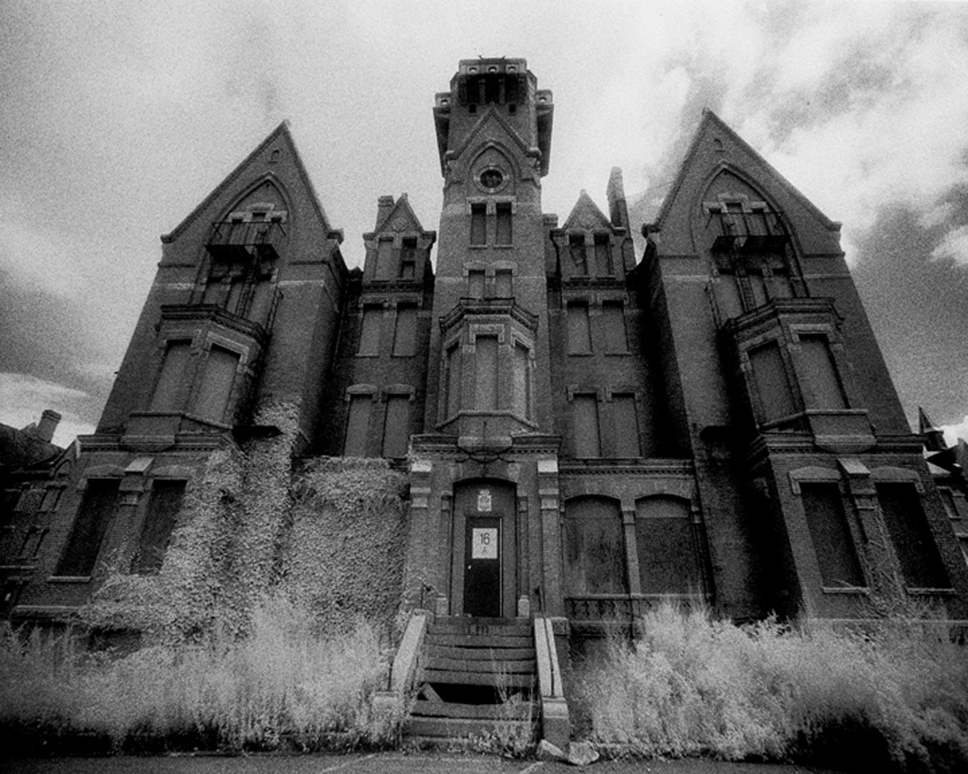
History of the Treatment of the Mentally Ill

Slide 2
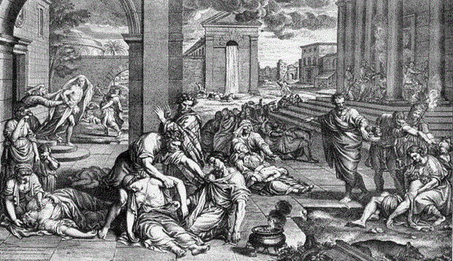
Many names, Same Disorders
It has only been in the last 60 years or so that we have begun to categorize and label the various psychological disorders that exist today.
However, these disorders have existed for hundreds, if not thousands of years, only under different names.

Slide 3
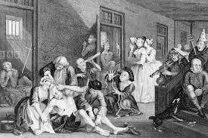
Hundreds of Disorders
Today the DSM-5 categorizes and labels literally hundreds of different disorders, however, in the past, fewer diagnoses were used to describe a variety of symptoms.

Slide 4
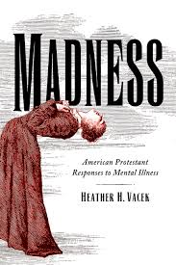
Historical Names
For example:
Madness – a general term used to describe mental illness, particularly in those who seemed to have lost touch with reality
Hysteria – a diagnosis primarily in women who were “overly emotional” and whose emotions were out of control or “hysterical”
Melancholy or Melancholia – a term used to describe sadness or depression

Slide 5
The Middle Ages
During the Middle Ages the Church had a huge influence over people’s lives and this impacted their views of mental illness.
If a person acted mentally ill then something bad must have happened to their soul.

Slide 6
It must be the work of the Devil
They believed that negative behaviors were caused by the devil and therefore any mental abnormality must be due to demonic possession,
The “cure”, therefore involved driving out these spirits.

Slide 7
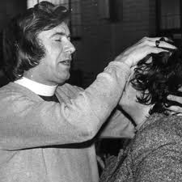
Exorcism
A religious ceremony performed to cast out evil spirits possessing you.

Slide 8
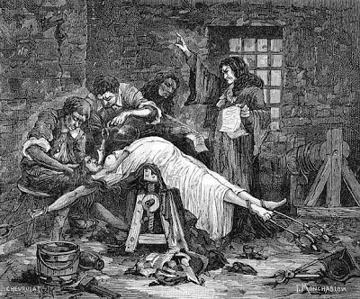
Other “Cures”
If exorcism was not successful then the next form of treatment would involve making the possessed individual so uncomfortable that the demon would not want to remain there.
Thus, torturous treatments were often used to “drive the devil out”
Of course, none of these methods actually worked and often times killed the person

Slide 9
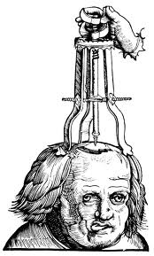
Trepanation
Drilling holes in the skull to let the demons out

Slide 10
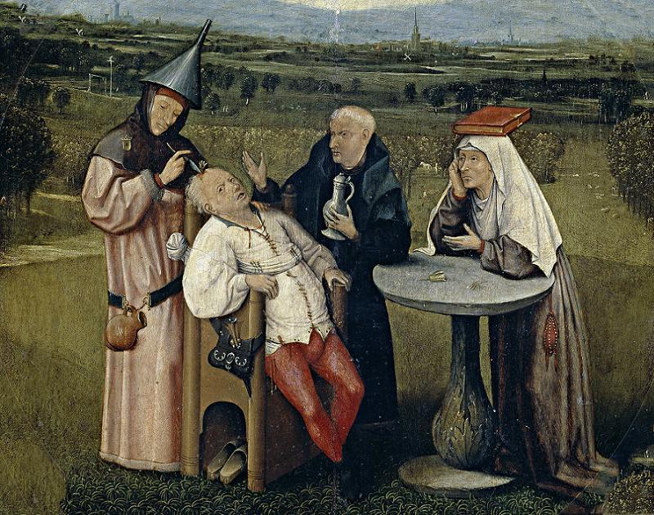

Slide 11
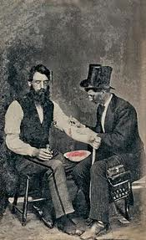
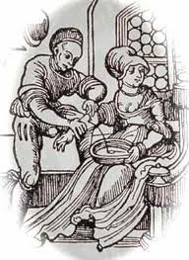
Bloodletting
Draining the blood to get the evil out (which was believed to be contained in your bodily fluids).

Slide 12
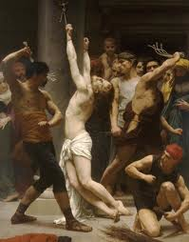
Treatment or Torture?
Beatings, floggings, and other cruel methods of torture were used to drive out evil or bring the person “back to their senses.”

Slide 13
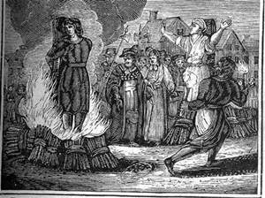
Witchcraft and Sorcery
Many young women and teenage girls with mental illness were accused of being witches and hanged, drowned, or burned at the stake.

Slide 14
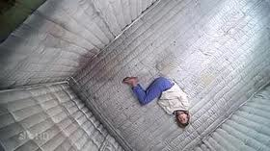
1800s
“Treatment” was still little to none.
People were locked away from the rest of society.
Done for the protection of society not the well being of the patients.

Slide 15
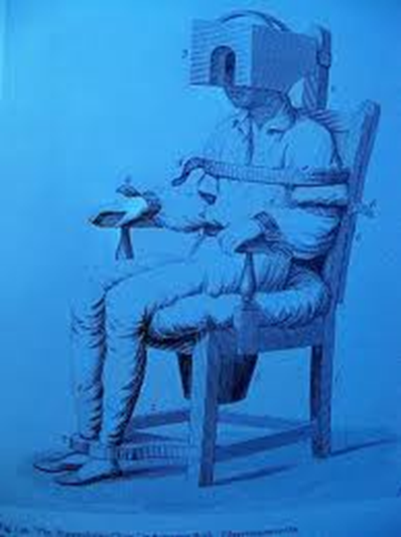
How does this help?
This chair was developed 200 years ago. It was believed that the restraint and restricted sensation it provided would help patients regain their self-control.

Slide 16
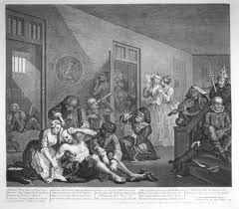
Insane Asylums
Most sufferers of mental disorders throughout history have not been treated as patients, but rather as prisoners.
Asylums operated as prisons, not a hospital, where people were chained to the walls and neglected.

Slide 17
Entertainment

Slide 18
Many Derogatory Names
Mental Institutions have been referred to by many derogatory names over the years:
Madhouse
Lunatic Asylum (falsely believed behaviors were caused by the phases of the moon)
Loony Bin
Funny Farm
Nut House
Sanitarium
and Snake Pit … to name just a few

Slide 19
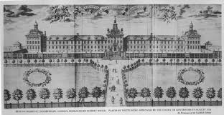
Bedlam
Probably the most Famous mental institution of all in London that was known for its chaos & disorder
Its infamous history has inspired several horror films

Slide 20
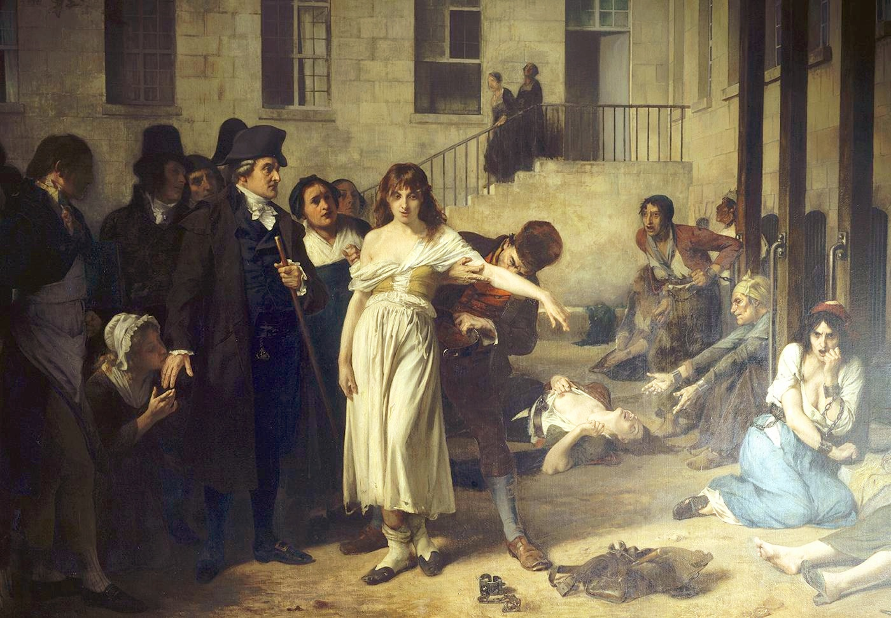
Philippe Pinel – French physician who believed they shouldn’t be chained and locked up like zoo animals – pushed for humane treatment rather than institutionalized brutality

Slide 21
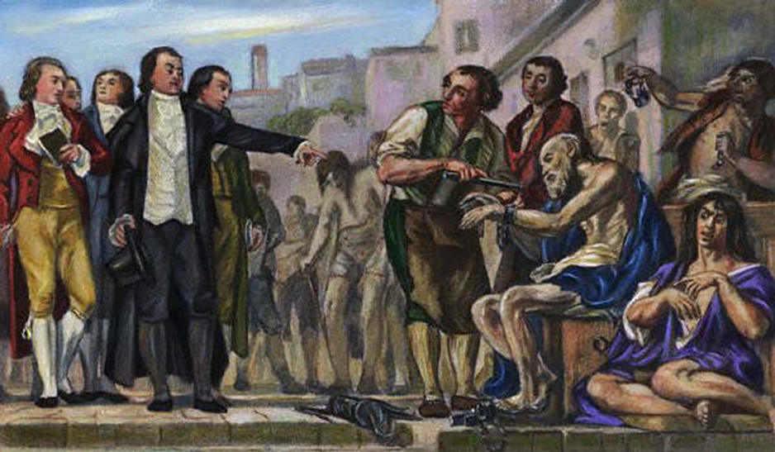
Humane treatment
Pinel and other reformers helped change Europe’s view of psychological disorders

Slide 22
1st Institutions in America
Psychiatric institutions first appeared in the United States during the Colonial era as a result of urbanization, according to the website of the U.S. Surgeon General.
Blackwell's Island Lunatic Asylum, built in New York at the beginning of the 19th century, was the first municipal mental hospital in the United States, according to the American Journal of Psychiatry.

Slide 23
Blackwell's Island Lunatic Asylum

Slide 24
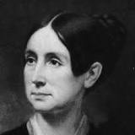
Dorothea Dix
Much like Pinel in France, she helped change the public’s view of the mentally ill and helped establish dozens of mental institutions across America after the Civil War

Slide 25
Warehousing
The policy of rounding up the mentally ill and simply storing them away from society and leaving them in institutions for the rest of their lives

Slide 26
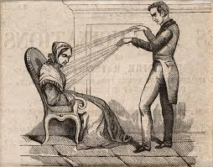
Treatment for the Rich
Those privileged members of society who could afford it were often able to avoid the institutions that were crammed full with the poor
However, they still turned to other seemingly bizarre treatments such as hypnosis, first introduced by in the late 1700’s Franz Mesmer (from whom we get the term “mesmerized”).

Slide 27
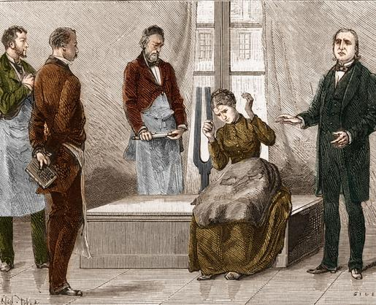
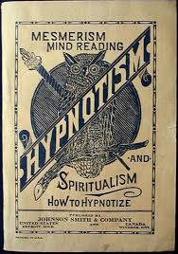
“Nervous Sleep”
Hypnotism predated psychological study, but was first described in clinical terms in the 19th century.

Slide 28
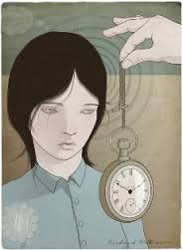
Hypnotism
It was employed as a diagnostic and treatment tool by some of the earliest pioneers of the field of psychology, including Sigmund Freud, who eventually fell out of favor with the practice. Even today, hypnotism is promoted with the promise of helping patients with sleep disorders, nicotine addiction, depression, and a whole range of diseases and conditions.

Slide 29
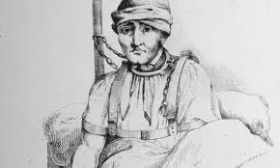
1900s
Although conditions began to improve, the belief that patients were undesirable and dangerous persisted.
Asylums were replaced by the “modern” psychiatric hospital.

Slide 30
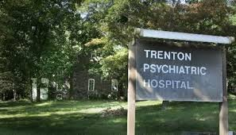
Psychiatric Hospitals
Patient care became a higher priority for mental health professionals instead of simply corralling patients into a facility to segregate them from society
What were once called lunatic asylums gave way to psychiatric hospitals.

Slide 31
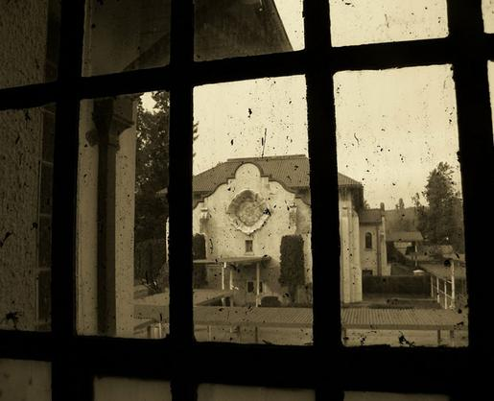
An abandoned asylum, like Northern State Hospital for the Insane (pictured above), still conveys an eerie quality as though still haunted by the patients who used to be kept there.

Slide 32
From Confinement to Treatment
Mental health asylums gradually transformed into institutions that went from confining those with mental health disorders to treating them, and psychiatrists began experimenting with different therapies for treating a range of diseases.

