Slide 1
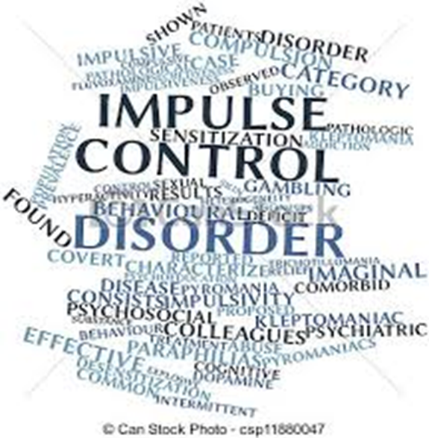
Disruptive, Impulse Control, and conduct Disorders
Intermittent Explosive Disorder
Kleptomania
Pyromania

Slide 2
What sets humans apart
As humans, the ability to control our impulses or urges helps distinguish us from other species and marks our psychological maturity.
Most of us take our ability to think before we act for granted. But this isn’t easy for people who have problems controlling their impulses.

Slide 3
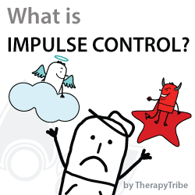
What is an impulse control disorder?
People with an impulse control disorder can’t resist the urge to do something harmful to themselves or others.

Slide 4
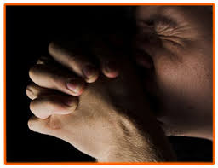
What are the different kinds of ICDs?
Impulse control disorders include addictions to alcohol or drugs, eating disorders, compulsive gambling, and compulsive hair pulling.
However, while these disorders may involve difficulty controlling impulses, that is not their primary feature.
We will be focusing on stealing, fire setting and intermittent explosive attacks of rage.

Slide 5
Similarities of Impulse Control Disorders
Some of these disorders, such as intermittent explosive disorder, kleptomania, pyromania, compulsive gambling and trichotillomania, are similar in terms of when they begin and how they progress.

Slide 6
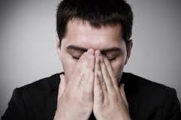
How does a person feel before, during, and after?
Usually, a person feels increasing tension or arousal before committing the act that characterizes the disorder.
During the act, the person probably will feel pleasure, gratification or relief.
Afterward, the person may blame himself or feel regret or guilt.

Slide 7
What is Intermittent explosive disorder?
Intermittent explosive disorder involves repeated, sudden episodes of impulsive, aggressive, violent behavior or angry verbal outbursts in which you react grossly out of proportion to the situation.

Slide 8
What impact does this disorder have on your life?
These intermittent, explosive outbursts cause you significant distress, negatively impact your relationships, work and school, and they can have legal and financial consequences.

Slide 9
What are examples of this behavior?
Road rage, domestic abuse, throwing or breaking objects, or other temper tantrums may be signs of intermittent explosive disorder.

Slide 10
How long does it last?
Intermittent explosive disorder is a chronic disorder that can continue for years, although the severity of outbursts may decrease with age.

Slide 11
What does an outburst look like?
Explosive eruptions occur suddenly, with little or no warning, and usually last less than 30 minutes.
These episodes may occur frequently or be separated by weeks or months of nonaggression

Slide 12
. Less severe verbal outbursts may occur in between episodes of physical aggression. You may be irritable, impulsive, aggressive or chronically angry most of the time.

Slide 13
What are the symptoms of IED?
Aggressive episodes may be preceded or accompanied by:
Rage
Irritability
Increased energy
Racing thoughts
Tingling
Tremors
Palpitations
Chest tightness

Slide 14
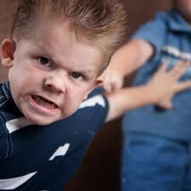
The explosive verbal and behavioral outbursts are out of proportion to the situation, with no thought to consequences, and can include:
Temper tantrums
Tirades
Heated arguments
Shouting
Slapping, shoving or pushing
Physical fights
Property damage
Threatening or assaulting people or animals

Slide 15
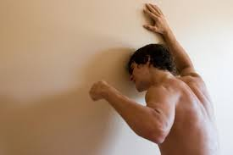
Do they feel bad about it afterward?
You may feel a sense of relief and tiredness after the episode.
Later, you may feel remorse, regret or embarrassment

Slide 16
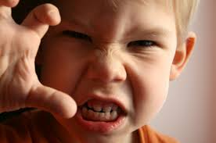
What causes intermittent explosive disorder?
The exact cause of intermittent explosive disorder is unknown, but it's probably caused by a number of environmental and biological factors.
The disorder typically begins in childhood — after the age of 6 years — or during adolescence and is more common in people under the age of 40.

Slide 17
Nature and nurture
Environment. Most people with this disorder grew up in families where explosive behavior and verbal and physical abuse were common. Being exposed to this type of violence at an early age makes it more likely these children will exhibit these same traits as they mature.
Genetics. There may be a genetic component, causing the disorder to be passed down from parents to children.
Brain chemistry. There may be differences in the way serotonin, an important chemical messenger in the brain, works in people with intermittent explosive disorder.

Slide 18
Who is at a higher risk of developing it?
These factors increase your risk of developing intermittent explosive disorder:
History of physical abuse. People who were abused as children or experienced multiple traumatic events have an increased risk of intermittent explosive disorder.
History of other mental health disorders. People who have antisocial personality disorder, borderline personality disorder or other disorders that include disruptive behaviors, have an increased risk of also having intermittent explosive disorder.

Slide 19
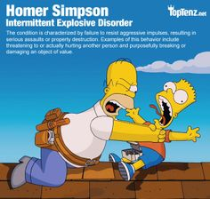
Negative effects on your life
Not surprisingly, people with IED often have Impaired interpersonal relationships. They're often perceived by others as always being angry. They may have frequent verbal fights or there can be physical abuse. These actions can lead to relationship problems, divorce and family stress.

Slide 20
Trouble with the law
Trouble at work, home or school. Other complications of intermittent explosive disorder may include job loss, school suspension, car accidents, financial problems or trouble with the law.

Slide 21
Other problems
Other problems can include Problems with mood (depression and anxiety), Problems with alcohol and other substance use, Physical health problems (like high blood pressure), and Self-harm or even suicide

Slide 22
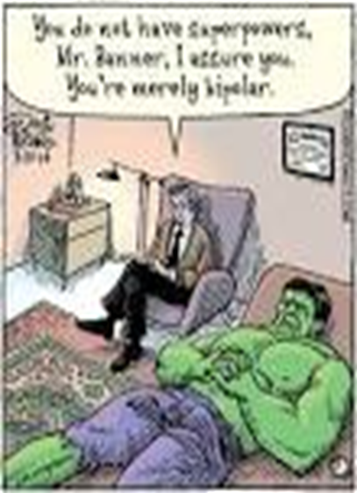
Can this be treated?
Treatment may include therapy and/or medication.
Talk therapy may help you to Identify which situations or behaviors may trigger an aggressive response as well as help you learn how to manage anger and control inappropriate
SSRIs may be prescribed to help with serotonin levels

Slide 23
Domestic violence
Intermittent explosive disorder can lead to a domestic violence situation.
If you see that a situation is getting worse, and suspect your loved one may be on the verge of an explosive episode, try to safely remove yourself and any children from the scene. However, leaving someone with an explosive temper can be dangerous.
In this situation, you should contact someone that you can trust to make them aware of what is going on.
The National Domestic Violence Hotline: 1-800-799-SAFE (1-800-799-7233).

Slide 24
What is kleptomania?
Kleptomania (klep-toe-MAY-nee-uh) is the recurrent failure to resist urges to steal items that you generally don't really need and that usually have little value.

Slide 25
Secret shame
Kleptomania is a serious mental health disorder that can cause much emotional pain to you and your loved ones if not treated.
Many people with kleptomania live lives of secret shame because they're afraid to seek mental health treatment.

Slide 26
what are the symptoms of kleptomania?
Besides stealing, Kleptomania symptoms may include:
Inability to resist powerful urges to steal items that you don't need
Feeling increased tension, anxiety or arousal leading up to the theft

Slide 27
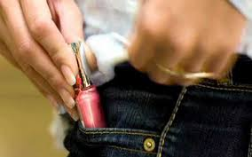
Trapped in a cycle of stealing
Feeling pleasure, relief or gratification while stealing
Feeling terrible guilt, remorse, self-loathing, shame or fear of arrest after the theft
Return of the urges and a repetition of the kleptomania cycle

Slide 28
How is it different from shoplifting?
Unlike typical shoplifters, people with kleptomania don't compulsively steal for personal gain, on a dare or out of rebellion. They steal simply because the urge is so powerful that they can't resist it.
Only 1% of people who steal are Kleptos.
They don’t care about the object.
It’s the thrill of stealing itself.

Slide 29
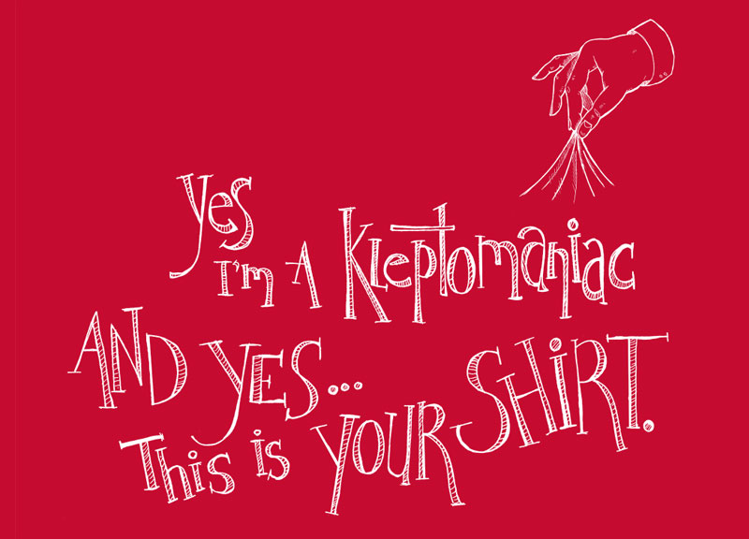
What triggers it?
Negative feelings (loneliness, stress, etc…)
Sights and sounds of stores

Slide 30
Don’t they fear Getting Caught?
They fear it, but the fear is outweighed by the need to steal.

Slide 31
Episodes of kleptomania generally occur spontaneously, usually without planning and without help or collaboration from another person.

Slide 32
Most people with kleptomania steal from public places, such as stores and supermarkets. Some may steal from friends or acquaintances, such as at a party.

Slide 33
More Women than men

Slide 34
Often, the stolen items have no value to the person with kleptomania, and the person can afford to buy them.

Slide 35
The stolen items are usually stashed away, never to be used. Items may also be donated, given away to family or friends, or even secretly returned to the place from which they were stolen.

Slide 36
Urges to steal may come and go or may occur with greater or lesser intensity over the course of time.

Slide 37
Getting help
Many people who may have kleptomania don't want to seek treatment because they're afraid they'll be arrested or jailed. However, a mental health provider typically doesn't report your thefts to authorities.
Some people seek medical help because they're afraid they'll get caught and have legal consequences. Or they've already been arrested, and they're legally required to seek treatment.

Slide 38
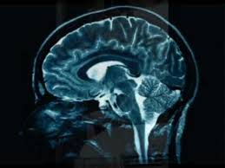
What causes kleptomania?
Low levels of serotonin are common in people prone to impulsive behaviors.
Stealing may cause the release of dopamine (another neurotransmitter). Dopamine causes pleasurable feelings, and some people seek this rewarding feeling again and again.

Slide 39
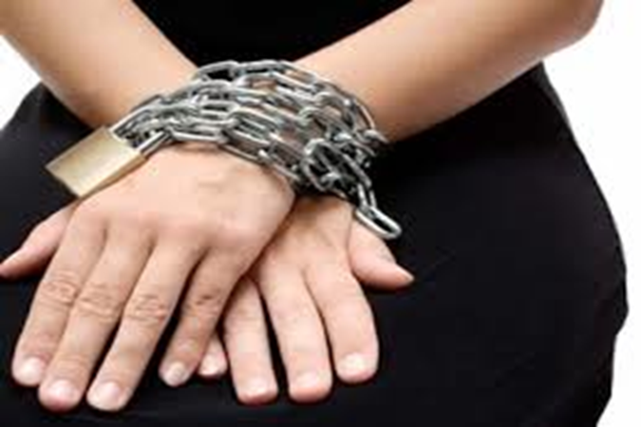
What negative effects can it have on your life?
Left untreated, kleptomania can result in severe emotional, family, legal, work and financial problems.
For example, you know stealing is wrong but you feel powerless to resist the impulse, so you may be wracked by guilt, shame, self-loathing and humiliation. You may otherwise lead a moral, upstanding life and be confused and upset by your compulsive stealing.

Slide 40
Other Complications
Compulsive gambling or shopping
Arrest for shoplifting
Imprisonment
Alcohol and substance abuse
Eating disorders
Depression
Anxiety

Slide 41
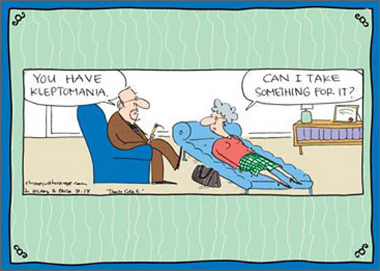
What is the treatment for kleptomania?
Treatment usually consists of therapy and possibly medication.
Therapy can help you identify situations, thoughts and feelings that may trigger urges to steal so you can take steps to manage them.

Slide 42
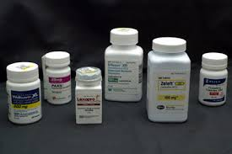
Avoiding Relapses
There is no FDA-approved medication for kleptomania. However, certain medications may help, depending on your situation and whether you have other mental disorders, such as depression or obsessive-compulsive disorder.
It's not unusual to have relapses of kleptomania. To help avoid relapses, be sure to stick to your treatment plan.

Slide 43
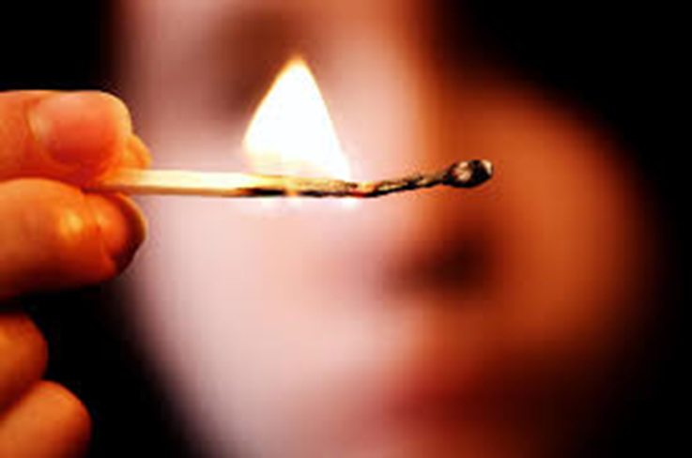
What is pyromania?
Pyromania is an impulse control disorder in which individuals repeatedly fail to resist impulses to deliberately start fires, in order to relieve tension or for instant gratification.

Slide 44
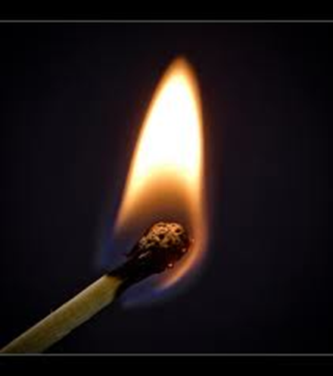
How is it different from arson?
The fire setting is not done for monetary gain, as a political statement, to conceal criminal activity, to express anger or vengeance, to improve one’s living circumstances, in response to a delusion or hallucination, or as a result of impaired judgment.

Slide 45
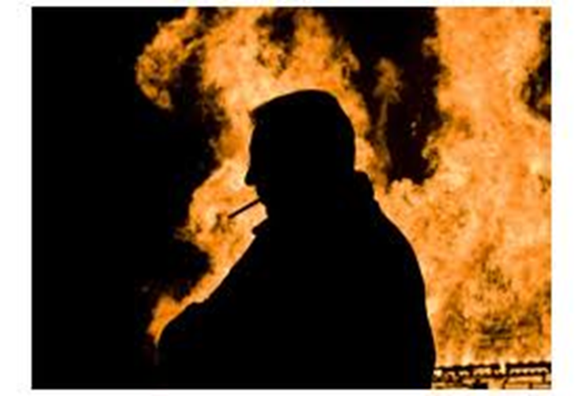
Who does this?
It is more often diagnosed in men than in women and although it may begin in childhood the age of onset is unclear.

Slide 46
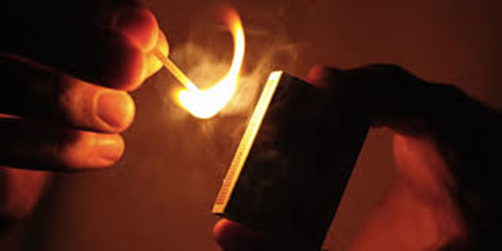
What are the symptoms?
Deliberate and purposeful fire setting on more than one occasion.
Tension or increased arousal before the act.
Fascination with, interest in, curiosity about, or attraction to fire and things related to it (e.g., lighters, fire stations, etc.).
Pleasure, gratification, or relief when setting fires, or when witnessing or participating in their aftermath.

Slide 47
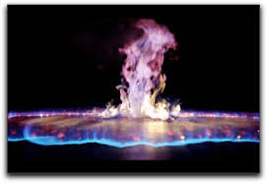
What causes pyromania?
Like other ICDs there may be biological and environmental factors that cause someone to start fires.
Sensation seeking - attracted to fire out of boredom
Attention seeking - a way of provoking reactions from adults
Loners - may lack social skills or important friendships

Slide 48
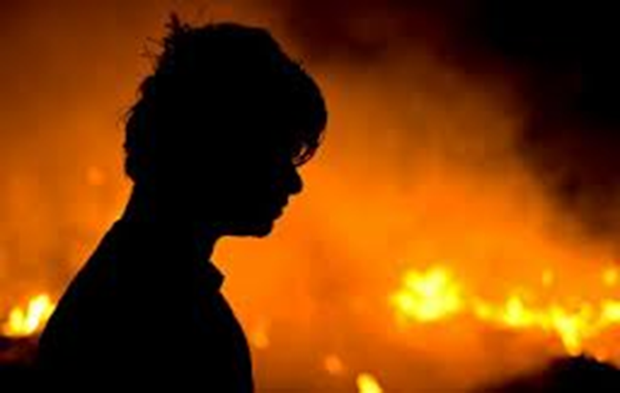
Other CAuses
Stressful life events - a way to cope with crisis
Early trauma - individuals who set fires are more likely to have been physically or sexually abused as children. They may have also seen their parents abuse drugs.
Learning experience - children may watch adults use fire carelessly.

Slide 49
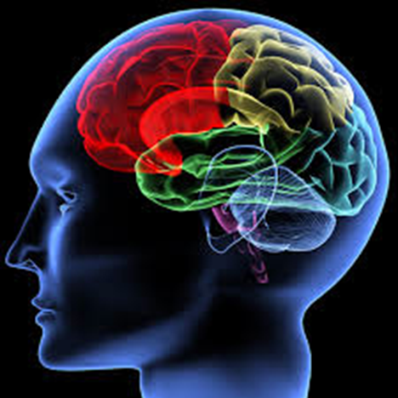
How do you treat pyromania?
Treatment can involve a combination of therapy and/or medication, however, adults often do not respond well due to a high relapse rate and a lack of cooperation in therapy.

Slide 50
Sources
MayoClinic.org
PsychCentral.com

